Slide 1
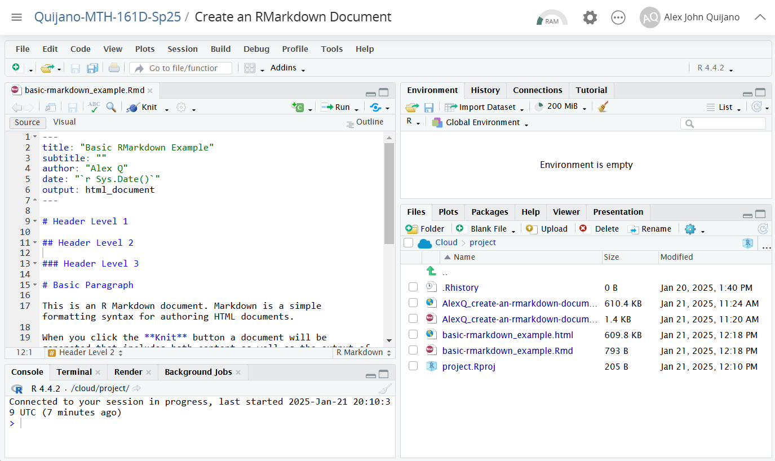
.Rmd and .html file
This is an RMarkdown file viewed in R Studio
“knit”-ing .Rmd file creates an .html file
Current working directory

