Slide 1
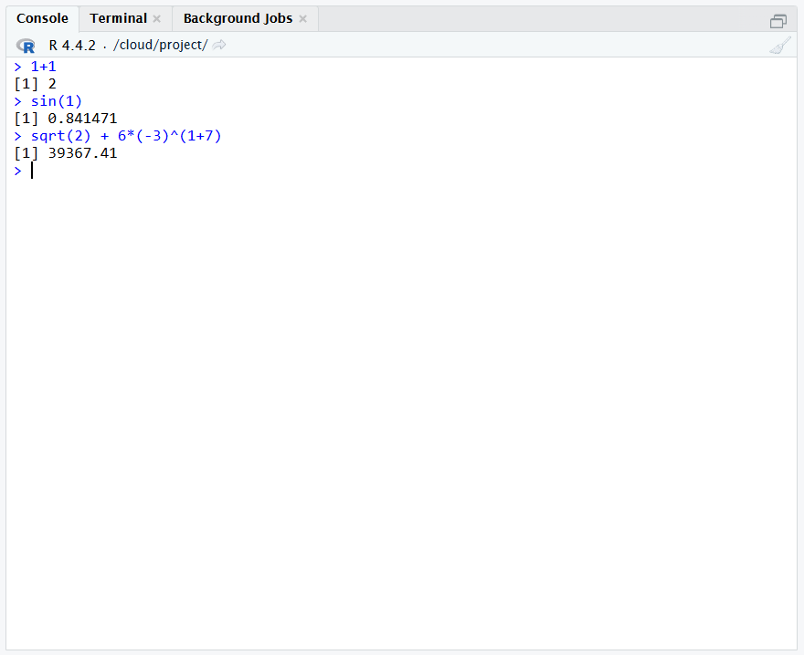
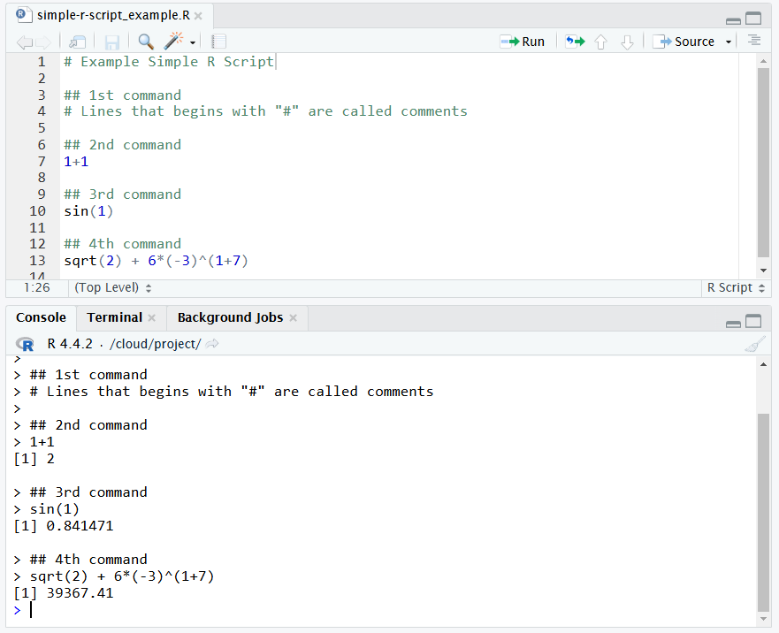
Run the current R script to the console.
Running R commands directly on the console.
Running R directly on the console is useful if you need a quick result but the commands may not be saved.
Both methods is using the same system but in different pathways.
Writing R on a script file is useful if you need to save your work.
Running R commands from an R script.

