Slide 1
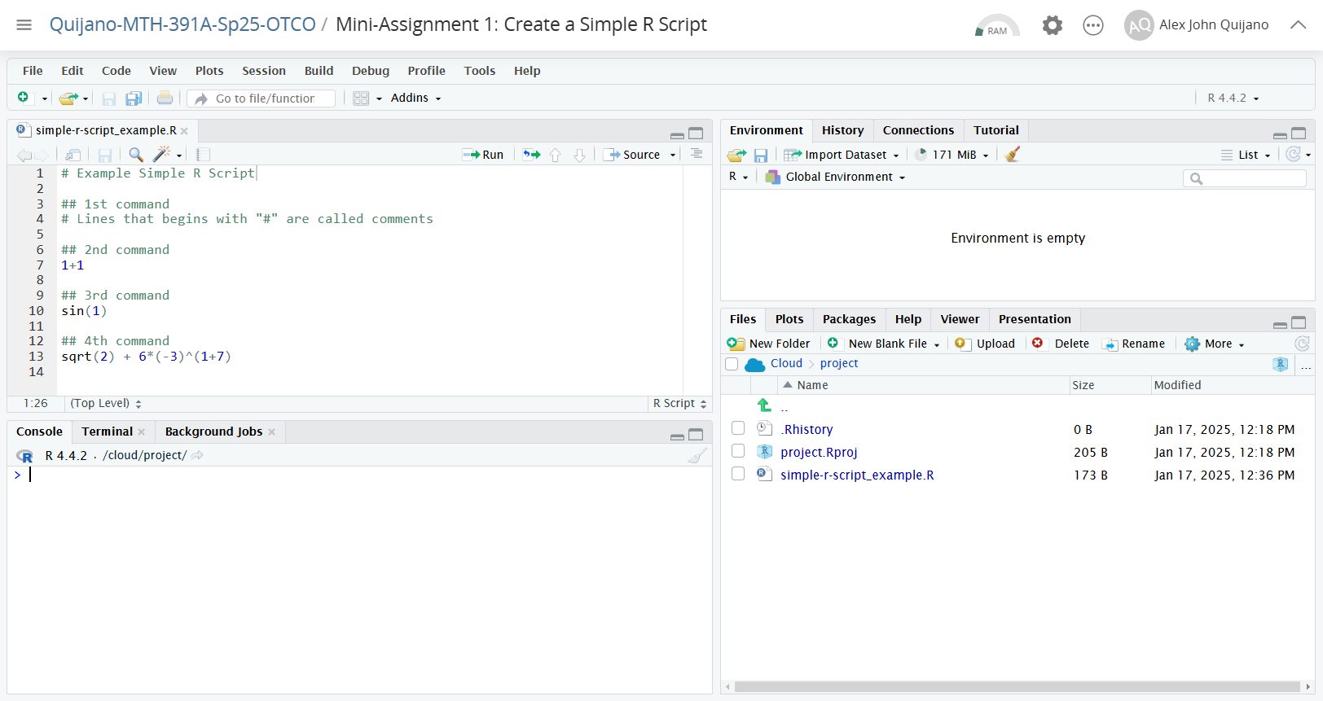
You can create new R script file here.
R scripts will be saved in your working directory.
An R script with defined lines of R commands.
Current working directory

