Slide 1
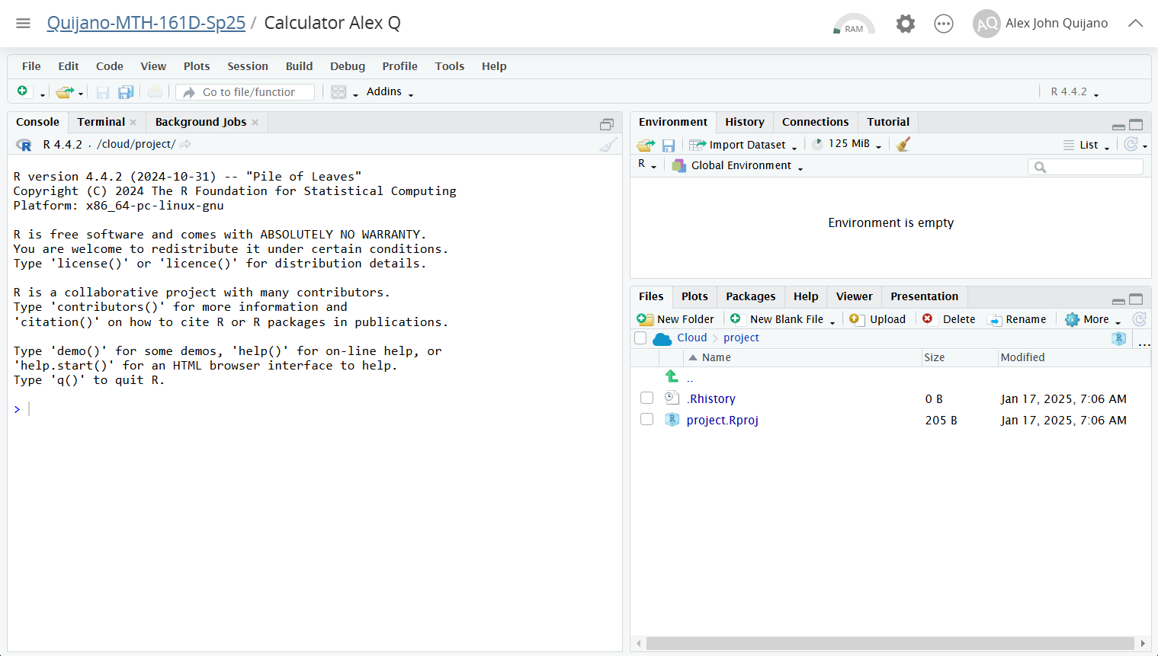
You can set any working directory here.
Go to current working directory
Current working directory

