Slide 1
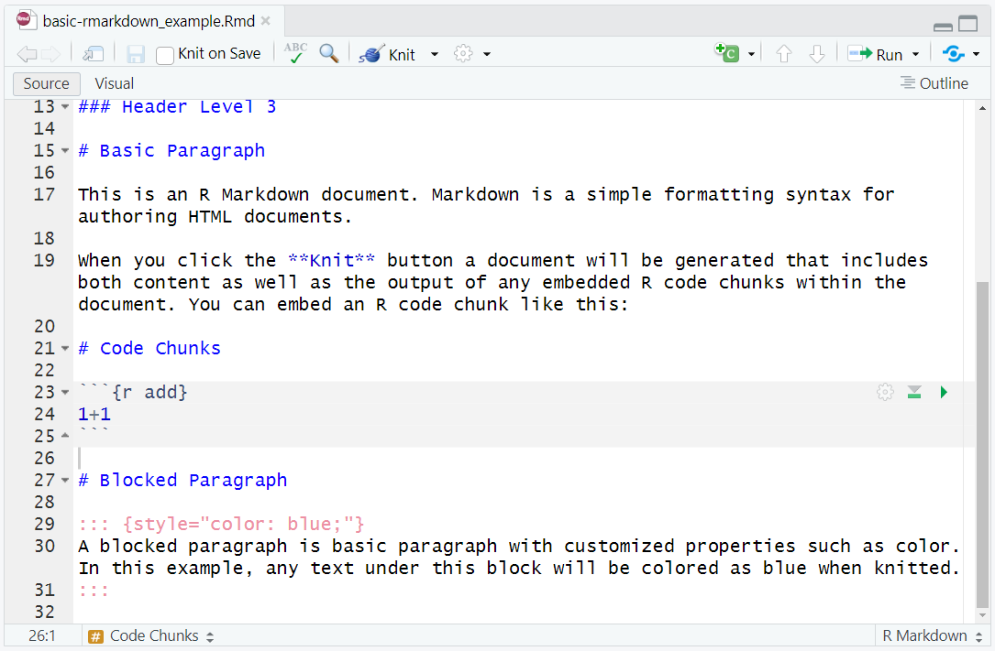
Creates a code chunk on where your cursor is placed in the RMarkdown file

Slide 2
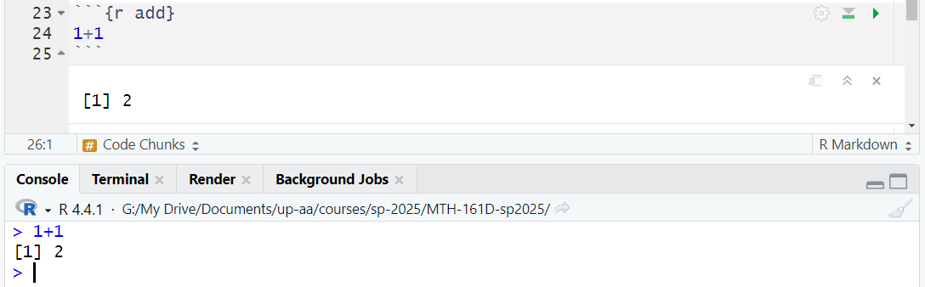
Every code chunk starts with “```{engine chunk-label}” and ends with “```”
Code Engines:
“r” for R
Chunk Labels:
Any labels with no space.
Runs all previous code chunks
Runs the current code chunk within the RMarkdown file to the console and outputs it in both the file and console

