Slide 1

Retromanija
E-shop project assignment for the course Managing Sophisticated Projects in Academia and Industry (USPI)
Autori: Uroš Poznan 1036/2019
Kristina Gavrilović 1015/2018
Mentori: Prof dr. Veljko Milutinović
Aleksandar Veljković
1/10

Slide 2

Introduction
Nowadays online sales have become a normal and usual thing
E-shops – Online stores are being developed in almost every branch of the trade
Less and less people have an aversion to this type of trade
2/10

Slide 3

Problem statement
Collector shops are becoming
less widespread
High prices for maintenance of these stores
Required things for the shoppers are often not available in stores like this
3/10

Slide 4

Existing solutions
Sometimes outdated items are sold through social networks – Instagram and Facebook
Problem: False representations of sellers
The frauds are not so rare
Collectionare stores -
often expensive
4/10

Slide 5
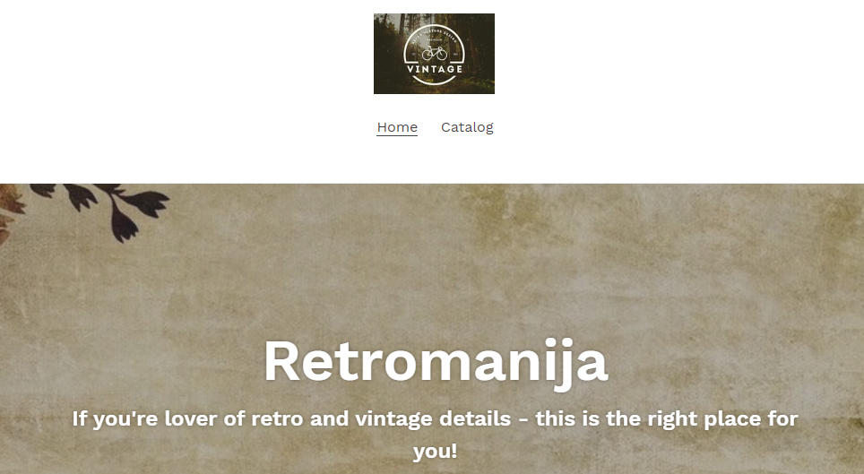
Solution: Retromanija
Unique E-shop for selling these kind of items
Retro and VIntage lovers will enjoy it
Selling of used retro articles for affordable prices
Reliable way to shop online
5/10

Slide 6
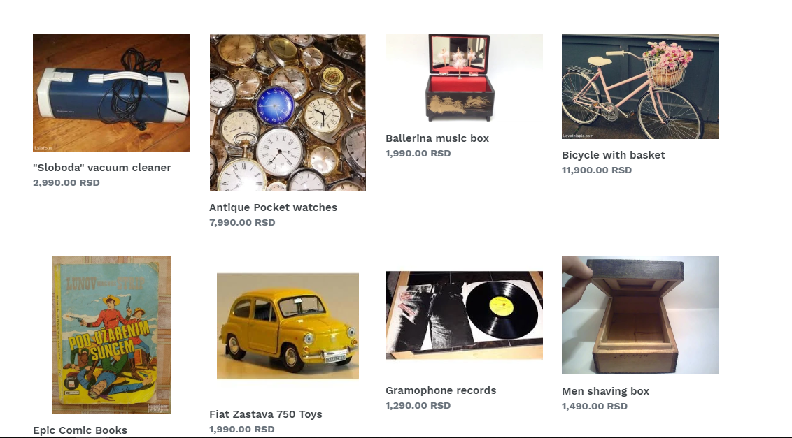
Retromanija: There is some item for everyone – for young and old, ladies and gentlemen
6/10

Slide 7
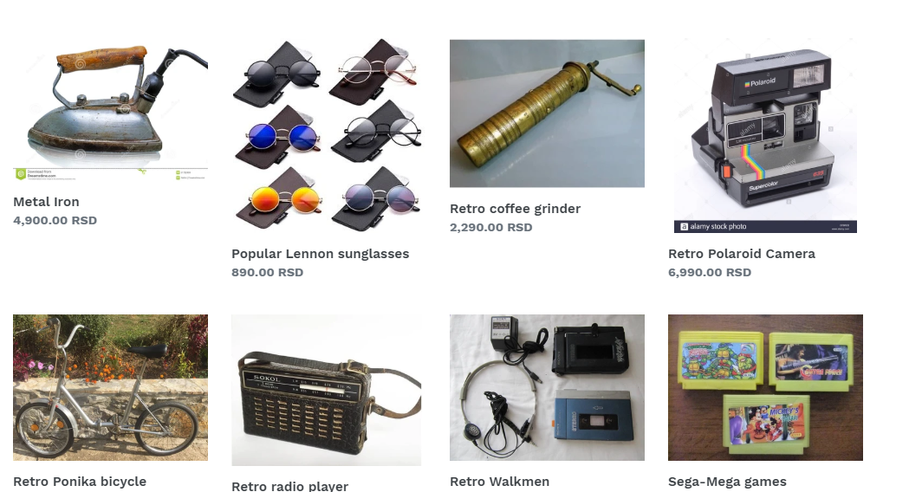
Retromanija: Returns us in our childhood
7/10

Slide 8
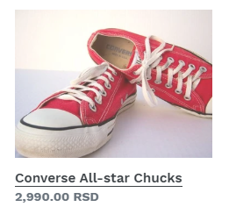

Conclusion
Retromanija is certanly an interesting and imaginative solution developed by several enthusiasts
It offers easy accesible and affordable shopping over the Internet
This is the first E-shop of this kind in our country
Be welcome to visit it and find something for everyone's taste
8/10

Slide 9
References
http://home.etf.rs/~vm/os/osuspi.html
http://poincare.matf.bg.ac.rs/~aleksandar/upin.html
https://retromanija.myshopify.com/
https://en.wikipedia.org/wiki/Online_shopping
9/10

Slide 10

Thank you for your attention!
Any questions?
10/10

