Slide 1
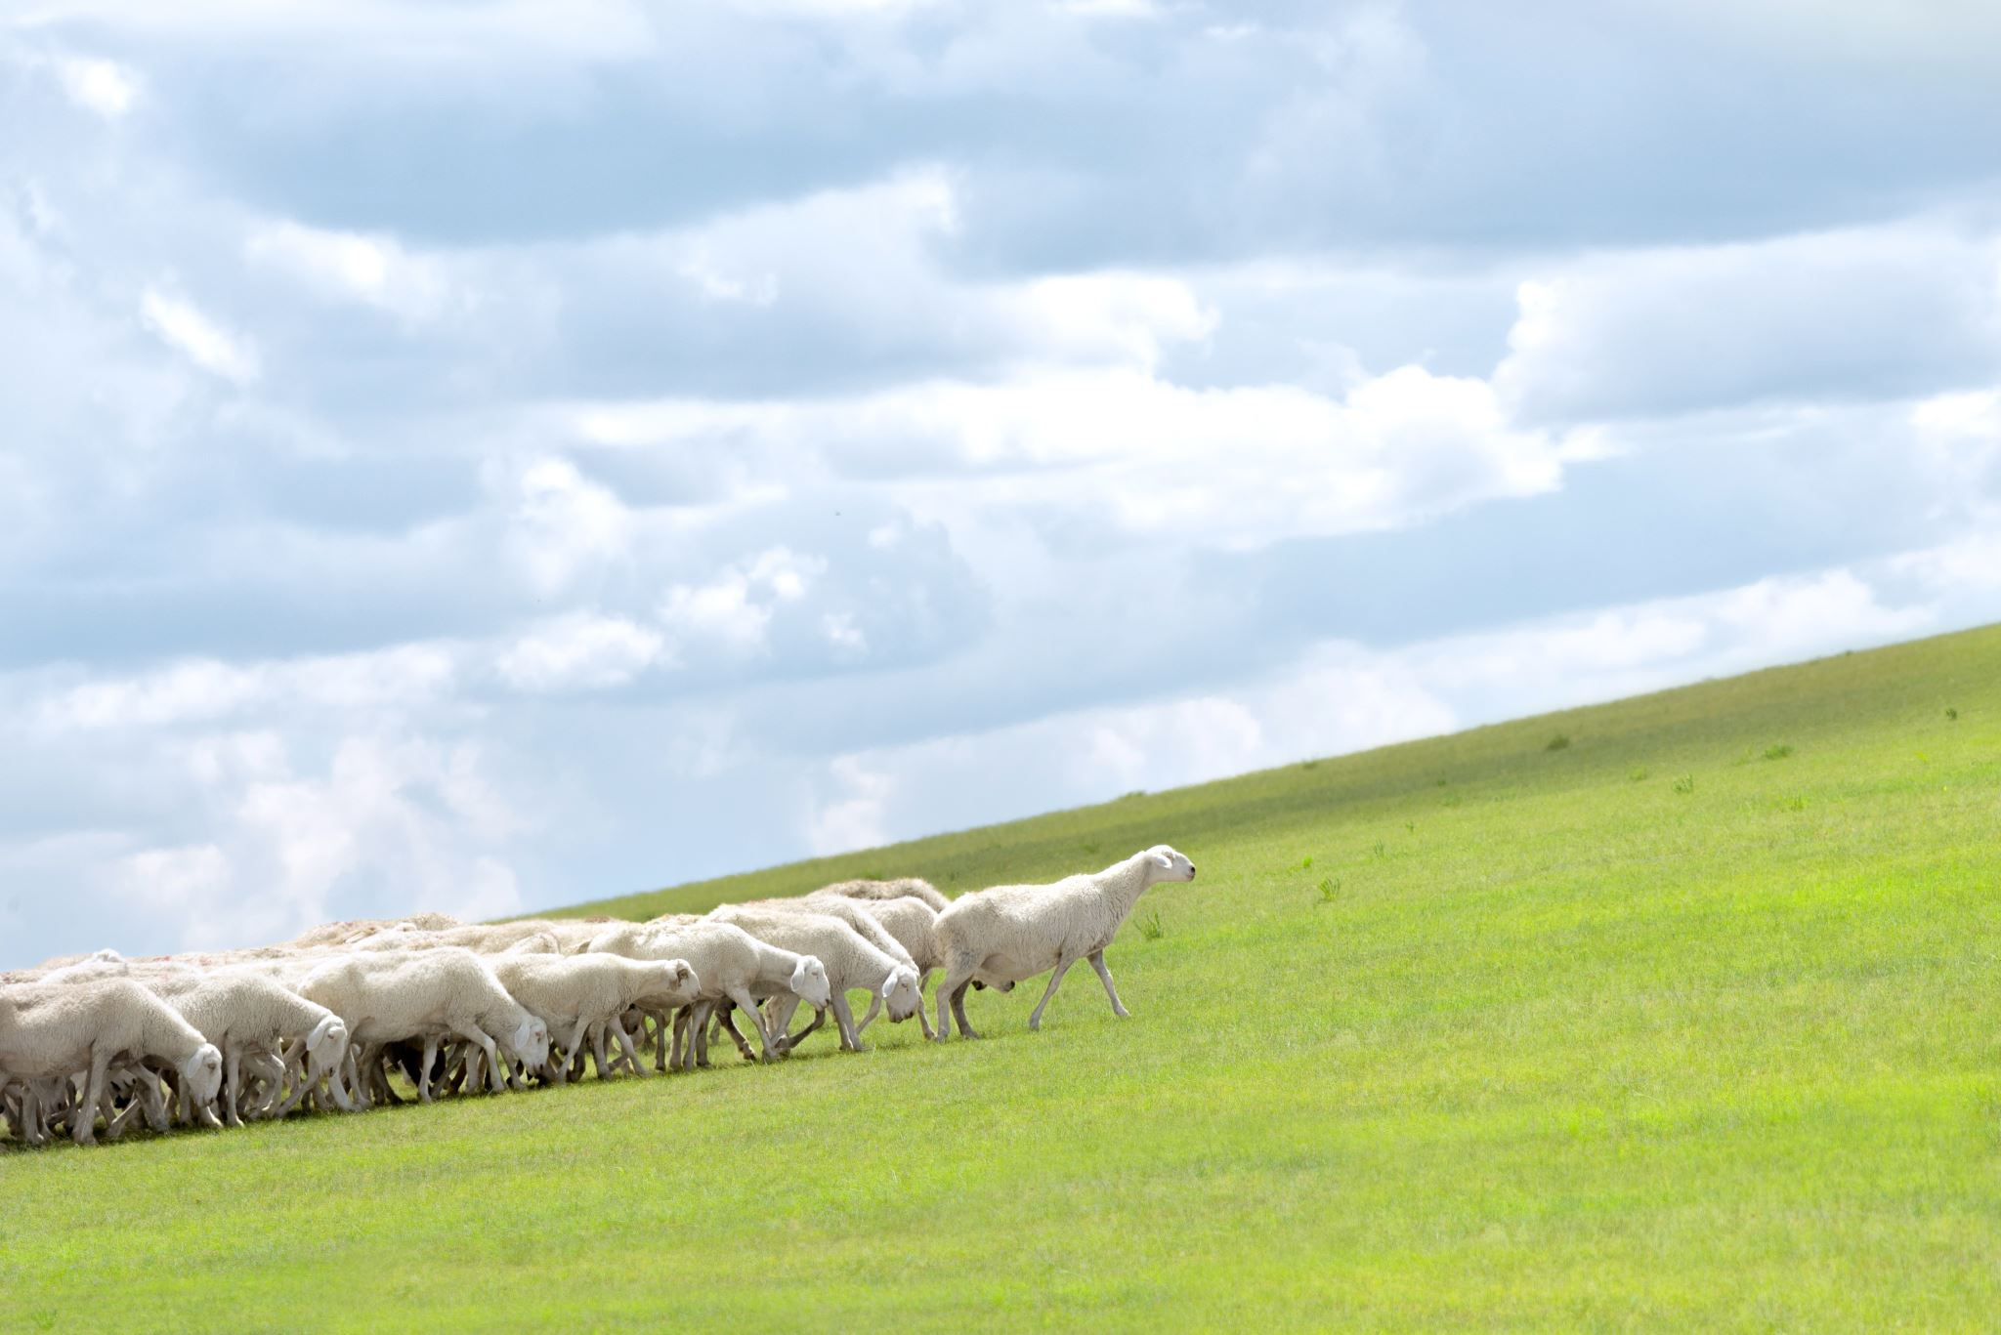
Animal husbandry support platform
Autori: Uroš Poznan 1036/2019
Mentori: Prof. dr. Veljko Milutinović
Aleksandar Veljković
Kristina Gavrilović 1015/2018
Project assignment for the
course Managing Sophisticated Projects in Academia and Industry (USPI)
1/10

Slide 2
Animal husbandry support platform
Introduction: How to make life of stockmen easier?
In era when almost everything is digitalized why would this industry branch remain excluded?
Idea: To create platform which would allow stockmen to keep trick of their business
Allow stockmen to interact and find business partners
Add ability to create and follow their own projects and accomplishments
2/10

Slide 3

Animal husbandry support platform
Problem statement
Currently there is no digital solution made for stockmen and their business. Most of them keep track of their business on the fly: Often they don't have a clear information of money invested and earned in their business
It's difficult to find other stockmen and protentional business partners and information about them
For stockmen having large number of animals is harder to keep track of the number
Most of them aren't used to use computers at all
3/10

Slide 4
Animal husbandry support platform
Existing solutions
Currently this or similar kind of platform doesn't exist
There is no way to find other stockmen online
Digitalized interaction among stockmen is sometimes accomplished via Facebook
Based on research made in Serbia, highest level of using digital resources among stockmen is use of Excel sheet and formulas for calculations
4/10

Slide 5
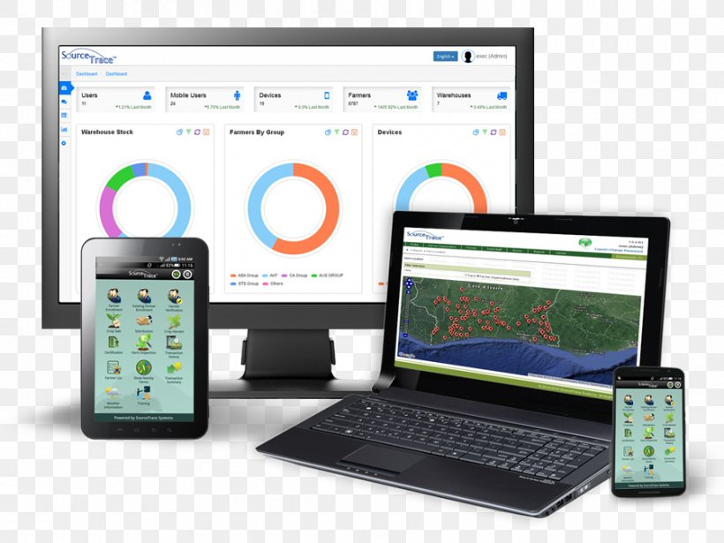
Animal husbandry support platform
Proposed solutions
Platform for supporting stockmen in animal husbandry
5/10

Slide 6

Animal husbandry support platform
The overall strategy of the work plan
The project is oganized in 9 work packages as follows:
WP0 - Project management
WP1 - Research and introduction
WP2 - System research
WP3 - Projecting the system and preparing for the implementation
WP4 - Building a database
WP5 - Development of system architecture
WP6 - User acceptance test
WP7 - Extended support
WP8 - Performing education and media campaigns
6/10

Slide 7
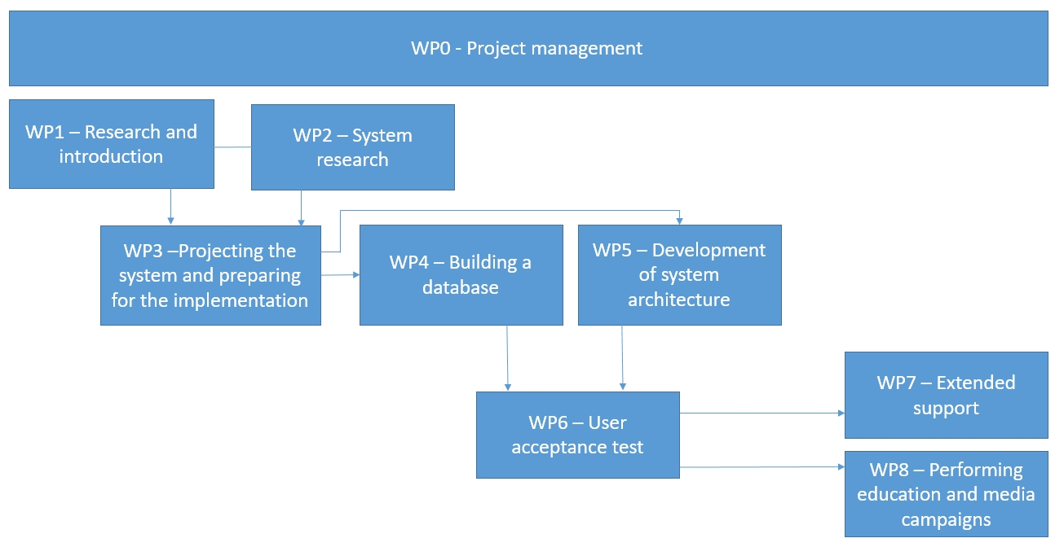
Animal husbandry support platform
PERT Diagram of work packages
7/10

Slide 8
Animal husbandry support platform
Participants:
Faculty of Mathematics, University of Belgrade
Faculty of Agriculture, University of Belgrade
Ministry of Agriculture, Forestry and Water Economy of the Republic of Serbia
Faculty of Electrical Engineering, University of Belgrade
IAHA - ANIMAL HUSBANDRY ALLIANCE
Selerant Inc., Italy
8/10

Slide 9
Animal husbandry support platform
References:
http://home.etf.rs/~vm/os/osuspi.html
http://poincare.matf.bg.ac.rs/~aleksandar/upin.html
https://ec.europa.eu/programmes/horizon2020/en/what-horizon-2020
9/10

Slide 10
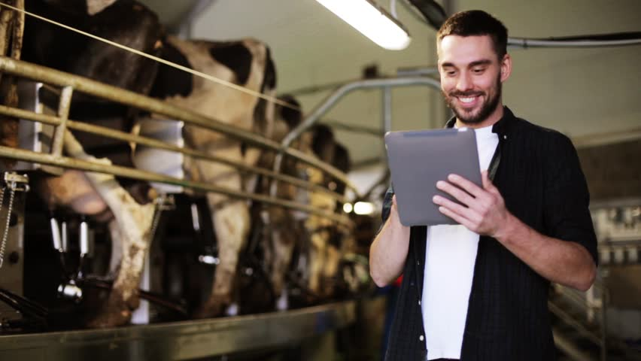
Animal husbandry support platform
Satisfied and happy stockmen are the ones who can run their business in most efficient way
Thank you for the attention!
Questions?
10/10

