Slide 1
Book Store Management System
Group Members:
Manasa Uppala (1261320)
Rohit Peddapalli (1249285)
Tushar Uppal(1256211)
Submitted to: Dr. Dae Wook (Wooky) Kim

Slide 2
Problem: Convert manual bookstore system to digital by using python
Solution: Today, it is very difficult to maintain the record manually. So, this python program will help to maintain the record of books in a very easy manner. This bookstore management system is used to overcome the entire problem which they are facing currently, and make the complete automatization of the manual system to computerized system

Slide 3
Project Objective
It helps automate and manage the entire campus operations, administration, and learning needs in a very effective way. This python solution will make the bookstore owner’s life easier.
To search record of books efficiently.
To provide better service.
It keeps database of book details, record at store.

Slide 4
Features
View all books
Search by (Title,year, author,ISBN)
Add entry
Update
Delete
Close

Slide 5
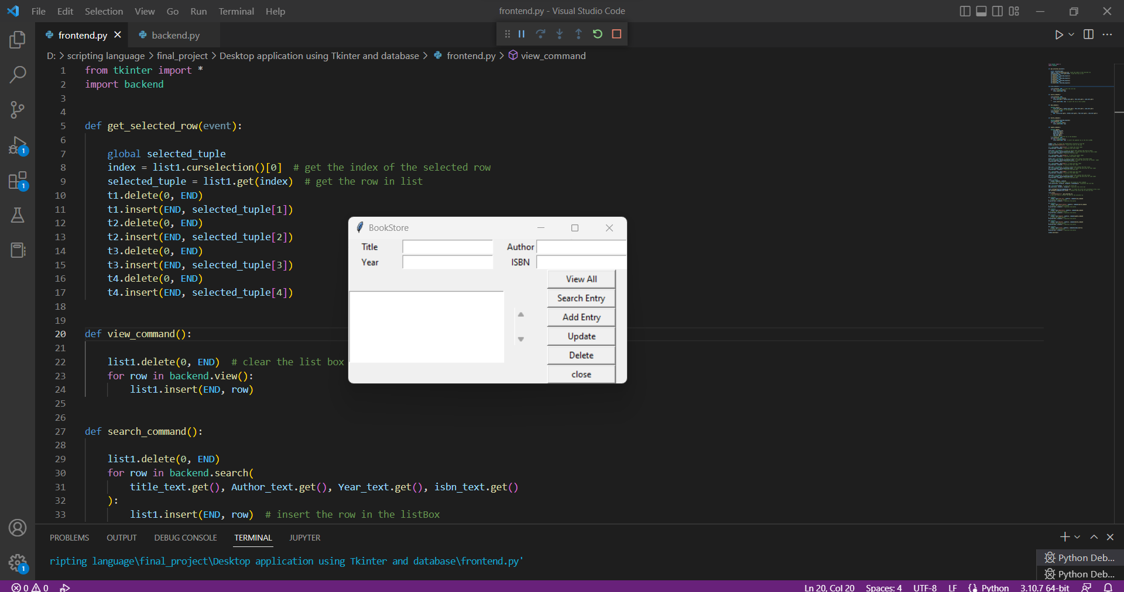
Project method to solve the problem
Frontend

Slide 6
Book store Management system : Backend
Technology Used :
Sqlite
Sql

Slide 7
DEMO

Slide 8
Future enhancements
In the future, our aim is to develop it for maintaining a super book management system and extends the system with payment methods.
Also in the future we can add the location of the book so that we can easily find out the book at the bookstore.

Slide 9
Conclusion
This program is successfully done to maintain the record of books in the bookstore.
This program is completed that follows to connect the backend with the front end.

Slide 10
References
https://www.programiz.com/python-programming
https://www.tutorialspoint.com/python/python_database_access.htm
https://realpython.com/python-gui-tkinter/
https://datatofish.com/executable-pyinstaller/

