Slide 1
MUSIC GENRE CLASSIFICATION SYSTEM
PROJECT DETAILS
Student: [Placeholder]
Roll Number: [Placeholder]
Guide: [Placeholder]
Dept: Electronics & Communication (ECE)
College: [Placeholder]
Using audio signal processing and deep learning models
Automated feature extraction, time-frequency representation, and CNN acoustic classification
Notes:
Introduce the project: an end-to-end engineering solution that leverages digital signal processing and deep convolutional neural networks to classify raw musical audio into predefined genres.

Slide 2
01 — MOTIVATION & SCALE
MILLIONS OF TRACKS NEED A SMARTER WAY TO ORGANIZE
Digital music catalogs and streaming archives expand faster than human teams can catalog them.
01
02
03
04
01 · INGESTION
02 · COMPUTATION
03 · INFERENCE
04 · OUTPUT
Audio Song
Signal Processing
Deep Learning
Genre Prediction
Streaming libraries receive millions of uncurated and independently produced digital tracks daily.
Converts continuous acoustic waveforms into structured, multi-dimensional time–frequency maps.
Learns complex hierarchical frequency and rhythm patterns directly without hand-crafted rules.
Automated genre assignment with associated classification confidence for downstream discovery.
Core Bottleneck: Manual genre tagging is slow, inconsistent, and cannot scale to modern catalog ingestion rates.
Music Genre Classification System
2
Notes:
Explain the core challenge: manual tagging cannot keep pace with exponential streaming growth. Audio signal processing paired with deep learning provides an automated, scalable pipeline.

Slide 3
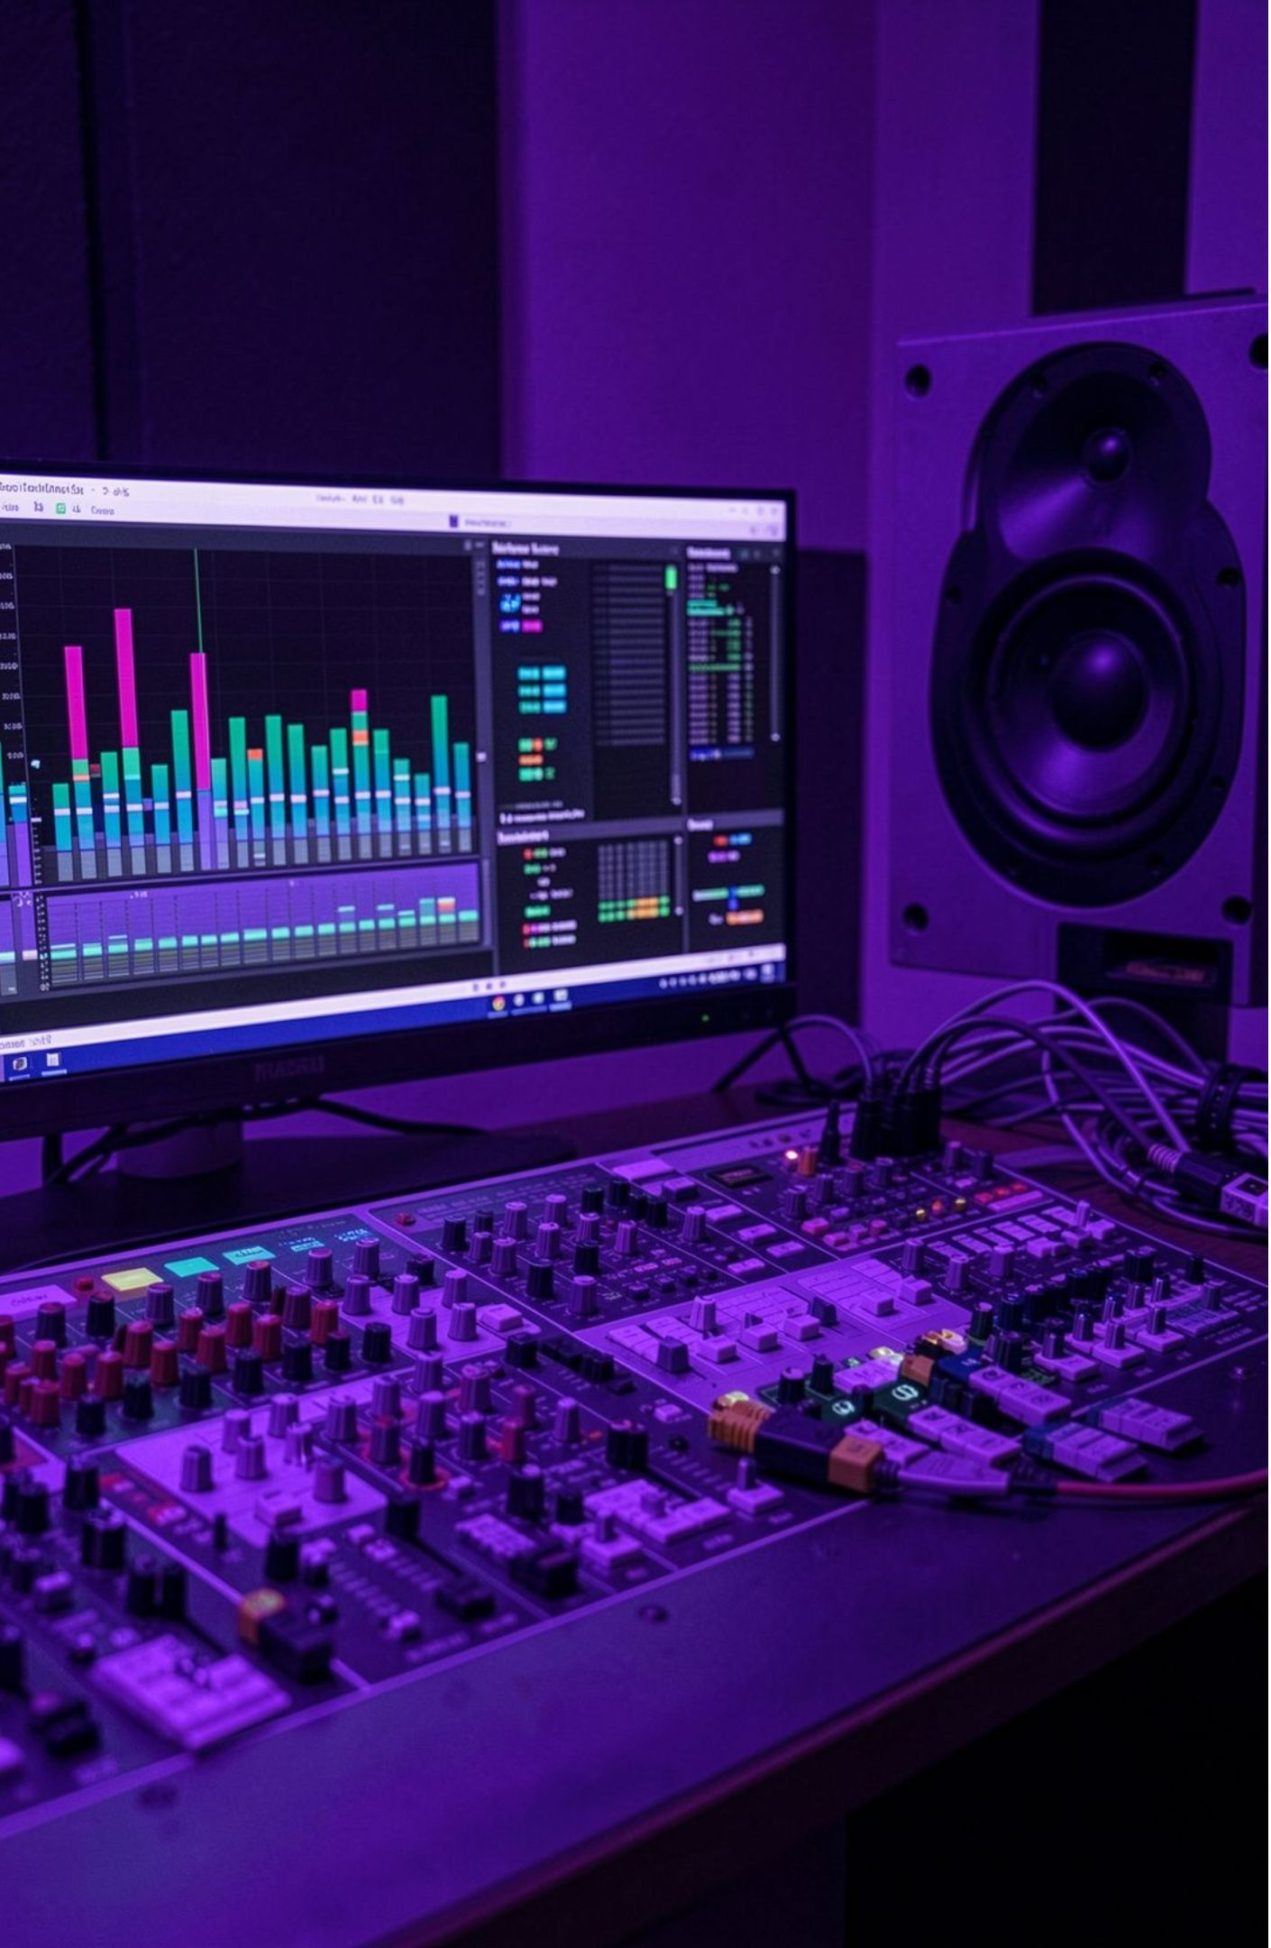
02 — PROBLEM DEFINITION
MANUAL CLASSIFICATION CANNOT KEEP PACE WITH LARGE MUSIC LIBRARIES
Genre depends on rhythm, melody, tempo, pitch, frequency, and instrumentation
Human labeling is time-consuming and vulnerable to inconsistency
Metadata and tags do not fully capture the audio itself
SYSTEM REQUIREMENT
The system must return a genre, confidence score, and performance analytics
Music Genre Classification System
3

Slide 4
03 — CURRENT STATE AUDIT
EXISTING APPROACHES RELY TOO HEAVILY ON PEOPLE AND METADATA
Methodology | Primary Mechanism | Critical Bottleneck | System Limitation
Manual Tagging | Human editors and crowd workers listen and tag | Labor-intensive, slow, subjective listener bias | Cannot scale to streaming catalogs
Metadata Matching | Artist, title, and studio ID3 tags | Frequently missing, falsified, or inconsistent | Ignores the actual acoustic content
Classical ML (SVM/kNN) | Heuristic hand-crafted acoustic feature vectors | Struggles with non-linear time–frequency dependencies | High feature engineering overhead
Proposed Deep Audio | End-to-end spectrogram learning via CNN | Automated feature extraction directly from signal | High scalability, zero manual tagging
Observed Failure Mode: Excessive human overhead, inconsistent ground truth, and fragile text metadata necessitate direct signal-level classification.
Music Genre Classification System
4
Notes:
Compare the conventional approaches against our proposed deep learning solution. Highlight how metadata-based and manual approaches fail to exploit the rich acoustic texture of the audio itself.

Slide 5
The proposed system learns from the audio signal itself
Upload audio
Preprocess and normalize the signal
Extract MFCC, Mel spectrogram, and complementary features
Classify with a CNN
Return genre, confidence, and analytics
Upload audio → Preprocessing → Features → Spectrogram/MFCC → CNN → Prediction
Music Genre Classification System
5
Notes:
Upload audio; preprocess and normalize the signal; extract MFCC, Mel spectrogram, and complementary features; classify with a CNN; return genre, confidence, and analytics.

Slide 6
05 — PROJECT OBJECTIVES
CONNECTING SIGNAL PROCESSING TO AN EXPLAINABLE RESULT
OBJECTIVE 01
OBJECTIVE 02
OBJECTIVE 03
Automated Classification
Multi-Domain Extraction
Visual Representation
Classify musical tracks into predefined genre categories reliably without manual listening.
Extract rhythm, frequency distribution, pitch classes, tempo (BPM), and spectral energy metrics.
Generate high-fidelity Mel spectrograms and Mel-frequency cepstral coefficient (MFCC) matrices.
OBJECTIVE 04
OBJECTIVE 05
OBJECTIVE 06
CNN Model Training
Confidence & Metrics
Downstream Utility
Train an optimized 2D convolutional neural network capable of spatial pattern recognition in audio.
Deliver transparent predicted genre labels alongside percentage confidence scores and loss curves.
Build an enterprise foundation for scalable music recommendation systems and digital libraries.
Music Genre Classification System
6
Notes:
Summarize the engineering objectives: we bridge raw digital signal manipulation with modern neural architectures to create an interpretable, production-ready system.

Slide 7
06 — SYSTEM ARCHITECTURE & DATA PIPELINE
ONE PIPELINE CONNECTS THE DATASET TO THE FINAL PREDICTION
OFFLINE TRAINING PIPELINE
Dataset
Training data
Feature extraction
CNN training
Trained CNN model
Trained CNN model → Genre classification
REAL-TIME INFERENCE PIPELINE
Audio input
Preprocessing
MFCC / Mel spectrogram
Genre classification
Confidence score
Results and performance analytics
Music Genre Classification System
7
Notes:
Clarify the relationship between training and inference: the offline pipeline trains the CNN on audio features, producing a frozen model artifact that is loaded by the real-time inference pipeline.

Slide 8
07 — SIGNAL CONDITIONING
PREPROCESSING TURNS RAW AUDIO INTO A STABLE MODEL INPUT
01
02
03
04
05
Load audio
Convert format
Reduce noise
Segment signal
Normalize amplitude
Load the audio file.
Convert format and normalize sampling rate.
Reduce noise and convert to mono.
Segment the signal into analysis windows.
Normalize amplitude before feature extraction.
Raw audio waveform → Clean, normalized waveform
Music Genre Classification System
8
Notes:
Describe each phase of preprocessing: load the audio file, convert format and normalize sampling rate, reduce noise and convert to mono, segment the signal into analysis windows, and normalize amplitude before feature extraction.

Slide 9
08 — ACOUSTIC FEATURE EXTRACTION
DIFFERENT FEATURES REVEAL DIFFERENT MUSICAL CHARACTERISTICS
No single metric characterizes genre; multiple complementary mathematical representations are extracted.
TIMBRE & PERCEPTION
TIME–FREQUENCY
RHYTHM METRIC
HARMONY PROFILE
MFCC
Mel Spectrogram
Tempo (BPM)
Chroma Features
Represents envelope of short-term power spectrum mapped to the non-linear human auditory system.
Visualizes frequency energy evolution over time scaled to the perceptually uniform Mel scale.
Calculates fundamental periodicity and speed of the musical pulse in beats per minute.
Projects spectral energy onto 12 discrete semitone pitch classes, characterizing key and harmony.
BRIGHTNESS MEASURE
PERCUSSIVENESS
AMPLITUDE POWER
Spectral Centroid
Zero Crossing Rate (ZCR)
RMS Energy
Indicates center of mass of the spectrum; correlates directly with perceived sonic sharpness and brightness.
Measures rate at which the signal alternates between positive and negative; detects noise and percussive transients.
Computes root-mean-square energy per frame, quantifying perceived loudness and dynamic envelope.
Music Genre Classification System
9
Notes:
Explain the complementary feature set: MFCCs and Mel spectrograms provide timbral shape, while chroma, tempo, ZCR, and RMS energy quantify harmonic and rhythmic structure.

Slide 10
09 — TIME–FREQUENCY VISUALIZATION
SPECTROGRAMS MAKE GENRE-SPECIFIC PATTERNS VISIBLE
SPECTROGRAM COORDINATES
REPRESENTATION TRANSFORMATION
Time → X-axis | Frequency → Y-axis | Color → Signal energy
Audio waveform
Time–frequency spectrogram
Compact MFCC feature map
Genres produce different frequency distributions, rhythms, and energy patterns
MFCC compresses frequency information into features suited to machine learning
Music Genre Classification System
10
Notes:
Conclude with the spectrogram transformation: casting sound as a 2D image allows our convolutional network to treat genre classification as visual pattern recognition.

