Slide 1
Cognizant
K O C H I
PROJECT PRESENTATION
AI-Powered IT/Admin
Helpdesk Router
Intelligent ticket classification, RAG-based resolution, and smart escalation for faster, more reliable employee support.
TEAM
Nagesh Naik J
Suhas Mokhashi
Vijaya Kumar S
Prerana U
ID: 2496969
ID: 2496817
ID: 2496942
ID: 2496812

Slide 2









Cognizant
K O C H I
Project Objectives
What the AI Helpdesk system is designed to achieve
Automate Helpdesk Management
Intent Classification
Priority Assignment
Handle employee support requests efficiently end to end.
Classify tickets by category — IT, HR, finance, or network.
Auto-assign urgency based on issue type and impact.
Duplicate Detection
RAG-based Resolution
Auto-Resolve Common Tickets
Use semantic similarity to avoid repeated resolution work.
Retrieve knowledge base info and generate accurate answers.
Resolve issues automatically when confidence is high.
Smart Escalation
Audit & Feedback Trail
Boost Support Efficiency
Route complex/low-confidence tickets to Agent, L2, L3, or vendor.
Maintain ticket history, audit logs, and feedback for tracking.
Reduce manual effort and improve response times overall.
AI-Powered IT/Admin Helpdesk Router
2

Slide 3
Cognizant
K O C H I
Manual ticket handling is slow and error-prone.
Organizations receive many IT and admin support requests daily, often in natural language, requiring manual effort to identify, categorize, and route each ticket.
This causes delays, misrouting, and overload.
The process is time-consuming and increases workload on helpdesk staff, leading to delayed responses and incorrect ticket routing.
Known solutions go unused.
Many common issues already have documented solutions in the knowledge base, yet employees still raise tickets — adding unnecessary work.
01
Problem
Statement
AI-Powered IT/Admin Helpdesk Router
3

Slide 4
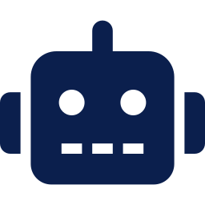



Cognizant
K O C H I
Proposed Solution
An Intelligent IT/Admin Helpdesk Router powered by AI
The system uses AI to understand user requests, automatically classify tickets, retrieve relevant solutions from a knowledge base using Retrieval-Augmented Generation (RAG), and deliver instant responses for common issues — routing anything it cannot resolve to the right support team.
01
→
02
→
03
→
04
Understand
Classify
Retrieve
Resolve or Route
Interprets natural-language requests using AI/NLP.
Auto-categorizes tickets by type and department.
Pulls relevant knowledge-base content via RAG.
Auto-resolves confident cases; escalates the rest.
AI-Powered IT/Admin Helpdesk Router
4

Slide 5
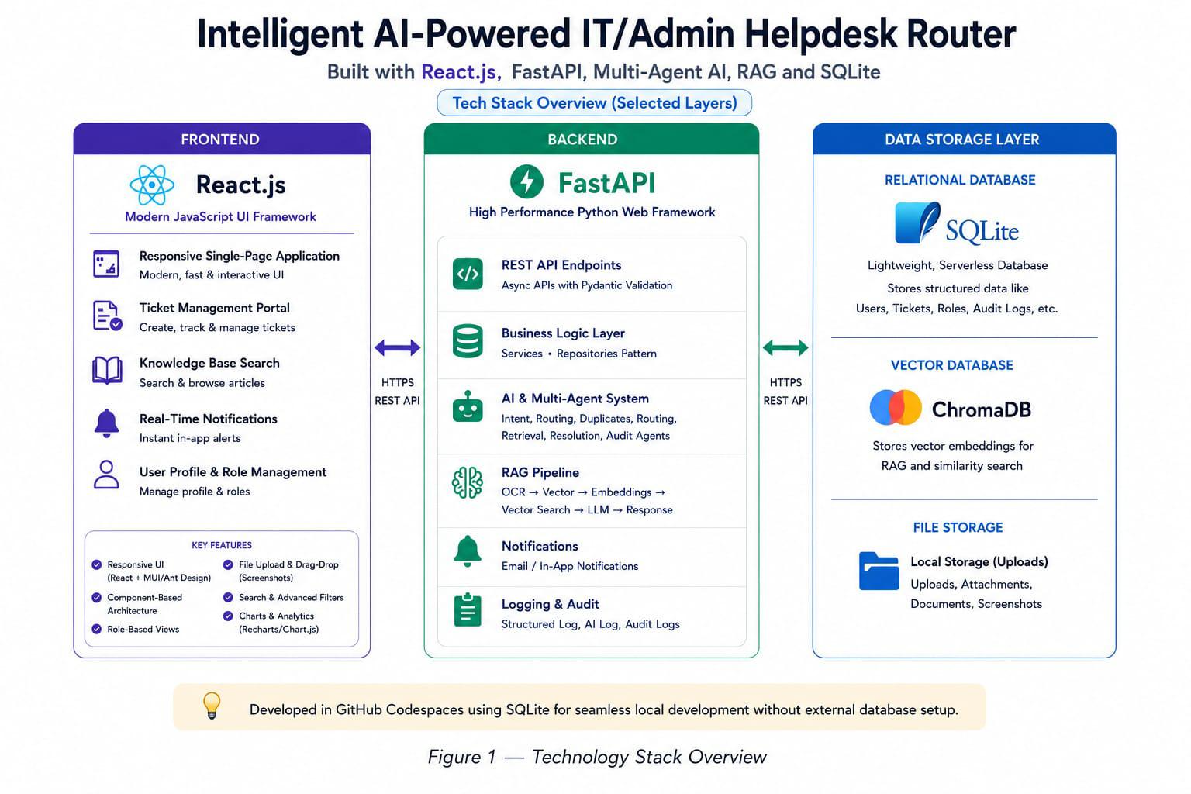
Cognizant
K O C H I
Technology Stack
React.js, FastAPI, multi-agent AI, RAG, and SQLite
AI-Powered IT/Admin Helpdesk Router
5

Slide 6
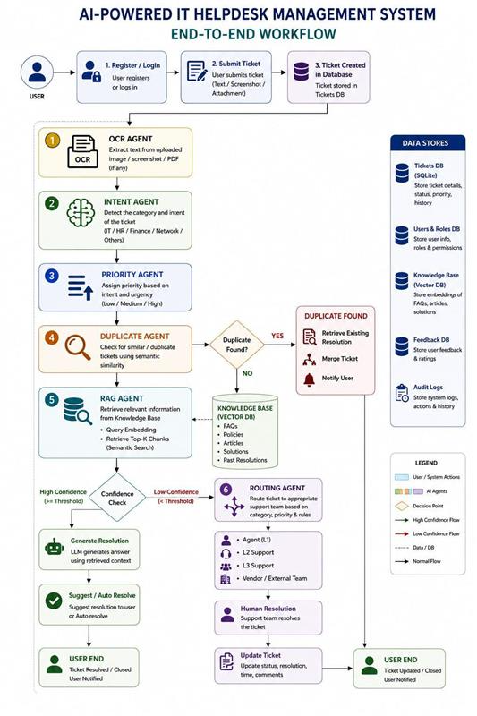
Cognizant
K O C H I
End-to-End Workflow
From ticket submission to resolution, duplicate handling, and escalation
AI-Powered IT/Admin Helpdesk Router
6

Slide 7


















Cognizant
K O C H I
System Architecture
React client, FastAPI gateway, multi-agent AI engine, and ChromaDB vector store
React UI Client
Multi-Agent AI Engine
Intent Agent
OCR Agent
React.js
Gemini API
Modern JS UI Framework
Vision Agent
Embedding Agent
Dashboard
FastAPI Gateway
Embedding Agent
RAG Agent
Claude API
Ticket
Submit Ticket
ChromaDB Vector Store
Legend
AI Chat
SQLite Database
Direct integration
Document chunks
Ticket embeddings
Others...
Tickets
Tables
Direct API call
Feedback
Feedback
Optional API calls
Logs
AI-Powered IT/Admin Helpdesk Router
7

Slide 8




Cognizant
K O C H I
Conclusion
The AI Helpdesk Management System automates support ticket handling by combining classification, priority assignment, duplicate detection, and RAG-based resolution — reducing manual effort and routing complex tickets to the right team.
Overall Impact
Faster response time
Improved response time, support efficiency, and ticket management accuracy — with reliable tracking end to end.
Higher resolution accuracy
Full audit & feedback trail
Reliable escalation flow
Thank You

