Slide 1


Slide 2

CONTENTS
1. Background
2. ERD & Business Rules
3. Codes
4. Tableau Reports & Future Prospects

Slide 3

1. Background

Slide 4

BACKGROUND
In view of the current global epidemic of the COVID-19, online medical services can reduce the risk of infection to some extent.
01
Purpose
02
Information needs
maintain the data used to generate and support patients getting preliminary medical services online
appointment service;
online diagnosis service;
medical record management service...

Slide 5
2. ERD & Business Rules

Slide 6
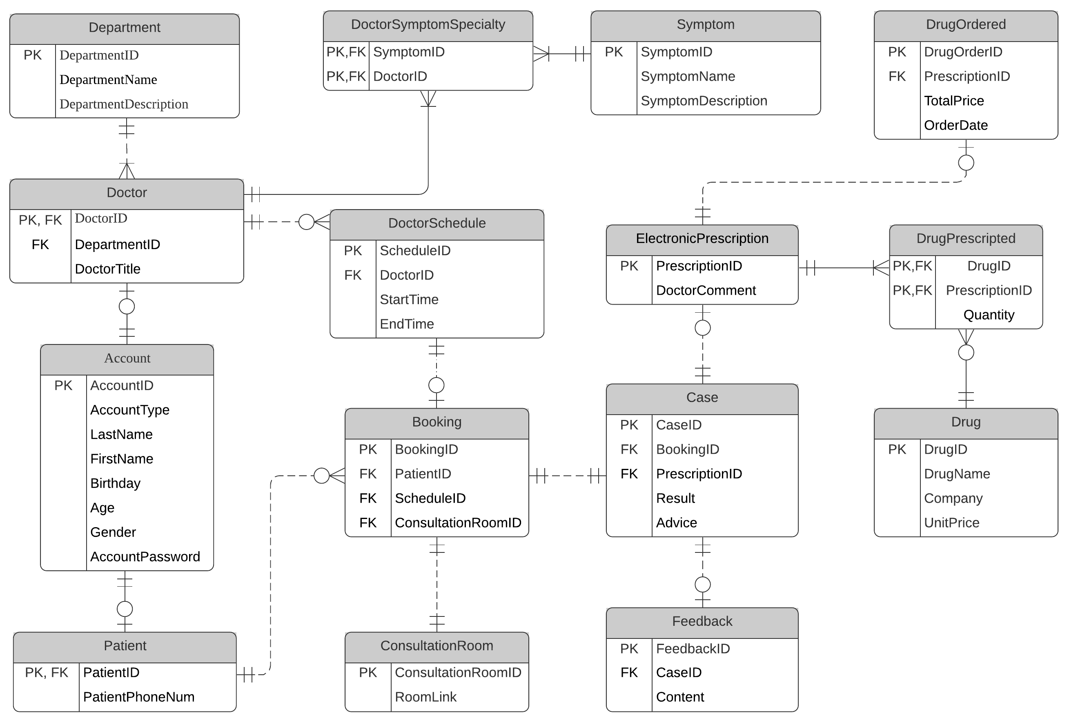
ERD Design
15 Entities

Slide 7
ERD Section1
Basic Info Storage
6 Entities
Business Rules:
• Each account should belong to a doctor or a patient but not both.
• Each department may have one or more doctors.
• Each doctor can handle more than one symptom.
• Each patient has only one primary phone number stored.

Slide 8
ERD Section2
Booking Process
9 Entities
Business Rules:
• Each patient may have zero or more bookings.
• Each doctor may have zero or more doctor schedule.
• Each doctor can only treat one patient at a scheduled time slot.
• Each booking may have only one case associated with.
• Each booking may have only one consultant room associated with.
• Each booking may be associated with at most one scheduled time slot.
• Each case may be associated with at most one feedback.
• Each case may be associated with at most one electronic prescription.
• Each electronic prescription may have one or more drug prescripted.
• Each electronic prescription may have zero or one drug order.

Slide 9
3. Codes

Slide 10

Column Data Encryption
Column Data Encryption
Account Password
Inline Gender Constraint
Male or Female
Inline Age Calculator
Using Birthdate

Slide 11
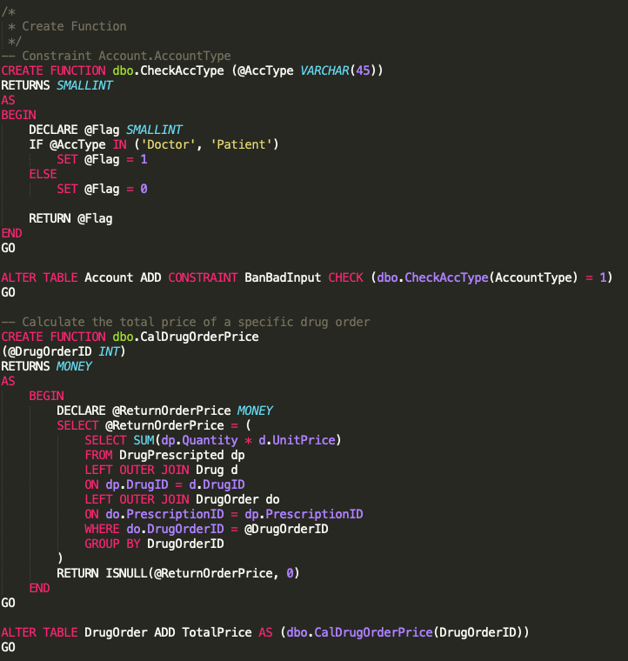
Functions
Table-Value CHECK Constraints
Used to limit the exact input of the AccontType attribute
Computed Columns
Used to calculate the total drug price of a order

Slide 12
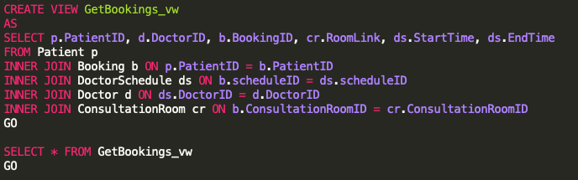
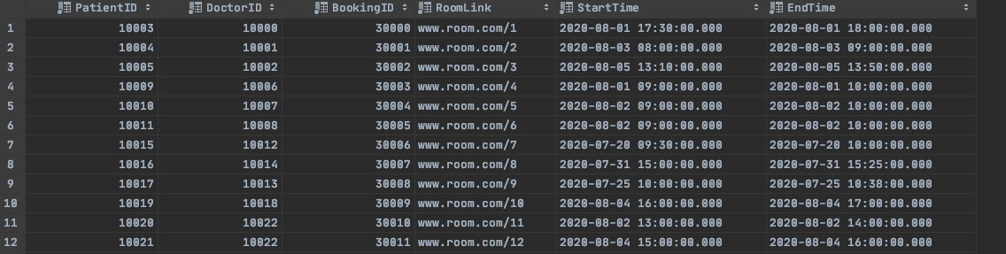
Views
GetBookings

Slide 13
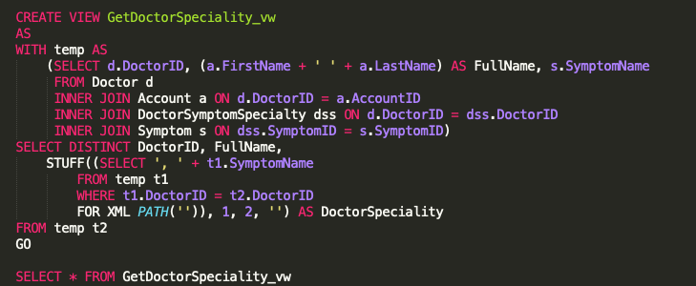
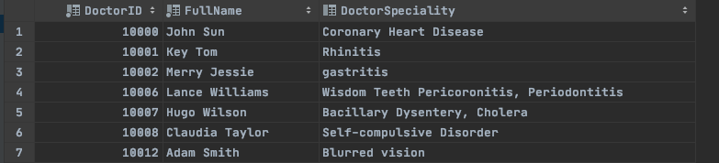
Views
GetDoctorSpecialty

Slide 14
4. Tableau Reports & Future Prospects

Slide 15
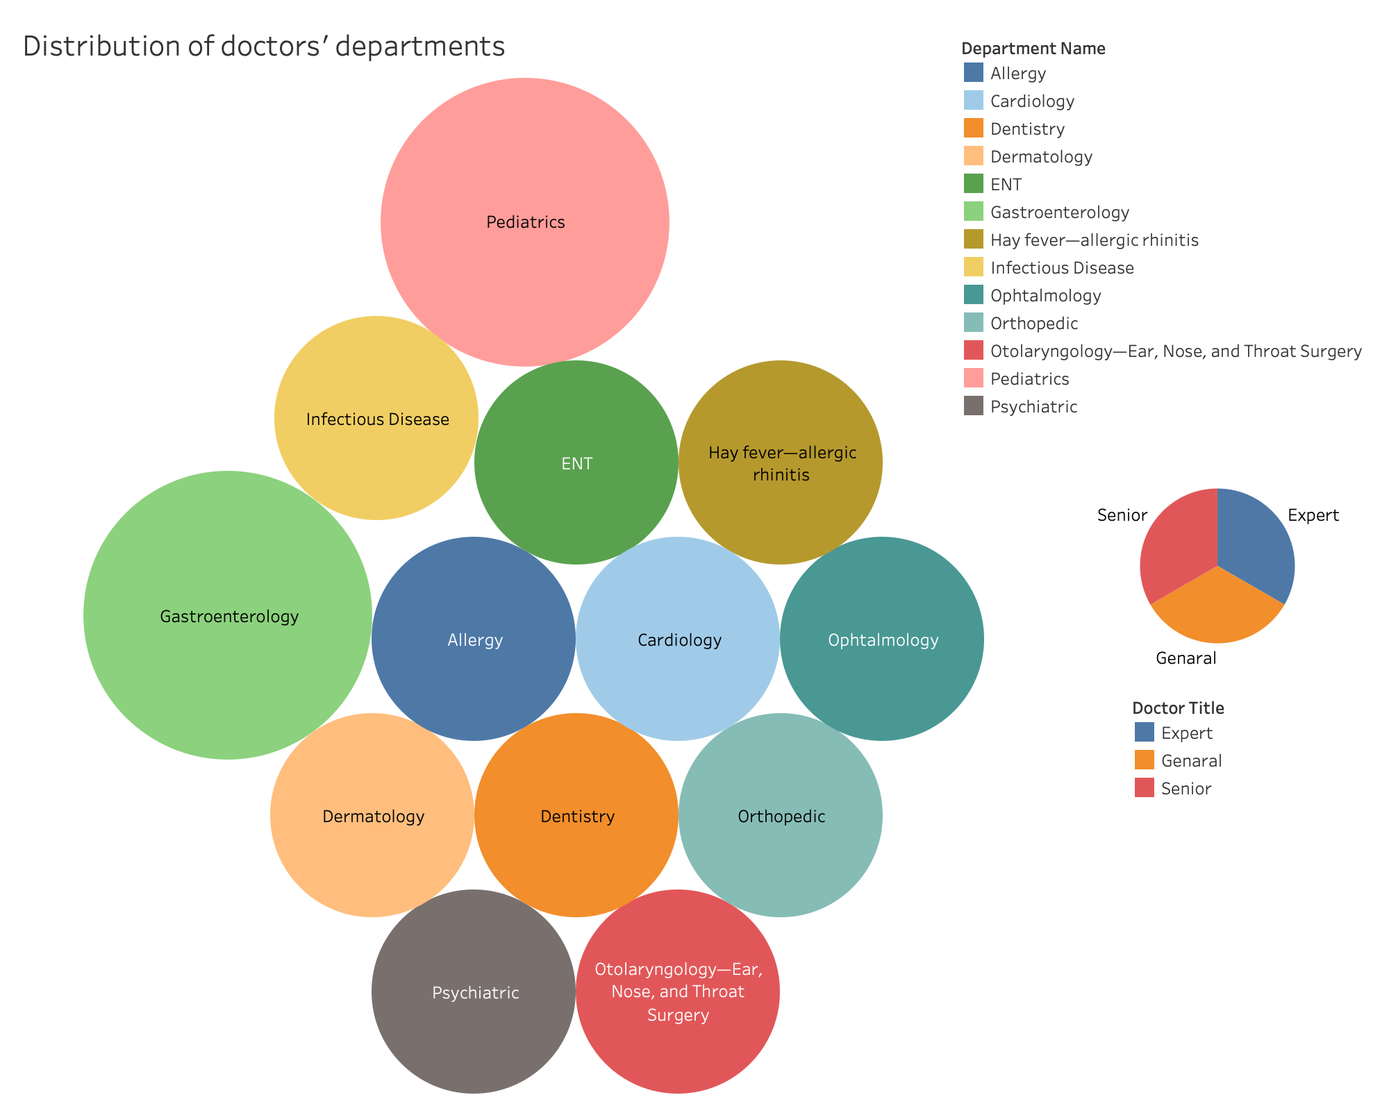

Slide 16
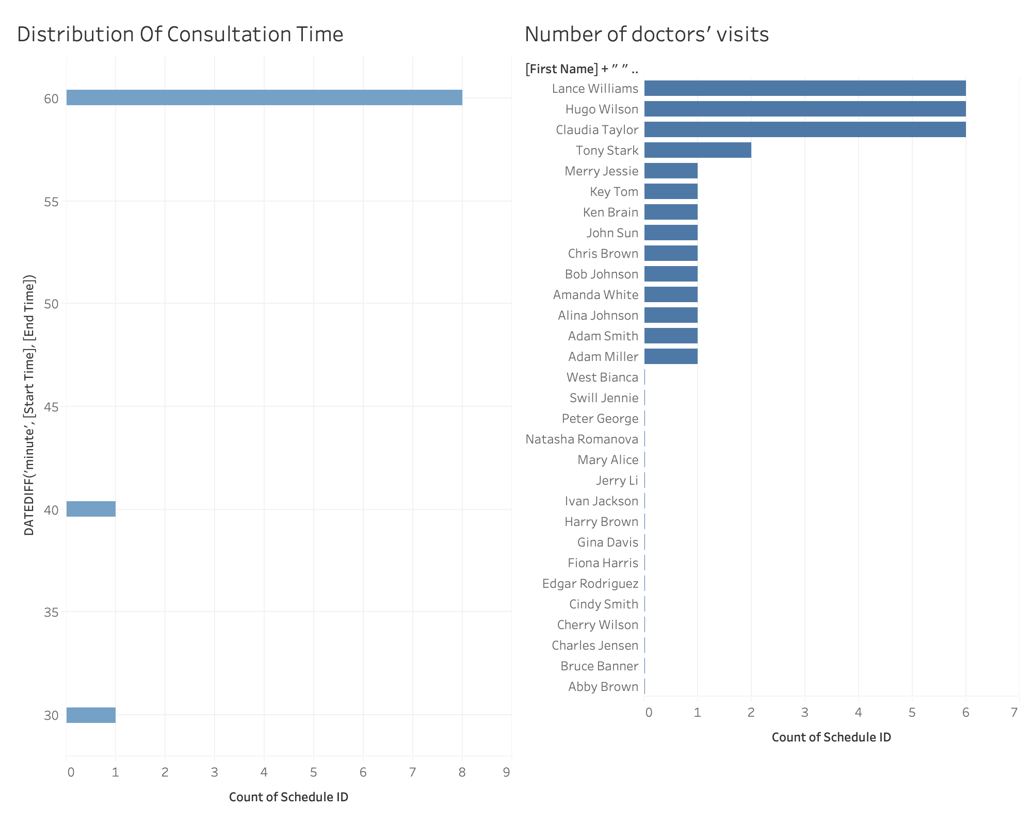

Slide 17


