Slide 1
Alignment IV
BLOSUM Matrices

Slide 2
BLOSUM matrices
Blocks Substitution Matrix. Scores for each position are obtained frequencies of substitutions in blocks of local alignments of protein sequences [Henikoff & Henikoff92].
For example BLOSUM62 is derived from sequence alignments with no more than 62% identity.

Slide 3
BLOSUM Scoring Matrices
BLOck SUbstitution Matrix
Based on comparisons of blocks of sequences derived from the Blocks database
The Blocks database contains multiply aligned ungapped segments corresponding to the most highly conserved regions of proteins (local alignment versus global alignment)
BLOSUM matrices are derived from blocks whose alignment corresponds to the BLOSUM-,matrix number

Slide 4
Conserved blocks in alignments
AABCDA...BBCDA
DABCDA.A.BBCBB
BBBCDABA.BCCAA
AAACDAC.DCBCDB
CCBADAB.DBBDCC
AAACAA...BBCCC

Slide 5
Constructing BLOSUM r
To avoid bias in favor of a certain protein, first eliminate sequences that are more than r% identical
The elimination is done by either
  removing sequences from the block, or
  finding a cluster of similar sequences and replacing it by a new sequence that represents the cluster.
BLOSUM r is the matrix built from blocks with no more the r% of similarity
  E.g., BLOSUM62 is the matrix built using sequences with no more than 62% similarity.
  Note: BLOSUM 62 is the default matrix for protein BLAST

Slide 6
Collecting substitution statistics
Count amino acids pairs in each column; e.g.,
  6 AA pairs, 4 AB pairs, 4 AC, 1 BC, 0 BB, 0 CC.
  Total = 6+4+4+1=15
Normalize results to obtain probabilities (p_{X}’s and q_{XY}’s)
Compute log-odds score matrix from probabilities:
s(X,Y) = log (q_{XY} / (p_{X} p_{y}))
A
A
B
A
C
A

Slide 7
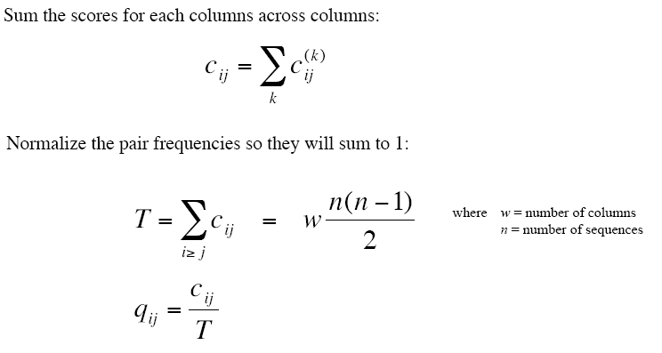
Computing probabilities
From http://www.csit.fsu.edu/~swofford/bioinformatics_spring05/lectures/lecture03-blosum.pdf

Slide 8
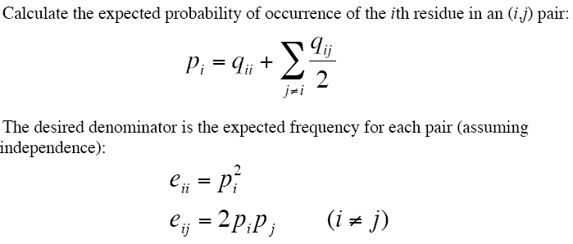
Computing probabilities

Slide 9
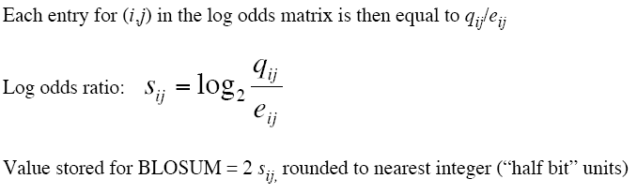
Computing probabilities

Slide 10
Computing probabilities

Slide 11
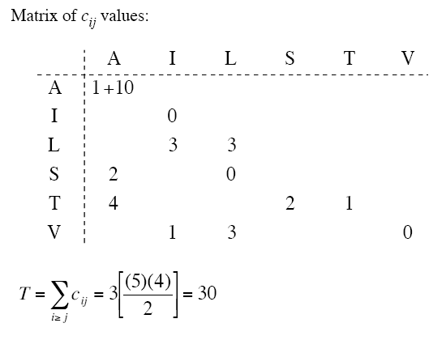
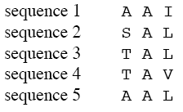
Example
From http://www.csit.fsu.edu/~swofford/bioinformatics_spring05/lectures/lecture03-blosum.pdf

Slide 12
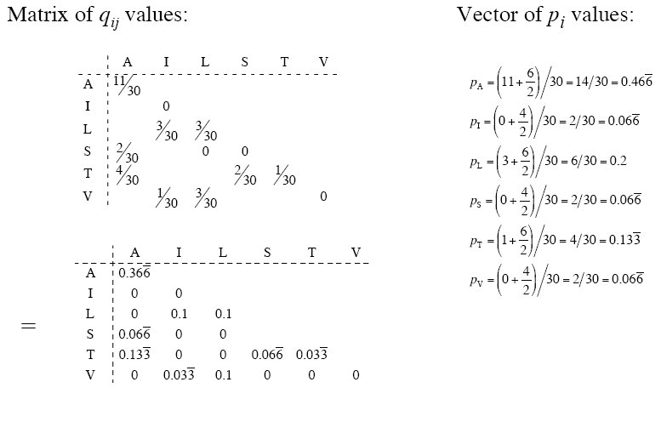
Example

Slide 13
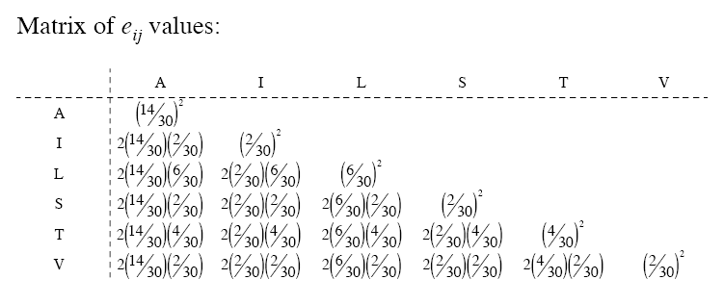
Example

Slide 14
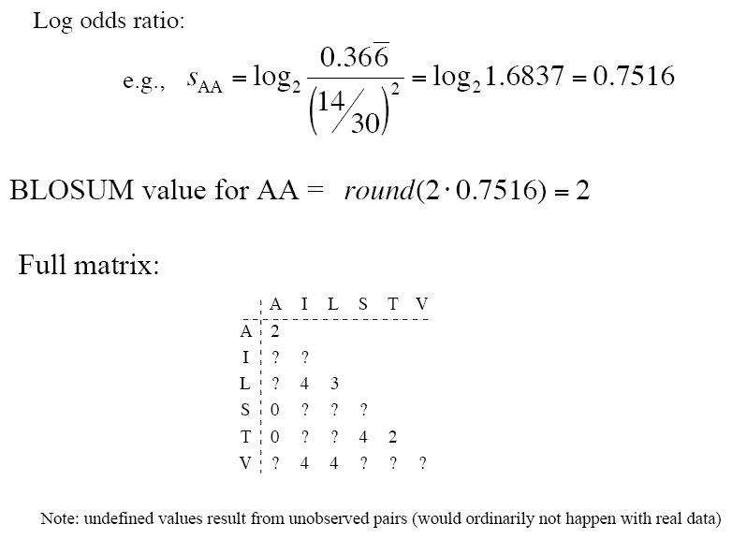
Example

Slide 15

Comparison
PAM is based on an evolutionary model using phylogenetic trees
BLOSUM assumes no evolutionary model, but rather conserved “blocks” of proteins

Slide 16
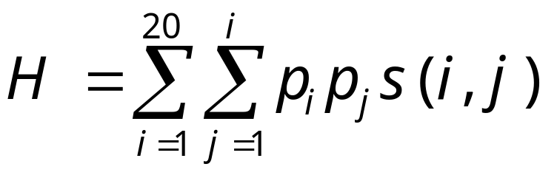
Relative Entropy
Indicates power of scoring scheme to distinguish from “background noise” (i.e., randomness)
Relative entropy of a random alignment should be negative
Can use H to compare different scoring matrices

Slide 17
Equivalent PAM and Blossum matrices (according to H)
PAM100 ==> Blosum90
PAM120 ==> Blosum80
PAM160 ==> Blosum60
PAM200 ==> Blosum52
PAM250 ==> Blosum45

Slide 18
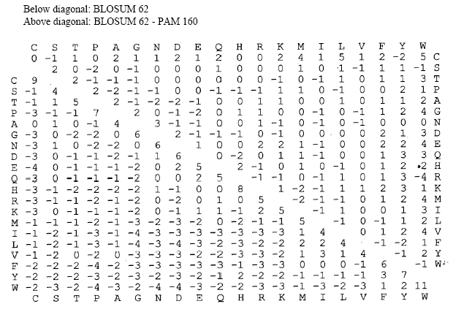
PAM versus Blosum
Source: http://www.csit.fsu.edu/~swofford/bioinformatics_spring05/lectures/lecture03-blosum.pdf

Slide 19
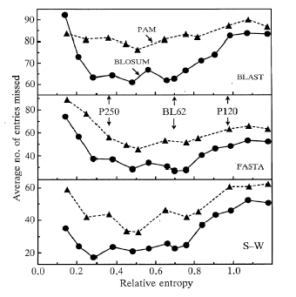
Superiority of BLOSUM for database searches
(according to Henikoff and Henikoff)

