Slide 1

通过Azure自动化服务实现高效的云中自动化运维
翟爽 | 微软云计算技术顾问
徐磊 | 微软最有价值专家

Slide 2
课程内容
01 | 自动化服务介绍
02 | 运用自动化服务连接到Azure云
03 | 管理运行手册和资产
04 | 自动化服务最佳实践
05 | 自动化服务场景示例
06 | 问答
Notes:
Architecture overview along with resources and requirements for DSC
Perform a push deployment configuring the LCM and your first DSC configuration
Explore the Pull server options SMB and HTTP
Preparing your environment for pull configurations and querying diagnostic information
Start working with the available resources in your configurations
Enhance your configurations with parameters, credentials and more

Slide 3
通过Azure自动化服务实现介绍

Slide 4
通过自动化可以极大的简化云中的管理
优化和扩展已有投资
集成
可以通过PowerShell的模块集成现有系统
可以构建新的PS模块实现扩充与其他系统的集成
交付灵活和可靠地服务
调度 通过灵活的工作流程价值加速时间
跨多个工具、 系统和部门改进服务的可靠性
降低成本并提高可预见性
自动化
让服务所有者专注于提升业务价值
在降低成本的同时降低出错的手动操作
Notes:
Although it’s not a panacea for all configuration and testing scenarios, automation can truly be an incredible timesaver and increase the consistency of complex dependent deployment and testing scenarios. An enterprise best practice is to look at processes that are frequently repeated and then automate them. Automation minimizes the chance of errors tremendously because the same script is always running every time.
Repeatable deployment
Automation provides the support for repeatable and reproducible results every time a deployment occurs. Deployment can be done rapidly and in a consistent manner each time it’s executed, yielding the same results and configurations in less time. The key term here is ―same results.‖ Deployment can be one of the most error-prone operations, and it’s typically done many times over the lifetime of an application. For example, deployment occurs before a product is released but also to re-create a test environment post-release during regression testing. An application in a test environment is typically deployed repeatedly. Automating the process makes perfect sense to ensure it happens consistently and quickly each time a deployment occurs.
Consistent testing configurations
Variations in testing are a common requirement and can be a significant nuisance at times. For instance, a test configuration might require a scenario with multiple replicated database servers. To set these up manually over a number of runs is a very time-consuming process. As testing progresses and becomes more complex, being able to tweak a base configuration script according to the stage in testing is a significant timesaver. Automating test cases via scripting allows quick configuration and setup of an environment for a test team. Often, there is more than one test team within an organization working in similar environments. Via automation, multiple test teams in an organization can share and modify workflows to fit the requirements of their applications. For example, for testing within an organization, sharing a base automation script across multiple units improves the time taken to plan, design, and deploy multiple test scenarios. In addition, shared automation scripts allow you to more accurately compare results across different applications with teams that might be using the original, or slightly modified, shared testing automation script. This is because when running the same scripts the output is of the same type and can be equally compared with a relative accuracy across different organizational units.
Integrating automation into testing minimizes the time for setup and execution of different and complex test scenarios. For example, consider testing a complex multi-server configuration with SQL Server or Microsoft SharePoint using a replicated Active Directory. As a key part of the testing configuration, automation allows simple setup and teardown of that environment many times in a test cycle. In a test scenario, automation allows you to focus on the processing flow and the value of the data instead of the configuration setup and management.

Slide 5
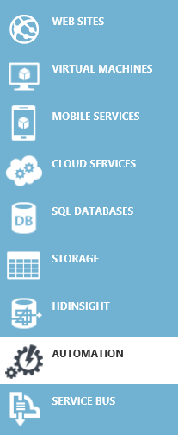
Azure 自动化服务能力
在Azure编辑运行手册(Runbook):
创建运行手册来自动执行所有方面的云业务，包括部署、 监控和优化
高可用引擎:
支持扩展和高可用架构。
基于PowerShell 工作流构建，实现了不同运行作业的隔离。
与其他系统集成性:
可以导入PS模块并且创建附加模块或运行手册与Azure其他服务或第三方系统连接。
Azure
Automation
Backup SQL Azure on a schedule
Patch Azure VMs without downtime
Remediate alert on a service
Staged deployment of a service
Monitoring
Systems
Change
Control
Systems
Anything ☺

Slide 6
自动化服务使用场景
部署
监控
部署补丁程序
管理虚拟机
运行虚拟机备份
容灾
高可用

Slide 7
运用自动化服务连接到Azure云

Slide 8
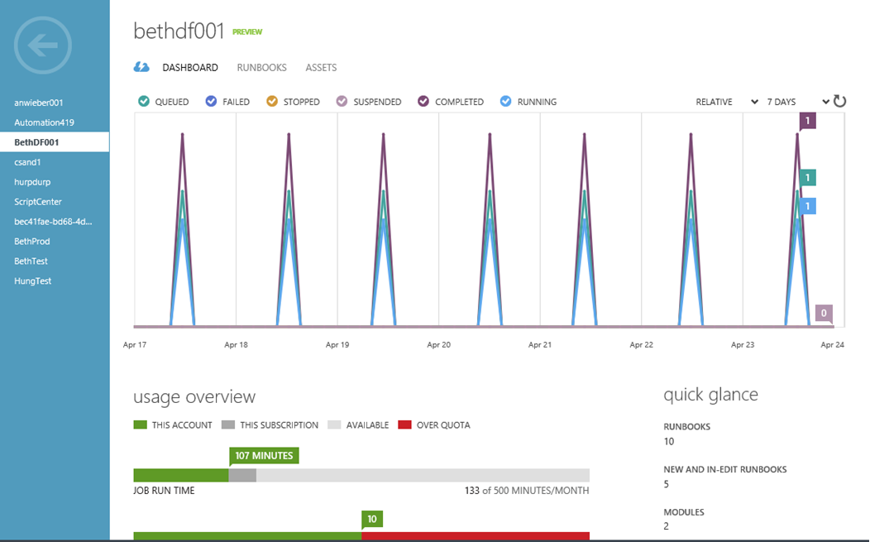

自动化管理账户和仪表板
创建自动化管理账户
通过分组或独立贡献者管理自动化管理账户
自动化管理账户可以通过区域划分
每个订阅最多30个自动化管理账户
自动化仪表板
运营仪表板用于分析和发现问题
可以通过仪表板快速访问出问题的运行作业并检查输出或运行

Slide 9
启用Azure自动化服务
Notes:
Dashboard tab Shows diagnostic, job, and usage information for the Automation jobs that have run. It indicates the different status of the jobs (queued, failed, stopped, suspended, completed, and running) with a granularity of one hour to 30 days. You can see the number of runbooks you have, assets (variables, connections, credentials, schedules), and more summary information.
Runbooks tab Provides a list of runbooks and their current view. You can filter the job status by specific dates and times. Other runbooks can be imported here, or you can export one of the runbooks from this Azure Automation account to be used in another account.
Assets tab Allows management of assets global to the mynewautomationacccount runbook. You can modify and create variables, connections, credentials, and schedules. You can also import additional modules that contain Windows PowerShell workflows to use in your runbooks.
点开一个模块，浏览包含在内的所有cmdlet
Scale tab Allows you to choose the Free or Standard Automation plan. The plan you choose applies to all Automation accounts in the subscription. The Free plan allows 500 minutes of job runtime per month and is not billed. If you need unlimited minutes of job use, choose the billed Standard plan. 免费包含500分钟/月
打开页面，说明价格
http://www.windowsazure.cn/home/features/automation/#price
You can use an Automation account to organize the automation runbooks specific to a person or a group. Think of an Automation account as a top-level file folder in which you store your runbooks in specific regions. You can have multiple automation accounts per subscription with a maximum of 30 Azure Automation accounts per subscription in different regions, if needed.
自动化保留所在区域的运行手册，每个订阅最多30个账户
For example, an IT operations person might create an Azure Automation account for different groups, such as Marketing, Finance, HR, Development/Test, and Research. These five individual accounts can then hold automation runbooks that are specific to each group’s provisioning and lifetime management of resources. Programmatically, the resources in one Azure Automation account don’t have scope in another Azure Automation account.
一个账户中的共享运行手册等内容。自动化账户是管理范围分界。

Slide 10
管理运行手册和资产

Slide 11
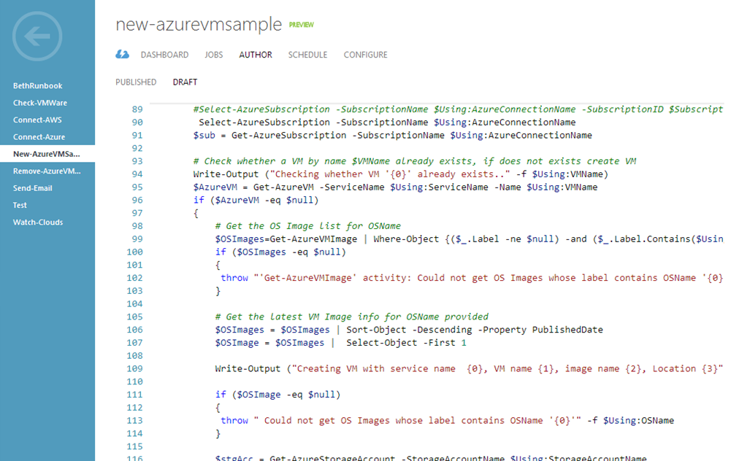
创作运行手册
创作
创建PowerShell 工作流运新手册
从脚本库中调用已有运行手册
管理浏览运行手册并加入资产
模块和活动
安全凭据 (PowerShell 安全凭据和证书)
变量 (standard and encrypted)
连接
计划日程
测试
运行运行手册并通过创作输出窗口查看
定位排查问题
发布
在发布前编辑调试草稿
Notes:
Let’s start by giving a definition of an Azure Automation runbook. If you’re familiar with the enterprise software development life cycle (SDLC), the definition of a runbook encompasses a set of processes and procedures that you execute repetitively to support various enterprise tasks. These tasks can include deployment and lifecycle management of resources, deployment, patching, upgrades, backups, error log management, database volume management, user management, and security management.
A runbook allows you to build processes that can be repeated using a Windows PowerShell Workflow script. This technology and methodology (and the script) is now being moved into Azure Automation runbooks, which map to automation of operational tasks. A runbook is one of the core components for Azure Automation that can be used to automate and orchestrate business processes. It is a container for a Windows PowerShell workflow script.
The Windows PowerShell Workflow code used in runbooks typically leverages Azure Automation Assets, which are common and reusable operations and items that can be shared globally across all runbooks. These items include schedules for which the runbooks can run, variables, connections to databases and resources, and authentication entities like certificates and credentials.
The Azure Management Portal is your one-stop shop for creating, importing, and managing runbooks. When creating a runbook, you can start it as a draft or you might have a library of runbooks inside your organization that you import from a common location. You can also import runbooks from the Microsoft Script Center. Creating a runbook refers to your creation of an empty runbook, for example, in the Azure Management Portal. Authoring a runbook refers to the editing and building of the code inside the runbook.
In addition to establishing the runbook via the Azure Management Portal, you can also do all of your runbook management there (including debugging). For example, you can insert Windows PowerShell Workflow scripts into the runbook, and edit and test the scripts. Then, you can debug the script, make sure it works, and see the results, all in the same portal. After you test the script, you can publish the runbooks, invoke them, and manage or view the execution of the job in an integrated manner in the Azure Management Portal.

Slide 12
管理运行手册和运行作业
仪表板视图
查看运行手册运行作业
发现需要给予注意的作业
运行手册视图
通过状态和时间过滤特定作业
检查创作状态
过滤标签分组运行手册
作业视图
运行手册作业的历史记录
最后更新日期和更新者
输入参数社输出结果
查看作业流输出帮助分析运行问题
停止，暂停或恢复作业

Slide 13
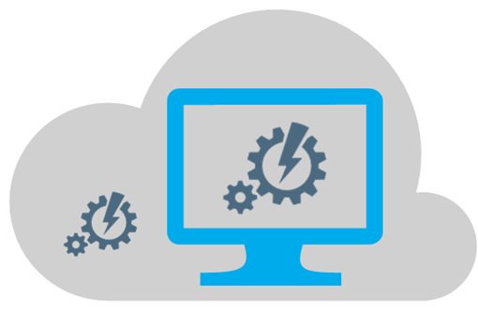

设置检查点
PowerShell工作流检查点
对于在Azure云中的分布式系统，通过设置检查点对长时间运行的自动化脚本可以提高可靠性。
设置检查点可以保证作业运行一次，防止非幂等性操作等问题。
SMA提供的检查点
在Azure自动化服务中运行手册检查点保留到Azure自动化服务数据库中而不是虚拟机本地，因此具有了高可靠性
检查点包含了运行瞬时状态，包含了变量及序列化状态等。
设置过多的检查点有可能影响性能，合理设置避免重新运行时间可能小于设置检查点的代价。
运行手册运行时间
运行手册运行时间确保不超过30分钟，因此可以对于运行时间过长的运行手册设置检查点，持续运行。
Checkpoint-Workflow
Notes:
The scripts used in Azure Automation are built on the Windows PowerShell Workflow model, which provides a powerful feature for checkpoints within the runbooks. By adding a checkpoint to a runbook, you increase its reliability to function despite transient errors, unexpected exceptions, service delays and outages, network downtime, and other issues that are commonly found in a distributed system such as Microsoft Azure for long-running and widely distributed resources. Using checkpoints allows you to confidently automate processes that span multiple networks and systems.
A checkpoint provides a persistence mechanism you can implement at various strategic points in the execution of the Windows PowerShell Workflow. If a problem occurs and the processing of the workflow is interrupted, it can be resumed again near the point of interruption. A checkpoint also ensures that an action will not occur more than once and have a negative duplicate effect. This is the concept of a workflow being idempotent; you can run the workflow more than once, but the result will be the same as if you only ran it once。
Checkpoints are used to persist the state of a running runbook to the Azure Automation database.
Think of a checkpoint as a point-in-time picture that includes any presently generated output, any other implicit, serialized state information, and any existing values of any variables when the checkpoint view was taken. A checkpoint exists in the database until another checkpoint is taken, in which case the first checkpoint is overwritten, or until the runbook completes.
Overhead is associated with the placement of a checkpoint within a runbook. Each time a checkpoint is invoked, a serialization of data persists to storage. If you have a large Windows PowerShell workflow and add a number of checkpoints to it, workflow performance can suffer noticeably. So, although you could place a checkpoint before and after each line in a script file, be smart about your use of checkpoints so performance isn’t negatively affected.
Although there are no firm rules on where to put checkpoints, you should plan and strategize their placement within a workflow. If the time it takes to rerun a section of an interrupted workflow is greater than the time it takes to persist the checkpoint, that’s probably not a wise use of a checkpoint. Rather, it makes more sense to place a checkpoint after a good chunk of work is done by the workflow itself. This could be defined as making a call to a resource that might or might not be available or ready, calling a routine that takes a very long time to complete its work, or an operation that coordinates multiple distributed resources that are geographically distributed or are highly contended for by a number of processes.
Where you place checkpoints is specific to the workflow and its duties and performance constraints. You don’t want to persist a checkpoint when it’s not really necessary. Look at activities that might be prone to failure. You also want to avoid having to take the time and resources to do expensive work. Therefore, set checkpoints in the runbook at critical points, and ensure that any runbook restarts do not redo any work that has already completed. Also, you want to encompass any idempotent activities to make sure they don’t run more than once when the workflow resumes.
For example, your runbook might create an instance of a Microsoft Azure HDInsight Hadoop cluster with perhaps a hundred or so VMs to handle a big data issue with your script. You could set a checkpoint both before and after the commands to create the cluster. If the runbook fails during cluster creation, when the runbook is restarted, it will repeat the cluster creation work. If the creation succeeds but the runbook later fails, the HDInsight cluster will not be created again when the runbook is resumed.
Azure Automation limits the amount of time a runbook can execute to 30 minutes. Azure will unload a runbook that takes longer than that, assuming that something has gone wrong or the runbook is monopolizing the system. The runbook will eventually be reloaded, and you will want to resume it from where it left off. To ensure that the runbook will eventually complete, you should add checkpoints at intervals under the 30-minute limit.
By using the Checkpoint-Workflow activity within a Windows PowerShell workflow, you tell the system to immediately persist a checkpoint. If an error occurs and the workflow is suspended, the workflow will resume from the point of the latest checkpoint when the job is resumed.
Checkpoint-Workflow is a simple call that does not take any parameters and can be placed before or after any workflow command. However, you can’t use the Checkpoint-Workflow activity within an inline block of code.
Let’s take a look at some sample workflow code that takes a checkpoint. From within the Azure Gallery, I created a new Azure Automation runbook using the New-AzureEnvironmentResourcesFromGallery runbook that is part of the Microsoft Azure Automation gallery. This is a great example of a runbook that uses a lot of checkpoints. It was written by my good friend Charles Joy, who has a great Azure Automation ―Building Cloud‖ blog at http://aka.ms/BuildingClouds. This script provisions a lot of Azure resources such as an Azure affinity group, adds Azure VMs to that affinity group, and creates a cloud service, among other things. Many of these operations need to occur only once and they need to be successful. For brevity, the entire script isn’t included here, just the checkpoint-related sections.

Slide 14
下载，导入，编辑，运行和 查看运行手册
Notes:
Importing a runbook is a very powerful way to quickly add functionality to your script library. When you import a runbook you typically are working with runbook code that has already been written, tested, and made ready to go. You might need to assign your specific values to the variables when you run it, or modify the code slightly after import to meet your specific needs. You can import from a file share on your internal company site where you store your company Windows PowerShell scripts. You can also import runbooks from community sites or the Microsoft Script Center. Many common scripts are available from the Script Center that you can import and use as is or modify for your deployment.
Internal site You can import from a file share on the internal company site where you store your company PowerShell scripts.
Script Center You can import from community sites or the Microsoft Script Center. To import a runbook, you can go to the TechNet Script Center and filter by technologies you might want to consider. Many common scripts are available that you can import directly or copy and modify a bit for your deployment. For more guidance, see ―Import a runbook from the Script Center‖ later in this chapter.
Runbook Gallery—Portal You can import a runbook from the Azure Management Portal Runbook Gallery that contains similar functionality to what you can download from the Script Center for Azure. The best recommendation is to use the Azure Portal Runbook Gallery first, and then go to the online Runbook Gallery if you can’t find what you need
Runbook Gallery—Online You can also download and import from the online Runbook Gallery, which continues to expand with many scenarios and sample utility runbooks. Get more information about the Runbook Gallery at Introducing the Azure Automation Runbook Gallery.
MC上目前没有开放直接从库中导入功能 ☹ ，因此无法在MC上演示此功能。演示导入Script Center中的Hello World，
When it’s in a draft state, a runbook cannot be linked to a schedule asset. It also cannot be invoked by another runbook. Calling runbooks in a nested pattern is a powerful paradigm that you can use to combine existing functionality of runbooks to make up a solution. Any time you import or create a runbook, it is in in a draft state until you explicitly promote it to a published state. You can test the runbook while authoring in draft mode, and then promote it to the published state when it’s ready to be used in production. After it’s in a published state, the runbook is eligible to be invoked by a schedule asset and called by other runbooks
发布之后的运行手册才可以被资产计划日程引用，或被其他运行手册调用。
published version will be run. Also, if you have an already published version of a runbook and then publish a draft, any runbook that is currently in the execution statThe in edit state creates an additional draft version of a runbook that can only be run in test mode. The published version also still exists; thus, if you call this runbook from another runbook, even if it’s in the in edit state, the previous e will continue to use the original version of the runbook under which the job was started. This applies even if the job is in a suspended state. The published version of the runbook will always be called outside of the test experience. The published runbook will run from the schedule, from any other runbooks that call it, or from the command line if you use Start-AzureAutomationRunbook.
测试，测试通过后运行，查看作业摘要

Slide 15
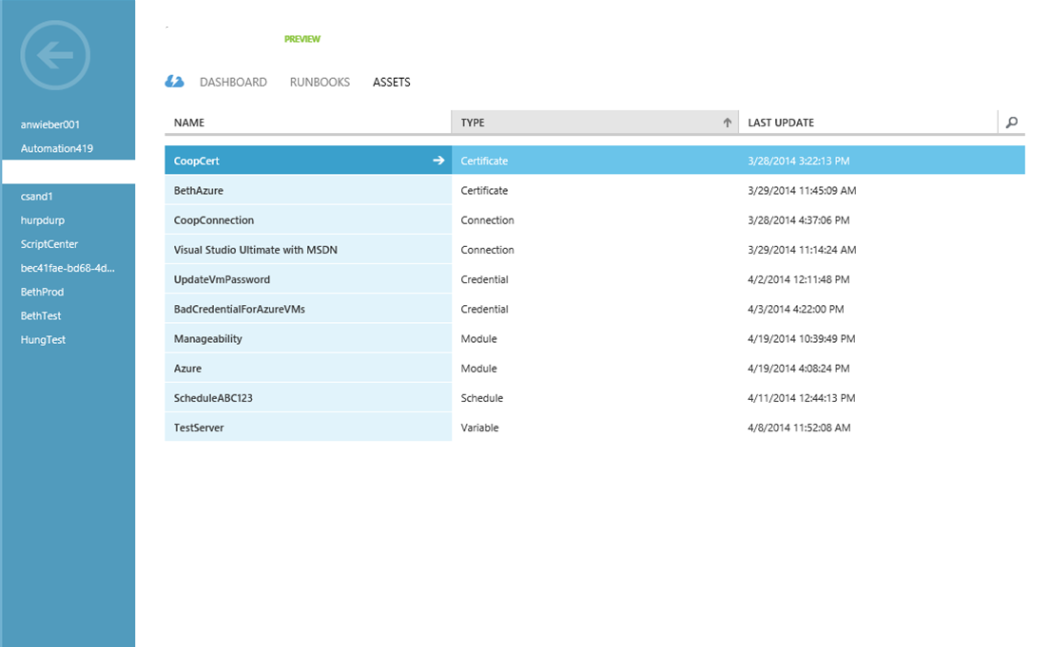
管理自动化资产
管理全局资产
添加集成模块
更新集成模块
创建和管理安全凭据
创建和管理连接
创建和管理变量
管理作业计划日程
资产边界
全局资产在同一个自动化服务账号内生效
在同一订阅下不同自动化服务账号不同资产
Notes:
Microsoft Azure Automation assets are global resources used by runbooks to assist in common tasks and value-specific operations. Assets can be imported into modules. Types of assets include connections, credentials, schedules, variables, and integration modules. Global connections and credentials help authenticate between the Windows PowerShell workflows and Azure when the Azure Automation scripts are run against a specific Azure subscription. For instance, Microsoft published the Connect-Azure runbook, which can be used globally within an Azure Automation account to encapsulate the connection and login functionality needed to connect to Azure. Schedule assets can be linked to runbooks, allowing them to run at a specific date and time. Variable assets are used to provide runtime values for runbooks to work on specific subscriptions, as well as to control the logic within the Windows PowerShell code.
You can share certificates across Azure subscriptions with different subscription owners. This helps you to limit the actual number of certificates you have to create in an enterprise subscription. The limit is 100 certificates per subscription.
However, for Azure Automation, the management certificate is also uploaded as an Azure Automation Credential asset if you choose to authenticate using the Certificate Credential asset. This is a key point: To work correctly for Azure Automation, a management certificate has to exist both in the Settings for the subscription and be created as a Certificate automation asset. Why the certificate needs to exist concurrently in two different forms at once at first might seem very confusing.
Assets serve a very similar purpose in Azure Automation as the modern day public water system. Assets are reusable shared global resources that support global and common connections, credentials, variables, and schedules. These can be shared across runbooks in the same Azure Automation account, or between multiple jobs from the same runbook. They can also manage a value from the Azure Management Portal or the Windows PowerShell command line that can be shared across runbooks. Assets promote centralized management of constant values. In the Automation area of the Azure Management Portal, assets are also referred to as settings. You can create variables that can be input by the administrator of the scripts at runtime or set via code. Assets allow a simple standard mechanism for sharing of global entities between jobs, such as variables, schedules, credentials, and connections. By using assets to encapsulate connections and credentials, the login security information is much safer than being hard-coded in workflow code. Schedule assets provide a global scheduling capability.
Assets are useful for keeping your configuration values consistent across all runbooks. Using assets simplifies runbook maintenance by storing and maintaining configuration values in a central location. You will most likely want to use assets across multiple runbooks, so allowing updates in one place ensures the changes are reflected everywhere they are used
相当于一个跨越多个运行手册的配置集合，修改时只要修改一个位置对所有引用生效。
The scope of assets is global within an Azure Automation account and shared across all runbooks in that account.
用wirte-output stdout不要用write-host

Slide 16
管理资产
Notes:
Integration modules versus runbooks
A common misunderstanding in Azure Automation is the concept of a module versus a runbook, as well as the terms import and insert.
An Azure Automation runbook is an execution unit that contains Windows PowerShell Workflow scripts. Scripts are a program, a group, or many Windows PowerShell commands in one file. Runbooks contain scripts. A runbook that is less than 1 MB in size and not currently part of an Azure Automation account can be imported in PS1 format into that Azure Automation account. When a runbook is invoked, it is sent to a virtual runtime environment to run, which occurs transparently behind the scenes. Runbooks are invoked by a schedule, called by other runbooks (when the runbook has been published) when they are inserted during authoring, or run manually by themselves.
A module is a group of activities (cmdlets) that you can insert into a runbook after the module has been imported. You can import a module into an Azure Automation account via controls in the Assets area of the Azure Management Portal runbook UI. All runbooks in an account can then call any activities of that runbook. (Remember, an activity is a cmdlet.) The module must be in zipped format, up to a 30 MB limit. By default, Azure activities are imported as assets for use in all your runbooks. In the Azure Management Portal, when you look at Assets under any new Azure Automation account, the runbook that contains the Azure activities is named Azure.
演示：
创建管理证书资产用于连接Azure管理。

Slide 17
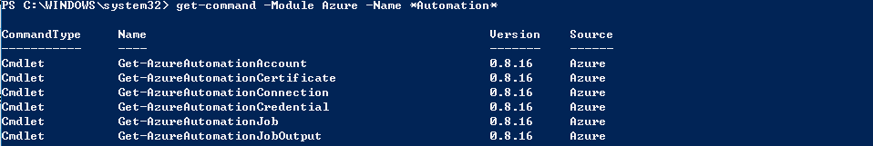
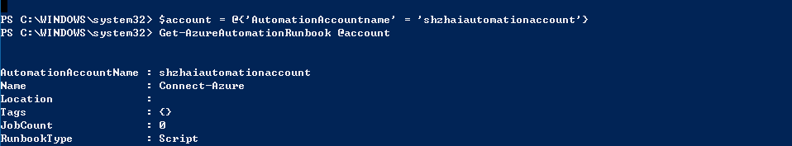
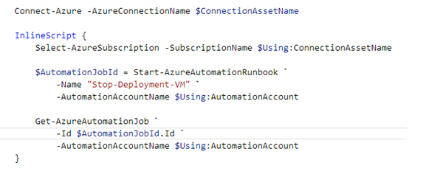
Azure Automation PowerShell Cmdlets
可以在运行手册中通过调用新的运行手册的异步作业

Slide 18
自动化服务最佳实践

Slide 19

“对于云中可重复性的操作，请考虑通过自动化服务实现！”

Slide 20
运行手册
创建小的模块化，通过参数化调用完成所需任务流程的运行手册
创建小颗粒度的运行时间短的运行手册
在Azure门户通过标签明确运行手册的用途和分类
标签格式（”Tag1,Tag2” 或”tagKey1:tagValueA,tagKey2:tagVauleB”)
多利用现有的脚本中心库
将运行手册分割为小的模块化活动，便于持久化工作流或针对不同的活动添加检查点
测试后再发布运行手册
确保子运行手册先于父运行手册调用前发布

Slide 21
Azure自动化服务账号
为不同的组织单元，环境，团队创建不同的自动化服务账号
每个订阅不超过30个账号
运行手册的代码管理http://azure.microsoft.com/blog/2014/07/24/azure-automation-integrating-runbook-source-control-using-visual-studio-online/
导入工具帮助已有PowerShell脚本转换为InlineScript作为工作流运行手册http://azure.microsoft.com/blog/2014/11/25/introducing-the-azure-automation-script-converter/

Slide 22
检查点
对于非幂等性操作确保通过设置检查点避免一场退出恢复操作（例如创建了新的虚拟机，或创建了集群节点）
对于退出恢复操作需要很长时间的操作尽量采用检查点
自动化服务的“Fair Share”机制会对超过30分钟的操作采用暂停，为了避免重复执行已经完成的上述操作设置检查点
对于InlineScript是独立的运行空间，无法对每个脚本内设置检查点，但可以在脚本之间设置检查点
对于需要手工确认应答的过程中可以先设置检查点，确认后恢复
对于不必要的操作例如幂等性操作或短时间操作设置检查点会增加额外开销
$PSPersistPreference = $True

Slide 23
资产
通过定义资产集中和标准化定义和管理实体，而不是在每个运行手册中单独定义这些值，便于维护和管理。
在运行手册代码运行之前定义和引用资产。
对于任何安全性敏感的实体如用户名密码，通过设置用户凭据资产加密存放。

Slide 24
安全凭据,连接
为了减少管理复杂性以及安全性考虑，尽量采用Azure AD验证方式而不是证书验证方式。
可以通过为特定用途的自动化脚本单独创建Azure AD 账号。
.

Slide 25
编辑运行手册
Windows PowerShell Integrated Scripting Environment (ISE)是更好的PowerShell开发工具，尽量在本地创建 PowerShell 工作流然后倒入到Azure资产中。
按照调用链从下至上的方式开发子运行手册。依赖调用的运行手册先开发。
可以通过变量前引用指令在InlineScript中引入工作流级别的变量值
使用Start-AzureAutomationRunbook cmdlet 作运行手册中的并行操作，避免使用并行执行模式，如果任务并行执行的内部彼此依赖
运行手册运行记录信息可以通过Write-Verbose，Write-Output 用于输出运行手册返回值
可以采用try…catch 语句， 该语句包含了检测处理异常的代码，抛出异常时，catch语句可以控制异常。

Slide 26
Built on PowerShell Workflow
Centralized store
Highly Available
PowerShell Workflow
Use Windows PowerShell syntax
Running a single task to manage complex, end-to-end processes
Automated failure recovery
Connection and activity retries
Multi-device management
Historical Analysis
View runbook used for all jobs
Reporting through Excel PowerPivot for ROI
Historical view of runbook jobs
SQL Server clustering / always on
Odata Web service to submit / retrieve status
Runbook servers to process jobs
Scheduling
Runbooks (draft / published versioning)
Modules
Global connection for runbooks
Global variable
Credentials / certificates
PowerShell Workflow
Centralized store
Microsoft Azure Automation
Highly Available
Historical Analysis

Slide 27
自动化服务场景示例

Slide 28
典型的应用Azure自动化服务的场景
对Azure IaaS 虚拟机补丁升级，配合流量控制Traffic manager规避停机时间。
定期重新生成存储账号秘钥，避免对应用程序的影响
计划任务调度SQL数据库备份
备份和恢复 Azure IaaS 虚拟机
升级 补丁 备份调度
虚拟机报警，启用跟踪程序，收集日志并上传到Azure存储，用于之后通过Visual Studio 排错诊断。
新服务创建后的警报，配置相应的跟踪和备份设置。
提示用户订阅使用情况，例如某些虚拟机使用率问题，性能恢复等。
在Azure中部署虚拟机并启用虚拟机监控。
在Azure 部署新服务并配置端点，CPU，内存警报等。
从Git中部署应用程序，验证测试，切换生产环境和测试环境。
监控和修复
变更管理及部署

Slide 29





Azure自动化服务场景示例
Provisioning
Monitoring
Monitoring
Manual Tasks
Patch Remediation
Check Web App VM on Azure
Backup
Collect logs
to Azure Blog Storage
Disaster Recovery
Incidents Response
Enable Intellitrace
On VM catch Prodcution
Live Bug
Send notification to Devs with logs location for investigation
VM Lifecycle Mgmt.
Change Control
Release Mgmt.
Send notification to OPS to recovery
Release management rollback to previous health version
Compliance
SLA Adherence
Notes:
改并加入Sample Code

Slide 30



Enable Automation Across Azure resources and external systems
Provisioning
Monitoring
Applying Policy
Manual Tasks
SharePoint
Release
Management
Update SharePoint with progress
Patch Remediation
Backup
Deploy to production
Disaster Recovery
Monitor SharePoint
for new deployment
in staging
Incidents Response
Apply policy to the
deployment in staging
VM Lifecycle Mgmt.
Change Control
Update SharePoint with progress
Release Mgmt.
Compliance
SLA Adherence

Slide 31
Azure自动化服务场景

Slide 32
问答

Slide 33
参考资源
Azure自动化服务门户介绍
http://www.windowsazure.cn/home/features/automation/
Azure 自动化入门
http://www.windowsazure.cn/documentation/articles/automation-create-runbook-from-samples/
如何创建 Runbook
https://technet.microsoft.com/zh-cn/library/dn469262.aspx
Azure 自动化 Cmdlet https://msdn.microsoft.com/zh-cn/library/dn690262.aspx
SMA服务管理自动化
https://technet.microsoft.com/zh-cn/library/dn469260.aspx
脚本中心
https://go.microsoft.com/fwLink/?LinkID=528317&clcid=0x4

