Slide 1
UP upscale ai
Walk: vision → draft plan → owners → pipeline
QoS buffer carving arch
Open after qos-architecture slides 1–2 — role-play, not a handoff
Confidential — Upscale AI
© 2026 Upscale AI – Proprietary and Confidential – Do Not Reproduce or Duplicate
UP upscale ai

Slide 2
Define task — after qos-architecture slides 1–2
Beat 1 · ~1 min
Transition — alignment deck framed situation + task; this walk defines how.
Assumption: **qos-architecture** aligned on tape-out program bar + QoS RM wedge at CSB.
Show validation machine, owners, QoS on logical pipeline — co-evolve plan live.
Close on qos-architecture slides 3–4 (near-term scope + Friday alignment) — not repeated here.
© 2026 Upscale AI – Proprietary and Confidential – Do Not Reproduce or Duplicate
UP upscale ai

Slide 3
Document discipline
Beat 2 · thin
Thin walk today; depth only if Gururaj redirects.
Friday meeting: qos-architecture slides 1–2, then this walk (~6 beats).
Next: expand swimlanes / integrated validation plans — format and depth per your steer.
Not this walk: 50-page dump, full HW catalog.
© 2026 Upscale AI – Proprietary and Confidential – Do Not Reproduce or Duplicate
UP upscale ai

Slide 4
Validation framework (I draft v0; peers align)
Beat 2 · ~3 min
Gates are v0 for group review — not unilateral.
Product / program use cases
Architecture validation ↔ datapath arch
Management plane — SONiC / FBOSS → SAI
Tape-out path: C-models → emulation / FPGA → silicon
SDK + SAI gates before tape-out
I socialize v0 gates for group review; peers own slice proof.
© 2026 Upscale AI – Proprietary and Confidential – Do Not Reproduce or Duplicate
UP upscale ai

Slide 5
Who owns what (don't read every row)
Beat 3 · ~2 min
My lane first; peer DRIs in W order — then point at pipeline slide.
Validation program + QoS RM: Diwakar Tundlam · QoSMAP · Queue · buffer carve at CSB
Peer DRIs: Shafi Mohammad · L2/L3/Mirroring · Tippanna Hongal · ECMP/LAG/Counters · Tilak · L2 · Girish Kale · L3
HW datapath / OCP ESUN: Rupa Budhia · SDK / SAI: SDK leads — consult, not my R
Program mesh: Prasun Sinha · Scope / company external: Gururaj
© 2026 Upscale AI – Proprietary and Confidential – Do Not Reproduce or Duplicate
UP upscale ai

Slide 6
My wedge — QoS / RM (HWv1)
Beat 4 · reference only (historical)
Kept for reference — validation scope lives on slide 3 framework.
VLAN-PRI, TOS/DSCP → queues → schedulers
Buffer management and carving (resource manager)
Port speed + queue/port policy coherence
ESUN — align buffer/TM with standardization (OCP)
HWv1: no MPLS EXP, no IPv6 priority mapping · HWv2: EXP + IPv6 pri
© 2026 Upscale AI – Proprietary and Confidential – Do Not Reproduce or Duplicate
UP upscale ai

Slide 7
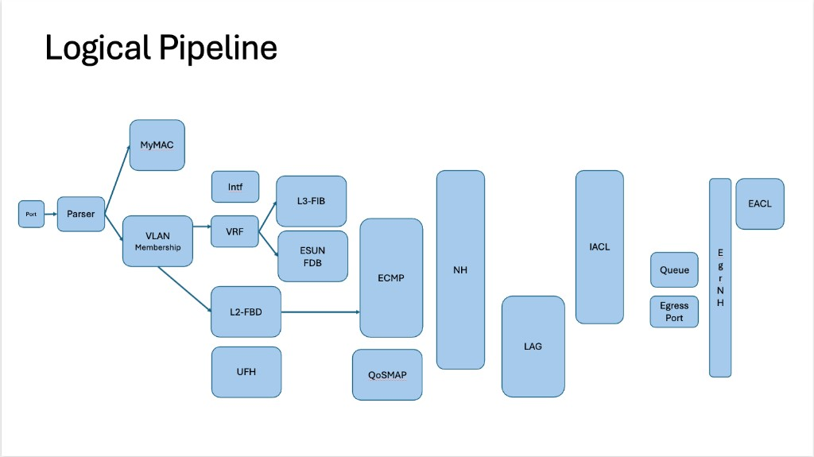
Your pipeline slide — my wedge (center of walk)
© 2026 Upscale AI – Proprietary and Confidential – Do Not Reproduce or Duplicate
UP upscale ai

Slide 8
On the picture — blocks and validation tie-in
Beat 4 · optional detail
Only if Gururaj asks — each block needs AV + software proof before silicon.
Ingress / Parser — parse correctness with Rupa before OCP/BCM calls
L2 — Shafi · Tilak · L3 — Girish · Forward: ECMP/LAG/Counters (Tippanna), QoSMAP (me) · Egress Queue/carve (me)
I draft cross-block tape-out gates; block DRIs own slice proof (C-model → emulation)
© 2026 Upscale AI – Proprietary and Confidential – Do Not Reproduce or Duplicate
UP upscale ai

Slide 9
Explicit deferrals (do not merge)
Beat 5 · ~1 min
Out of this walk — weekly sync, not merged plans.
Rupa SDK/SAI/datapath layout — related, different plan; weekly sync
OCP ESUN: coordinate with Rupa before vendor calls; company position through Gururaj
Prabu execution mesh / bs-2 — round 2 unless you redirect
© 2026 Upscale AI – Proprietary and Confidential – Do Not Reproduce or Duplicate
UP upscale ai

Slide 10
If you want me to drive — next beats
Beat 6 · after mandate
Offer only if asked — who must be in the room.
Expand QoS buffer carving arch: swimlanes, DRI depth, integrated AV / C-model / datapath / SDK / SAI validation
QoS RM HWv1 scope with HW datapath DRI (Rupa lane) — gates as we agree
Cadence: Shafi, Tippanna, Rupa, Prasun — if Gururaj redirects drive to me
Room list — offer here if you ask (not on qos-architecture slides)
© 2026 Upscale AI – Proprietary and Confidential – Do Not Reproduce or Duplicate
UP upscale ai

Slide 11
What this walk is not
Beat 5–6
Boundaries — keeps Friday walkable.
Not C40 / full HW digest · Not SDK program ownership day one
Not AI/token policy · Not sponsor homework-check — walkable backup only
Whiteboard backup: assets/dt100-whiteboards.md (only if asked)
© 2026 Upscale AI – Proprietary and Confidential – Do Not Reproduce or Duplicate
UP upscale ai

