Slide 1
UP upscale ai
Dynamic
Switch-Buffer
Management
qos architecture
Diwakar Tundlam - qos architect
Architecture review · Confidential — Upscale AI
© 2026 Upscale AI – Proprietary and Confidential – Do Not Reproduce or Duplicate
UP upscale ai
Notes:
This deck sells me in the role — vision, draft plan, how I drive — not a document handoff.
Left = program bar (done and validated to tape-out). Right = Diwakar DRI wedge (DBM). Close = mandate + **concrete draft in next few days** (steer post-meeting).

Slide 2
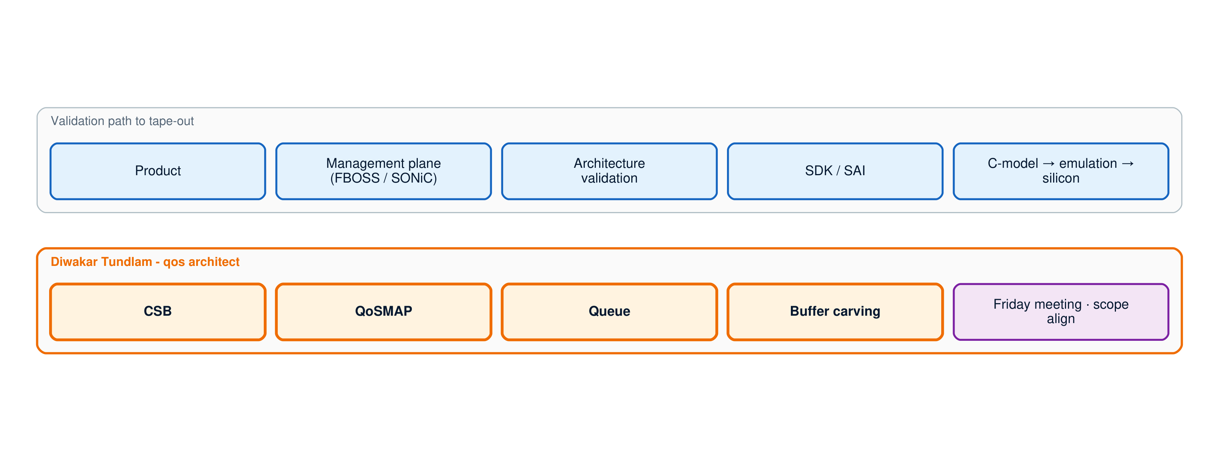
Dynamic Switch-Buffer Management
Buffer carving at Central Scheduler Block (CSB)
© 2026 Upscale AI – Proprietary and Confidential – Do Not Reproduce or Duplicate
UP upscale ai
Notes:
Sponsor is you — your name is not on this deck.
I am Diwakar. You need someone you can trust to drive with little supervision — not get lost or stuck — while you guide at critical junctures. These slides show what I will do in that role: vision, plans, draft execution path.
Two alignments: (1) your done-and-validated bar — product, mgmt plane, architecture validation, SDK/SAI, C-model → emulation → silicon; (2) my wedge — Dynamic Switch-Buffer Management (DBM) at CSB (QoSMAP, Queue, buffer carving).
DBM (say once): ESUN-world pair to DLB — buffers/CSB layer, not ECMP/fabric. **Datapath Architecture** (E-level lane; implicit owner — no name, no OCP on slide). W peers: Shafi (L2/L3/Mirroring), Tippanna (ECMP/Stats), Tilak (L2), SDK leads.
Flow: slides 1–2 (situation + task) → QoS buffer carving arch walk → slides 3–4 (mandate + alignment).
What I will drive in your program bar — not owning product, mgmt, full AV, or SDK programs, but contributing with a clear wedge.
Bottom band = function lane (not role title): QoSMAP, Queue, buffer carving at CSB. Bounded scope under steer.
Selling: I have a bounded wedge and understand how it sits in the full tape-out path.
Pipeline walk is not a deliverable — it is how I show vision, draft plans, and execution instinct. Walk it; steer me at junctures. Role-play the arch execution plan.

Slide 3
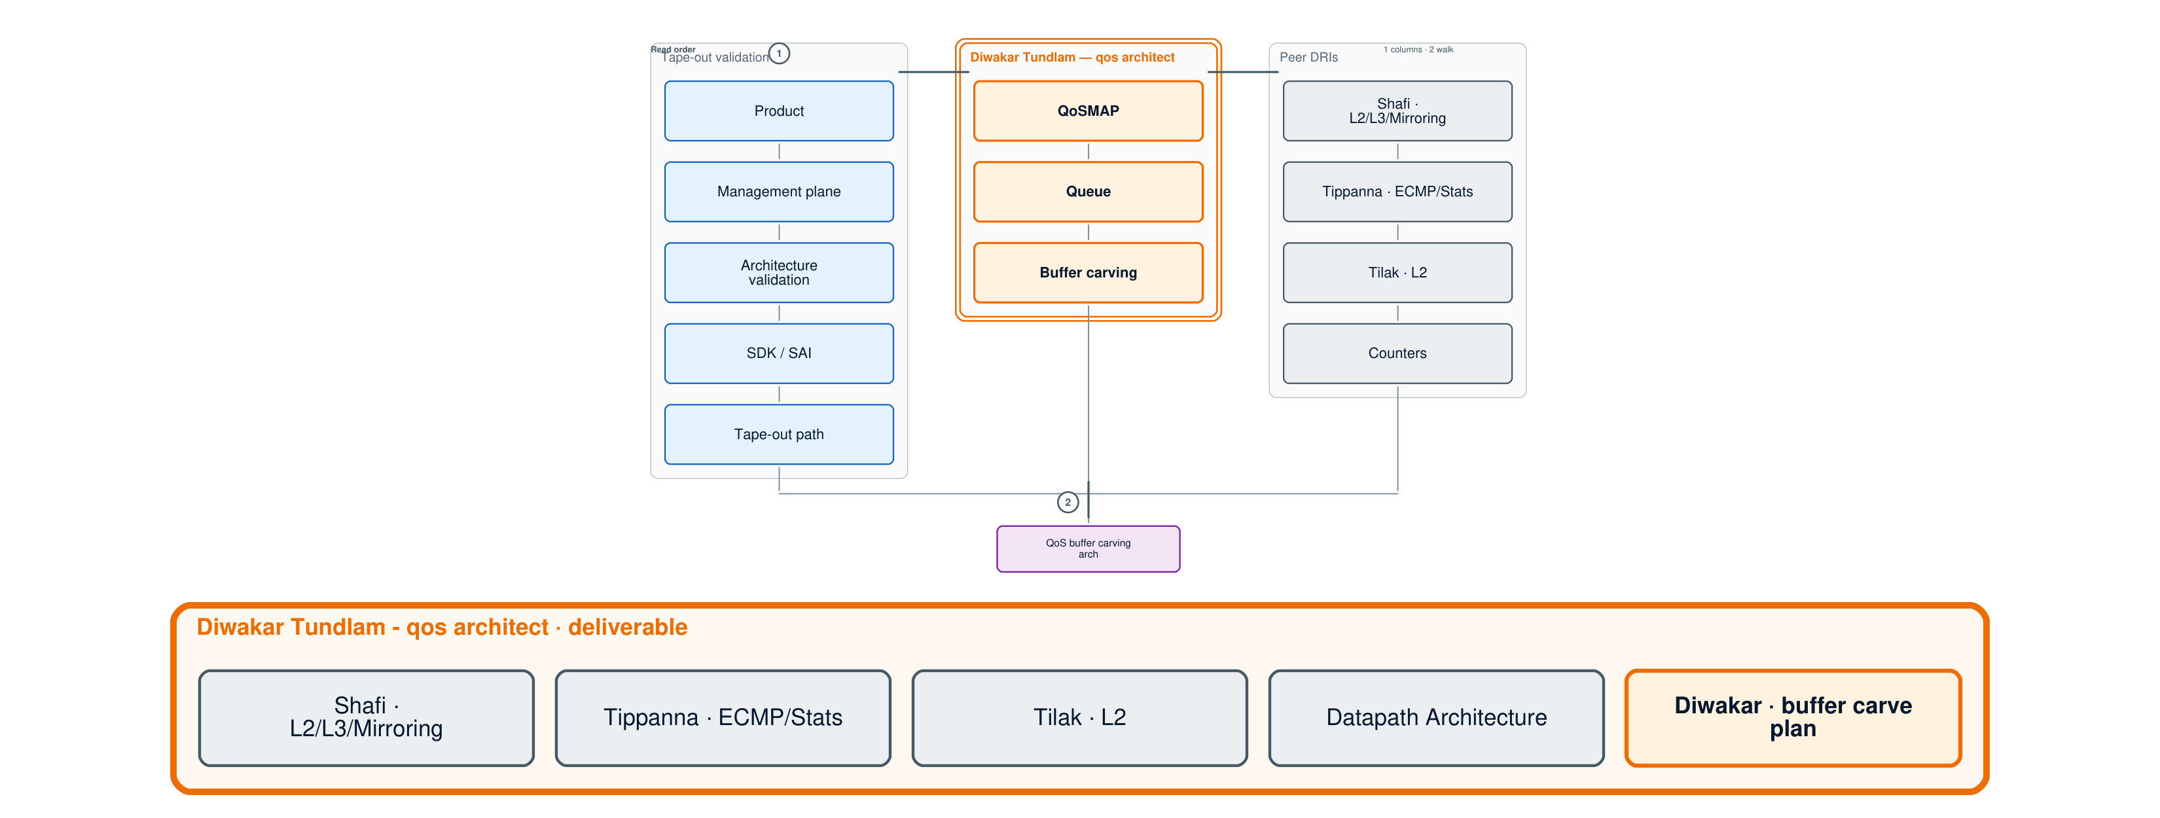
Validated to tape-out
© 2026 Upscale AI – Proprietary and Confidential – Do Not Reproduce or Duplicate
UP upscale ai
Notes:
Walk order: three columns **left → right**, then **down** to QoS buffer carving arch walk. **Read order** on-slide: 1 → 2.
Col 1 = tape-out validation (program). Col 2 = Diwakar lane (orange). Col 3 = peer DRIs. **Bottom row** = W intersects + buffer carve plan.
**No gate diamond** — stand-alone / forward-safe (Thippanna Sr.W + Prabhu A). Alignment / reframe with sponsor — spoken at Friday meeting, not on-wall.
*(Thippanna stacked layout → B6 backlog.)*

Slide 4
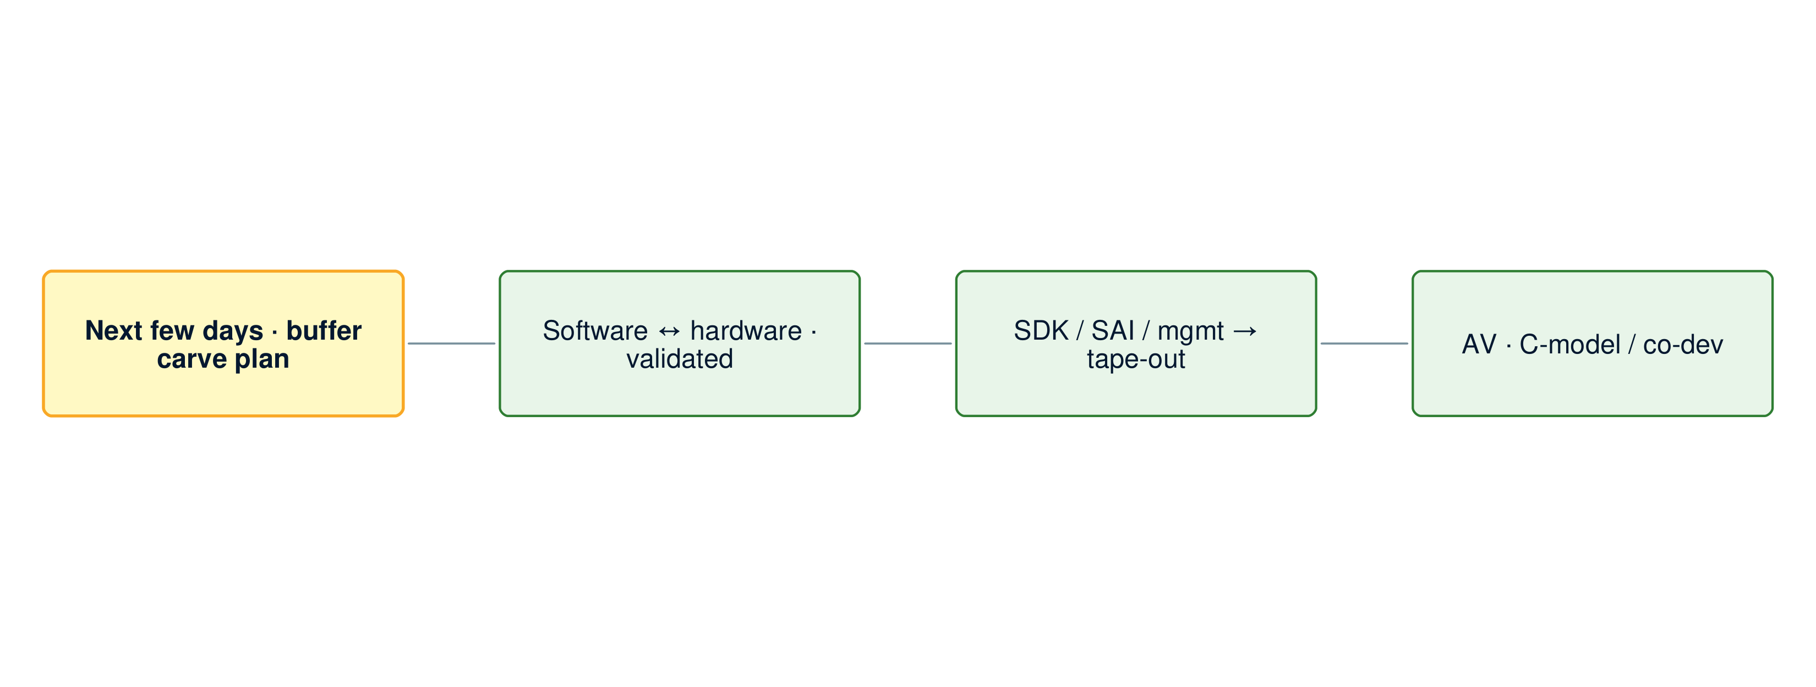
Near-term scope
© 2026 Upscale AI – Proprietary and Confidential – Do Not Reproduce or Duplicate
UP upscale ai
Notes:
SharePoint timeline: 2–3 month window was too slow — concrete output in the **next few days** (yellow highlight on slide).
Say: **buffer carve plan** + validation gates v0 (format per steer) — not another 50-pager. North star unchanged: tape-out with SDK, SAI, mgmt on silicon.
Sponsor touch-in at gates; Diwakar drives day-to-day technical work.
Slide 4: four engineering checkpoints before Friday meeting close. Mandate = permission to drive the sprint. Pipeline plan co-evolved on the walk — alignment, not a doc handoff.

Slide 5
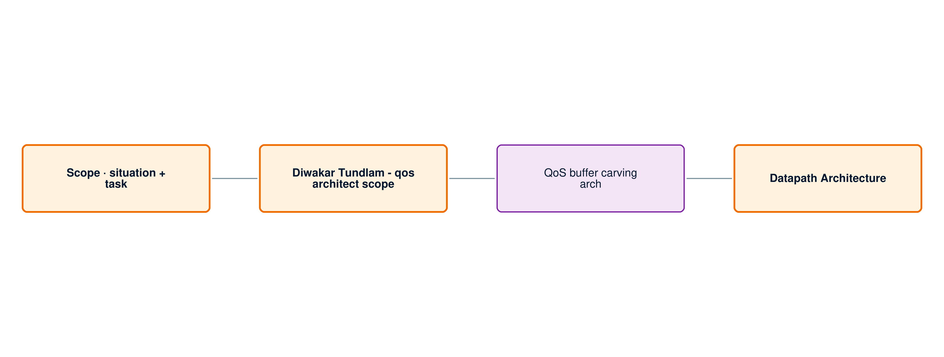
Alignment · Friday meeting
© 2026 Upscale AI – Proprietary and Confidential – Do Not Reproduce or Duplicate
UP upscale ai
Notes:
Four checkpoints — technical, not a sign-off deck.
Scope: slides 1–2 — program bar + DBM at CSB framed correctly? Lane: QoSMAP, Queue, buffer carving vs peer DRIs. Pipeline walk: logical pipeline and draft validation path. **Datapath Architecture** checkpoint — her lane; OCP implicit, not on slide.
If aligned: mandate to ship **buffer carve plan in next few days** → iterate toward tape-out (AV/C-model, SDK/SAI/mgmt).

