Slide 1
UP upscale ai
Companion to A3
Arch vision plan (B6)
Walk if Yes · Draft
Confidential — Upscale AI
© 2026 Upscale AI – Proprietary and Confidential – Do Not Reproduce or Duplicate
UP upscale ai

Slide 2
The question — and my answer (A3 slide 1 expanded)
Your question: SW done and validated with product, mgmt plane, datapath/AV, SDK/SAI proof before tape-out.
My answer: drive 2-pager + validation-gate machine; DRI on arch-vision + QoS/RM (QoSMAP, queue/buffer carve).
Peers: Shafi (L2/L3/ACL) and Tippanna (ECMP/AV) stay DRIs; I align the shared story, not their ownership.
© 2026 Upscale AI – Proprietary and Confidential – Do Not Reproduce or Duplicate
UP upscale ai

Slide 3
Document discipline (AWS-style)
Thu: A3 (2–3 slides) + this B6 (walkable).
Next: Cx 2-pager — decisions, gates, open issues (~2 weeks).
Not Thu: 50-page arch dump, full HW catalog digest.
Exec read stays thin; full truth can exist later.
© 2026 Upscale AI – Proprietary and Confidential – Do Not Reproduce or Duplicate
UP upscale ai

Slide 4
End-to-end validation framework (I drive draft; peers align)
Product / customer use cases
Arch validation (AV) ↔ datapath arch
Mgmt plane — deployment-shaped (SONiC / FBOSS lands)
SW validation ↔ C-models → emulation / FPGA → silicon
SDK + SAI done with explicit gates before tape-out
I socialize v0 of done per gate for group review — not unilateral mandate.
© 2026 Upscale AI – Proprietary and Confidential – Do Not Reproduce or Duplicate
UP upscale ai

Slide 5
DRI map
Sponsor / exec alignment: Gururaj
Arch vision + validation program: Diwakar Tundlam
QoS / buffer / queue / scheduler / RM carve: Diwakar Tundlam
L2/L3 / ACL pipeline: Shafi Mohammad
Arch validation / use-case framing: Tippanna Hongal
SDK / SAI: SDK leads (e.g. Girish, Shravan) — consult, not my R
Program / sprint mesh: Prasun Sinha
HW datapath / OCP ESUN: Rupa Budhia — weekly align before Thu OCP calls
© 2026 Upscale AI – Proprietary and Confidential – Do Not Reproduce or Duplicate
UP upscale ai

Slide 6
My wedge — QoS resource management (RM)
Classification: VLAN-PRI, TOS/DSCP → queues → schedulers
Buffer management and carving (traffic / resource manager)
Port speed and queue/port policy coherence
ESUN — align buffer/TM design with standardization (OCP context)
HWv1: mapping above; no MPLS EXP, no IPv6 priority mapping yet.
HWv2: EXP + IPv6 pri — planned extension.
© 2026 Upscale AI – Proprietary and Confidential – Do Not Reproduce or Duplicate
UP upscale ai

Slide 7
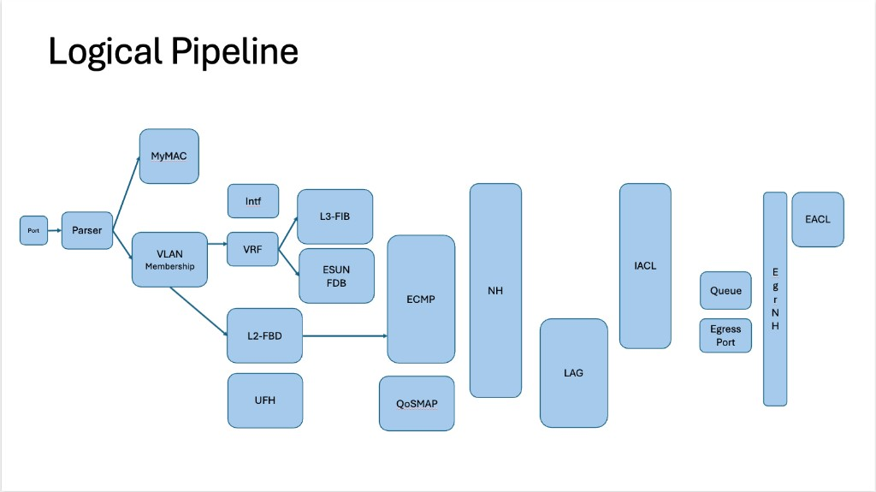
Logical pipeline (boss slide context)
My wedge: QoSMAP + Queue/buffer carve · Peers: Shafi (L2/ACL), Tippanna (ECMP), Rupa (parse/datapath)
© 2026 Upscale AI – Proprietary and Confidential – Do Not Reproduce or Duplicate
UP upscale ai

Slide 8
Pipeline DRIs on the picture (summary)
Ingress: Port → Parser → MyMAC · VLAN — parse correctness with Rupa
L2: L2-FBD · UFH — Shafi Mohammad
L3: VRF · Intf · L3-FIB · ESUN FDB — L3/ESUN peers + Rupa
Forward + QoS: ECMP (Tippanna) · QoSMAP (me)
Egress: NH · LAG · IACL · Queue · ports — Queue/carve: me · ACL: Shafi
Validation: each block needs AV done + SW proof (C-model → emulation) before silicon.
© 2026 Upscale AI – Proprietary and Confidential – Do Not Reproduce or Duplicate
UP upscale ai

Slide 9
Whiteboards — RM / SDK context (§6a)
arch-vision: buffer carving; lossy/lossless→PFC→Queues; WRED/ECN/PFC; ESUN-QoS
first-1-1: SONiC/FBOSS→SAI→USDK→ASIC; ties validation pyramid to SDK delivery
Annotations: manager-arch-vision-whiteboards.md · assets/pics/
© 2026 Upscale AI – Proprietary and Confidential – Do Not Reproduce or Duplicate
UP upscale ai

Slide 10
Parallel track (out of Thu scope)
This B6: DE role + QoS RM + validation framework (Gururaj 2-pager).
Rupa thread: SDK/SAI/datapath layout — related, different plan.
Weekly sync with Rupa; do not merge the two plans on Thu.
© 2026 Upscale AI – Proprietary and Confidential – Do Not Reproduce or Duplicate
UP upscale ai

Slide 11
External / OCP ESUN
Attend OCP ESUN as directed; coordinate with Rupa before Thu 8AM BCM/vendor calls.
SW architect on QoS/TM/ESUN — not full network-arch owner.
Company position through Sponsor until redirected.
© 2026 Upscale AI – Proprietary and Confidential – Do Not Reproduce or Duplicate
UP upscale ai

Slide 12
~2 weeks → Cx 2-pager (draft outline)
Decision: validation gate definitions (C-model / emu / pre-tapeout) v0
Decision: QoS RM HWv1 scope sign-off with HW datapath DRI
Open issues: access to models, lab, repos
Actions: cadence with Shafi, Tippanna, Rupa, Prasun
Non-goals: full C40-class HW digest in Cx
© 2026 Upscale AI – Proprietary and Confidential – Do Not Reproduce or Duplicate
UP upscale ai

Slide 13
Execution mesh (hook — detail round 2)
Align task intake with SDK/ASIC milestones and SONiC/FBOSS release cadence
Prasun Sinha — program touchpoint for sprint planning
Prabu brainstorm — not Thu center unless asked
© 2026 Upscale AI – Proprietary and Confidential – Do Not Reproduce or Duplicate
UP upscale ai

Slide 14
Asks for Gururaj — delta beyond A3 slide 3
Thu package: A3 hook + optional B6 walk; Cx 2-pager ~2 weeks — OK?
Cx scope v0: validation gates + QoS RM HWv1 — who must be in the room?
Step in if validation-gate consensus stalls beyond normal peer DRI friction.
© 2026 Upscale AI – Proprietary and Confidential – Do Not Reproduce or Duplicate
UP upscale ai

Slide 15
What Thu is not
Not finished C40 or full HW-doc digest
Not claiming SDK/SAI program ownership day one
Not AI tooling / token policy (separate thread)
Not a 50-page substitute — B6 is walkable backup
© 2026 Upscale AI – Proprietary and Confidential – Do Not Reproduce or Duplicate
UP upscale ai

