Slide 1
UP upscale ai
Walk: vision → draft plan → owners → pipeline
QoS buffer carving arch
Open after aligned on draft QoS slides — role-play, not a handoff
Confidential — Upscale AI
© 2026 Upscale AI – Proprietary and Confidential – Do Not Reproduce or Duplicate
UP upscale ai

Slide 2
Define task — after draft QoS slides
Beat 1 · ~1 min
Transition — draft QoS slides framed situation + task; this walk defines how.
Assumption: draft QoS slides aligned on program bar + QoS RM wedge.
Show validation machine, owners, QoS on logical pipeline — co-evolve plan live.
Close on draft QoS slides (near-term scope + alignment) — not repeated here.
© 2026 Upscale AI – Proprietary and Confidential – Do Not Reproduce or Duplicate
UP upscale ai

Slide 3
Document discipline
Beat 2 · thin
Thin walk today; depth only if Gururaj redirects.
Thu: draft QoS slides, then this deck (~6 beats).
Next: expand swimlanes / integrated validation plans — format and depth per your steer.
Not Thu: 50-page dump, full HW catalog.
© 2026 Upscale AI – Proprietary and Confidential – Do Not Reproduce or Duplicate
UP upscale ai

Slide 4
Validation framework (I draft v0; peers align)
Beat 2 · ~3 min
Gates are v0 for group review — not unilateral.
Product / customer use cases
AV ↔ datapath arch
Mgmt plane — SONiC / FBOSS lands
Software validation: C-models → emulation / FPGA → silicon
SDK + SAI done with explicit gates before tape-out
I socialize v0 “done” per gate; peers own slice proof.
© 2026 Upscale AI – Proprietary and Confidential – Do Not Reproduce or Duplicate
UP upscale ai

Slide 5
Who owns what (don't read every row)
Beat 3 · ~2 min
Name DRIs once; point at pipeline slide next.
Gururaj: scope · company / OCP external
Validation program + QoS RM: Diwakar Tundlam
L2/L3 / ACL: Shafi Mohammad · ECMP / LAG / Counters · AV: Tippanna Hongal
SDK / SAI: SDK leads — consult, not my R
Program mesh: Prasun Sinha · HW datapath / OCP: Rupa Budhia
© 2026 Upscale AI – Proprietary and Confidential – Do Not Reproduce or Duplicate
UP upscale ai

Slide 6
My wedge — QoS / RM (HWv1)
Beat 4 · reference only (historical)
Kept for reference — validation scope lives on slide 3 framework.
VLAN-PRI, TOS/DSCP → queues → schedulers
Buffer management and carving (resource manager)
Port speed + queue/port policy coherence
ESUN — align buffer/TM with standardization (OCP)
HWv1: no MPLS EXP, no IPv6 priority mapping · HWv2: EXP + IPv6 pri
© 2026 Upscale AI – Proprietary and Confidential – Do Not Reproduce or Duplicate
UP upscale ai

Slide 7
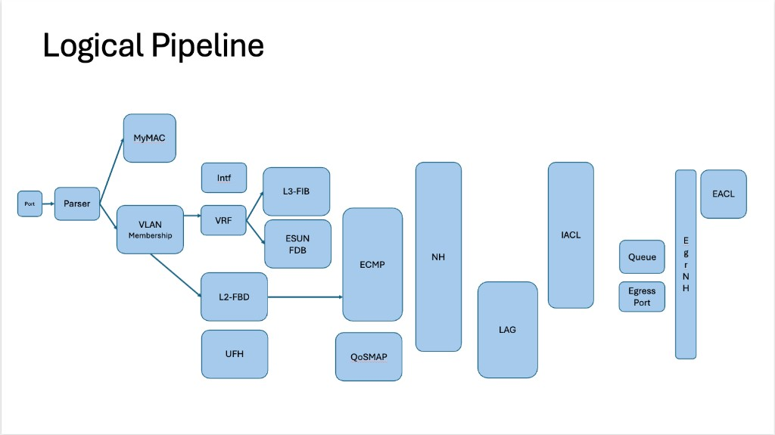
Your pipeline slide — my wedge (center of walk)
© 2026 Upscale AI – Proprietary and Confidential – Do Not Reproduce or Duplicate
UP upscale ai

Slide 8
On the picture — blocks and validation tie-in
Beat 4 · optional detail
Only if Gururaj asks — each block needs AV + software proof before silicon.
Ingress / Parser — parse correctness with Rupa before OCP/BCM calls
L2 — Shafi · Forward: ECMP / LAG / Counters (Tippanna), QoSMAP (me) · Egress Queue/carve (me)
I draft cross-block gates; block DRIs own slice proof (C-model → emulation)
© 2026 Upscale AI – Proprietary and Confidential – Do Not Reproduce or Duplicate
UP upscale ai

Slide 9
Defer on Thu (do not merge)
Beat 5 · ~1 min
Explicitly out of Thu — weekly sync, not merged plans.
Rupa SDK/SAI/datapath layout — related, different plan; weekly sync
OCP ESUN: coordinate with Rupa before vendor calls; company position through Gururaj
Prabu execution mesh / bs-2 — round 2 unless you redirect
© 2026 Upscale AI – Proprietary and Confidential – Do Not Reproduce or Duplicate
UP upscale ai

Slide 10
If you want me to drive — next beats
Beat 6 · not committed Thu
Offer only if asked — who must be in the room.
Expand QoS buffer carving arch: swimlanes, DRI depth, integrated AV / C-model / datapath / SDK / SAI validation
QoS RM HWv1 scope with HW datapath DRI (Rupa lane) — gates as we agree
Cadence: Shafi, Tippanna, Rupa, Prasun — if Gururaj redirects drive to me
Room list — offer here if you ask (not on draft QoS slides)
© 2026 Upscale AI – Proprietary and Confidential – Do Not Reproduce or Duplicate
UP upscale ai

Slide 11
What Thu is not
Beat 5–6
Boundaries — keeps Thu walkable.
Not C40 / full HW digest · Not SDK program ownership day one
Not AI/token policy · Not a second 50-pager — walkable backup only
Whiteboard backup: assets/dt100-whiteboards.md (only if asked)
© 2026 Upscale AI – Proprietary and Confidential – Do Not Reproduce or Duplicate
UP upscale ai

