Slide 1
UP upscale ai
Bugatti Scale-UP Switch
csb-buffer-carving-ccc
Diwakar Tundlam · 12 Jun 2026
Confidential — Upscale AI
© 2026 Upscale AI – Proprietary and Confidential – Do Not Reproduce or Duplicate
UP upscale ai

Slide 2
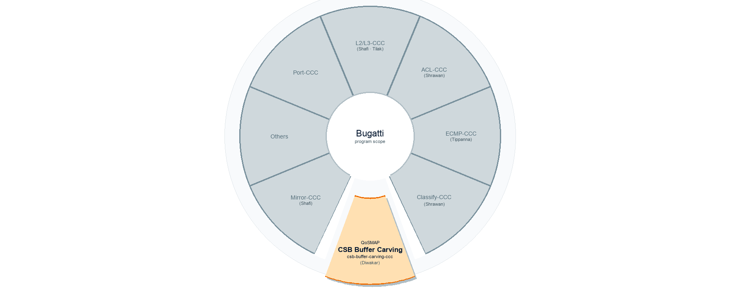
csb-buffer-carving-ccc scope
QoSMAP → buffer carving at CSB → csb-buffer-carving-ccc
© 2026 Upscale AI – Proprietary and Confidential – Do Not Reproduce or Duplicate
UP upscale ai

Slide 3
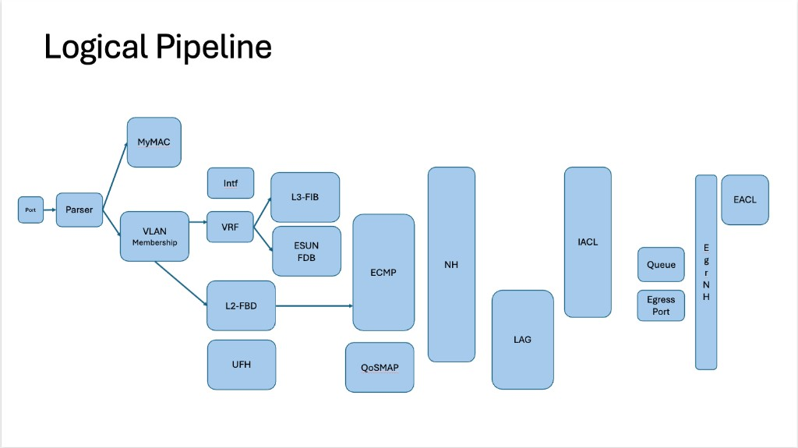
© 2026 Upscale AI – Proprietary and Confidential – Do Not Reproduce or Duplicate
UP upscale ai

Slide 4
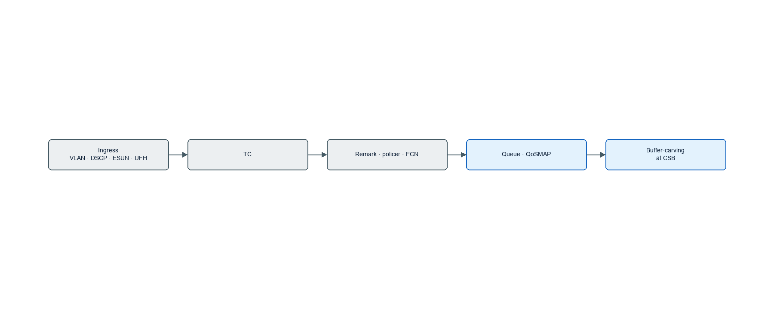
Capabilities · Classify, Enqueue and Remark
• (draft in progress ... RFC)
• Buffer-carving (CSB)
◦ Port-speed bifurcation → static carve → scheduler configuration
◦ TC → QoSMAP · queues · egress scheduler · per-port queue
• Classify · enqueue · remark
◦ ESUN-UFH → TC (4 or 3-bit=8) — different MAC layer
◦ AFH → (BCM: SUE) → vTC → VLAN · L3/DSCP → TC
◦ EFH → VLAN · PRI → L3/DSCP → TC
• L2/L3 datapath · ACL · police · ECN · PFC · global pause (802.3x) control
• Other peer contexts
◦ Dual-die Sky-Hammer · UCIe D2D · logical port mapping and X-connect verification
◦ ECMP · Mirroring · Counters/Stats · sFlow · CPU punt · Control / Management plane handling
◦ UA-Link (**descoped) — same PHY/PMD, different PCS/PMA
© 2026 Upscale AI – Proprietary and Confidential – Do Not Reproduce or Duplicate
UP upscale ai

Slide 5

Capacities · CSB Resource Management
• (draft in progress ... RFC)
• Port tiers · bifurcation table setup
◦ 200G · 400G · 800G modes and rate mapping
◦ Validating line-rate matching serdes and standard, optics tuning, etc.
• Buffer pools at CSB
◦ Lossless pools — pause / PFC · with headroom / guarantees
◦ Lossy pools — ECN · WRED controlled with qos-mapping
• Carve control
◦ Static and dynamic pool sizing
◦ Traffic-aware congestion management (WRED? Tail-drop, packet-id retire/drops)
• Egress bandwidth scheduling (EBS)
◦ Per-TC queues · WFQ/SPQ · Total port bandwidth
◦ ECMP DLB · entropy / dynamic readjust / re-write / encap size adjusting
• Other considerations (ideas..)
◦ AI/XPU workload rebalance · SDN/controller alignment
© 2026 Upscale AI – Proprietary and Confidential – Do Not Reproduce or Duplicate
UP upscale ai

Slide 6
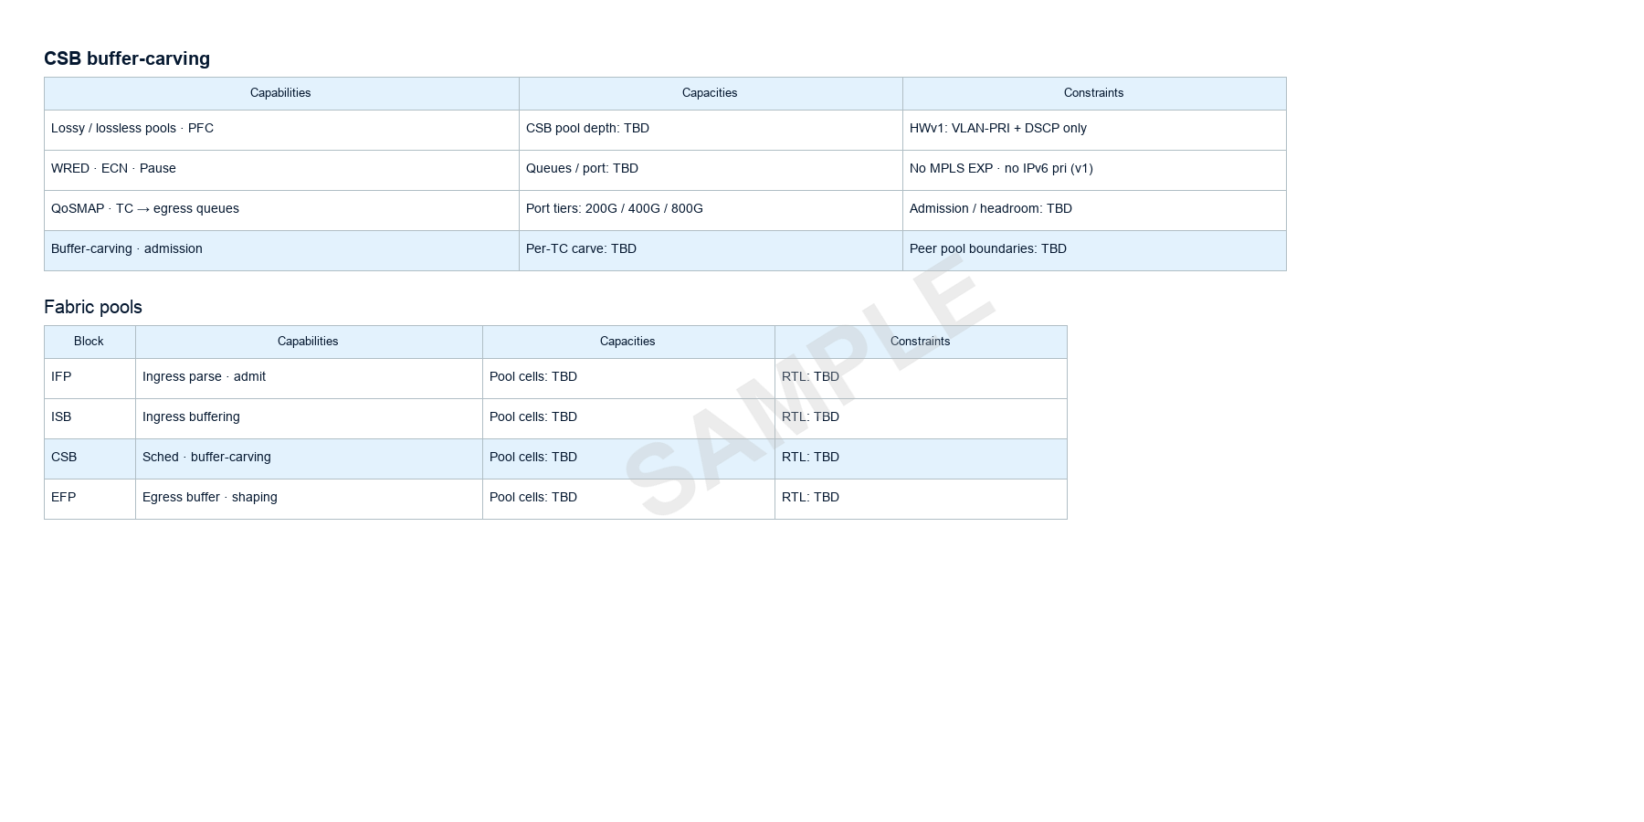
(sample table only - review with HW / Arch and publish)
© 2026 Upscale AI – Proprietary and Confidential – Do Not Reproduce or Duplicate
UP upscale ai

Slide 7
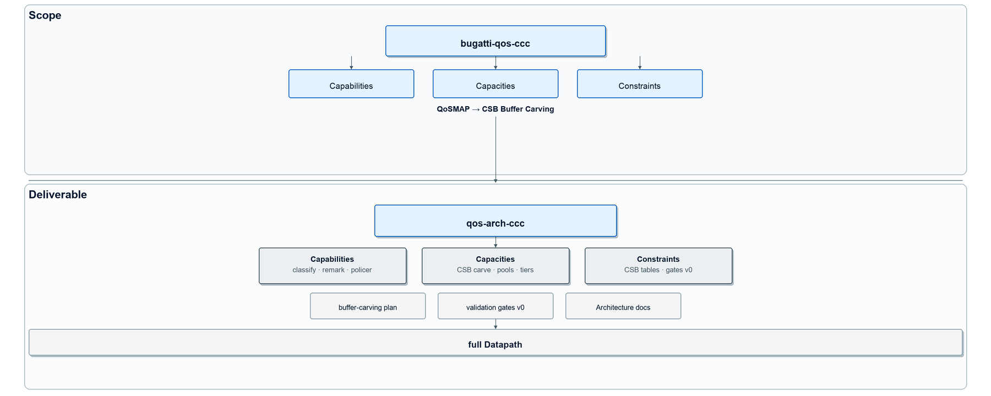
Scope · buffer-carving deliverable
© 2026 Upscale AI – Proprietary and Confidential – Do Not Reproduce or Duplicate
UP upscale ai

