Slide 1

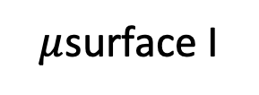
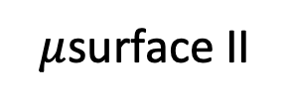
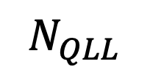
Water vapor
Deposition & ablation
Surface diffusion
$μ$surface II
$μ$surface I
$$N_{QLL}$$
$$N_{tot}$$
Quasi-liquid/ice equilibration
$$N_{ice}$$
Ice

Slide 2
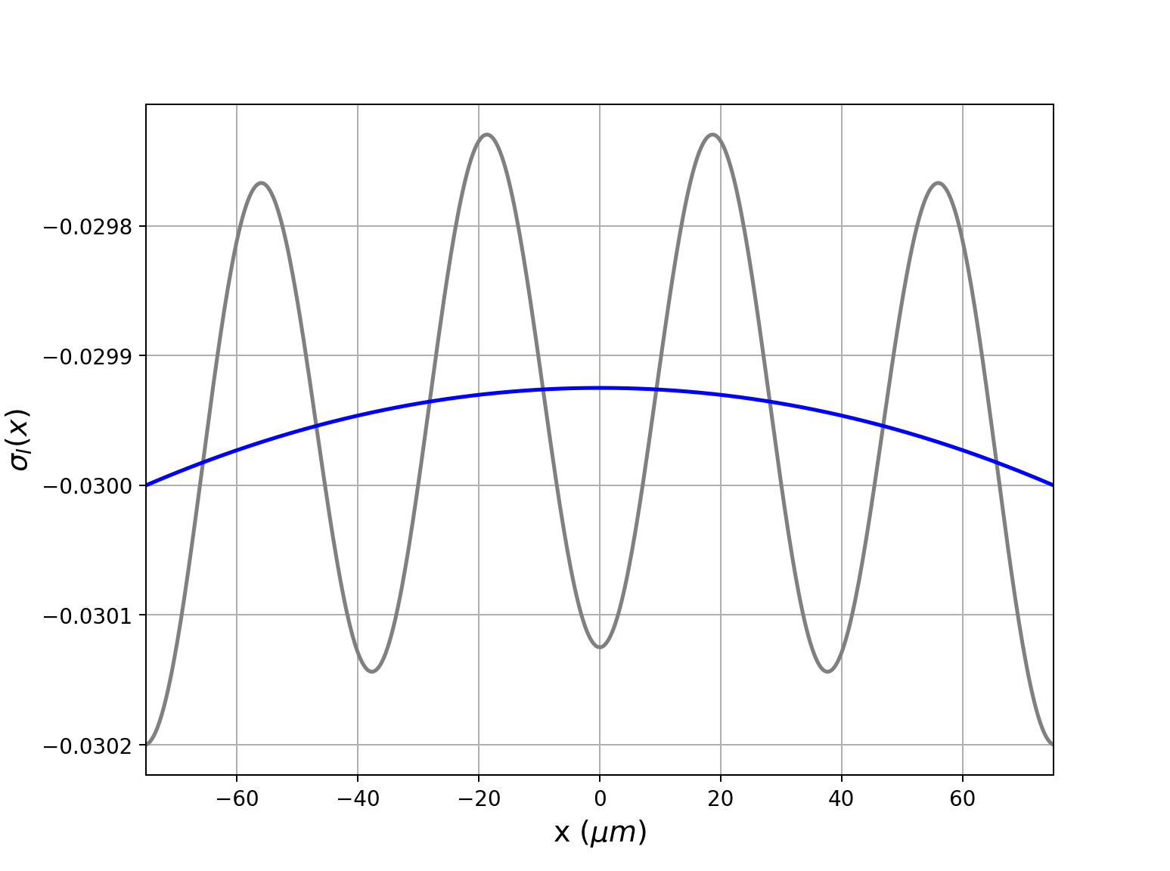

Slide 3
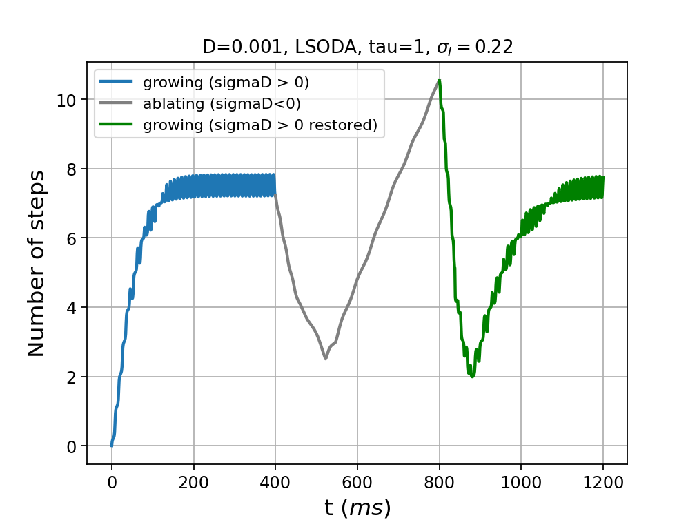
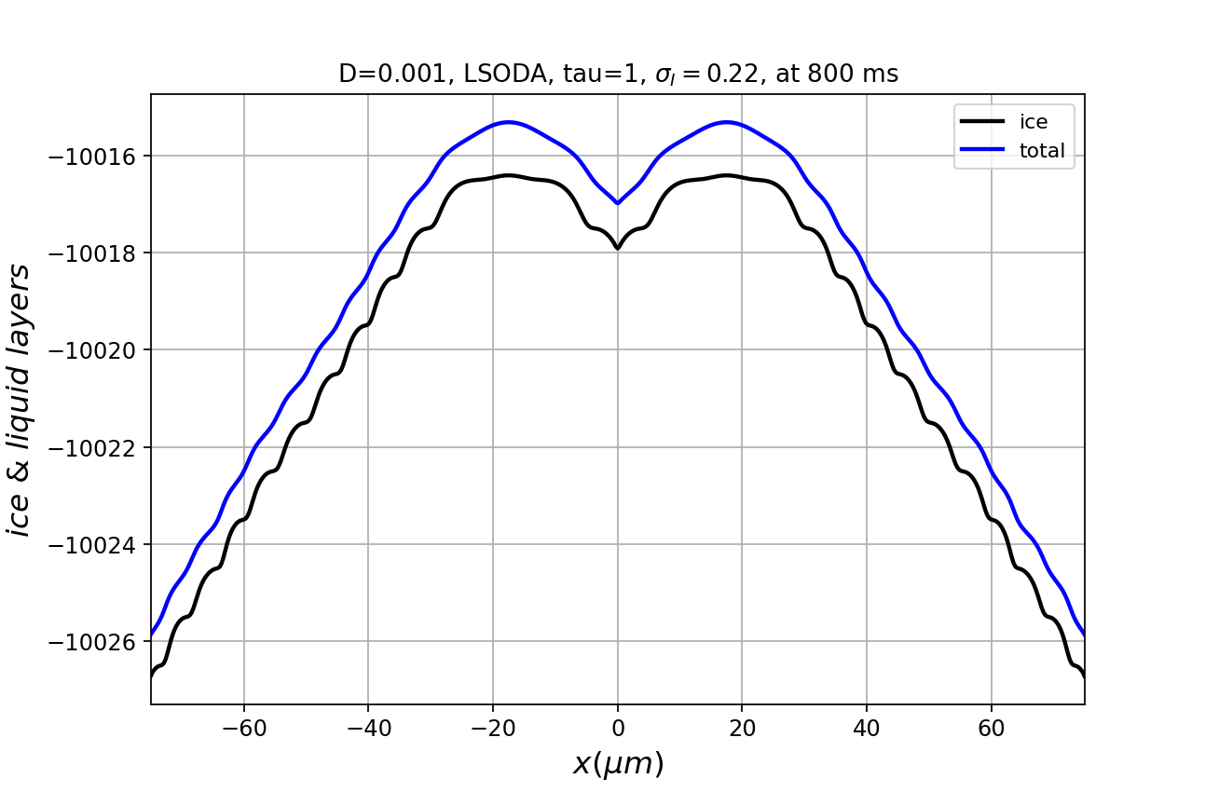
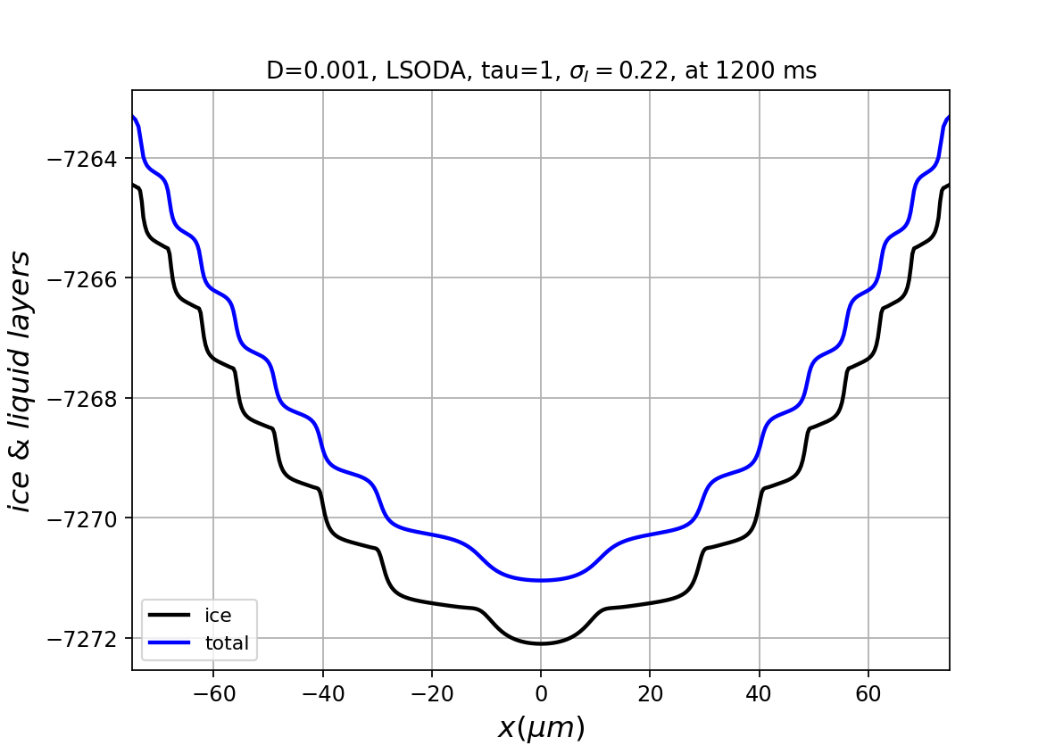
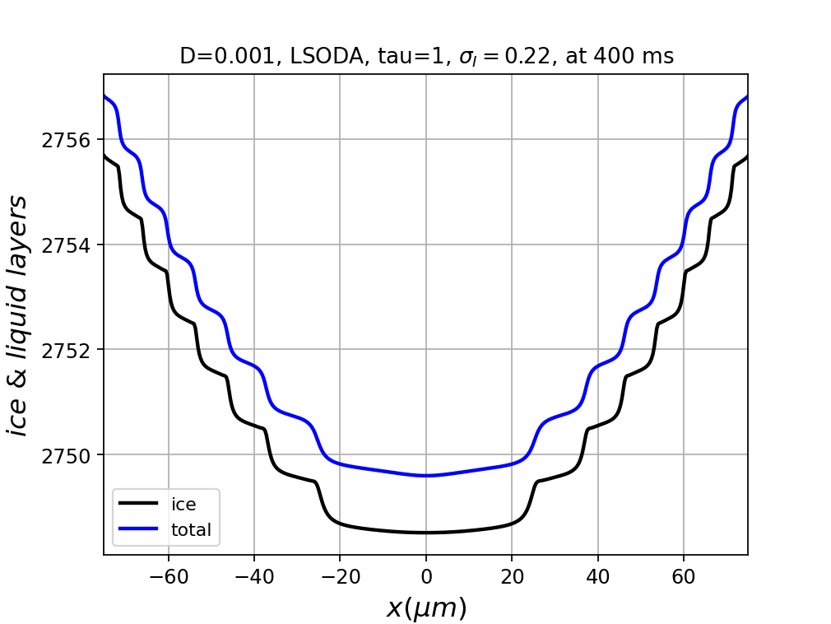
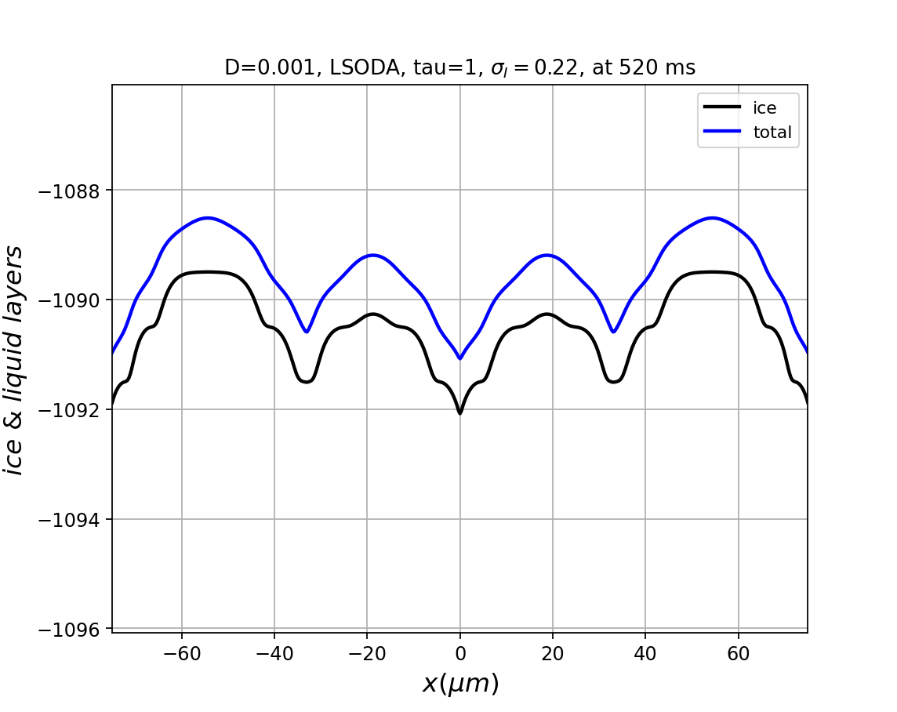

Slide 4
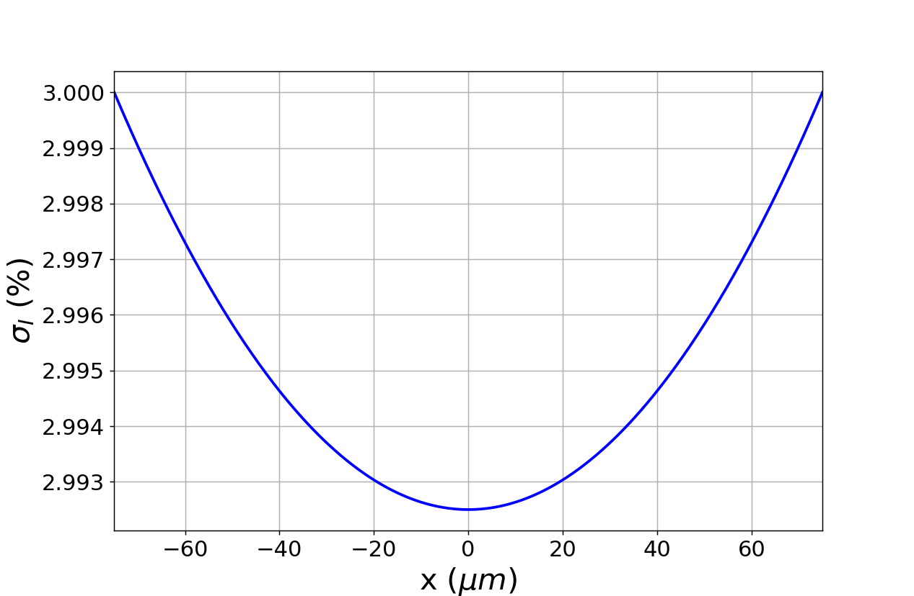
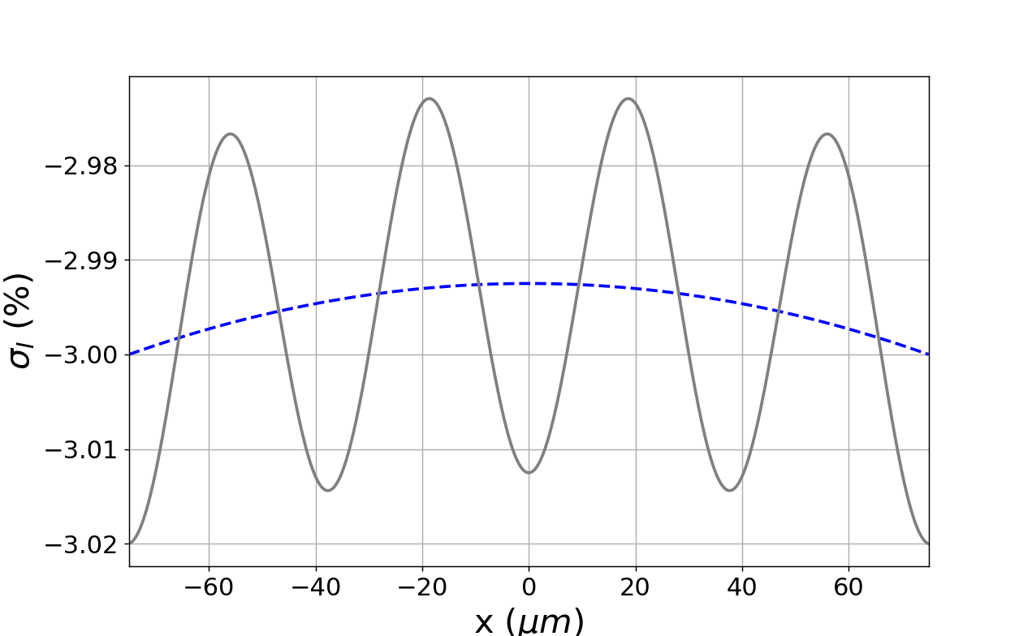
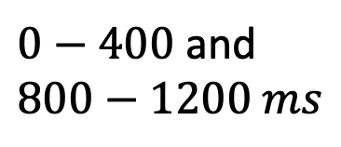

$0−400$ and $800−1200 ms$
B
A
C
$400−800 ms$
A
C
B

Slide 5
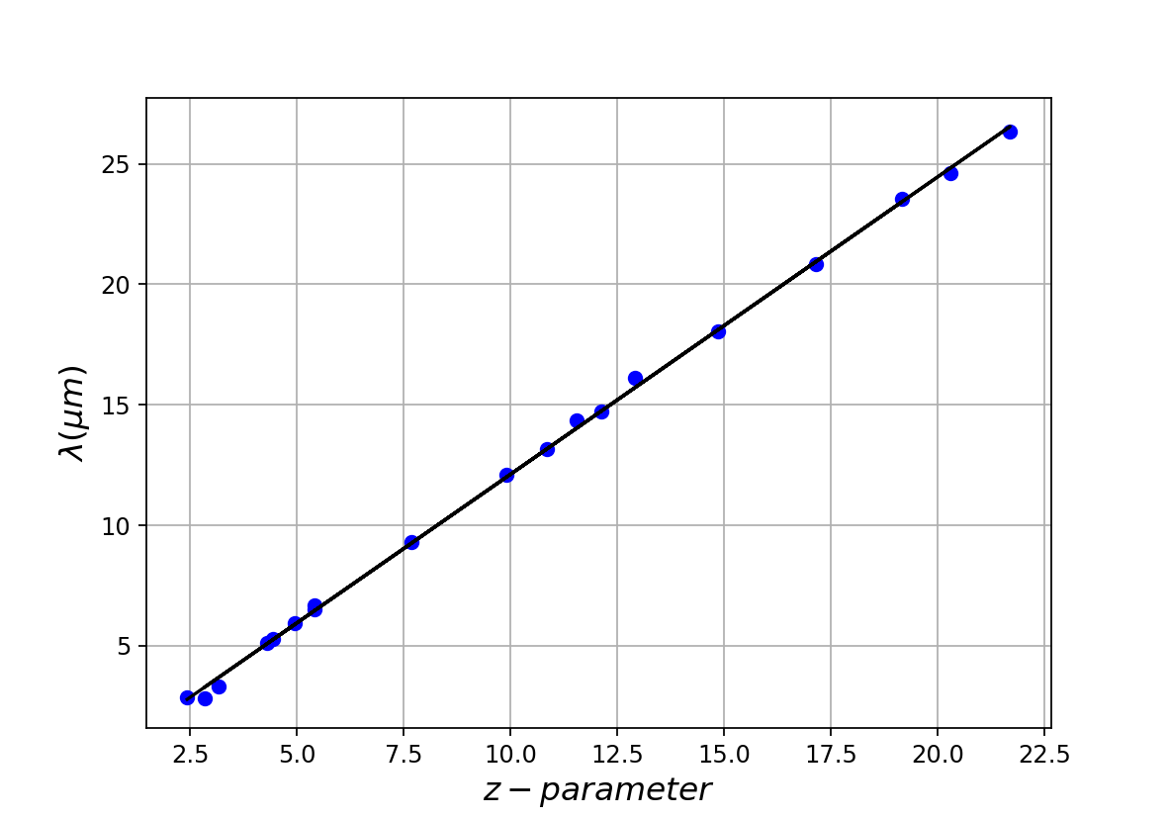

Slide 7
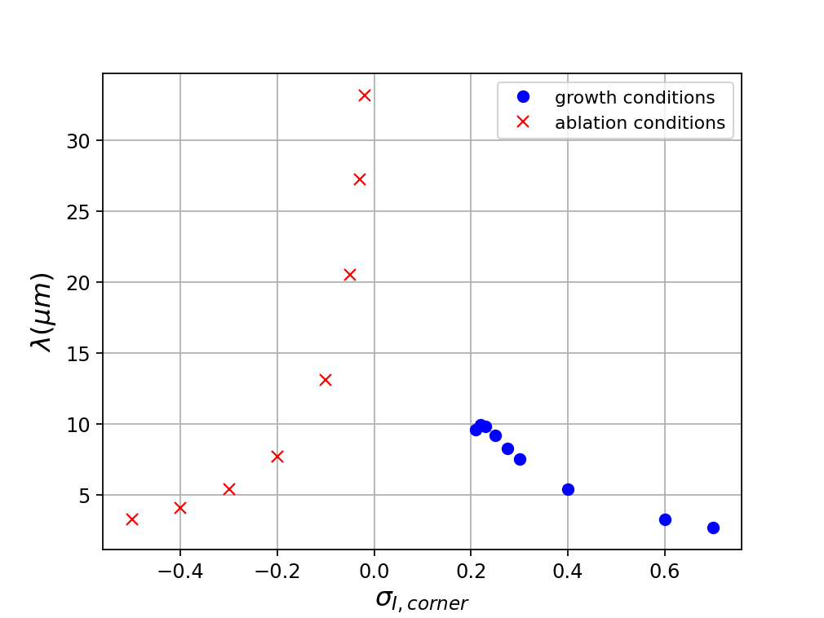
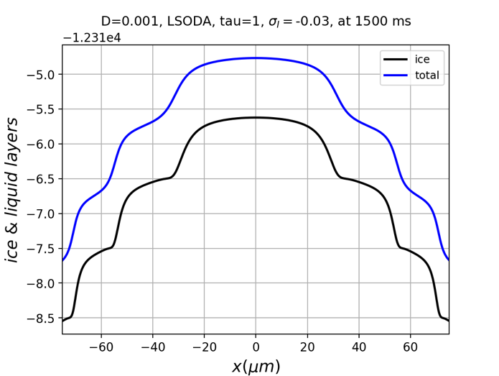
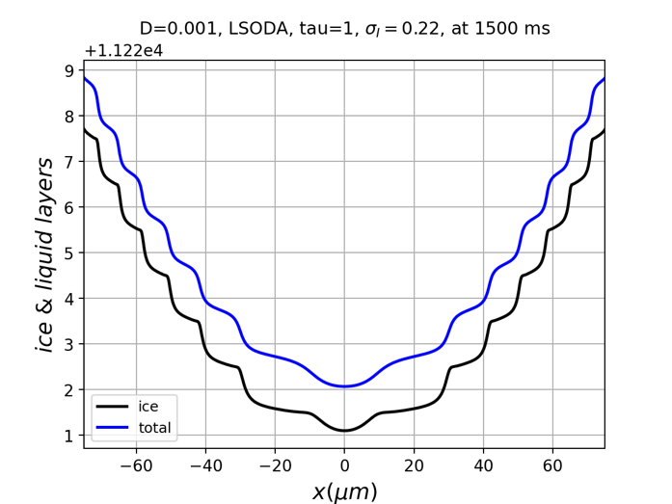
Concave ablation facets transition to rounding
Convex growth facets
transitions to
dendritic growth

Slide 8
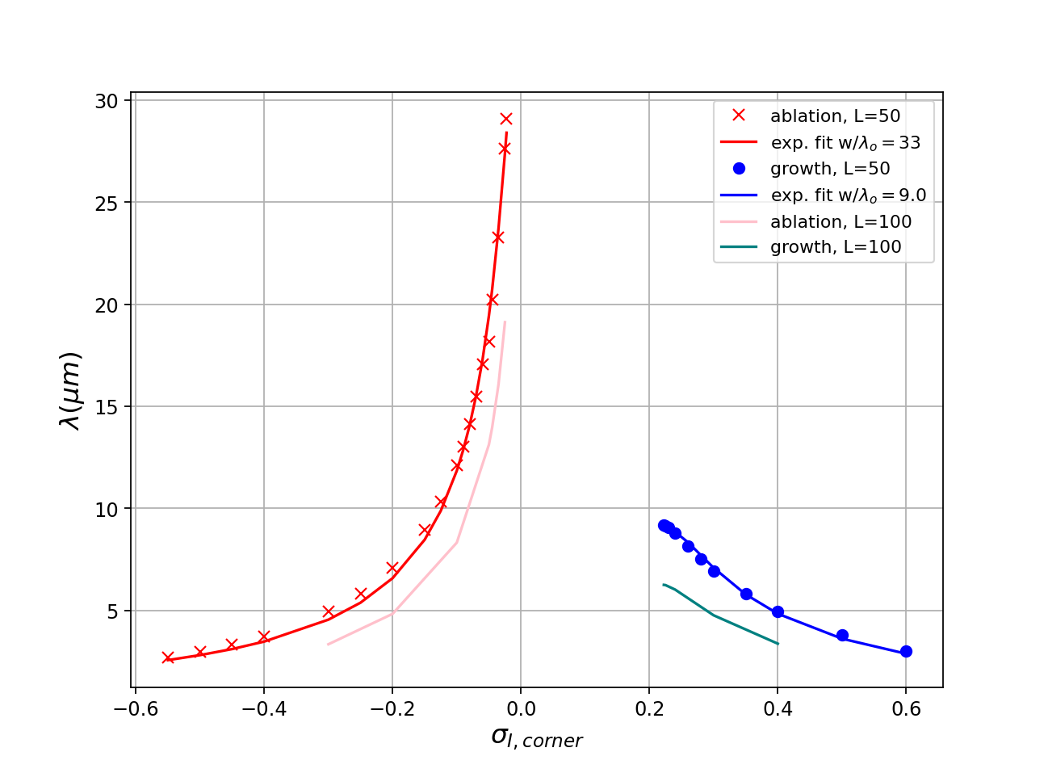
Concave ablation facets transition to rounding
Convex growth facets
transition to
dendritic growth

Slide 9
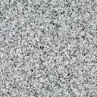
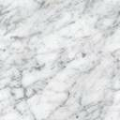
Need a real image here

Slide 10
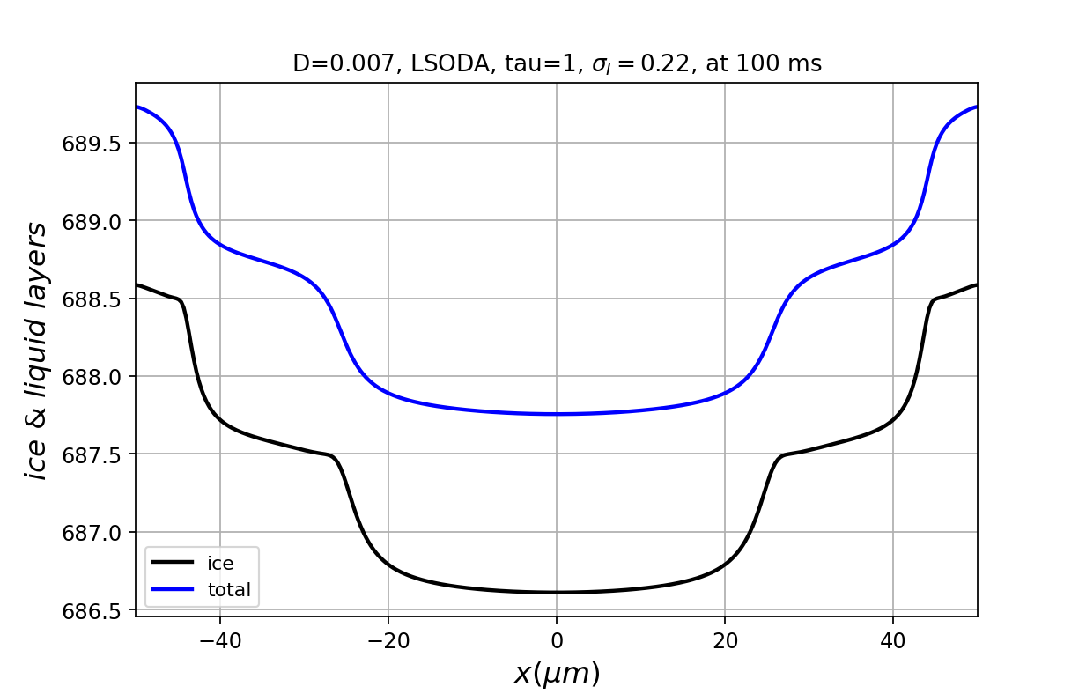
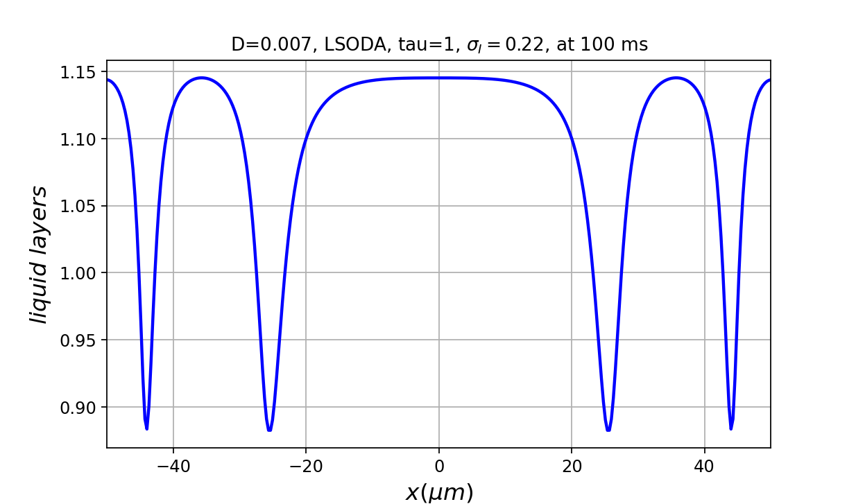



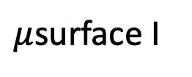
(a)
$μ$surface I
$μ$surface II
$$λ_{corner}$$
$$λ_{center}$$
II
II
(b)
I
I’

Slide 11
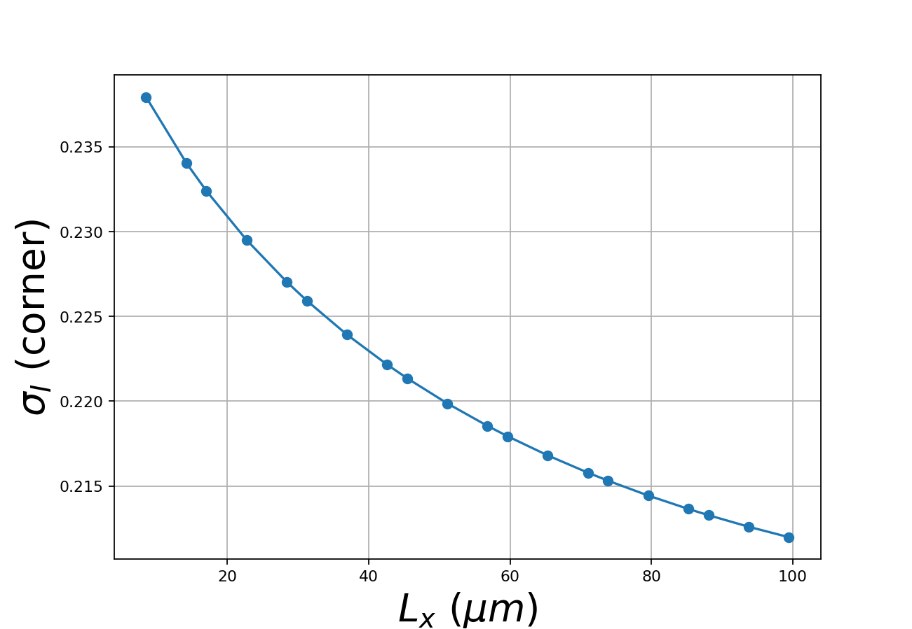
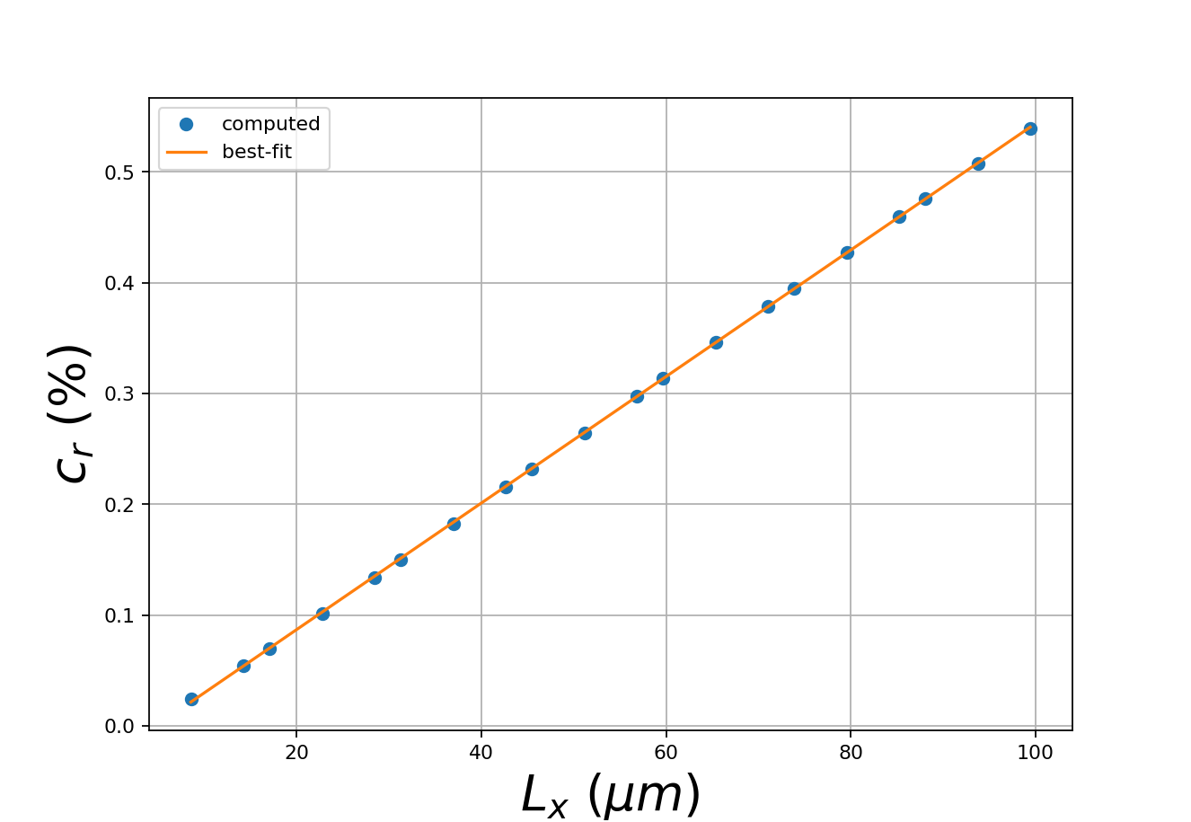

Slide 12
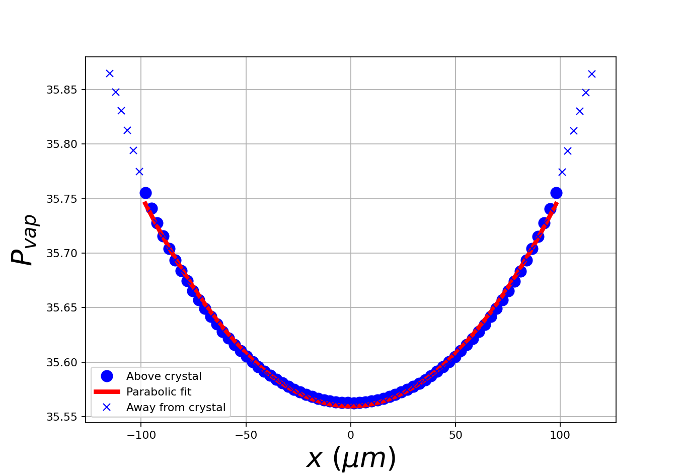

Slide 13
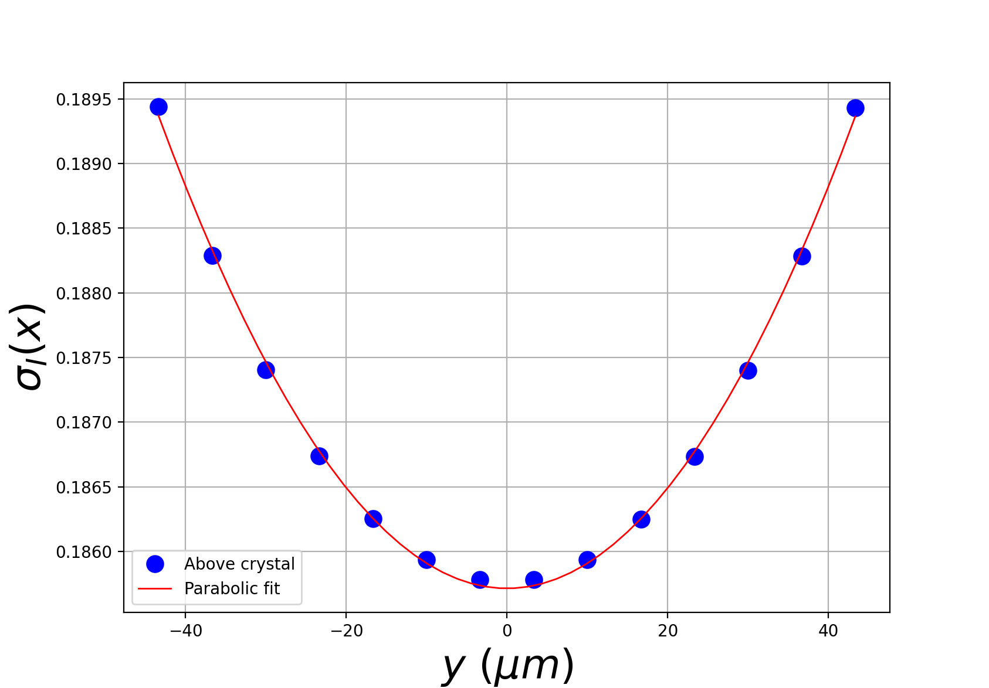

Slide 14
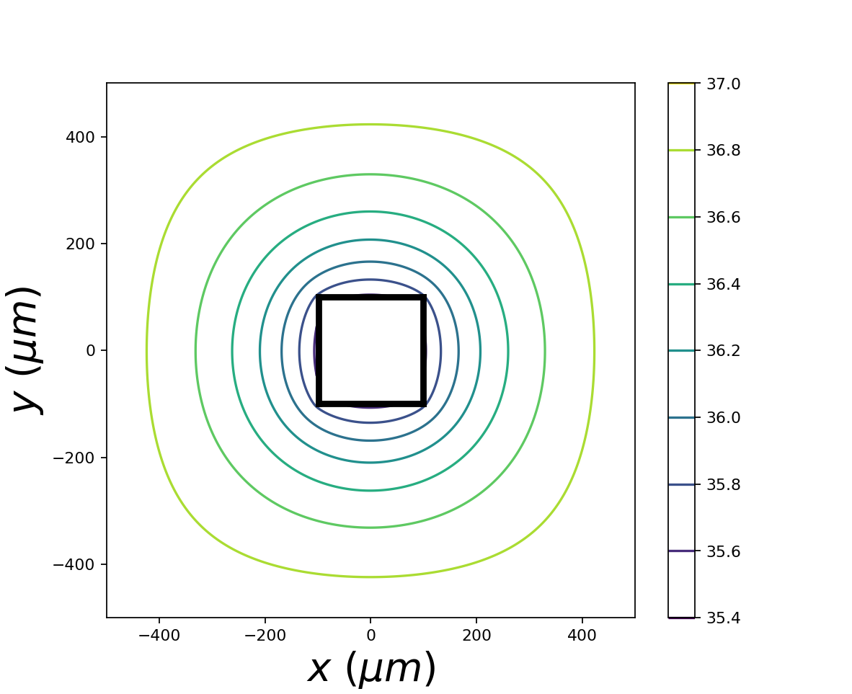

Slide 15
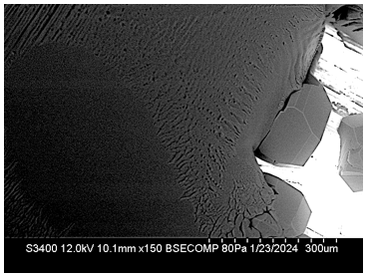
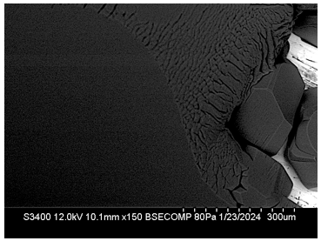

Slide 16
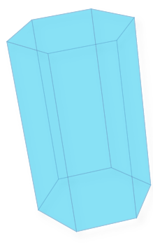

Water vapor
Ice crystal
(3D)
Ice crystal
(2D)
Ice crystal
(2D)

Slide 17








$$−L$$
$$L$$
$$30°$$
$$x$$
$$r_{hex}$$
$$r_{eff}$$
$${r′}_{hex}$$
$$r_{hex}$$

Slide 18
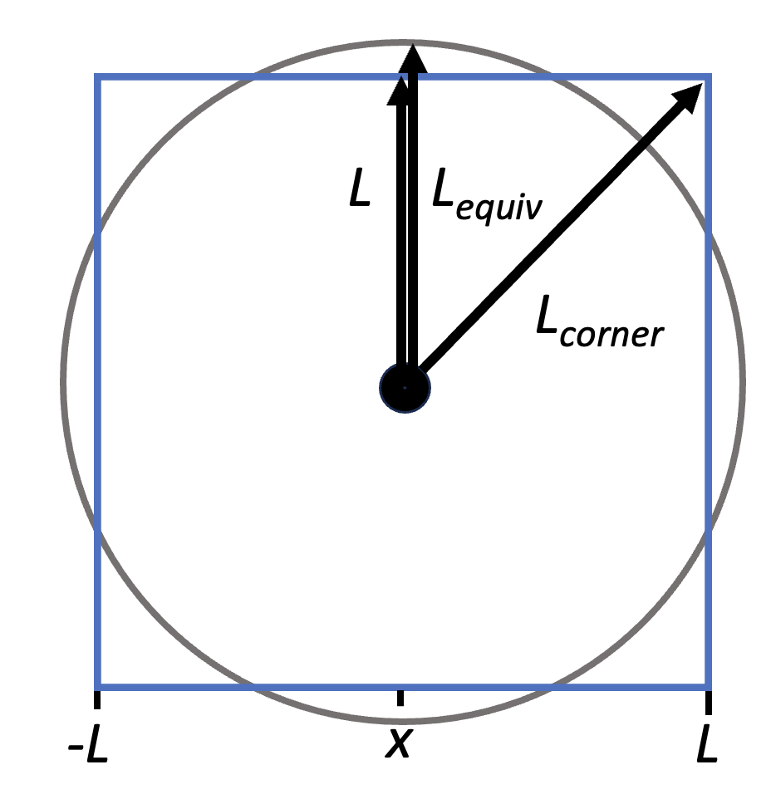
L
L_{equiv}
L_{corner}
-L
x
L

