Slide 1

Water vapor
Deposition & ablation
Surface diffusion
$$N_{QLL}$$
QLL
$$N_{tot}$$
Quasi-liquid/ice equilibration
$$N_{ice}$$
Ice

Slide 2
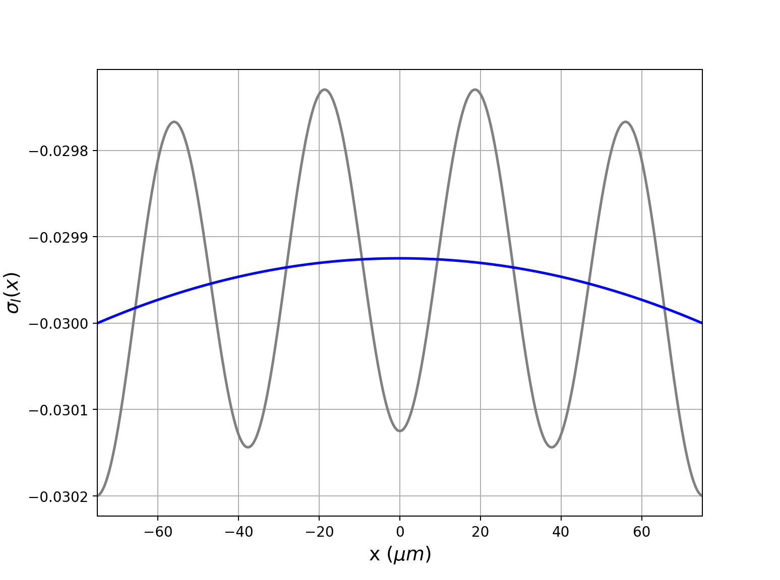

Slide 3
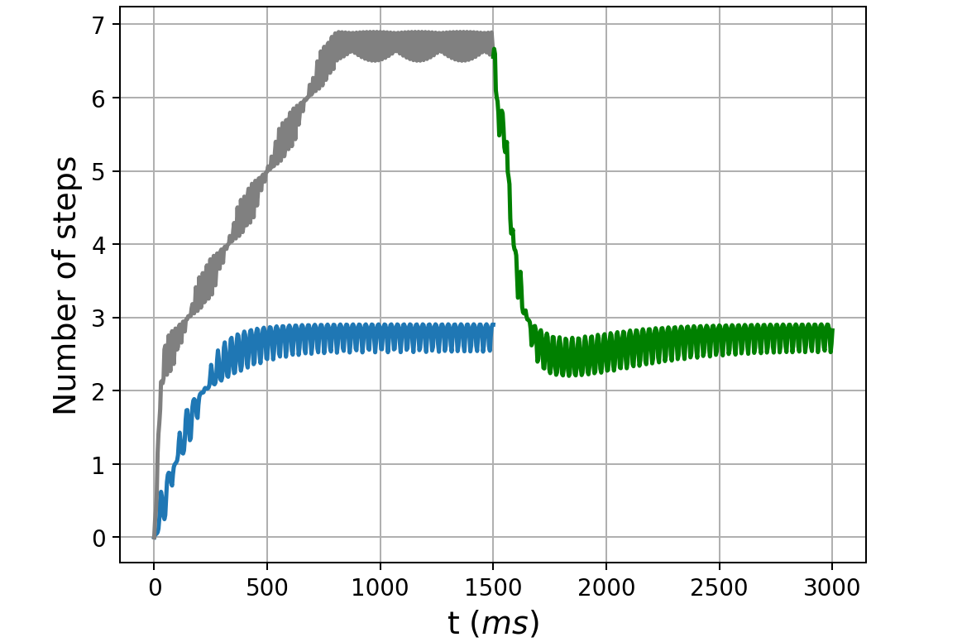
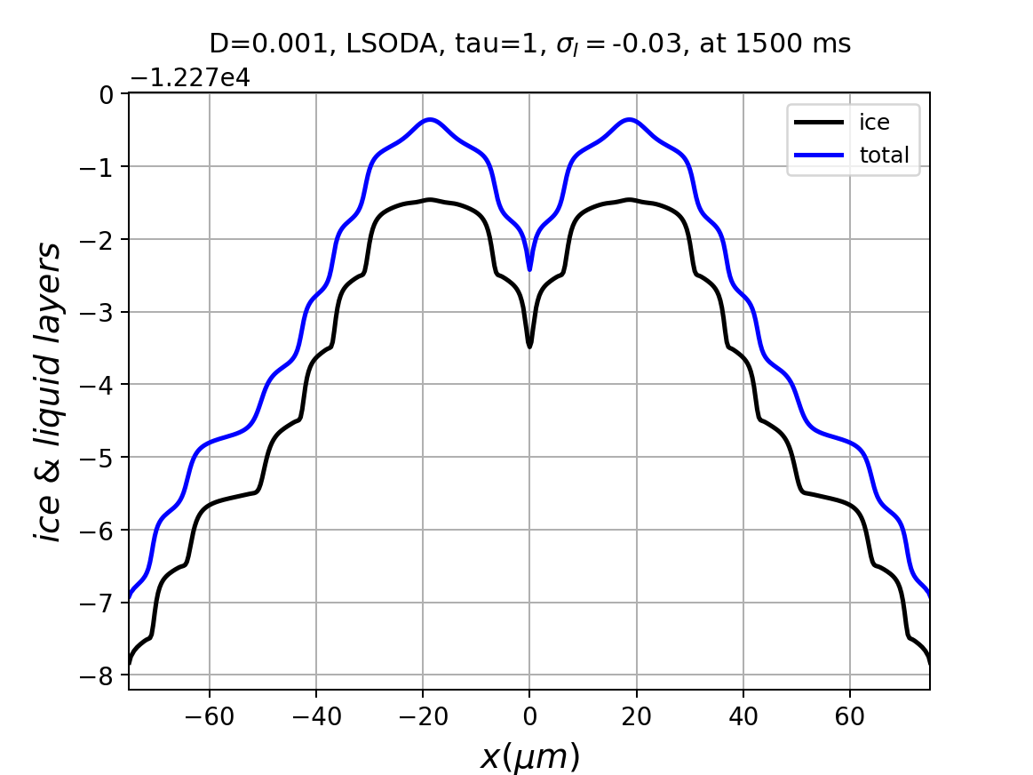
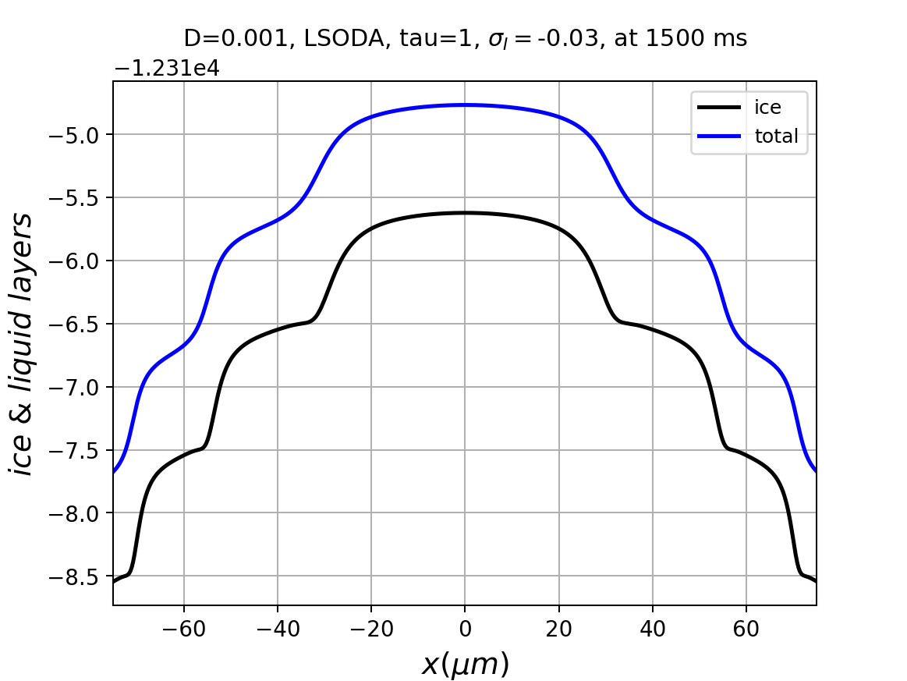
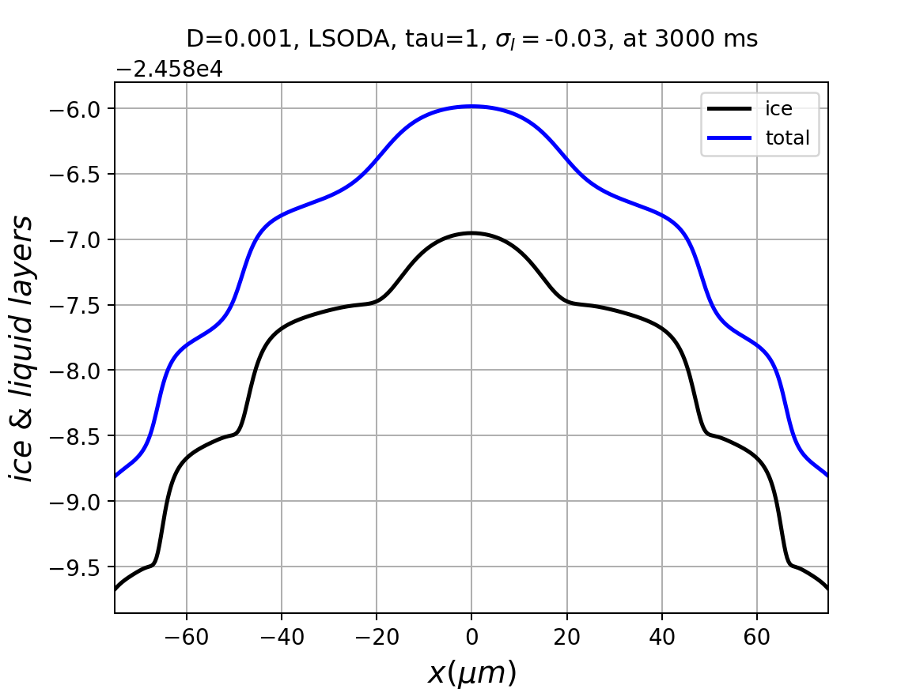

Slide 4
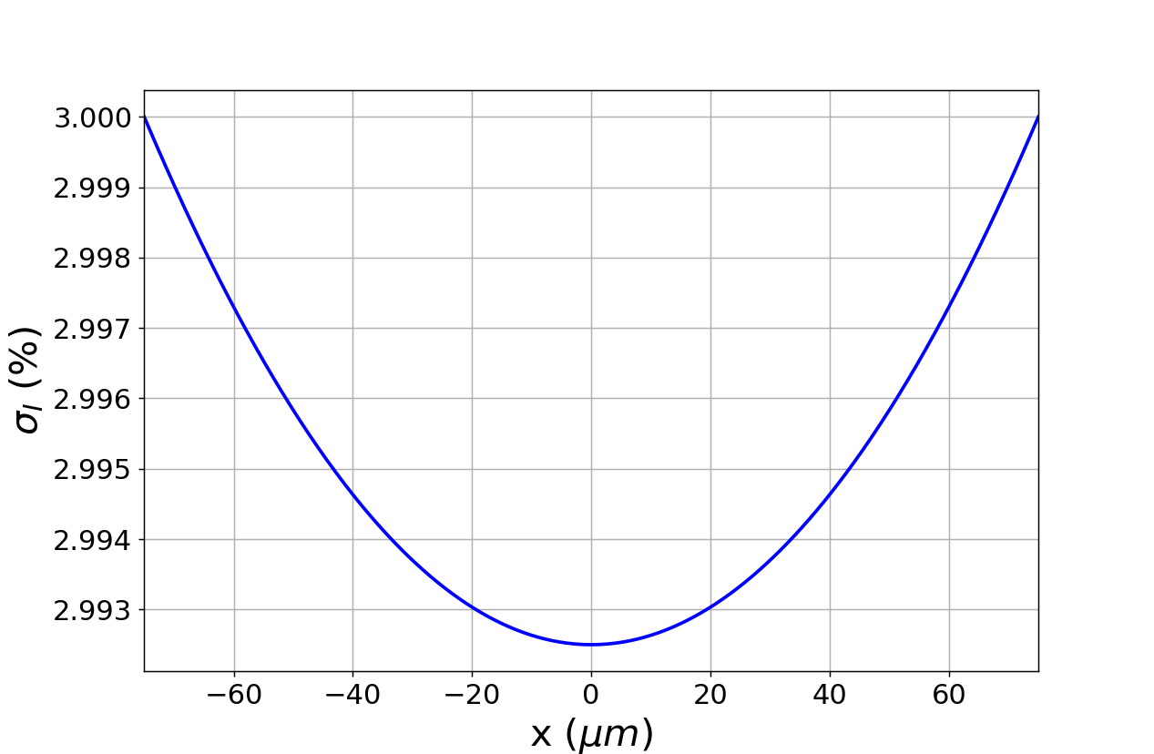
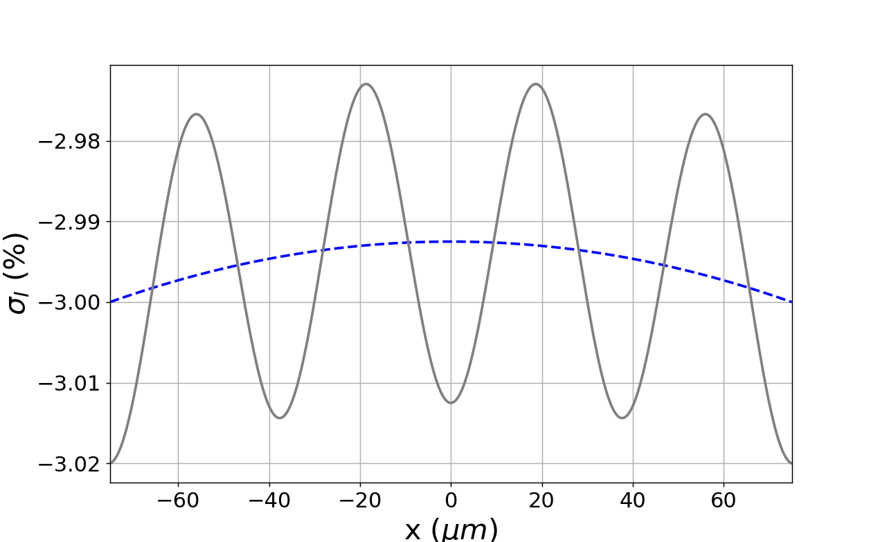

Slide 5
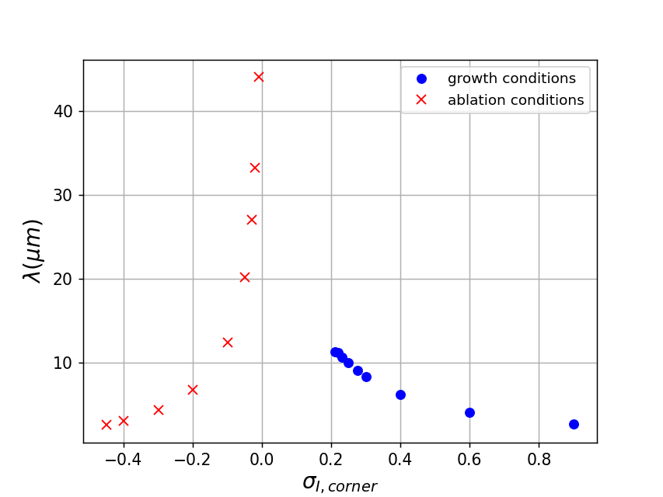
Faceted ablation transitions to rounding
Faceted growth
transitions to
dendritic growth

Slide 6
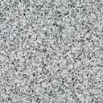
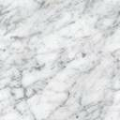
Need a real image here

