Slide 1
Software Asset Management
Standard Education Offering SW-332
SW Compliance Management
For Technical Support Teams
Last Updated 01-22-2008

Slide 2
Introduction
Welcome to the Software Asset Management education portfolio!
For the entire portfolio, access the Global Asset Management Portal at:
http://pokgsa.ibm.com/gsa/pokgsa/projects/a/asset_services/asset_management/index.html
In this presentation, you will become familiar with the submission of installed software inventories to the
Asset Management Infrastructure, including BRAVO.
This module is one of a series of modules designed to educate users on Software Compliance
Management:
SW-215 Validating Installed SW with BRAVO
SW-324 Performing SW Reconciliations with TRAILS 3.0
SW-330 SW Compliance Management for Asset Analysts
SW-331 SW Compliance Management for DPEs
SW-332 SW Compliance Management for Mainframe Technical Support
SW-325 SW Compliance Reporting Using TRAILS 4.0
Notes:
In progress:
SW-330 SW Compliance Mgmt Overview for Asset Managers
SW-331 SW Compliance Mgmt for DPEs
SW-332 SW Compliance Mgmt for Mainframe Technical Support Teams

Slide 3
Contents
Page 4: Overview
Page 11: Installed Software Inventory Scanning
Page 26: TRAILS 4.0 Alerts
Page 32: Appendix
Contacts
Glossary and Acronyms

Slide 4
Overview of Compliance Management

Slide 5
Overview: SW Compliance Management
Move from an annual “project driven reconciliation” to “alerts” .
  Alerts are created when a Software Compliance issue arises. For example:
    Missing or obsolete scans
    Missing HW
    Lack of valid entitlement
  Asset Management team drives resolution with technical, account teams
  Alerts are tracked on an aging report to ensure active management
An account is “compliant” if all alerts are closed within set criteria defined based on business processes
  Alerts are given 45 (calendar) days to be closed, based on time required to identify resolution with account team and DPE and resolve via change management (removal) or software request (new purchase)
  Alerts over 45 calendar days old place an account in ‘yellow’ status, with heightened review, management pressure
  Alerts over 90 calendar days old place an account in ‘red’ status and require a CIRATS to document exposure

Slide 6
Overview: Comparison of SW Compliance Mgt. Methods
Item | SW Recon | Compliance Mgt
Frequency | Annual, unless contract specifies otherwise | Ongoing; compliance checked with each new scan
Duration | Averages 6 months for most accounts; up to 16 months for difficult accounts (ex: IGA) | Ongoing; no labor ‘bubble’ required as long as scans are performed throughout the year
Scope | All commercial, internal accounts except transition accounts and accounts w/o SW License Mgt | All commercial, internal accounts except transition accounts and accounts w/o SW License Mgt
Platforms | MF (MVS, VM, IFL) Servers (Windows, Unix, Linux) AS/400 (I Series) | MF (MVS, VM, IFL) Servers (Windows, Unix, Linux) AS/400 (I Series)
Baselines | Account baseline (scope), Hardware baseline, Installed Software baseline, Entitlement baseline Baselines reloaded each recon. | Account baselines are loaded once and ongoing work limited to addressing changes in other baselines (ex: new accounts, new software, new hardware, discos)

Slide 7
Overview: Comparison of SW Compliance Mgt. Methods
Item | SW Recon | Compliance Mgt
Approval | DPE is presented with compliance gaps for initial signoff, compliant status for final signoff | DPE has dashboard with up-to-date view of compliance status; no formal signoff required. Use standard reports for signoff, if required.
SW Reuse | Data usually too old to make business decisions between accounts | Free pool should present accurate view of available software; regular scans will allow more frequent reuse decisions
Compliance Measurement (Audit Posture) | Binary status determined once annually, i.e. account is compliant or not | Compliance status based on age of discrepancies at any point in time: green = issues < 45 days old yellow = issues are 45-90 days old red = issues > than 90 days
Compliance Measurement | Little insight into type of discrepancy, i.e. required labor intensive manual assessment | Dashboard view showing type and age of existing discrepancies HW without a scan New installed software etc.

Slide 8
Step-by-Step Changes

Slide 9
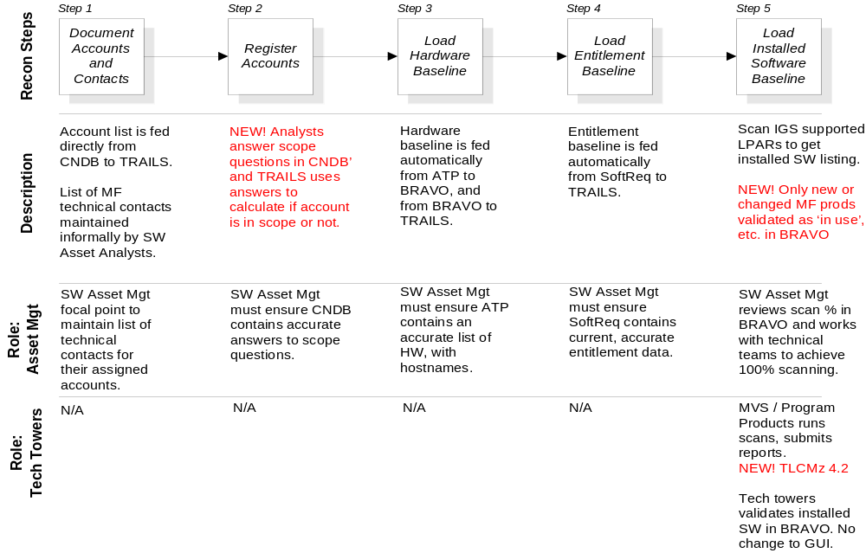
Step-by-Step Changes

Slide 10
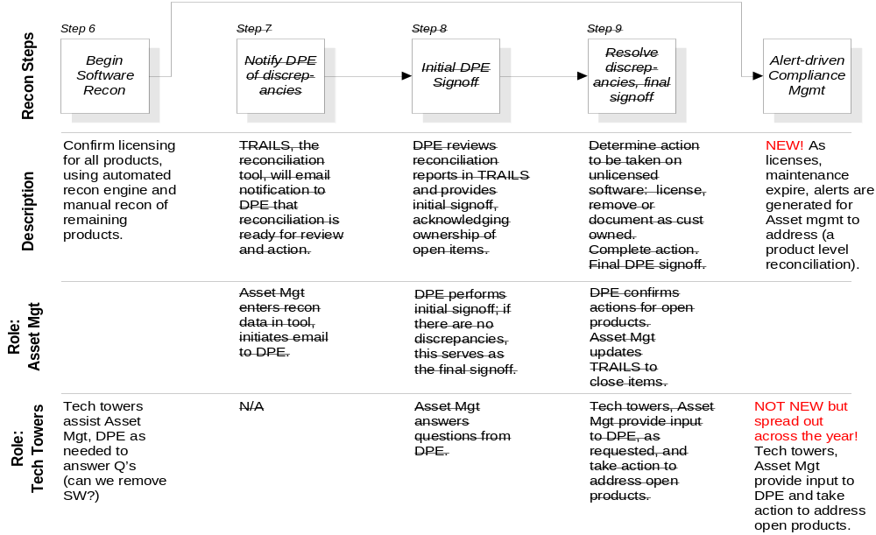
Step-by-Step Changes

Slide 11
Installed Software Inventory Scanning

Slide 12
Installed Software Inventory Scanning
Scanning tools
  Desired scanning tool: TLCMz 4.2 with 2Q07 knowledge base(KB)
    Assumes current (or recent) OS that supports TLCMz
  Minimum scanning tool: SoftAudit 3.2 with 2Q07 KB
    Assumes antique OS that cannot support TLCMz
  NOTE: All machines with shared DASD or in a SYSPLEX must have same level of the KB!
Scanning frequency
  Desired scanning frequency: Monthly
    Using new automated file submission to eliminate work for MVS support team
  Minimum scanning frequency: Quarterly
    Scheduled at convenient time for customer, support
    Also after significant changes (CPU up/downgrade or consolidation, major SW upgrades)

Slide 13
Installed Software Inventory Scanning
Submitting scan data
  Two methods:
    (Automated) Submit using File Transfer Program (FTP) ←RECOMMENDED!
    (Manual) Submit to Asset website
    ….. instructions on following pages
Submitting scan data via the Web (Manual method)
  Steps
    Execute TRNPRDS on the Mainframe and create the file; then save as an ASCII file on your workstation.
    Open BRAVO tool (http://tap2.raleigh.ibm.com/) and navigate to the account.
    Select the LPAR to submit and click the ‘Submit’ button.
    Use ‘Browse’ to select the file; click ‘ok’.
    Check the processed file web page to confirm report was accepted.

Slide 14
Installed Software Inventory Scanning
Submitting scan data via FTP
  Restrictions
    Submit files generated on subject LPAR. Do not submit the same file multiple times for mirrored LPARs!
    The LPAR must be entered into ATP correctly (Asset Analyst can confirm this).
  Steps
    Create the file normally; no need to transfer the file to your PC if you are transmitting directly from the mainframe to the tap.raleigh.ibm.com server).
    Name the file LPAR_YYMMDD.txt where:
      LPAR = LPAR name
      YY = two digit year
      MM = month
      DD = day
    Log into tap.raleigh.ibm.com as ‘anonymous’, using your email address as the password
    Execute ‘cd mf_scan’
    Transfer the file to the server
  Bad files and partial loads will be logged at http://tap.raleigh.ibm.com/mf_inv_logs/.

Slide 15
Installed Software Inventory Scanning
Scanning parameters
  Execute TRNPRDS for each logical partition
    Specifics are documented on page 99 of the Tivoli License Compliance Manager for z/OS System Administration Guide (GC32-2267-00), found at http://publib.boulder.ibm.com/tividd/td/ITLCMfzOS/GC32-2267-00/en_US/PDF/LCM4.1_Admin.pdf
Optional filters
  IDNTDATA (IDDATA) Required. Identifier output. The value in parenthesis can be specified in the IDNTFIER PROC EXEC statement.
  SURVDATA (SRVDATA) Required. Surveyor output. The value in parenthesis can be specified in the IDNTFIER PROC EXEC statement.
  USRPDATA Optional. User Product Data File. Parameters Use of the default is recommended for the parameters below:
  COPYR NOCOPYR Specifies that copyright information be used in module identification. The default, NOCOPYR, indicates that copyright information, even if available, should not be used for module identification. If copyright information was not collected during the Surveyor run, it will not be available to the Identifier.

Slide 16
Installed Software Inventory Scanning
Optional filters
  DLIB NODLIB Specify NODLIB to exclude SMP/E distribution libraries specified in the Extractor Output file from identification. DLIB (to include these libraries) is the default. MINMODULES=nn The minimum number of modules associated with a product that must be found in a library before the identification of a product is made. Valid values are 1 through 10. The default value is 2.
  STOP STOPONERROR Stops the Identifier due to a conflict between the ASSIGN and DONTHAVE statements.
  UNV UNVERSIONED Identifies all modules identified as versioned products to be identified without a version. The purpose of the parameters listed below is outdated and has been replaced by newer methods. It is likely they will no longer be supported in future versions of SoftAudit. Use of these parameters is not recommended.
  IGNOREMISMATCH Allows the Identifier to run with a version of the Knowledge Base that is earlier than the version used in the last run of the Surveyor.
  MAXUPLV=nn Specifies the maximum percentage of unknown modules allowed in a library (that otherwise contains a single identified product) that still qualifies for versioning by library name. The default is 10.

Slide 17
Installed Software Inventory Scanning
Optional filters
  LPV LIBPVER NOLIBPVER NOLPV Use LIBPVER to activate product versioning inferences by library name. The default NOLIBPVER indicates that product versioning inferences by library name should not take place. NOSMP Run the Identifier without using Extractor data. PRINTUSRPDATA Lists the entire contents of the User Product Data file, if one is used in the current run of the Identifier. By default, the Identifier lists only those statements in the User Product Data file that contain errors.
  NOSA SA NOSHOWALL SHOWALL Use NOSHOWALL to exclude those modules that are marked –UNRECOG and those that are marked – from being displayed in output. The default, SHOWALL will display these modules. Use of vendor or product filters with values containing a leading hyphen (for example,
  PRODEXCL=–UNRECOG) will cause the SHOWALL parameter to be in effect regardless of the SHOWALL/NOSHOWALL parameter specified.
  NOREFERENCE NOREF Indicates that Identification by Reference processing should be bypassed.

Slide 18
Appendixes

Slide 19
Contacts
TOOL OWNERS
  Second line manager: Tom Coffas / Raleigh
  First line manager: Brent Lamm / Raleigh
  Team lead: Adam Dilling / Raleigh or John Gardner / Raleigh
PROCESS QUESTIONS:
  First line manager: Lisa Richardson / Lexington

Slide 20
Glossary and Acronyms
Account ID
Unique combination of customer name, account type, and asset management
department supporting the account.
CNDB (Customer Number Database)
The repository of U.S., Canadian and Mexican accounts and their corresponding
customer numbers. Support is currently restricted to U.S. Division 07 accounts.

