Slide 1
VELTRIX ECOSYSTEM
The Vision & Architecture
A Unified Suite of Fintech Platforms and Intelligent Assistants Created by The Accountant · Version by Version

Slide 2
OVERVIEW
The Connected Digital Ecosystem
STAGE 01
Veltrix VTU
BUILT / OPERATIONAL
Premium student fintech platform. Allows instant purchases of data & airtime, secure wallet funding via Paystack, transaction tracking, and admin controls.
STAGE 02
Veltrix Core
ACTIVE DEVELOPMENT
AI-powered intelligence system. Contains modular files for learning, identity databases, local facts memory, session reports, notes and tasks tracker.
STAGE 03
Veltrix Studio
PLANNED
AI website builder. Generates landing pages, copy, templates, layouts, and custom deployment structures. Will integrate closely with Veltrix Core.
STAGE 04
Veltrix OS
LONG-TERM VISION
Android-based custom mobile OS. Houses Veltrix Core as the underlying intelligence layer for AI-assisted phone experience and supervised tasks.

Slide 3
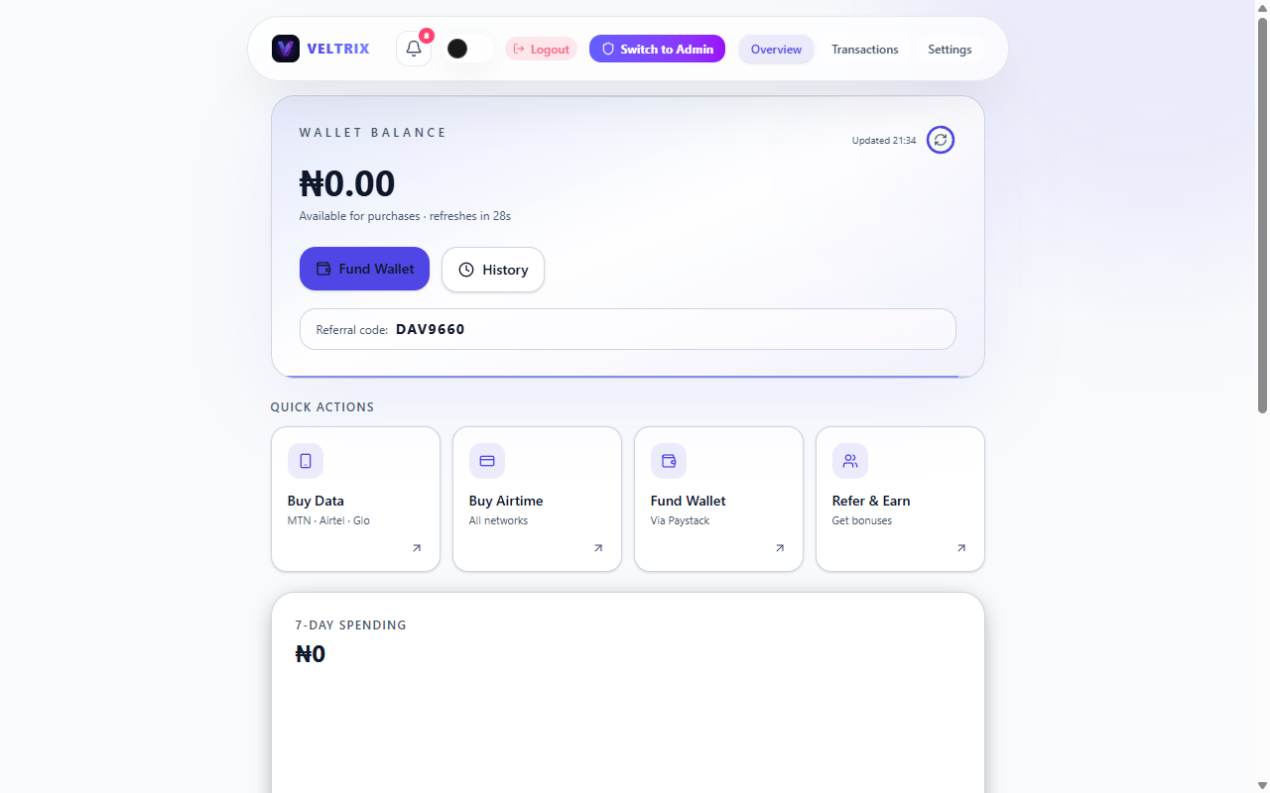
STAGE 01 — OPERATIONAL
Veltrix VTU: Campus Airtime & Data
Built for Campus Life
• Instant Top-Ups: Airtime and data delivered in milliseconds via premium provider APIs.
• Secure Payment Flow: Seamless wallet funding secured by Paystack flat-fee transactions.
• Security-First: User login, persistent session storage, and 4-digit transaction PIN verification.
• Referral Engine: Cash bonuses instantly credited to user wallets on referral funding.
• Management Hub: Full dashboard reporting, transaction logs, and administrative controls.

Slide 4
STAGE 02 — ACTIVE DEVELOPMENT
Veltrix Core: Visual Release Evolution
v0.1
Genesis
Pulse Dot
v0.2
Awakening
Active Panel
v0.4
Memory
Storage Recall
v0.8
Modular
Code Refactor
v0.95
Productive
Notes & Tasks
v1.0
Dream Alpha
Official Release

Slide 5
STAGE 02 — ARCHITECTURE
Veltrix Core: Internal System Modules
Identity & Knowledge
Reads configuration dynamically from dedicated JSON database categories (anime, personal, business focus). Stores state and local identities and updates categories via prompt instructions.
Memory & Fact Engine
Implements persistent session tracking using localStorage. Learns facts dynamically via prompt scripts, index lookups, exports local data reports, and removes forgotten records.
Productivity Utilities
Integrates user-focused note collections, interactive lists of tasks with toggleable completion checkboxes, aliases, and keyword search indexes across everything stored.

Slide 6
STAGE 02 — CORE ROADMAP
Veltrix Core: The Long-Term Vision
A Supervised Ambient Assistant
• Dynamic Learning: Learn continuously from connected documents, logs, databases, and APIs.
• Active Research: Access the internet to query details, summarize reports, and verify sources.
• Workspace Interaction: Read, analyze, write, and organize files in standard project directories.
• Self-Improvement: Suggest logic tweaks and improvements to its own engine dynamically.
• Supervisor Guardrails: Access computer-level tools only under direct human supervision.
• Strict User Approval: Never run major actions, modify files, or execute builds without explicit user permission.

Slide 7
STAGE 03 & 04 — EXPANSION
Future Frameworks: Studio & OS
Veltrix Studio
• Status: Planned / Future
• AI Website Generation: Instantly builds clean landing pages, portfolios, and blogs.
• Smart Content Copy: Automated layout design and text copy tailored for businesses.
• Interactive Customization: Drag-and-drop structural edits with deployable source files.
• Integrated Engine: Future direct control mapping via connected Veltrix Core assistants.
Veltrix OS
• Status: Long-Term Vision
• Android-Based Platform: A custom OS built strictly for Android mobile devices.
• Ambient Layer: Veltrix Core functions as the central system intelligence.
• App Automation: Supervised AI assistant automates screen actions, checks inputs, and coordinates workflows.
• Approval Protection: Built with user guardrails, preventing system tasks from running without explicit notification.

Slide 8
“Even dots can dream.”
From VTU infrastructure to intelligent systems, Veltrix is being built version by version into a connected digital ecosystem.

