Slide 1
Phishing Awareness Training
Recognizing phishing emails, fake websites, and social engineering attacks
Cybersecurity Internship Project CodeAlpha

Slide 2
Learning Objectives
Identify common phishing indicators in emails and websites
Recognize social engineering tactics used by attackers
Apply practical steps to avoid phishing attacks
Know how to respond and report suspected phishing
Test your knowledge with an interactive quiz

Slide 3
What Is Phishing?
Phishing is a social-engineering attack that attempts to trick a target into revealing information, clicking a malicious link, opening an attachment, or taking an unauthorized action.
Attackers commonly impersonate trusted people, organizations, or services.
Phishing can arrive through email, SMS, messaging apps, phone calls, or social media.

Slide 4
Common Types of Phishing
Email phishing — deceptive messages sent to targets
Spear phishing — highly targeted messages tailored to an individual or organization
Smishing — phishing delivered through SMS or messaging
Vishing — phishing conducted through voice calls
Business Email Compromise — impersonation used to influence payments or sensitive actions
Clone phishing — a legitimate-looking message is copied and modified with malicious content

Slide 5
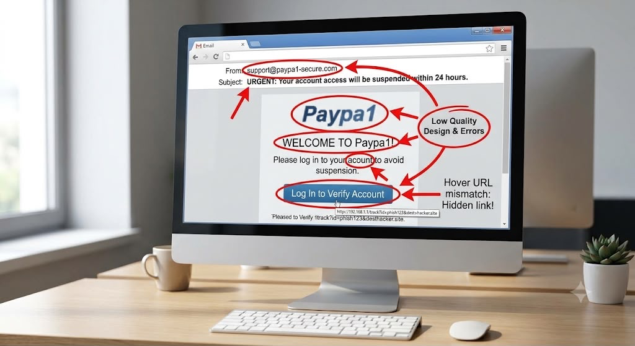
Anatomy of a Phishing Email
Sender: Does the address actually belong to the claimed organization?
Subject: Does it create unusual urgency, fear, or curiosity?
Body: Is the request unexpected or asking for sensitive information?
Links: Does the visible text match the actual destination?
Attachments: Was the file expected and independently verified?
Tone: Does it pressure you to bypass normal procedures?

Slide 6
How to Recognize Suspicious Emails
Be cautious with unexpected password, payment, or account-verification requests.
Inspect the sender address carefully rather than relying on the display name.
Hover over links before opening them and check the destination.
Treat urgent threats and unusual deadlines as warning signs.
Verify sensitive requests using a trusted channel.
Do not provide passwords, MFA codes, or financial information in response to unsolicited messages.
REAL WORLD EXAMPLE From: IT SUPPORT <support@paypa1_secure_login.com> URGENT: Your account will be suspended! Verify your account within 30 minutes:
[ Verify Account ]
Warning signs:
✓ Urgency
✓ Unexpected request
✓ Suspicious sender
✓ Login link

Slide 7
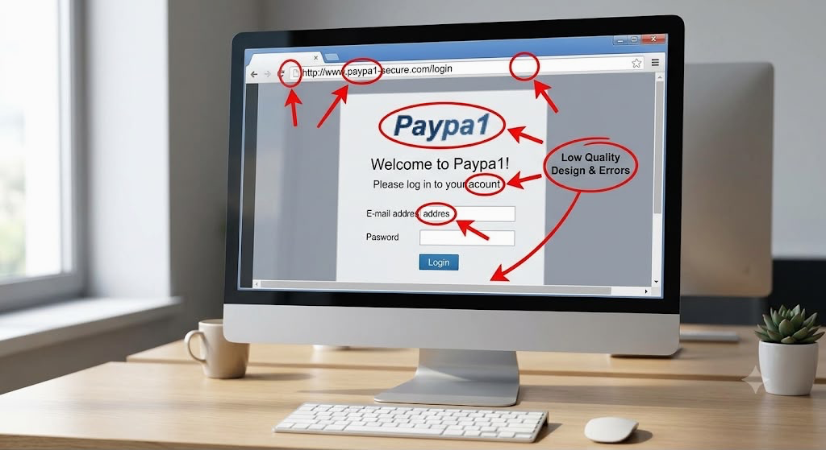
How to Identify Fake Websites
Check the domain name carefully for misspellings or lookalikes.
Do not assume HTTPS means a website is legitimate; it only protects the connection.
Be suspicious of unexpected login pages reached from messages.
Compare the site with the organization's known official website or app.
Avoid entering credentials after following an unexpected link.
Use bookmarks or manually enter known addresses for sensitive services.

Slide 8
Social Engineering Tactics
Urgency — “Act now” or a short deadline
Authority — pretending to be a manager, bank, IT team, or executive
Fear — threats of suspension, penalties, or account closure
Curiosity — enticing files, messages, or information
Trust — exploiting familiar names, brands, or relationships
Reciprocity — offering a benefit in exchange for an action

Slide 9
Real-World Examples
Google and Microsoft accounts are frequently targeted by credential-phishing campaigns.
Business Email Compromise has been used to impersonate executives or vendors and redirect payments.
Large-scale phishing campaigns often exploit current events, popular services, or account-security themes.
Lesson: the strongest defense is not recognizing one particular scam; it is consistently verifying unexpected requests.

Slide 10
What Happens After You Click?
A link may lead to a credential-harvesting page or a malicious download.
Stolen credentials can enable account takeover and further attacks.
Malware may provide an attacker with access to a device or network.
Compromised accounts can be used to target coworkers, customers, or contacts.
A single click can therefore become the starting point for a larger security incident.

Slide 11
Best Practices
Pause before acting on unexpected requests.
Verify sensitive requests through a separate, trusted channel.
Use strong, unique passwords and a password manager where appropriate.
Enable multi-factor authentication (MFA).
Keep operating systems, browsers, and security software updated.
Report suspected phishing to the organization's security/IT team.
When in doubt, do not click — verify first.

Slide 12
If You Fall for Phishing
Stop interacting with the message or website.
Notify your organization's IT/security team promptly.
If credentials were entered, change the affected password through the legitimate service.
Revoke or review active sessions where the service supports it.
If financial information was involved, contact the relevant financial institution.
Record what happened to help incident responders investigate.

Slide 13
Interactive Quiz
1. An email says your account will be closed in 30 minutes unless you click a link. What is the safest response?
A. Click immediately B. Reply with your password C. Verify through an official channel D. Forward it to coworkers
2. Which is a strong phishing indicator? A. Unexpected urgency B. A normal greeting C. A known contact D. A routine notification
3. Does HTTPS alone prove a website is legitimate? A. Yes B. No

Slide 14
Quiz Answers & Explanations
1. C — Verify through an official channel. Urgency is a common manipulation tactic.
2. A — Unexpected urgency can pressure users into bypassing normal verification.
3. B — No. HTTPS encrypts the connection; it does not establish that the site owner is trustworthy.
Bonus: Before entering credentials, independently navigate to the known service or use a trusted bookmark.

Slide 15
Key Takeaways
Phishing relies on human trust and manipulation, not just technical weaknesses.
Inspect senders, links, domains, attachments, and requests for sensitive information.
Urgency, authority, fear, and unexpected requests are common warning signs.
Verify important requests independently.
Report suspicious activity quickly — early reporting can reduce impact.
Think before you click.

