Slide 1
JUNIPER SALON
Filling last-minute
openings, calmly.
1
opening
A working prototype that replaces the spreadsheet-and-text scramble with one fair offer at a time.
one clear path to a filled
chair
THE PROBLEM
A cancellation creates an empty chair and a manual race to remember who was contacted, how long they have, and what happened.

Slide 2
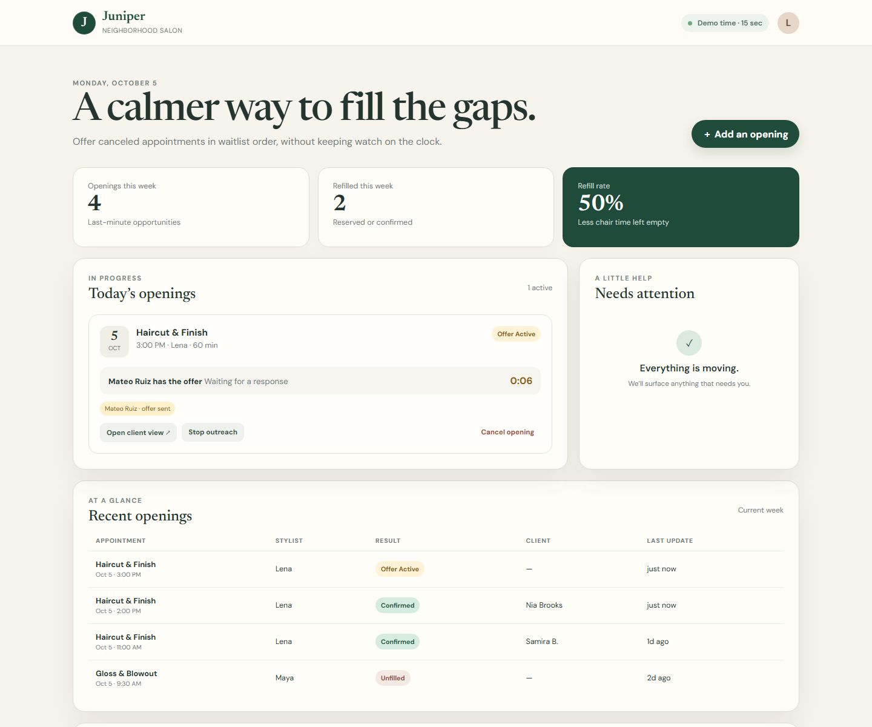
PROTOTYPE BEHAVIOR
From cancellation to a confirmed client
1
Add the opening
Staff enter the service, stylist, and appointment
time.
2
Offer it fairly
The earliest eligible client receives a private offer.
3
Keep it moving
A decline, timeout, or delivery failure automatically
advances the list.
4
Confirm one winner
The first acceptance reserves the chair and creates a
Square update task.
Working staff view from the prototype
JUNIPER SALON PROTOTYPE
CUSTOMER CONVERSATION + WORKING DEMO 2/4

Slide 3
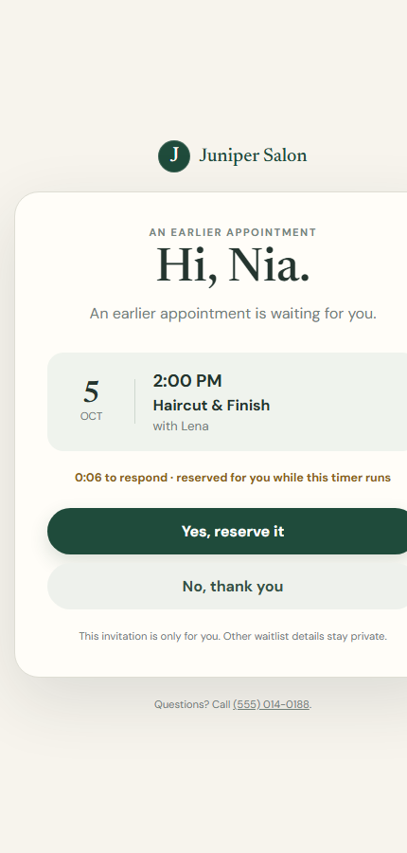
CLIENT EXPERIENCE + SCOPE
Simple for clients, honest about the demo
WORKING NOW
A private, phone-friendly accept or decline page.
A single winner when replies compete.
Staff visibility into every outcome.
SIMULATED OR EXCLUDED
Message delivery is simulated, and the 15-minute policy is compressed to 15 seconds.
No live SMS, Square changes, Google Sheets sync, or production sign-in.
JUNIPER SALON PROTOTYPE
CUSTOMER CONVERSATION + WORKING DEMO 3/4

Slide 4
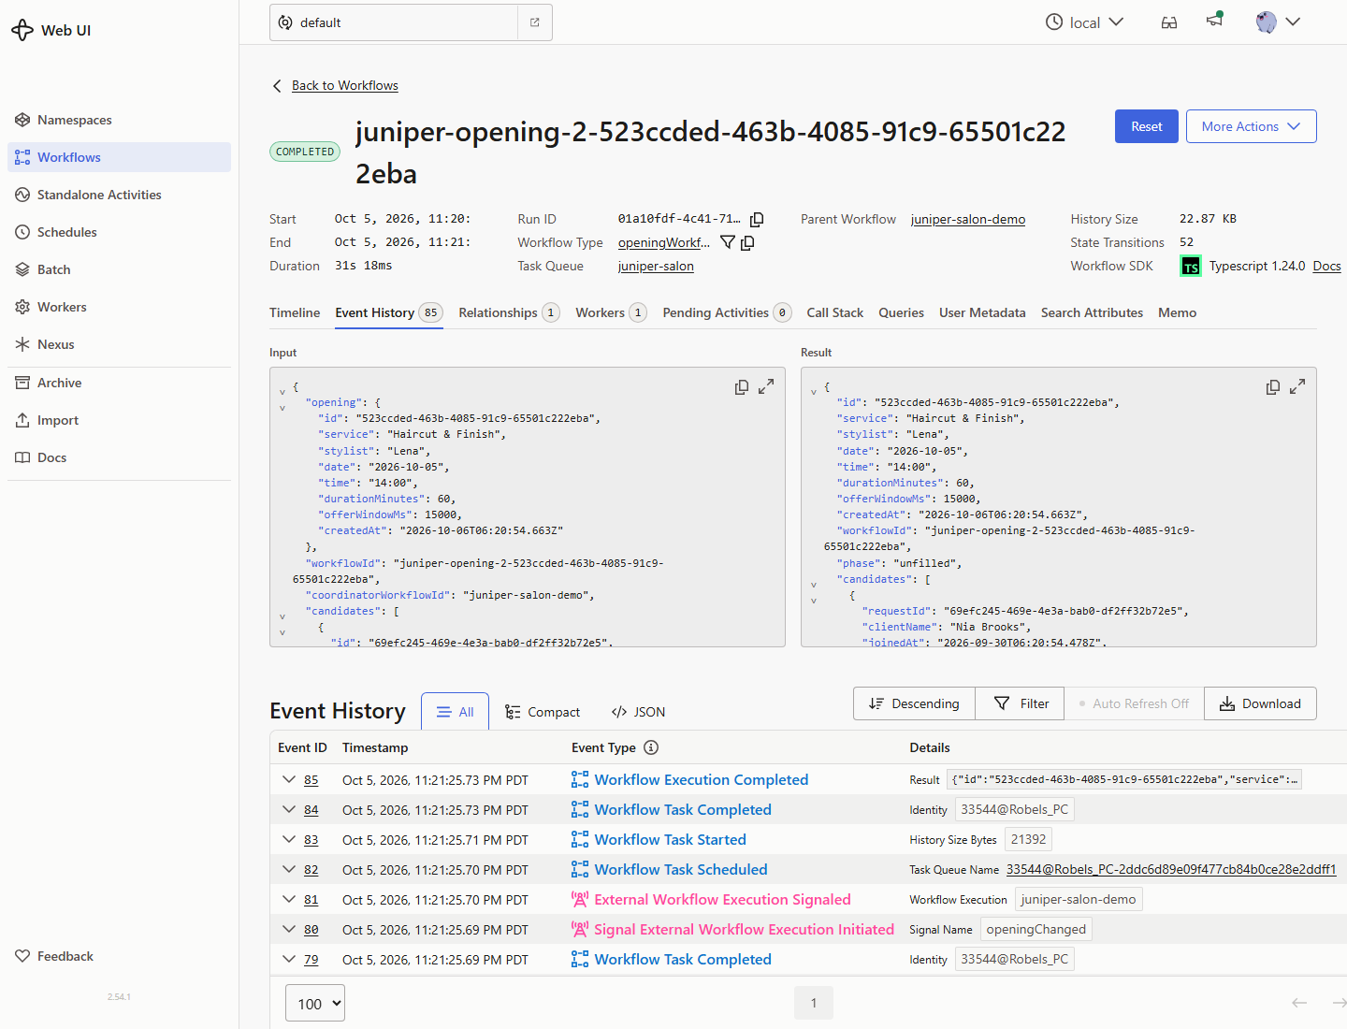
PRACTICAL NEXT STEP
Run one afternoon in shadow mode
Prove the handoff with real staff and real
openings before connecting live systems.
01
Add a small opt-in waitlist.
02
Let the prototype handle offers while Square remains the
source of truth.
03
Review whether staff stopped watching timers and clients
understood the offer.
04
If the pilot works, connect real SMS first; add Square after
the handoff is proven.
Every offer, timeout, and response stays visible
in the workflow history.
JUNIPER SALON PROTOTYPE
CUSTOMER CONVERSATION + WORKING DEMO 4/4

