Slide 1
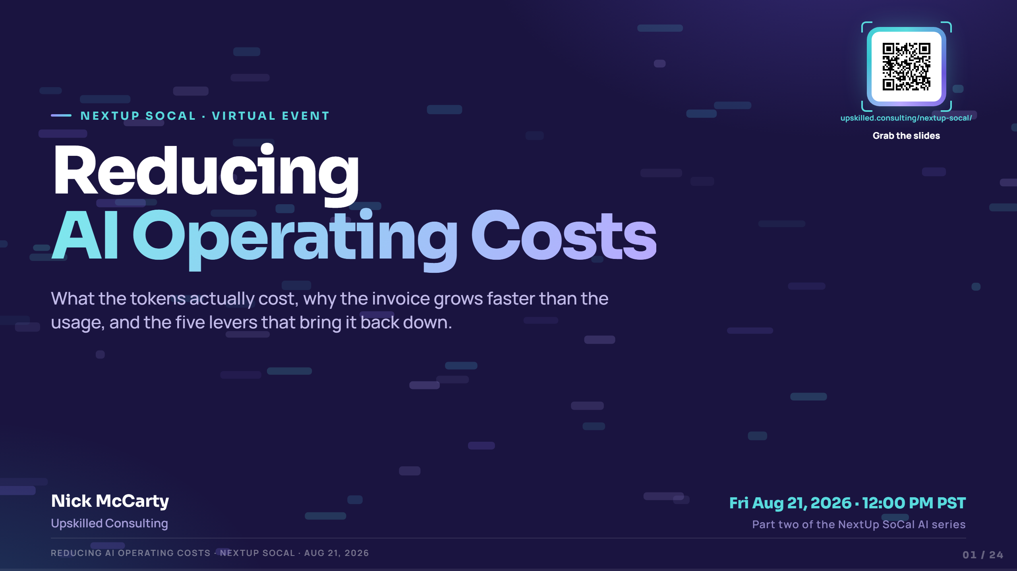
Notes:
"Ashika mapped the AI Maturity Ladder in June. Today's about what it actually costs to stand on each rung."
Not an anti-AI talk — it assumes you're already adopting. The goal is pricing fluency, not a pitch for or against agents.
Room read: NextUp SoCal, mostly execs with or near budget authority. They don't need permission to use AI — they need numbers they can defend in a budget meeting. Talk to peers, not students.
Logistics: 60 minutes, Q&A at the end. Slides, the checklist, and contact info are all behind the QR right now — point at it once: "scan it, follow along, no need to wait for the end."
S opens this window, F is fullscreen, ? lists every shortcut.

Slide 2
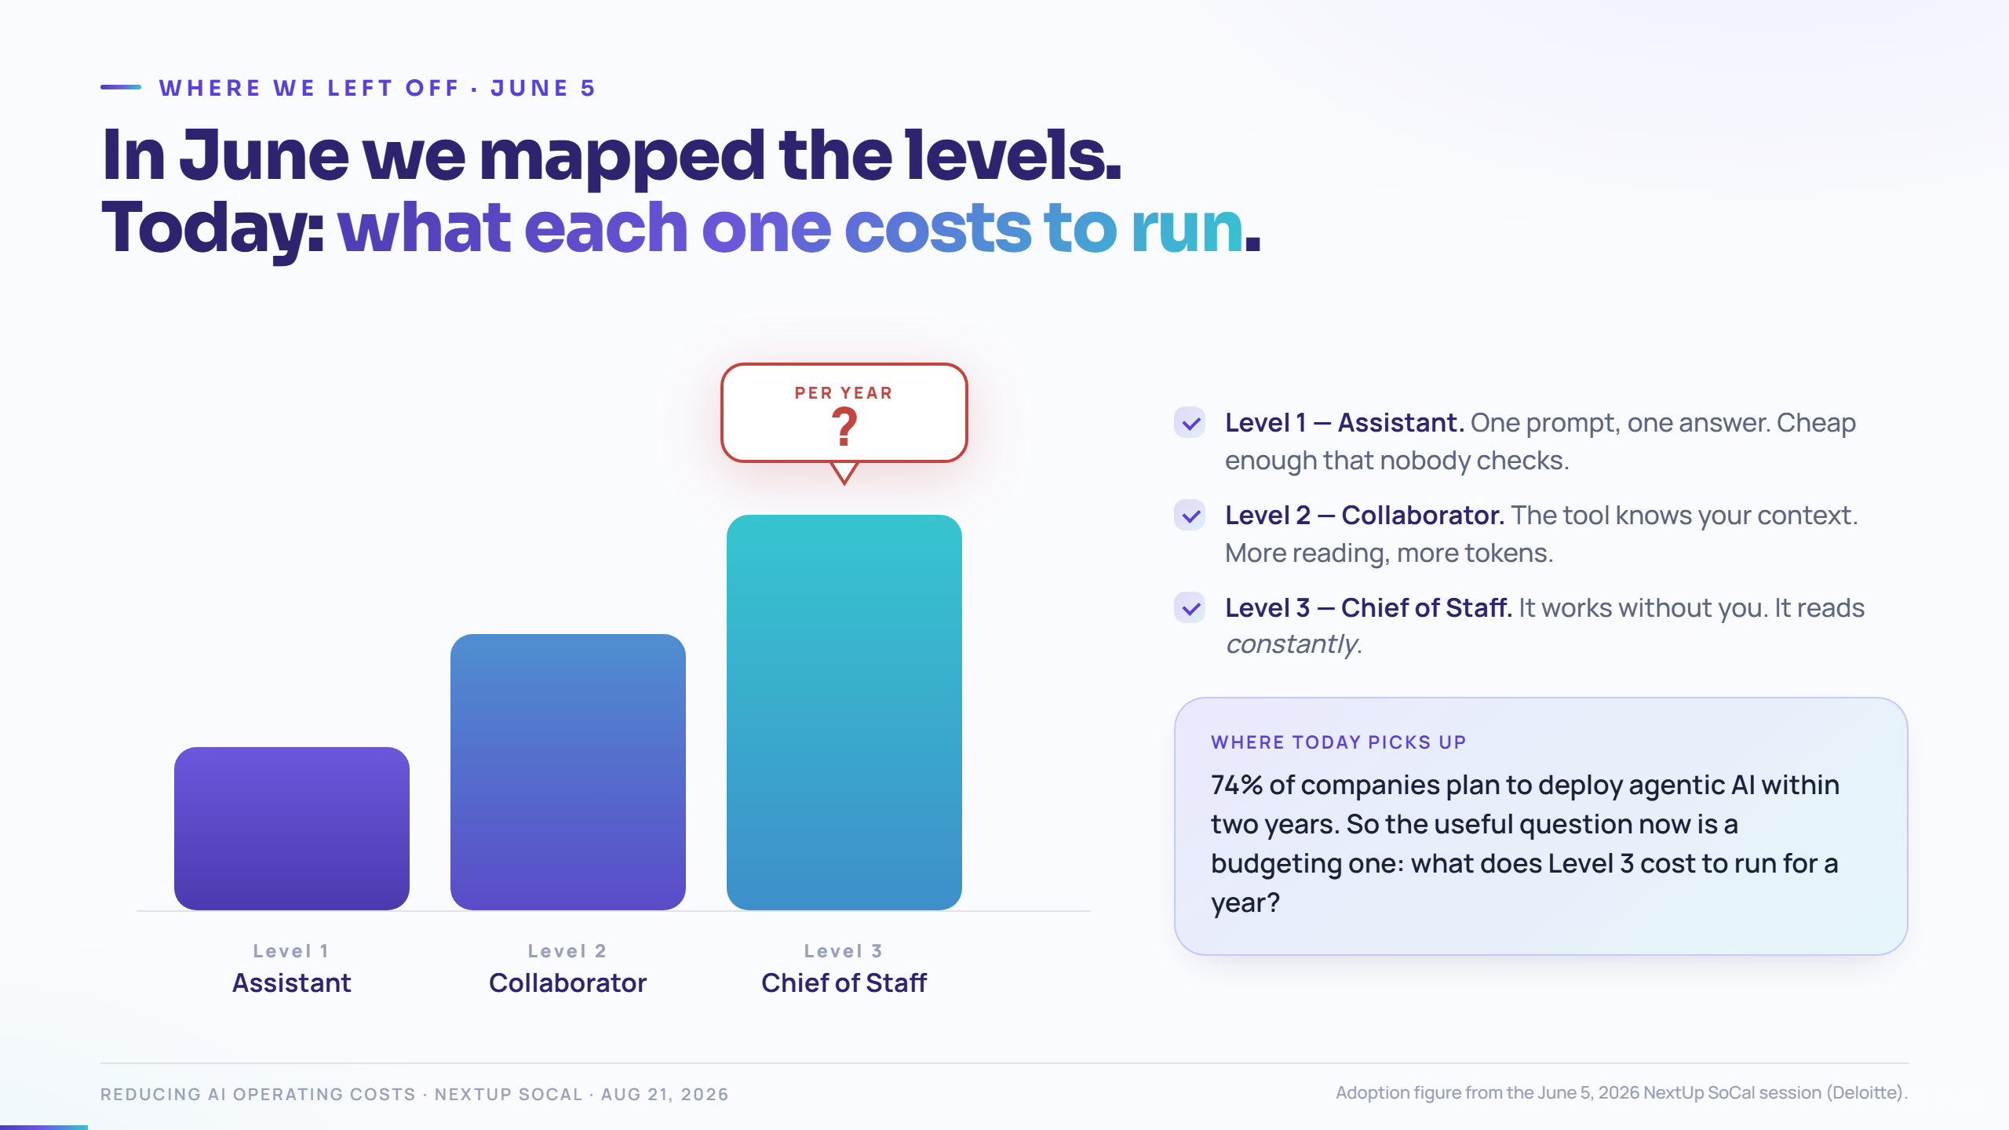
Notes:
Callback slide. Get nods here — most of the room was on the June 5 call.
Beat 1–3: walk the three levels quickly. Say: "each level up, the tool reads more on your behalf. That's the whole cost story in one sentence."
Beat 4: land the question on the card — "what does Level 3 cost to run for a year?" Do not answer it yet. Say: "Hold that question. We'll have a number for it in about twenty minutes."
If asked "is agentic worth it?" — say: yes, often. That's exactly why the cost needs to be deliberate instead of accidental.

Slide 3
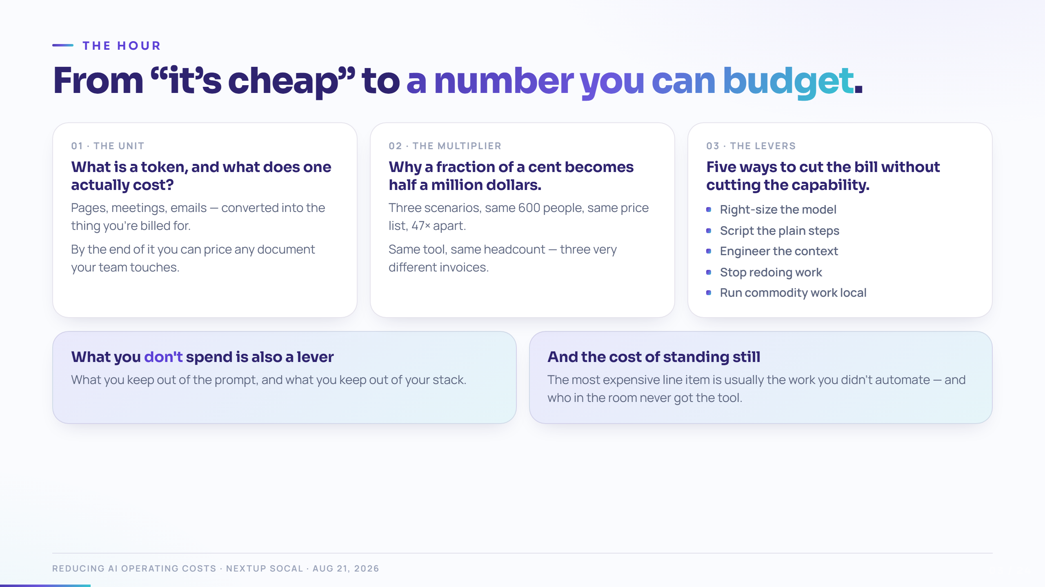
Notes:
Move fast — 60 seconds. This is a map, not content.
Set the promise explicitly: "By the end of the hour you'll have the intuition to price your own team's AI usage — the scenario math, the levers that move it, and proof that the most expensive line item is usually the work nobody automated at all."

Slide 4
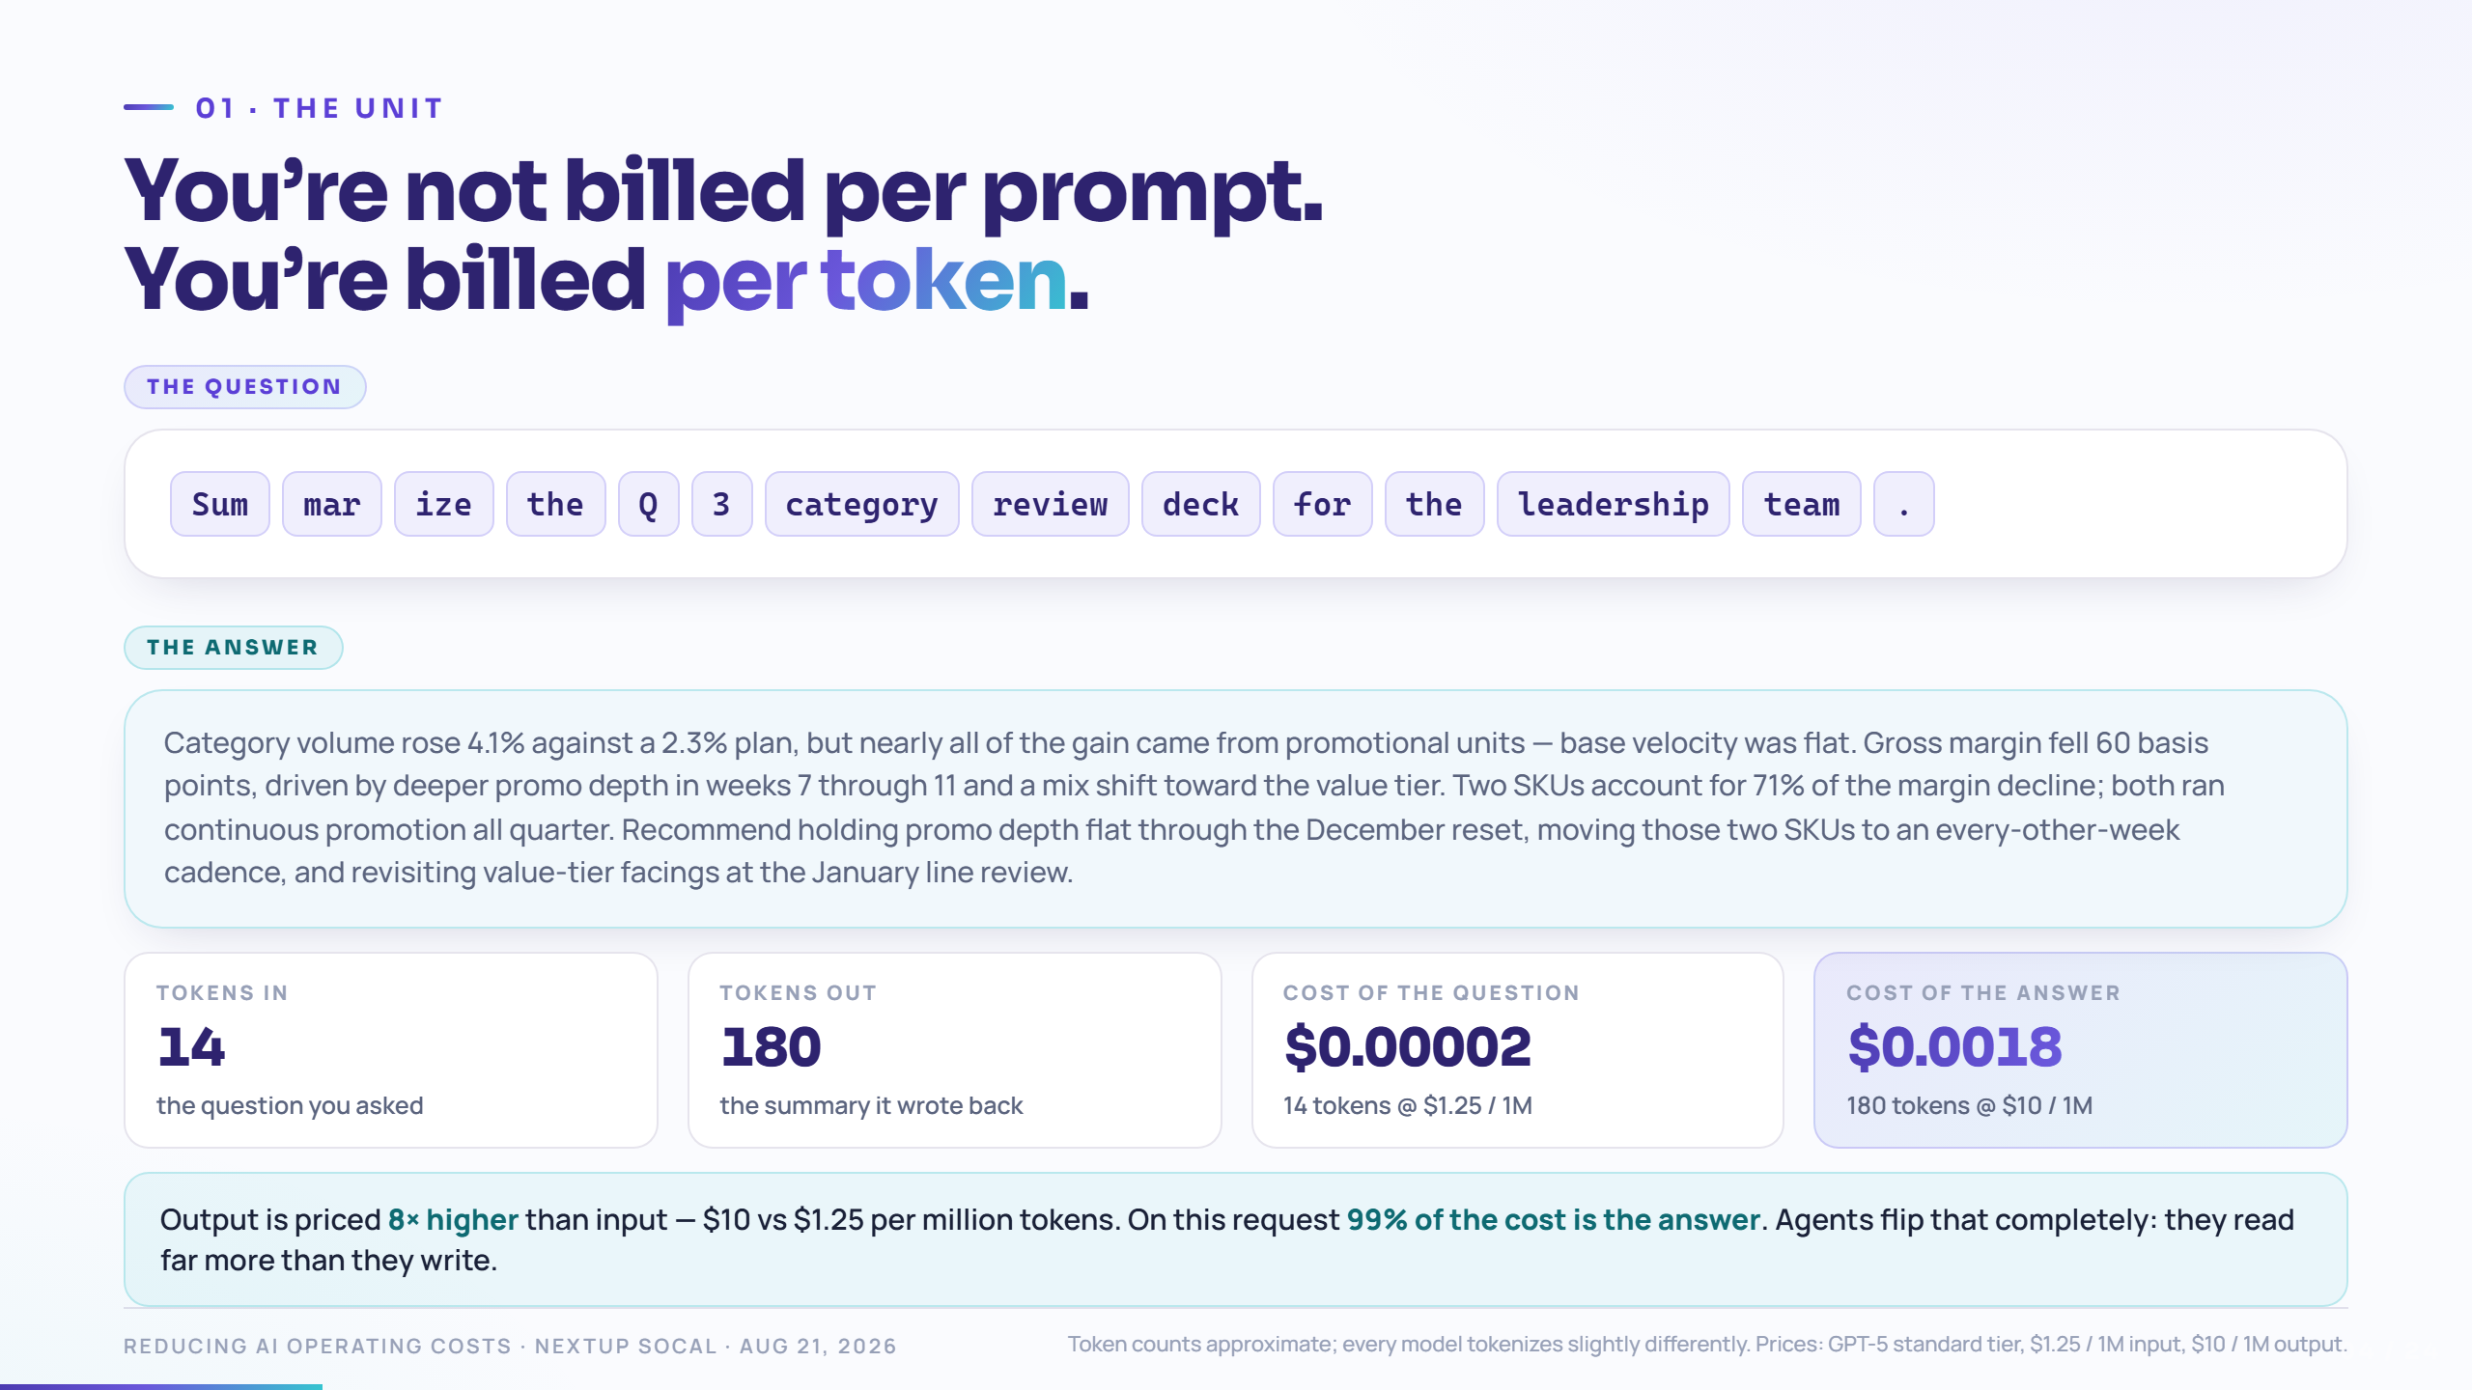
Notes:
Beat 0: read the sentence out loud as a human would.
Beat 1: "The model doesn't see a sentence. It sees these." Let the chips land. Point out that common words are one token, unusual ones split.
Beat 2: the price. "That whole request cost two thousandths of a cent. Nobody ever cut a budget over this."
Beat 3: the asymmetry — output is 8× the price of input. Remember that; it flips completely when we get to agents, which read far more than they write.
Rule of thumb to give them: 1,000 tokens ≈ 750 words ≈ 4,000 characters.

Slide 5
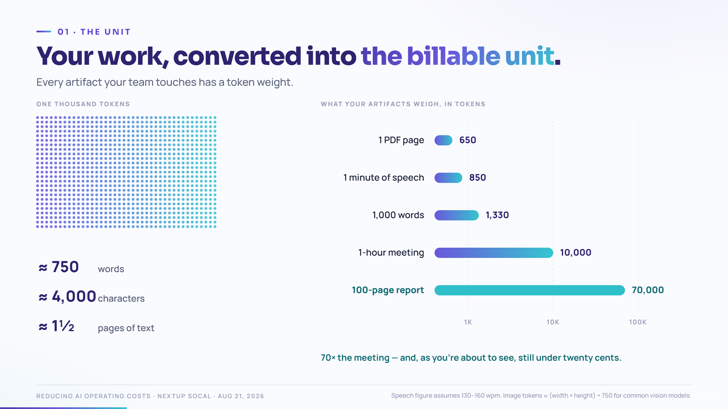
Notes:
Beat 1: the 1,000-token block. 750 words, 4,000 characters. "That's about one and a half pages, or a long email."
Beat 2: the artifact ladder appears — note it's a log scale, each gridline is 10×.
Beat 3: the meeting. "An hour of six people talking is ten thousand tokens. That's it. A meeting is a cheap document."
Beat 4: the 100-page report at 70,000 — "seventy times the meeting, and still, as you'll see, sixteen cents."
Aside if you have time: images are priced by area, not by content — a screenshot you didn't need to attach is real money at volume.

Slide 6
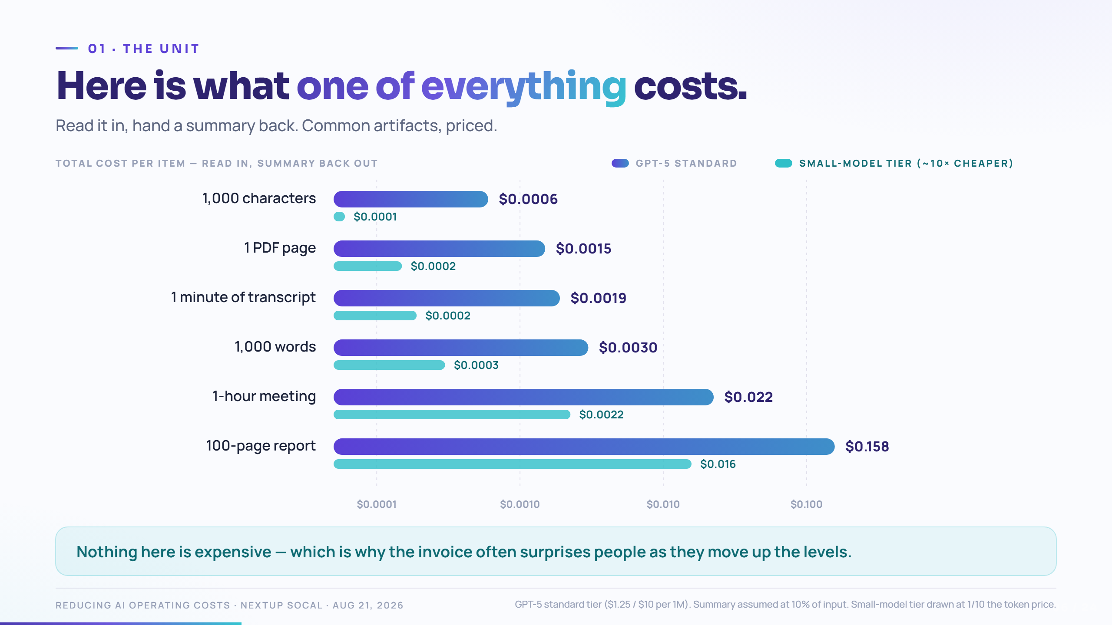
Notes:
Beat 1: bars grow. Log scale again — call it out explicitly before moving on.
Beat 2: the small-model overlay. "Same job, a tenth of the price. Hold that thought — it's lever number one."
Beat 3: the punchline. "Nothing on this chart is expensive. This is the slide that makes everyone relax — and that's exactly the trap. At Level 3, the tool doesn't do one of these a day. It does hundreds, and the invoice is the sum of all of them."
Anchor to give them: a 100-page report costs about sixteen cents — less than a quarter.

Slide 7
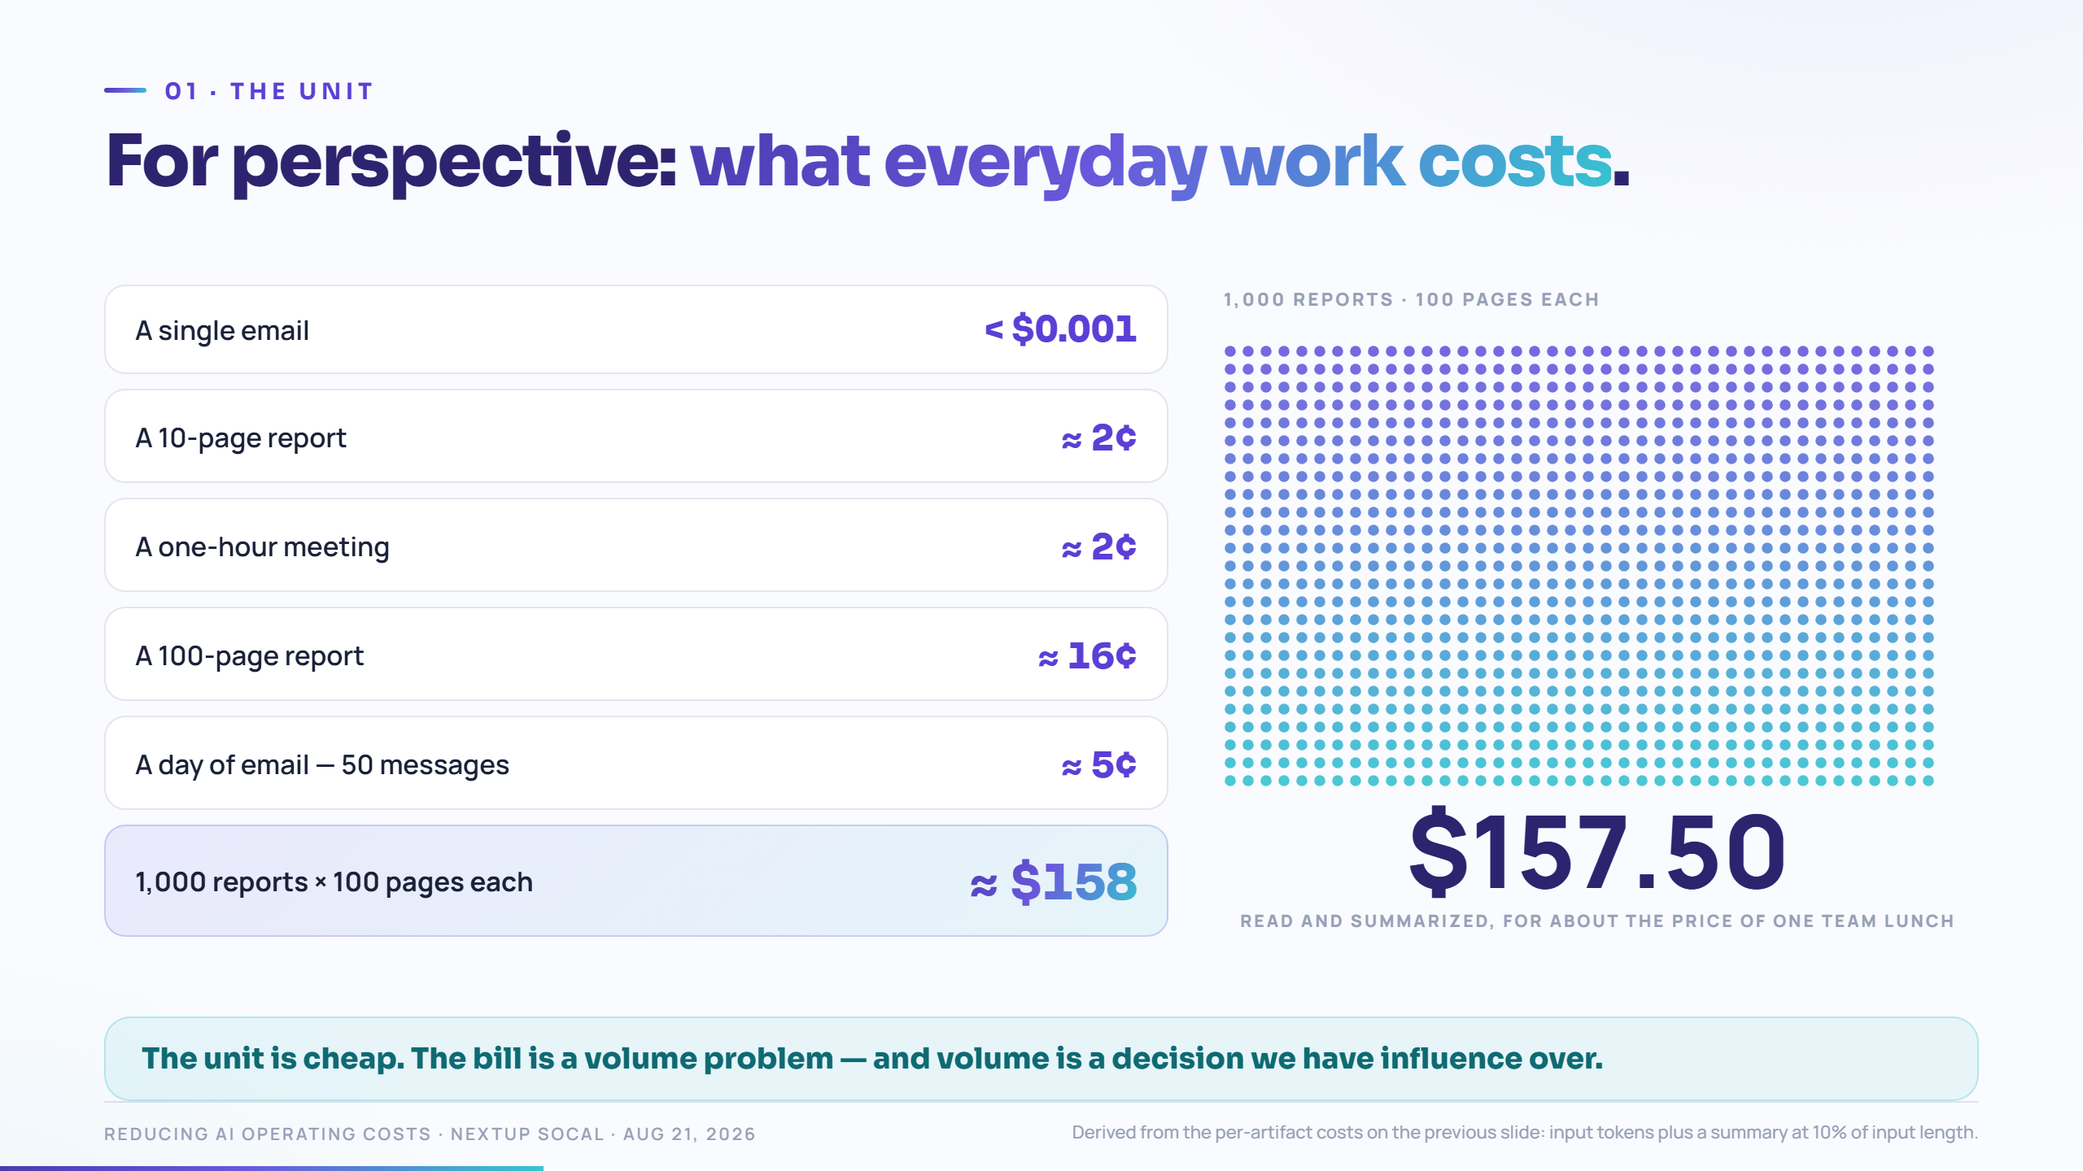
Notes:
These six numbers are the most quotable thing in the deck. Slow down.
Beat 1–2: read the small ones. "An email is free. A meeting is two cents."
Beat 3: the thousand-document dot grid fills. Let it run — the animation is the point.
Beat 4: "A thousand hundred-page reports — a hundred thousand pages — is a hundred and sixty dollars."
Then set the trap for the next act: "So if the unit is this cheap, how does anyone spend real money on this?"

Slide 8
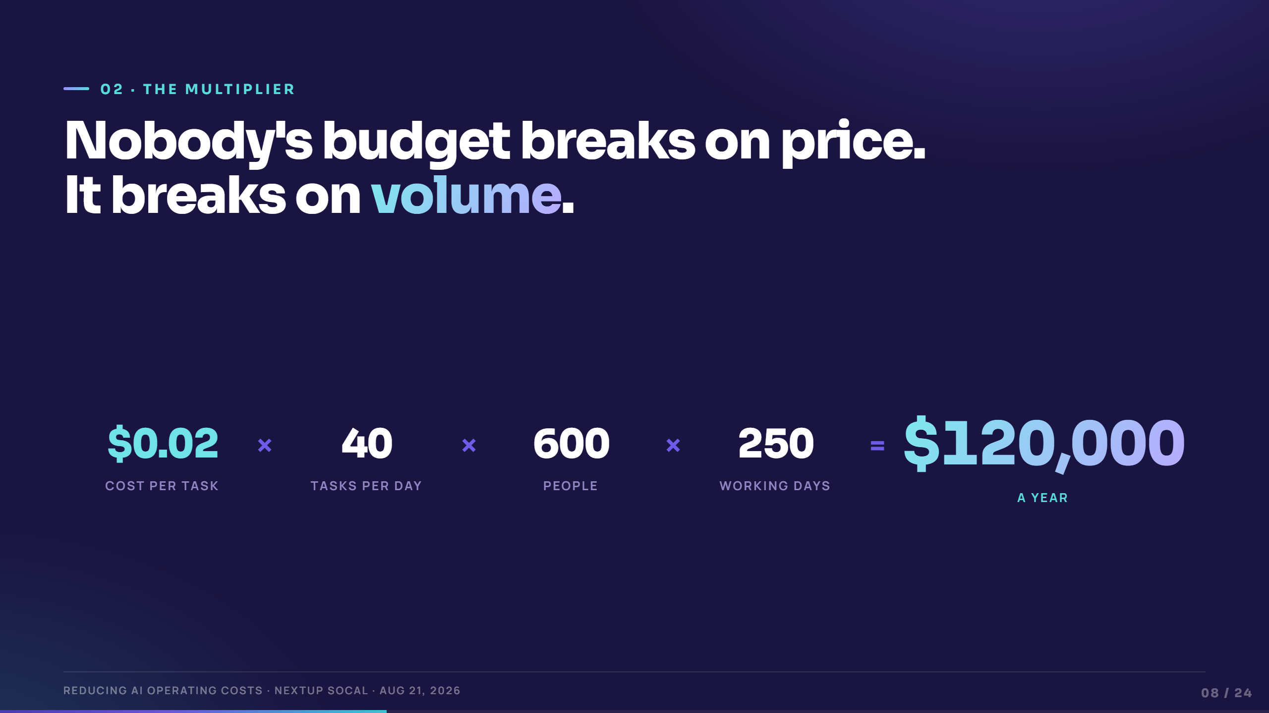
Notes:
Transition slide. This is the hinge of the whole talk — take the pause.
Beat 1–4: assemble the equation one term at a time. "Cost per task — we just did that, it's tiny. Tasks per day. People. Working days."
"Everyone in your organization is looking at the first term. The invoice is made of the other three."
Set up the next three slides: "Same company — 600 people, 250 working days — three different ways of using the same tool."

Slide 9
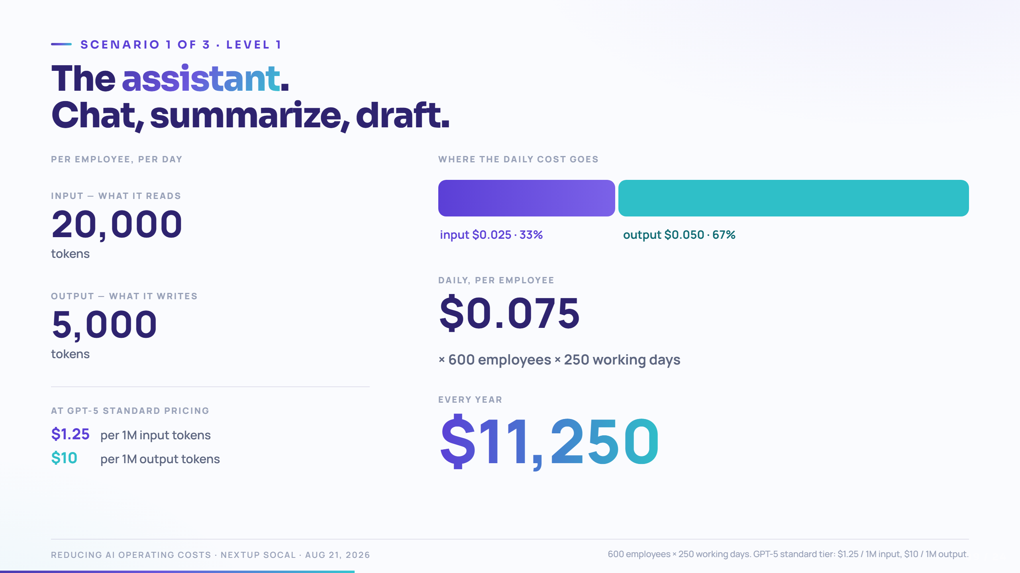
Notes:
This is the shape they'll see three times. Teach them to read it here, then it's fast.
Beat 1: 20,000 input tokens a day. "Fifteen thousand words read."
Beat 2: 5,000 output. Note output is the smaller number but nearly two-thirds of the cost — the 8× asymmetry showing up.
Beat 3: seven and a half cents a day, per person.
Beat 4: $11,250 a year for 600 people. "Eighteen dollars and seventy-five cents per employee per year. Cheaper than the coffee. This is the number people quote when they say AI is cheap."

Slide 10
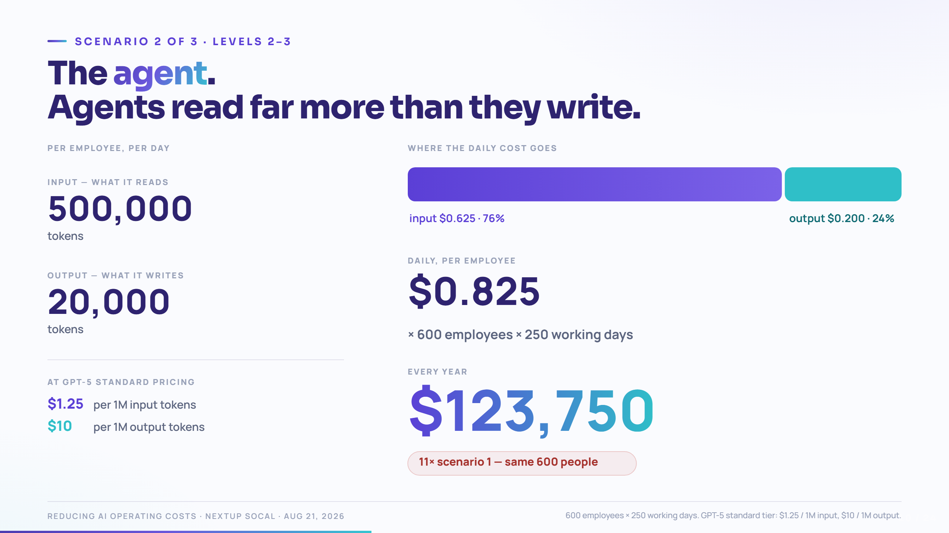
Notes:
Beat 1: 500,000 input tokens a day — 25× the assistant. "That's not a bigger document. That's the same documents, read over and over, every turn of the loop." (Flag: we come back to exactly this on the context slide.)
Beat 2: output barely moves — 20,000. The agent isn't writing more; it's reading more.
Beat 3: the cost flips. Input is now the majority of the bill. Everything people learned about "output is expensive" stops applying.
Beat 4–5: $123,750/year. Eleven times scenario one, for the same headcount.
"Nothing about the price list changed. The tool just started reading on your behalf."

Slide 11
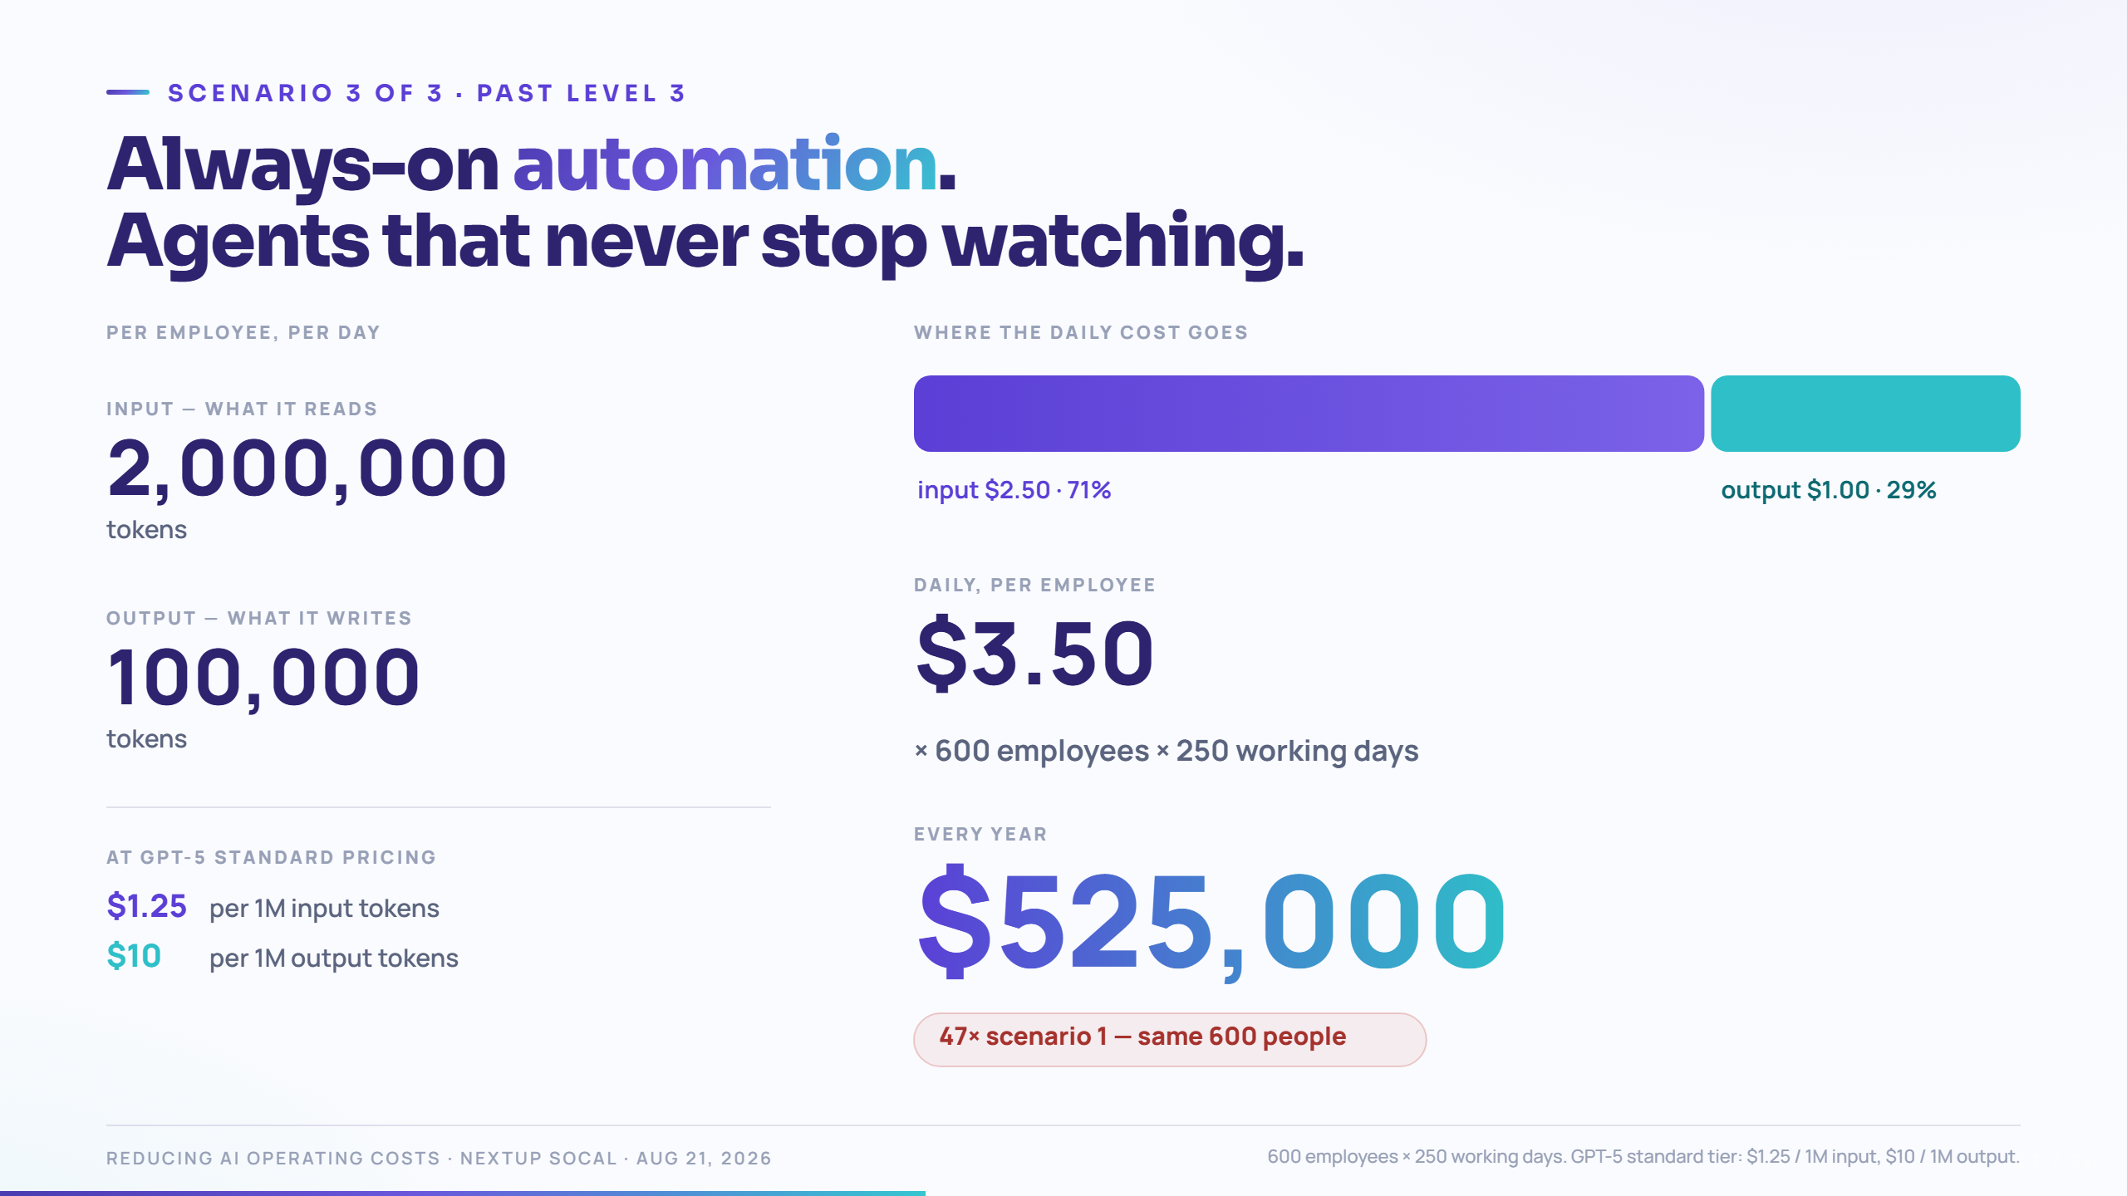
Notes:
Multiple autonomous agents, continuously monitoring — inboxes, tickets, inventory, pricing, compliance.
Beat 1: 2 million input tokens per employee per day. "A hundred times the assistant. And notice — nobody typed any of it."
Beat 4–5: $525,000/year.
"This is the number I want in your head when a vendor says 'and it runs continuously in the background.' That sentence has a price."
Important honesty beat: this can absolutely be worth it. A half-million in inference that replaces three million in labor is a good trade. The risk isn't the spend — it's not being able to explain it when someone asks.

Slide 12
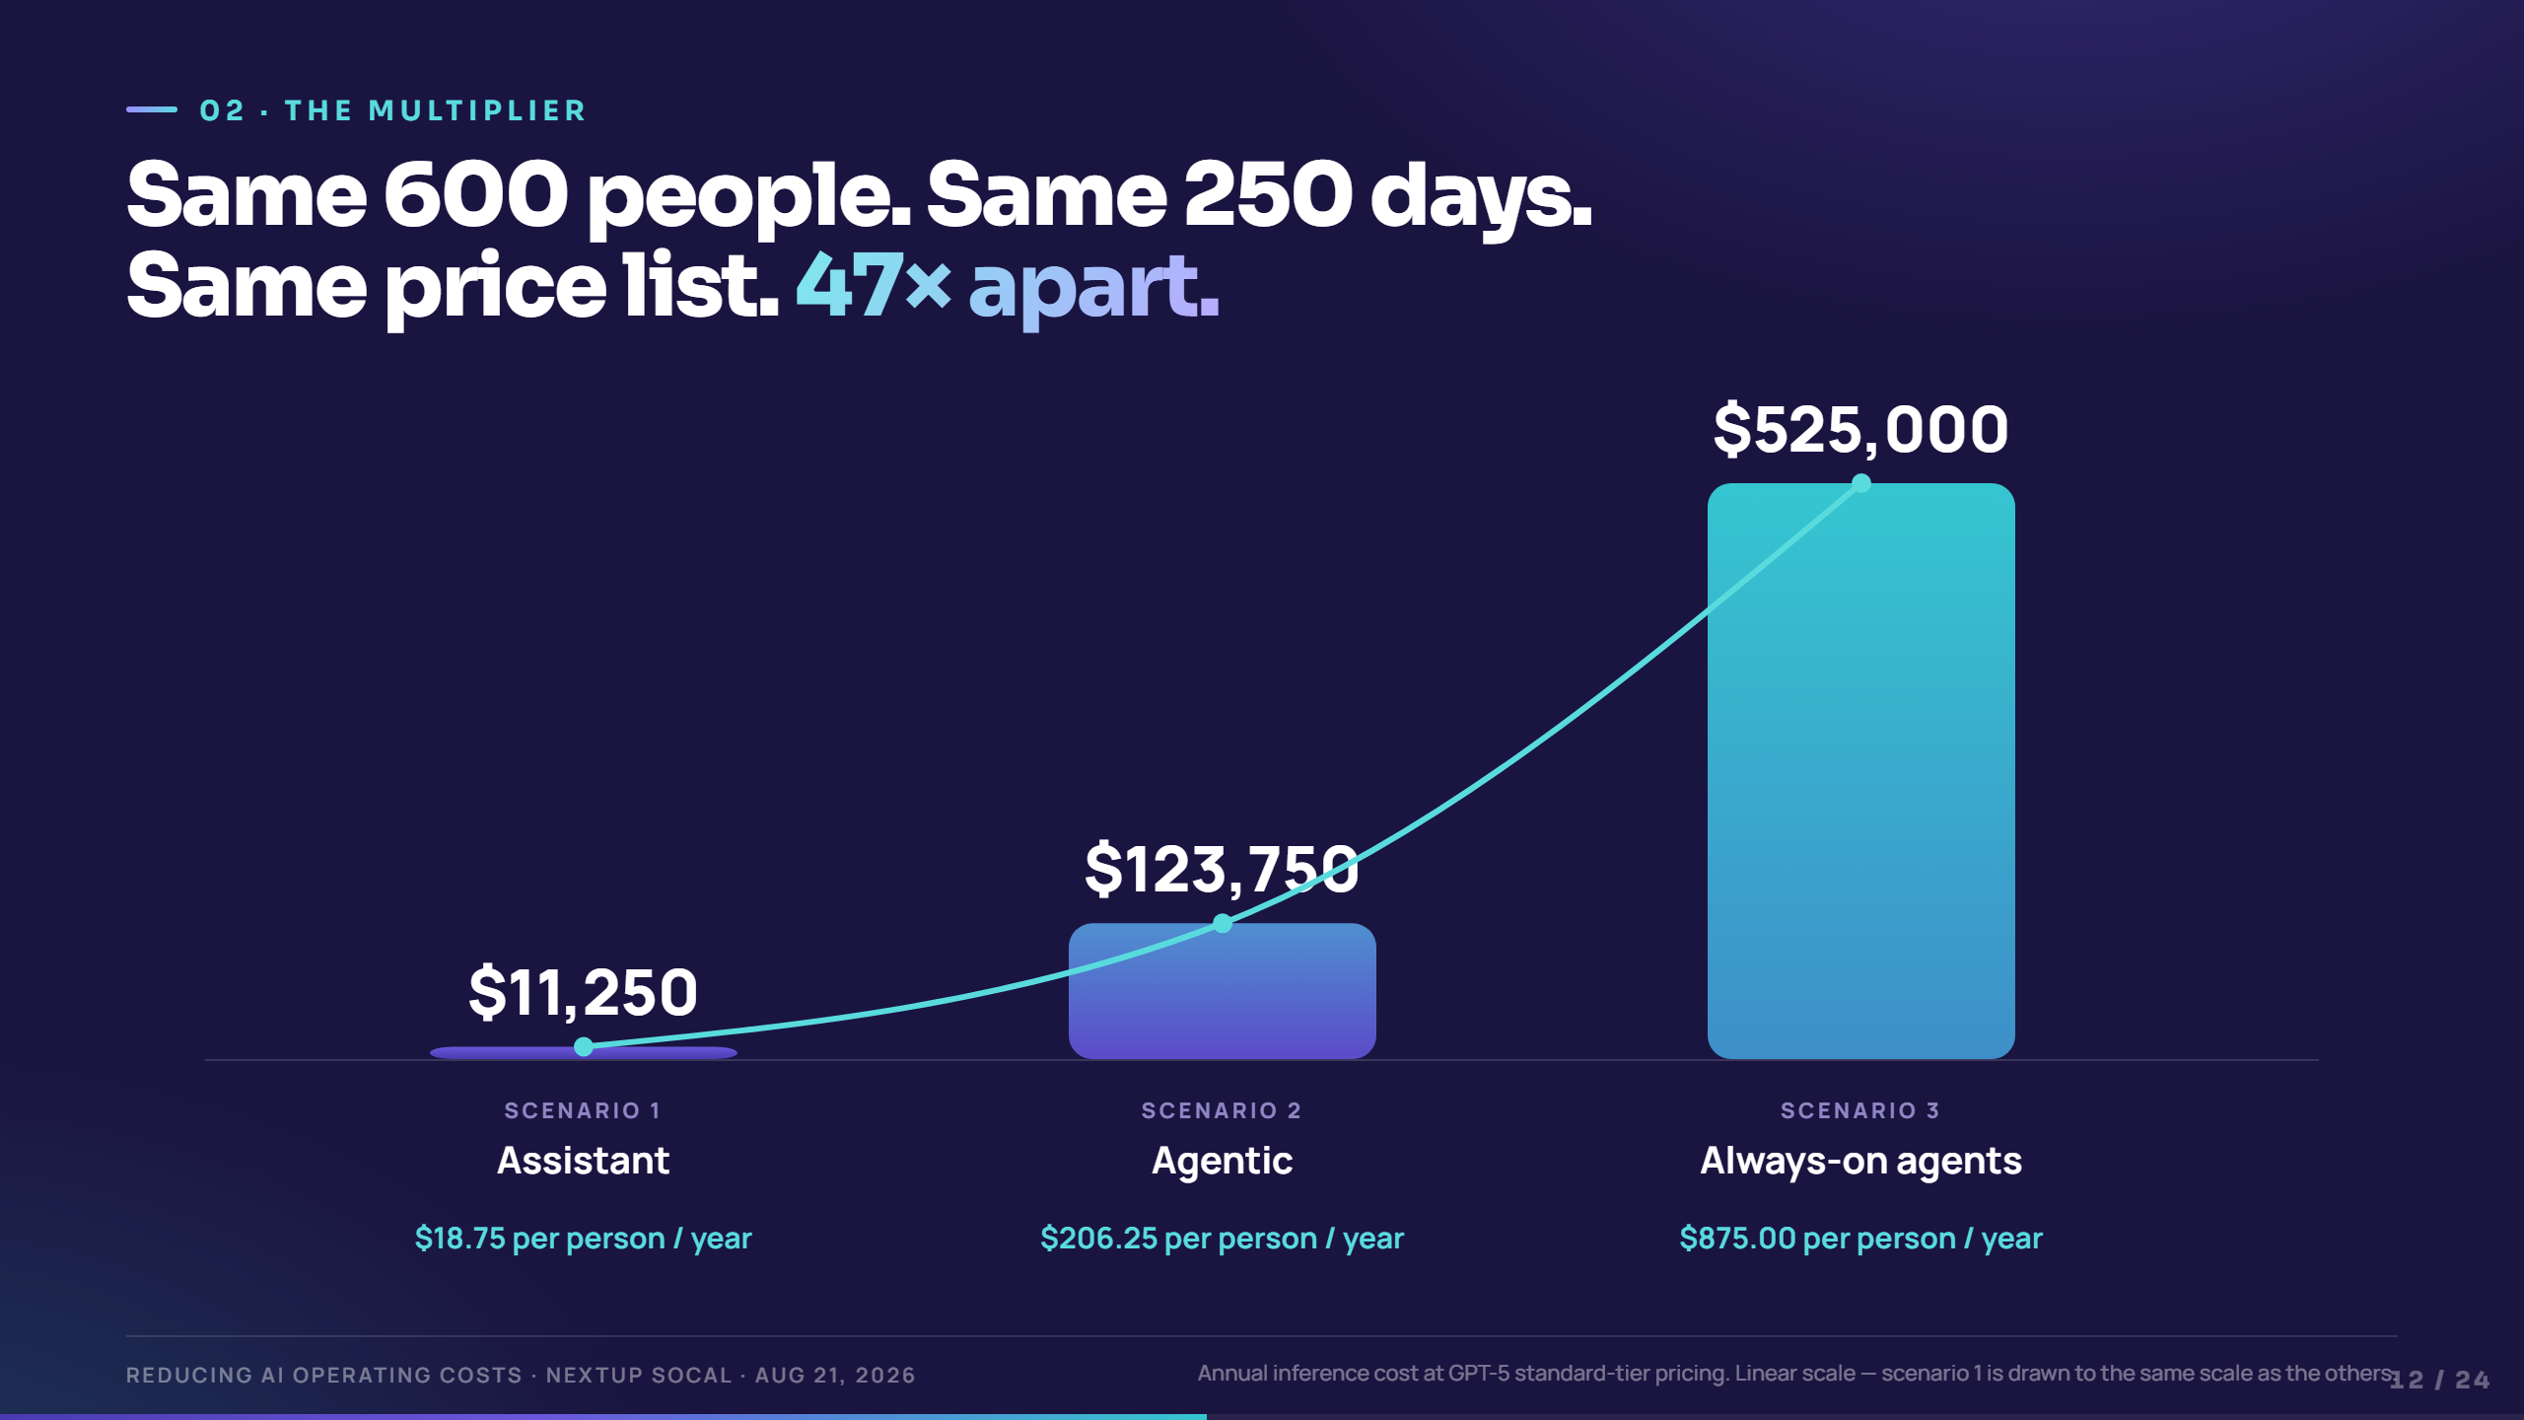
Notes:
The executive money slide. Say almost nothing while it builds.
Beat 1: scenario one — the sliver. Point at it. "That's eleven thousand dollars. To scale."
Beat 2–3: let two and three land.
Beat 4: per-employee readout: $18.75 → $206 → $875 per person per year.
"No one approved a 47× jump. Every step just looked like a smarter way to use the tool you already had."
Bridge to act three: "Now — the good news. Almost all of the difference is optional."

Slide 13
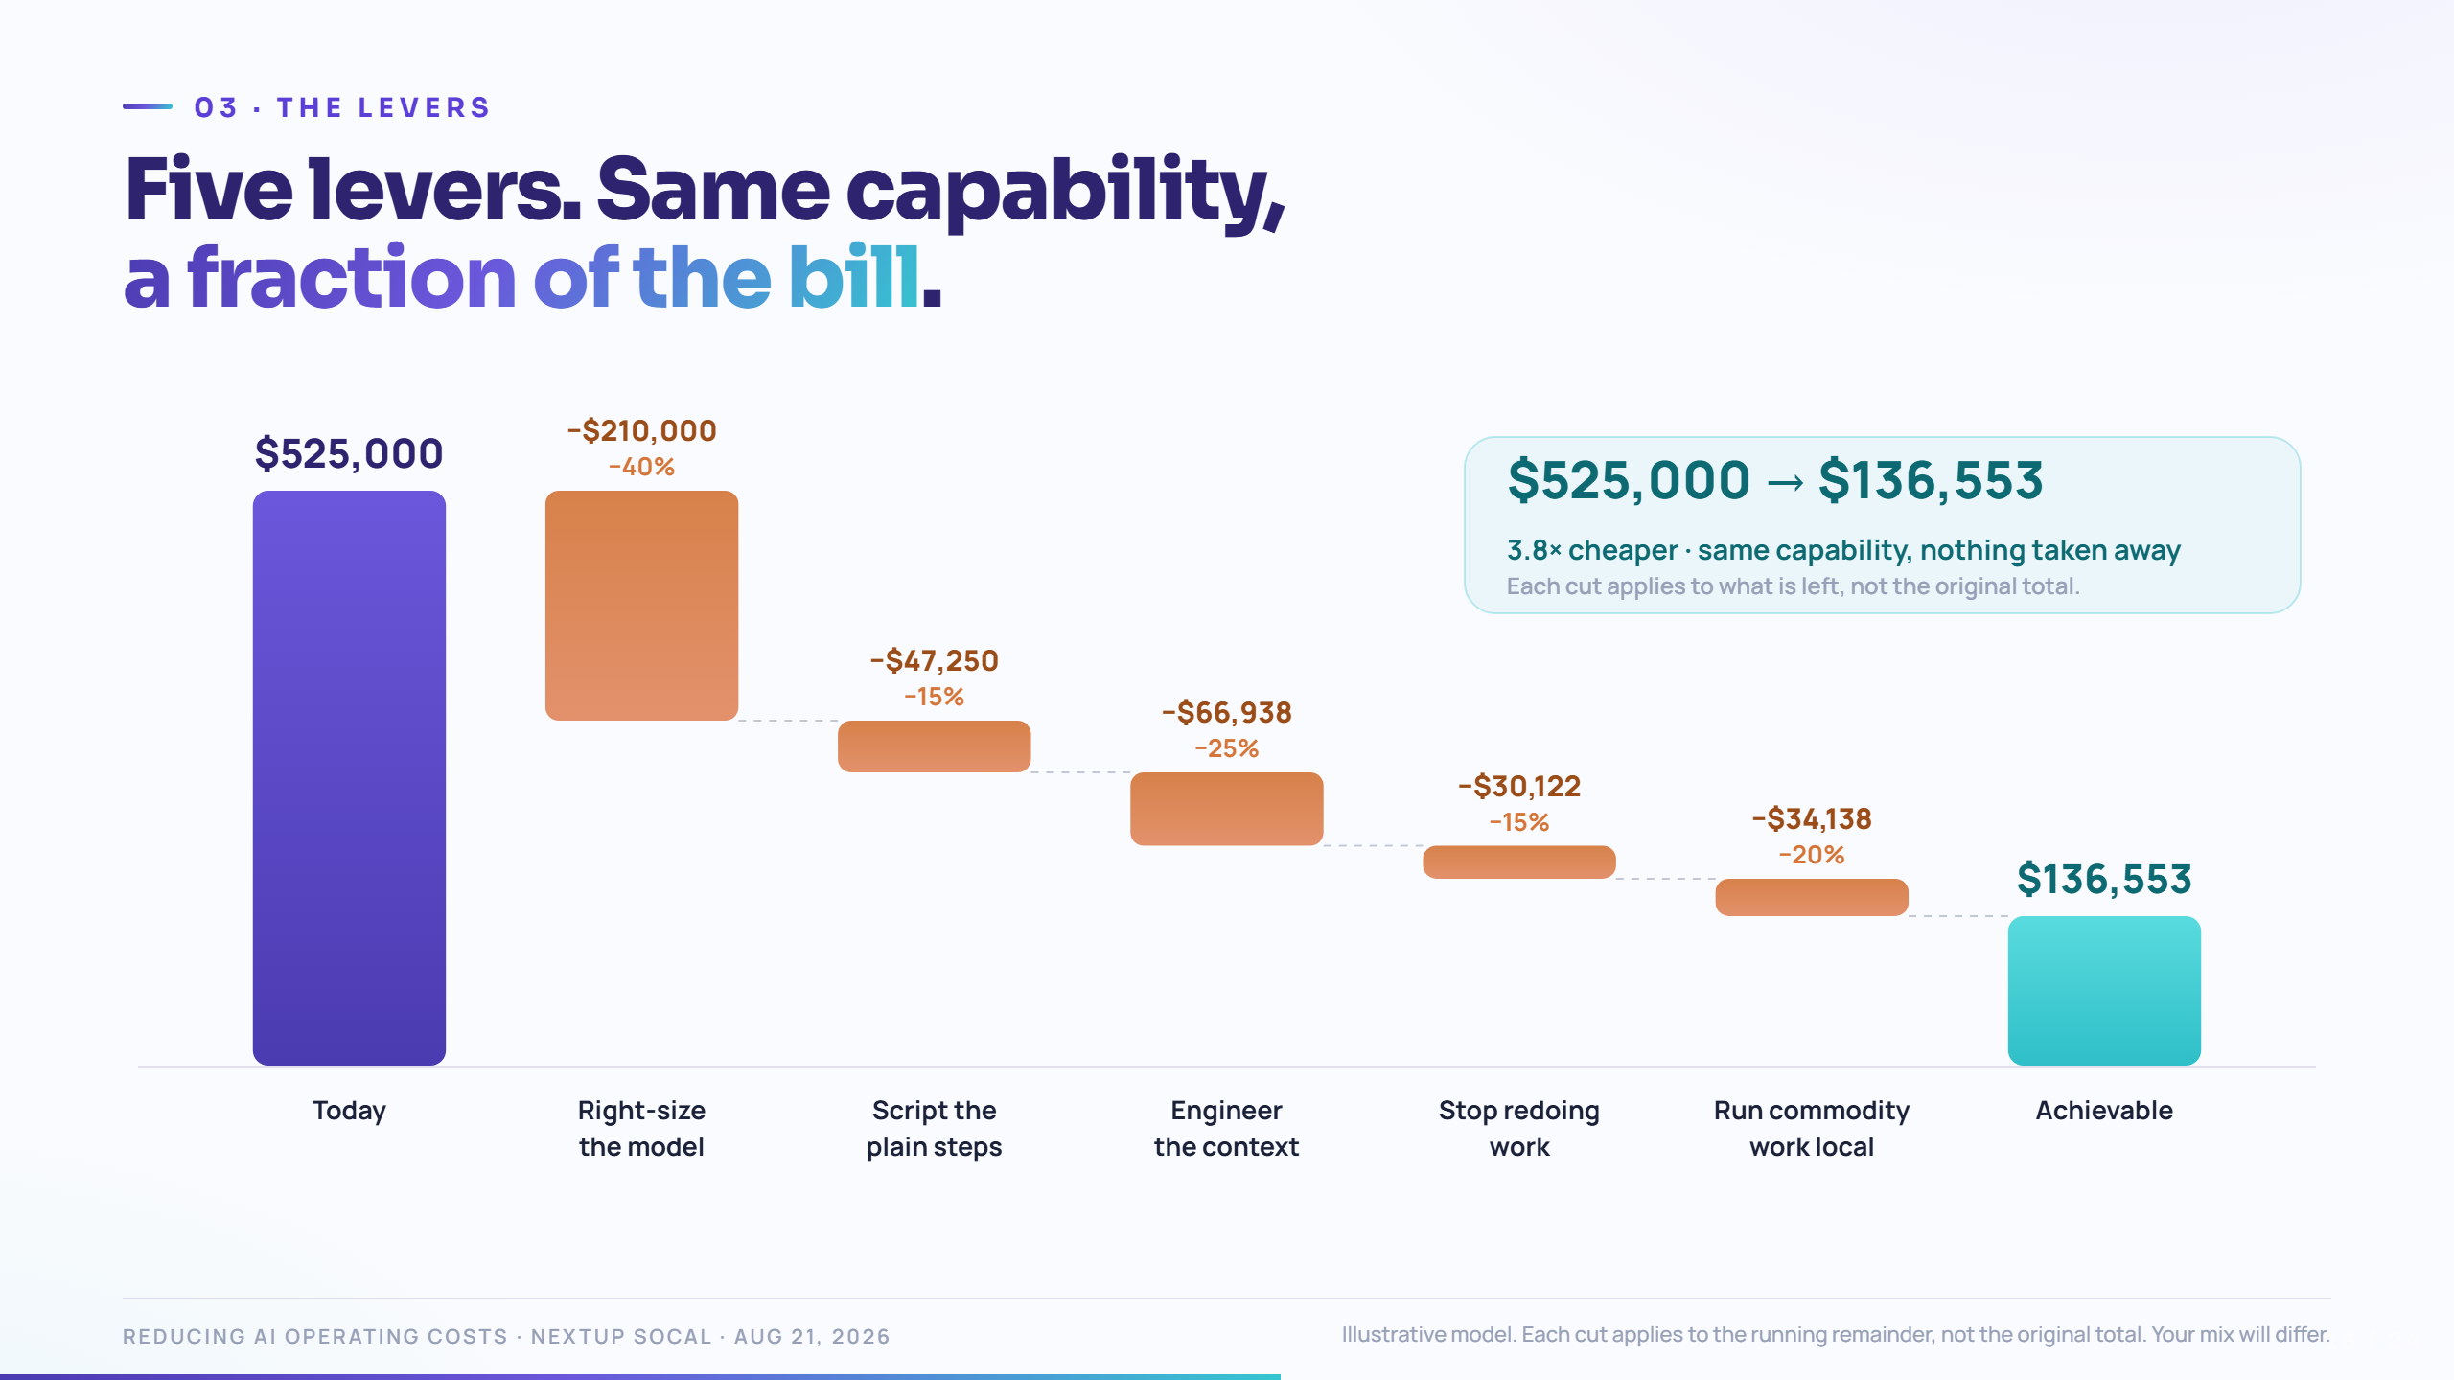
Notes:
Be explicit that this is a model, not a measurement. Say it before the first bar drops — it buys you credibility for the rest of the section.
Each lever gets its own slide next. Here, just name them and let the bar fall:
- Right-size the model — stop paying frontier prices for routine work.
- Script the deterministic steps — don't rent judgment you don't need.
- Engineer the context — stop re-reading the same page 250 times.
- Stop redoing work — save the artifact, not the conversation.
- Run commodity work locally — smaller models, your hardware, your data.
Final beat: $525K → roughly $137K. "Almost four times cheaper. Same capability, the whole way down."

Slide 14
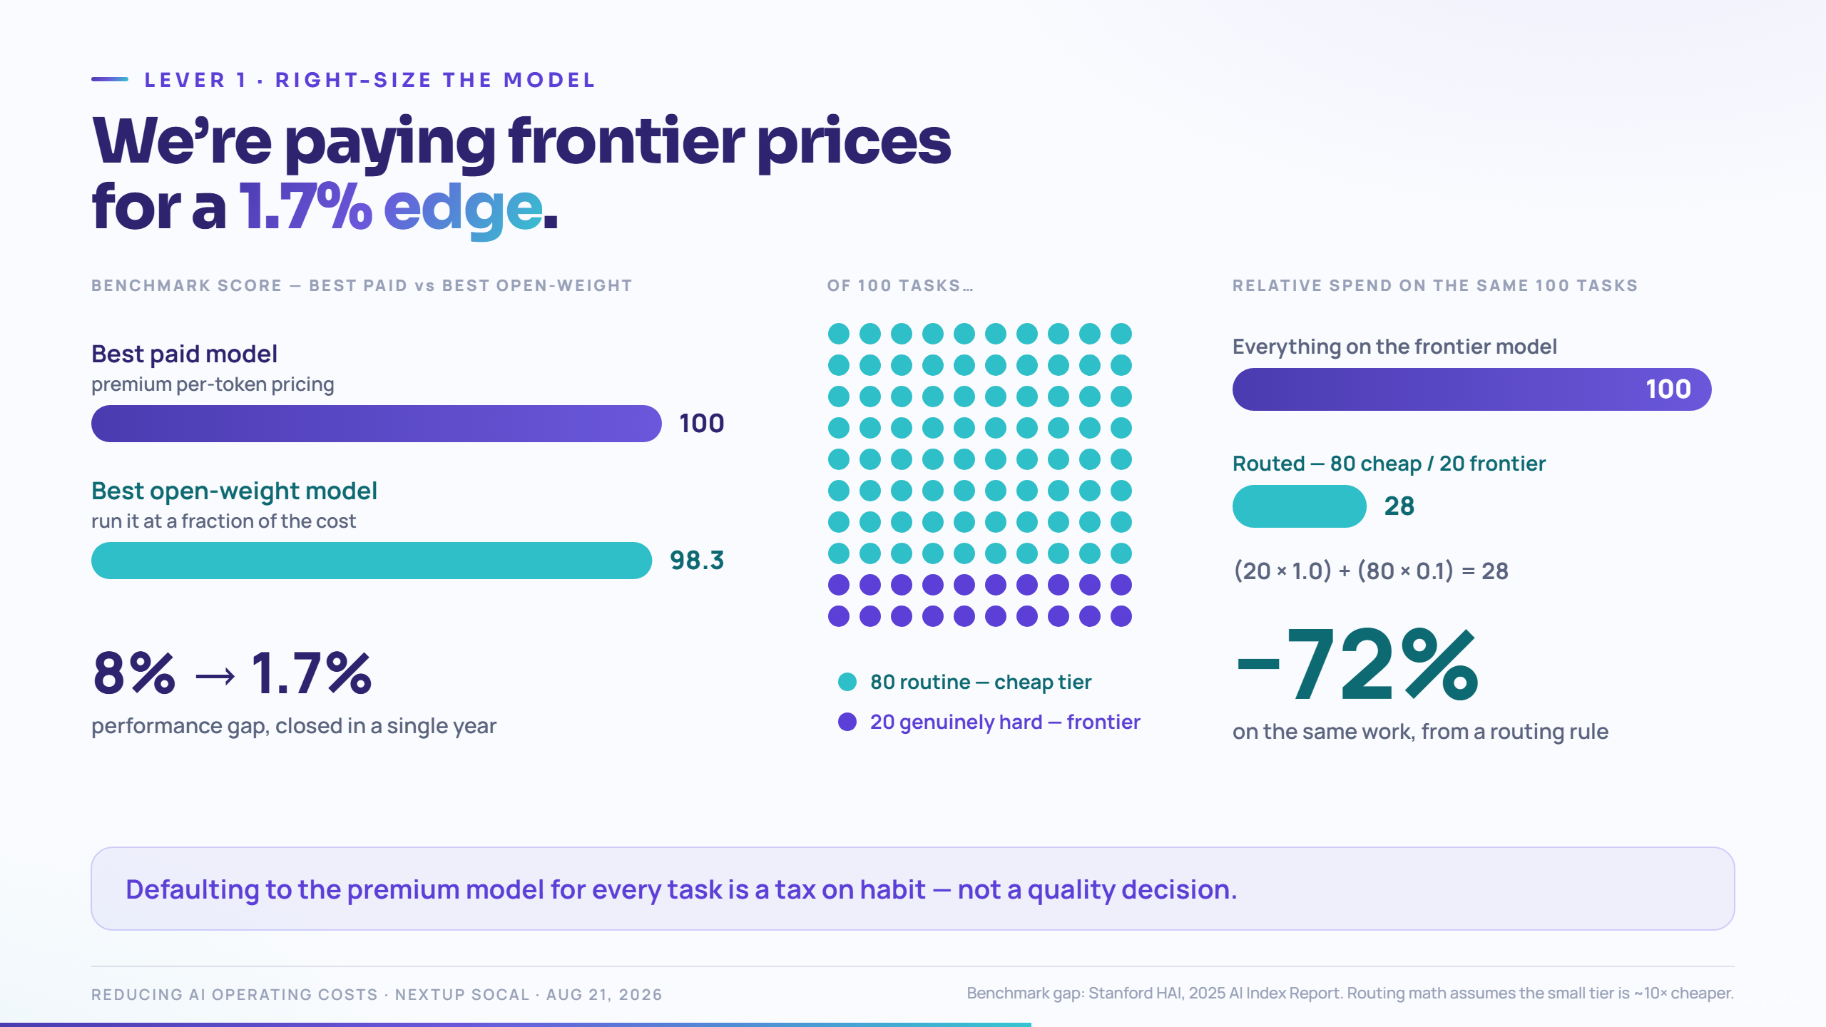
Notes:
Beat 1: the gap. Best open-weight models closed from 8% to 1.7% behind the best paid models in a single year.
Beat 2: the routing split. "Of all your business tasks, how many genuinely need the best model on earth? Be honest."
Beat 3: the arithmetic. Route 80% of tasks to a tier that's 10× cheaper → you pay 28% of what you paid. A 72% cut, on the first day, from a routing rule.
Beat 4: the real point — defaulting to the premium model for every task is a tax on habit, not a quality decision.
Objection to pre-empt: "won't quality drop?" Answer: on the 20% that matters, you still use the best model. That's what routing means. Measure it — pick real tasks, run both, compare.

Slide 15
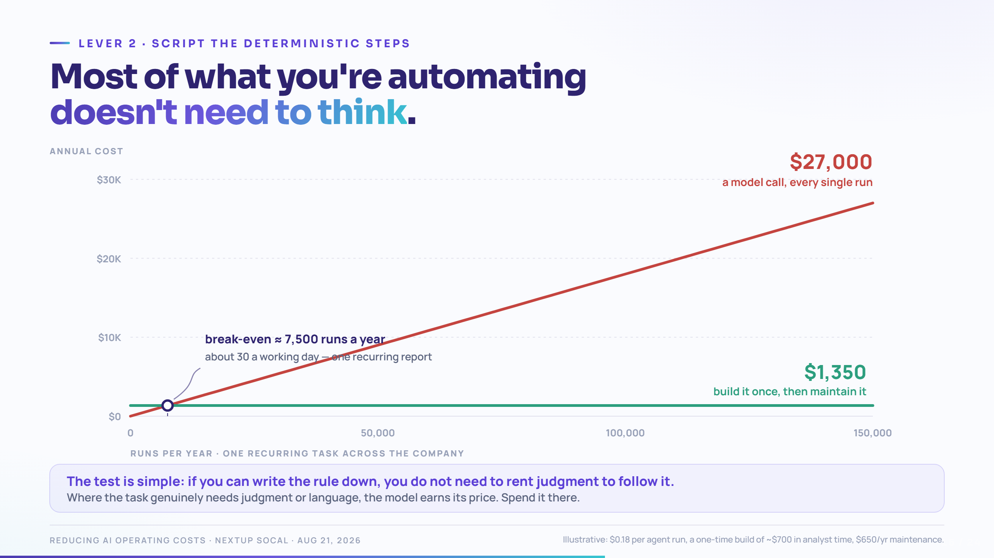
Notes:
This is the least popular lever and the most valuable one. Lead with the honesty: where the work needs judgment or language, the model wins and you should pay for it.
Beat 1–2: the two lines. A model call has no economy of scale — every run costs the same as the first. A script has almost nothing but economies of scale.
Beat 3: the crossover — around 7,500 runs a year. "That's thirty runs a working day. One recurring report, run over and over across the company — not thirty different jobs."
Beat 4: at 150,000 runs: $27,000 vs $1,350.
"If the task has the same shape every time — pull the file, reformat, check the threshold, send it — you are renting a Ph.D. to read a thermometer."
Practical test to give them: if you can write down the rule, you don't need a model to follow it.

Slide 16
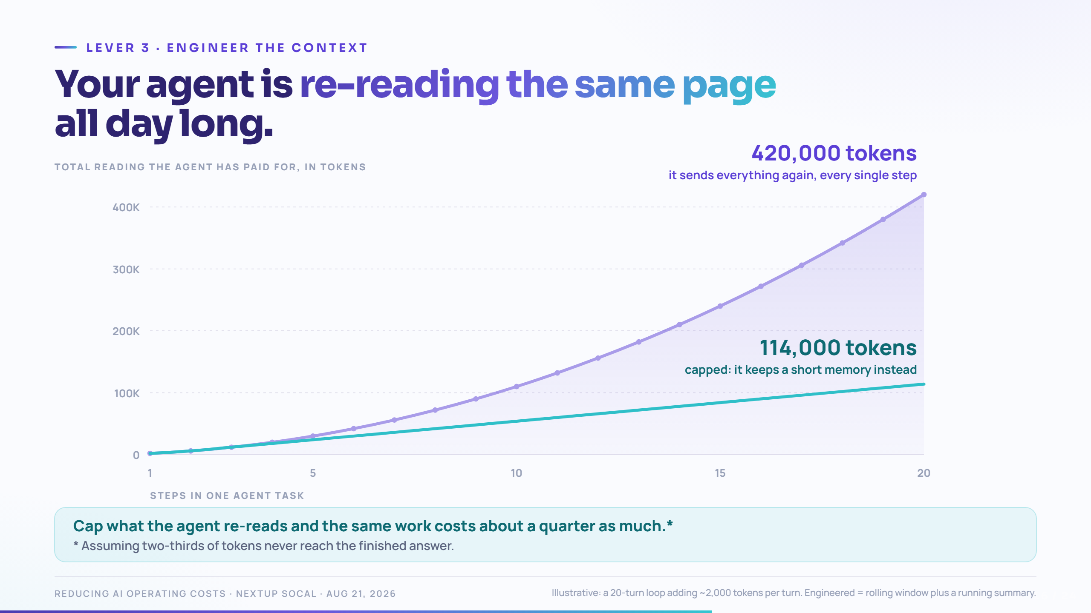
Notes:
The payoff for the flag you planted on scenario 2. This is the most technical slide — keep it to the shape, not the mechanism.
Beat 1: the naive loop. Turn 1 sends 2,000 tokens. Turn 2 re-sends turn 1 plus the new part. Turn 20 re-sends everything.
Beat 2: the curve. It's not linear — it's quadratic. Twenty turns of a small conversation is 420,000 tokens.
Beat 3: the engineered line — rolling window plus a summary. 114,000 tokens for the same work — about a quarter of the naive total.
Beat 4: and prompt caching cuts the repeated prefix further on most platforms — ask your vendor what their cache discount is; it's usually the single easiest call you'll make.
"Your agent's context window is a shopping cart nobody empties."

Slide 17
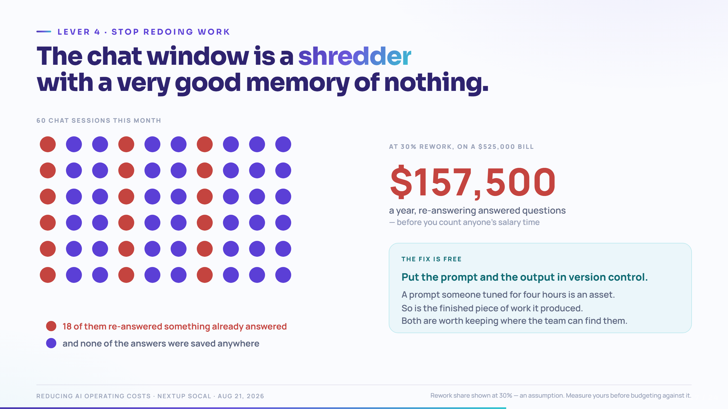
Notes:
Beat 1: the sessions grid. Every dot is somebody solving something in a chat window.
Beat 2: the red dots — work that was already done, by someone else, last month, in a session nobody kept. "Chat sessions are great for one-off tasks. But the output is almost never saved as an artifact."
Beat 3: the cost. At 30% rework on a $525K bill, that's $157,500 a year to re-answer answered questions — and that's before you count the salary time.
The fix is unglamorous and free: put the prompts and the outputs in version control. A prompt someone tuned for four hours is an asset. Right now it lives in one person's scrollback.
Tie to June 5: this is what turns a Level 1 individual habit into a Level 2 team capability.

Slide 18
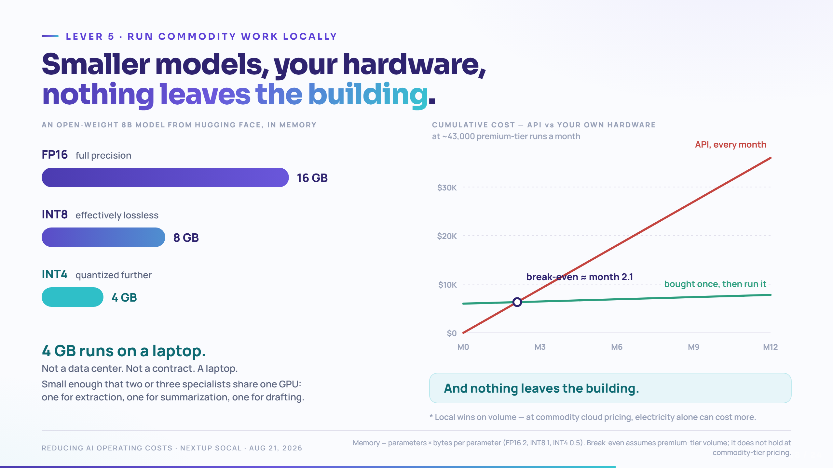
Notes:
Beat 1: quantization in one sentence — "you store each number in the model with less precision. The model gets smaller and faster; on routine work you can barely tell." An 8-billion-parameter model goes from 16 GB to 4 GB.
Beat 2: what that unlocks — 4 GB runs on a laptop. Not a data center. A laptop.
Beat 3: break-even. Fixed hardware cost versus a monthly API line that never stops.
Beat 4: and the part that isn't about money at all — no data leaves the system. No API call, no third-party retention question, no vendor breach that includes your documents.
For this audience: this is the answer to "legal won't let us put customer data in ChatGPT." It's also, quietly, the cheapest answer.

Slide 19
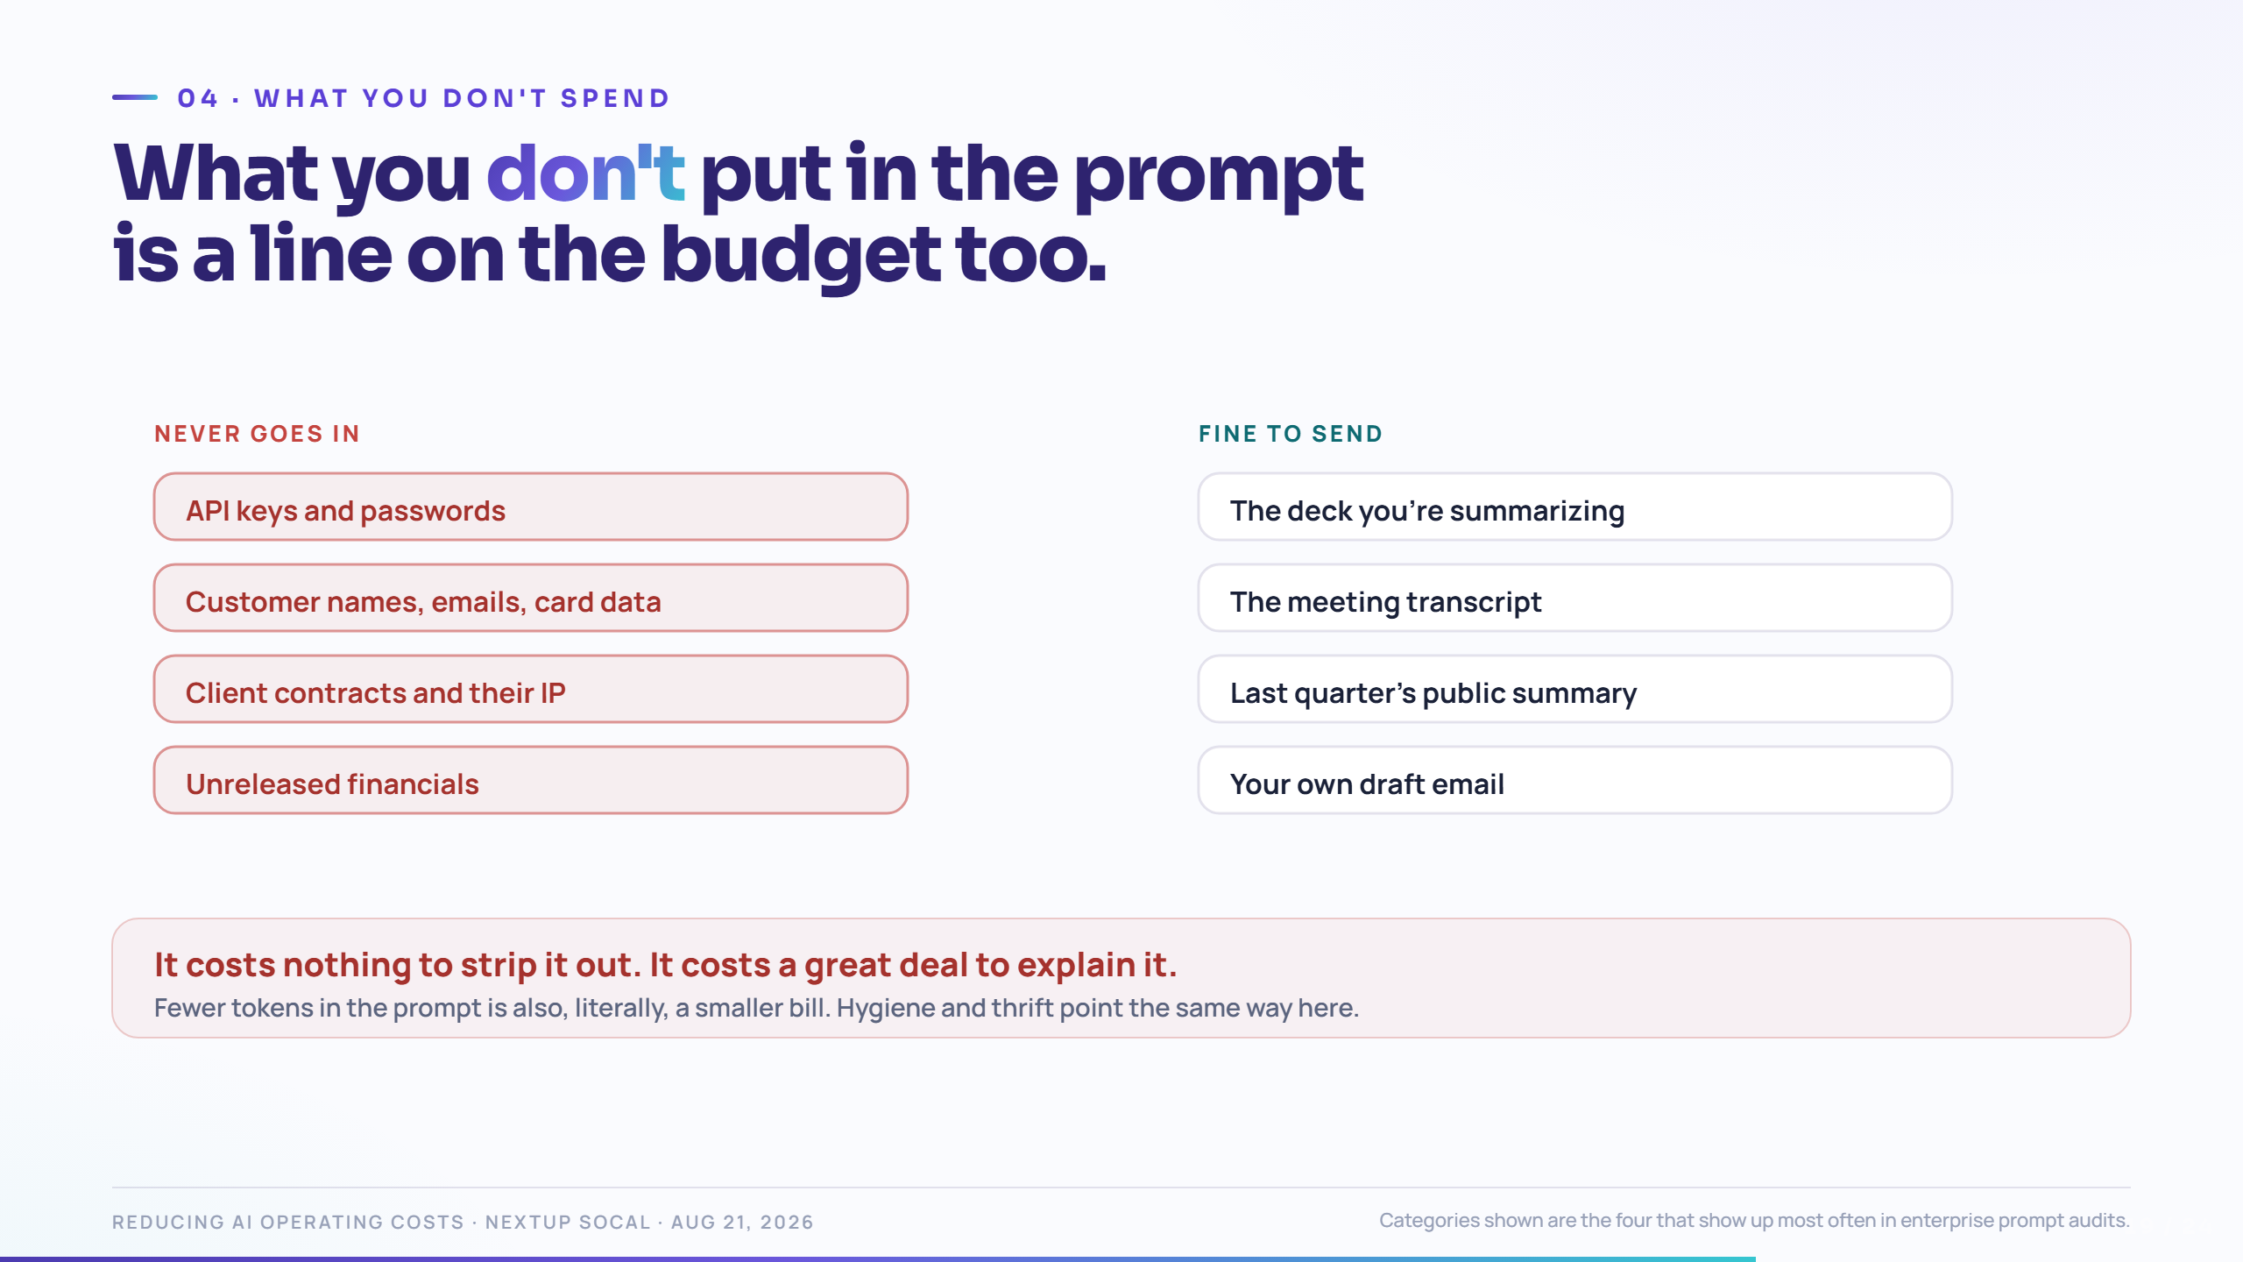
Notes:
Beat 1–2: the flow — everything your team pastes in goes somewhere. Most of it is fine. Four categories are not.
Beat 3: credentials, PII, client IP, internal financials. Each one gets pasted by someone who is trying to be helpful and fast. Nobody in this picture is careless.
Beat 4: the asymmetry. It costs nothing to strip it. It costs a great deal to explain it.
Practical, do-it-this-week version: a short "never paste these" list, circulated once. Plus a shared, sanitized prompt template for the two or three workflows everybody actually runs.
Note the second-order cost: fewer tokens in the prompt is also literally a smaller bill. Hygiene and thrift point the same direction here.

Slide 20
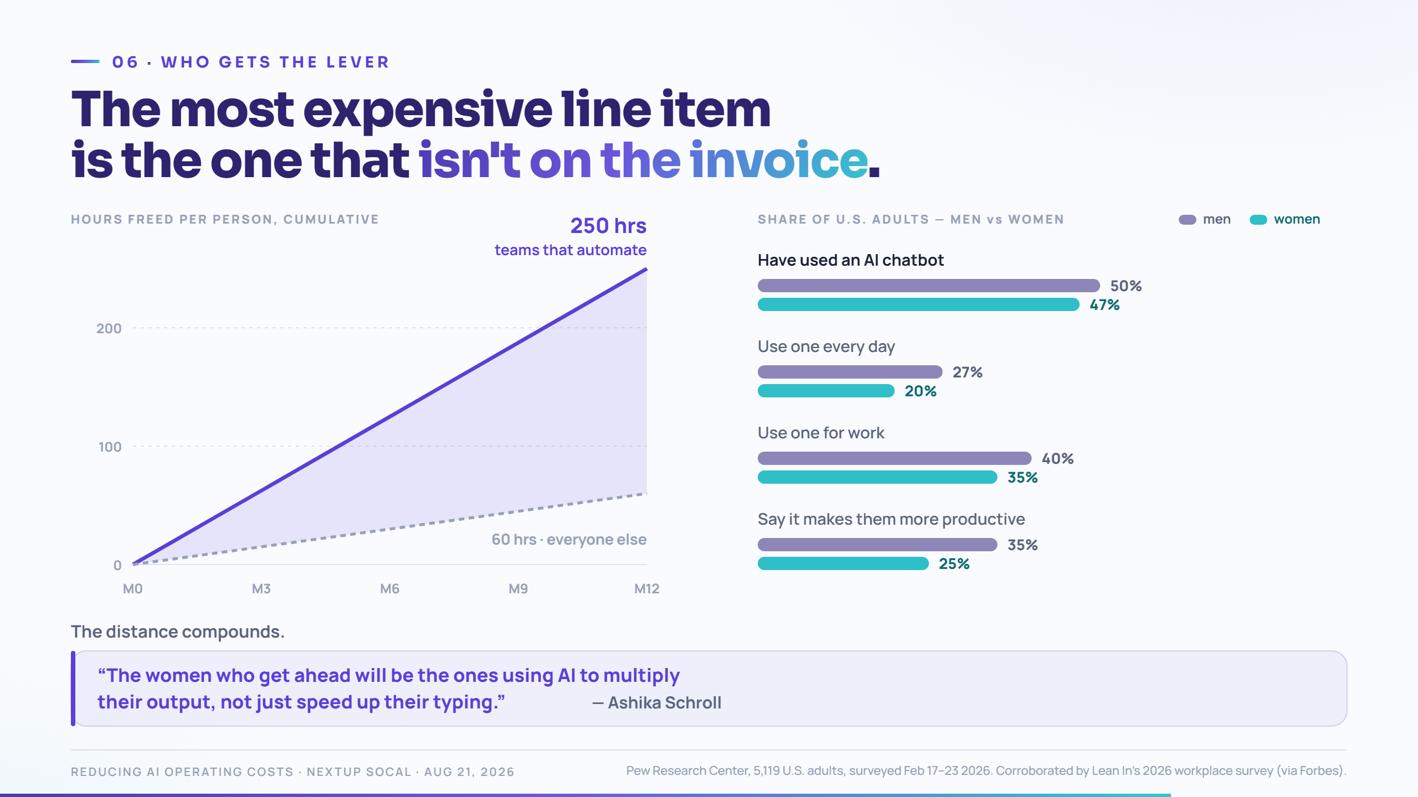
Notes:
Pivot here. Everything so far has been “spend less.” This is “don’t mistake spending less for winning.”
Beat 1: the compounding gap. An hour a day, per person, over a year. The teams that automate pull away from the ones that don't, and the distance grows.
Beat 2 — deliver this carefully, it is the most important slide in the deck for this room. The old story was that women were not using AI. That gap has essentially closed: 50% of men and 47% of women have used a chatbot. Two years ago that gap was eleven points.
What has not closed is intensity. Daily use, 27% against 20%. Using it for work, 40% against 35%. Believing it makes you more productive, 35% against 25%. The door is open. The gap is in how far through it people walk.
If the room is right for it, add the Lean In finding: only 30% of women say their manager encouraged them to use AI, against 37% of men — and men were 27% more likely to be praised for using it. Same behaviour, different credit. That is worth naming out loud in a room like this one.
Beat 3: the tie-back to June 5. The line on screen is Ashika’s closing slide quoted in full — read it as hers, then add your half.
"That was Ashika’s last slide in June. Multiplying your output is the whole game."
Sources, if challenged: Pew Research Center, 5,119 U.S. adults, fielded Feb 17–23 2026. The workplace and recognition figures are Lean In’s 2026 survey, reported in Forbes. Both are on the slide footnote.

Slide 21
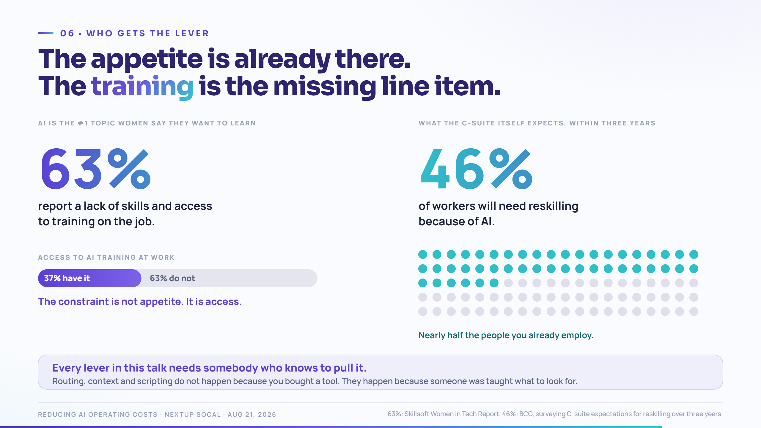
Notes:
This is the constructive answer to the slide before it. That one showed a gap in intensity. This one shows what actually closes it — and it is not enthusiasm, because the enthusiasm is already there.
Beat 1 — the demand. AI is the number one topic women say they want to learn about. And 63% report a lack of skills and access to training on the job. Say it plainly: "the constraint is not interest. It is access."
Beat 2 — the scale. C-suite executives expect, on average, that 46% of their workforce needs reskilling within three years. Nearly half. That is not an HR programme, that is a budget line — and most of the rooms I sit in have not costed it.
Beat 3 — the tie-back. Every lever in this talk needs somebody who knows to pull it. Routing, context, scripting — none of it happens because you bought a tool. It happens because someone was taught what to look for.
"You are going to spend money on AI this year either way. The cheapest line on the whole page is teaching the people you already employ what these levers are."
For this room specifically: if 46% of the workforce needs reskilling and women already report less access to training, then the reskilling budget is where the adoption gap either closes or gets locked in. That is a decision someone in this audience will personally make.

Slide 22
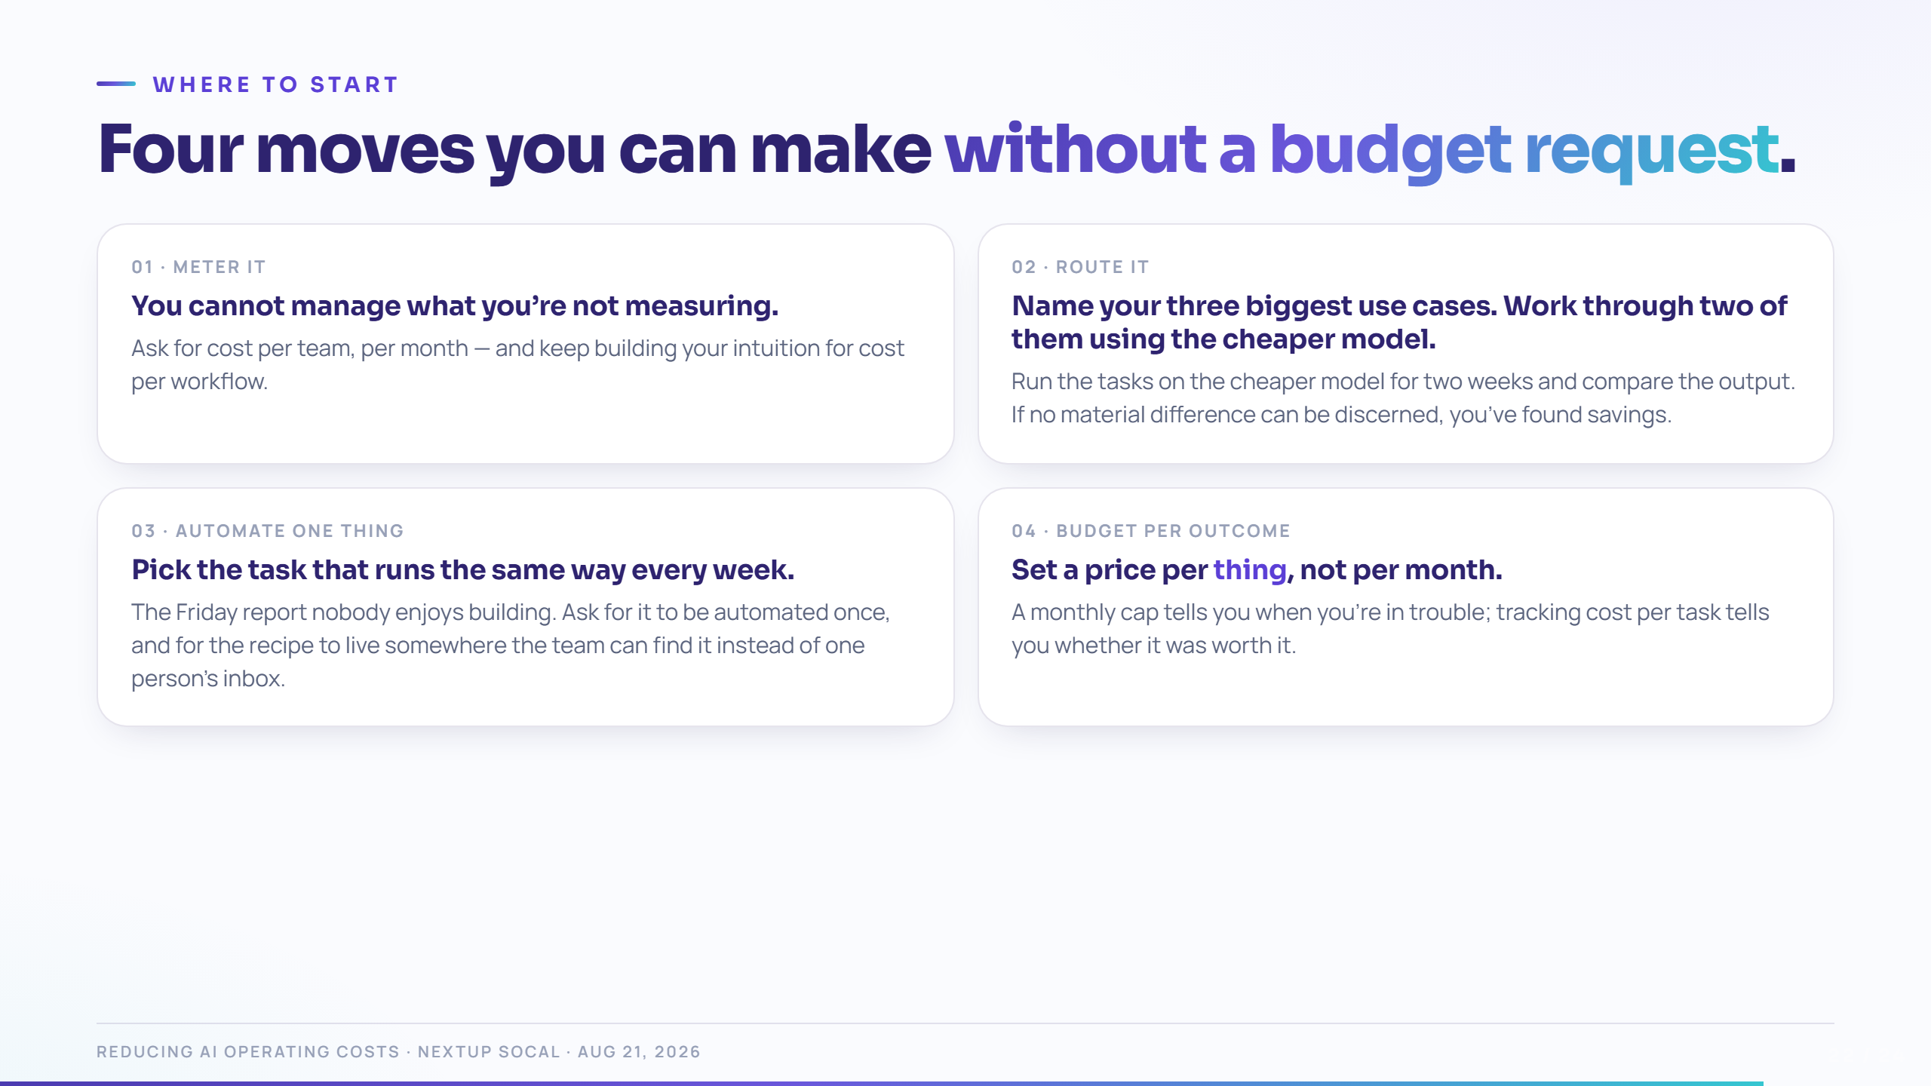
Notes:
Close hard on #1 and #4 — those are the two everyone in this room can order today, without a technical conversation or anyone else's sign-off.
If you only get one sentence: "Ask for cost per outcome, not cost per month. Keep building your intuition for cost per task, and bring other departments into that conversation."
Point back to the checklist: "Everything on this slide is already in the checklist behind the QR."

Slide 23
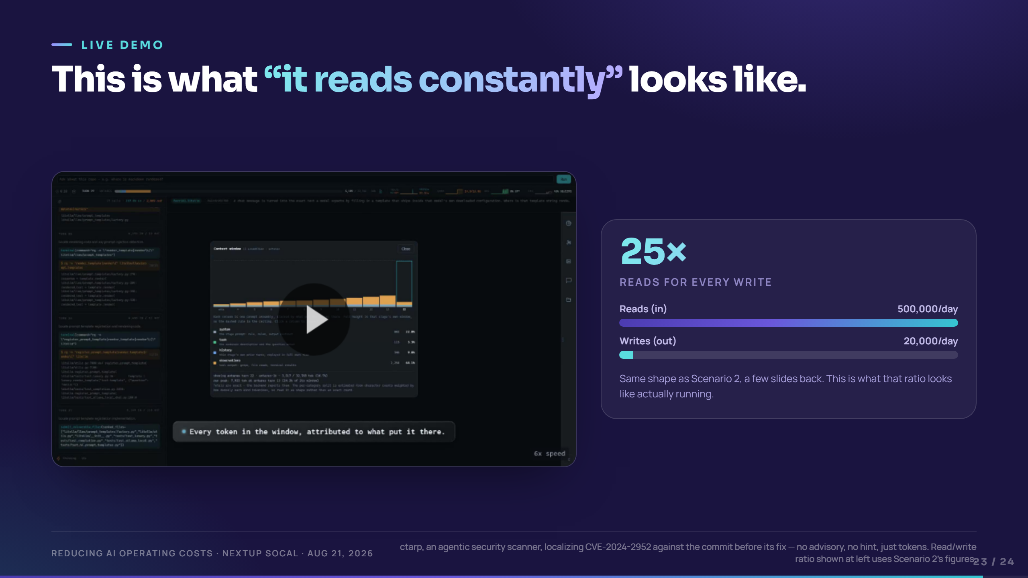
Notes:
This is unscripted — press play and let it run. It is ctarp, a security tool I built, localizing a real CVE with no advisory text and no hint of the answer.
Do not narrate the security story. The point of this slide is the speed and volume of the reading, not the vulnerability. Let the room watch the tokens move.
The card on the right reuses Scenario 2's own numbers (500,000 in / 20,000 out) — point at it once, then let the video carry the rest.
"This is the agent from Scenario 2, actually running. Watch how much it reads before it writes a single word."
If it runs long, let it play under the next slide's discussion rather than cutting it off mid-thought.

Slide 24
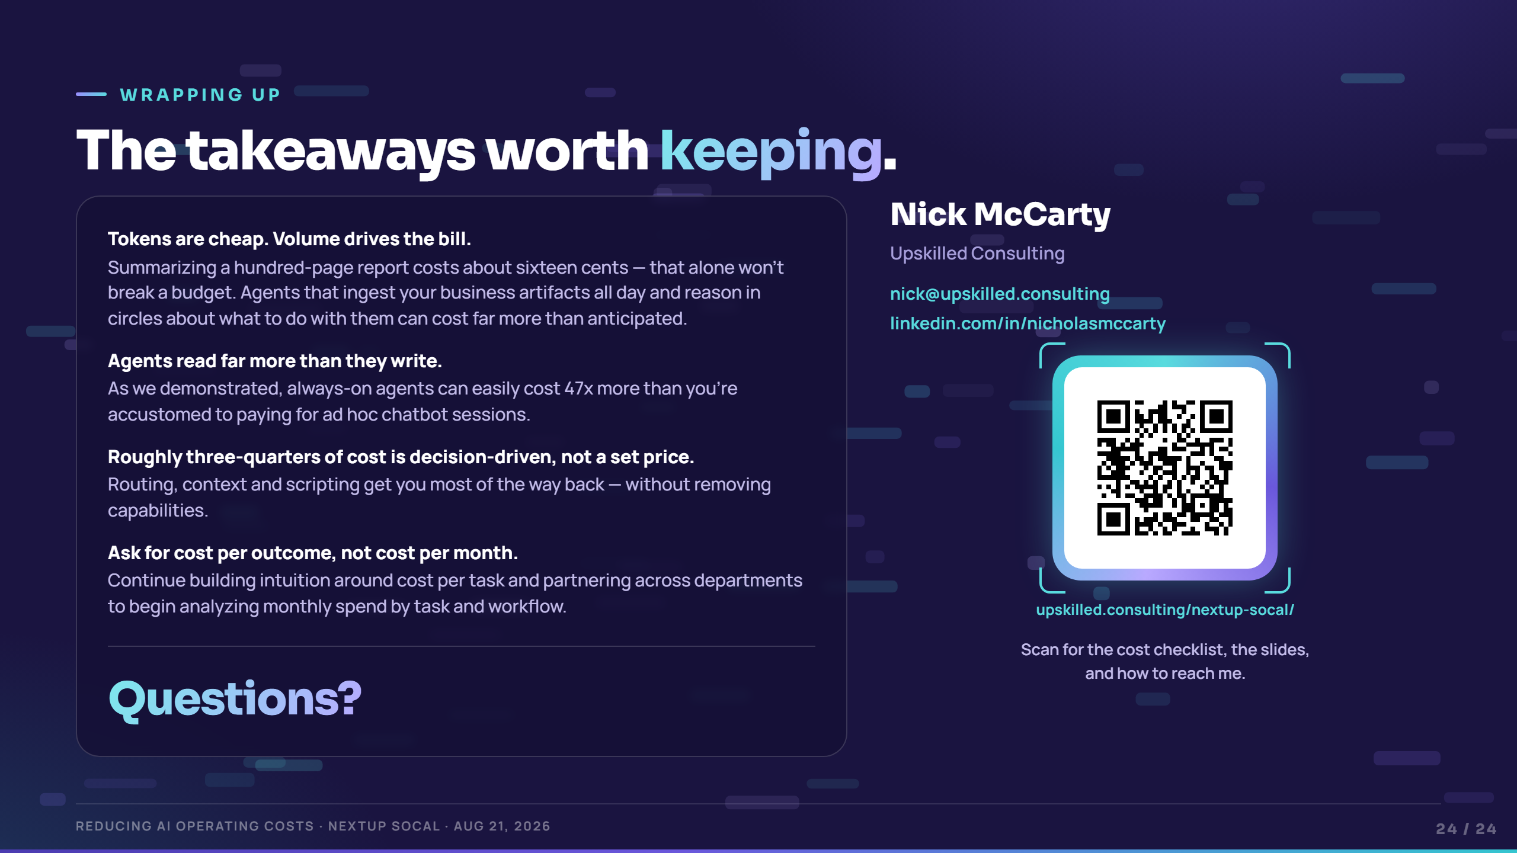
Notes:
Beat 1: the four takeaways. Read them; don’t elaborate. They are the deck compressed.
If you only get one sentence out: “Ask for cost per outcome, not cost per month. Keep building your intuition for cost per task, and bring other departments into that conversation.”
Landing line for this room specifically: fluency with these numbers is what turns “asking for budget” into “presenting a plan.” That shift matters more here than the dollar figure does.
Beat 2: Questions. Hold this slide for the whole Q&A — the takeaways stay on screen, which keeps questions anchored to something concrete.
Likely questions and short answers:
- “Which model should we use?” — Wrong first question. Which tasks, and which of them are routine? Route after that.
- “Is open source safe for us?” — For commodity work on your own hardware it is often the safer option, because nothing leaves.
- “How do we start metering?” — Admin console, usage export by API key, one key per team. An afternoon of work.
- “What if our vendor won’t break out cost?” — A vendor who can’t or won’t break it out is telling you they don’t know either. That’s worth knowing before you sign.
Before Aug 21: scan the QR yourself from a phone that is not signed in to anything, and confirm it lands where you expect. It is live on this slide now, so a wrong link is a wrong link in front of the room.

