Slide 1
Spring Framework
Designed by UpSkills Software Lab
Author : Sourav Maitra

Slide 2
Learning Path
Spring Level 1 – First few steps in Spring
Spring Level 2 – Spring in depth
Spring Level 3 – Spring boot beginner to expert level
Spring Level 4 – Spring AOP
Spring Level 5 – Spring Restful services
Spring Level 6 – Spring Microservices using Spring Cloud

Slide 3
Spring Level 1
Setting up a Spring Project using htttp://start.spring.io
Understanding Tight Coupling using the Binary Search Algorithm Example
Making the Binary Search Algorithm Example Loosely Coupled
Using Spring to Manage Dependencies - @Component, @Autowired
What is happening in the background?
Dynamic auto wiring and Troubleshooting - @Primary
Constructor and Setter Injection

Slide 4
Spring Level 2
Dependency Injection - A few more examples
Autowiring in Depth - by Name and @Primary
Autowiring in Depth - @Qualifier annotation
Scope of a Bean - Prototype and Singleton
Complex scenarios with Scope of a Spring Bean - Mix of Prototype and Singleton
Using Component Scan to scan for beans
Lifecycle of a Bean - @PostConstruct and @PreDestroy
IOC Container vs Application Context vs Bean Factory
@Component vs @Service vs @Repository vs @Controller
Read values from external properties file

Slide 5
What is Spring framework?
Dependency Injection framework.
What is Dependency?
What is Dependency Injection?

Slide 6
Java EE Typical Architecture
We have typically web layer, business layer and data layer.
Web layer is typically concerns UI of the application, how do you show stuff to the user?
Business logic is present inside business layer.
Data Layer takes care to the external interfaces as well as database.
If Business layer needs some data it calls some class inside the data layer, so business layer is dependent on data layer.
If you want to show some data on UI or if you want to save some data into database from user, the web layer first calls business layer
So web layer is dependent on business layer and business layer is dependent on data layer.

Slide 7
What is dependency?
Dependency in programming is an approach where a class uses specific functionalities of another class.
ComplexBusinessService uses the SortAlgorithm to sort the numbers.
ComplexBusinessService class depends on SortAlgorithm
SortAlgorithm is a dependency of ComplexBusinessService class.
In a real time application, we have lot of classes and lot of dependencies.
public class ComplexBusinessService {
SortAlgorithm sortAlgorithm;
}

Slide 8
Typical code
public class ComplexBusinessService {
SortAlgorithm sortAlgorithm = new BubleSortAlgorithm();
}
public class BubleSortAlgorithm implements SortAlgorithm {
}
ComplexBusinessService is directly instantiated the BubleSortAlgorithm over here.
What if you want to use a different Sorting Algorithm? Then I need to change the instantiation of sort algorithm.
This approach is called Tight Coupling. So, business service class is tightly coupled with BubleSortAlgorithm.
Tight Coupling is not good coding practice, so we need to remove tight coupling and make the code loose coupling

Slide 9
Removing the tight coupling
public class ComplexBusinessService {
SortAlgorithm sortAlgorithm; // removing the instantiation
public ComplexBusinessService(SortAlgorithm sortAlgorithm) {
this.sortAlgorithm = sortAlgorithm;
}
}
public class BubbleSortAlgorithm implements SortAlgorithm {
}
Who ever want to make use of ComplexBusinessService can provide what sort algorithm they can use.

Slide 10
We can write this code
SortAlgorithm sortAlgorithm = new BubbleSortAlgorithm();
ComplexBusinessService businessService = new ComplexBusinessService(sortAlgorithm);
Who ever want to make use of ComplexBusinessService can provide what sort algorithm they can use.
This code is called loosely coupled as complex business service is not dependent on specific sort algorithm so we can provide any sort algorithm and it can use it.
Its creating the complex business Service after populating the write dependencies.
So its creating objects and populating dependencies.
Important question is here:
Who does this?
Spring framework does exactly same job.
However it is your job as programmer to tell Spring framework what are the objects we need to manage and what are the dependencies of each class.

Slide 11
Problem to Manage dependencies
How does the Spring Framework know to create an instance of BubbleSortAlgorithm?
How does the Spring know to create instance of ComplexBusinessService and populate
BubbleSortAlgorithm?
As a programmer , you need to tell Spring framework what are the objects it needs to manage and what are the dependencies?
There are two annotation to determine what are the objects needs to manage and what are their dependencies:
@Component
@Autowired

Slide 12
@Component
@Component
public class ComplexBusinessService {
SortAlgorithm sortAlgorithm; // removing the instantiation
public ComplexBusinessService(SortAlgorithm sortAlgorithm) {
this.sortAlgorithm = sortAlgorithm;
}
}
@Component
public class BubbleSortAlgorithm implements SortAlgorithm {
}

Slide 13
@Autowired
@Component
public class ComplexBusinessService {
@Autowired
SortAlgorithm sortAlgorithm; // removing the instantiation
public ComplexBusinessService(SortAlgorithm sortAlgorithm) {
this.sortAlgorithm = sortAlgorithm;
}
}
@Component
public class BubbleSortAlgorithm implements SortAlgorithm {
}
When we put @Component then Spring would create instances of the class.
When we put @Autowired then Spring would start looking at dependencies. It would start looking among the components/ among the instances of the classes, it manages to find the matching things for the dependencies( in this case SortAlgorithm)

Slide 14
Important Terminology
Bean
Autowiring
Dependency Injection
Inversion of Control
IOC Container
Application Context

Slide 15
Spring Bean
Beans are different objects that are managed by Spring framework
In the previous example, ComplexBusinessService and BubbleSortAlgorithm are Spring beans.
A bean is an object that is instantiated, assembled, and otherwise managed by a Spring IoC container.

Slide 16
Autowiring
The process where Spring framework identifies the dependencies and identified the matches of Dependencies and populates them.
In the previous example, Spring creating BubleSortAlgorithm and populate the business service by creating the right sort algorithm.

Slide 17
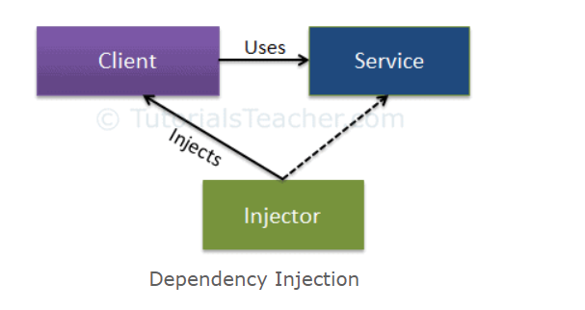
Dependency Injection
Dependency Injection (DI) is a design pattern used to implement IOC. It allows the creation of dependent objects outside of a class and provides those objects to a class through different ways. Using DI, we move the creation and binding of the dependent objects outside of the class that depends on them.
SpringFramework is injecting dependency of SortAlgorithm in ComplexBusinessService.
The Dependency Injection pattern involves 3 types of classes:
Client Class: The client class (dependent class) is a class which depends on the service class
Service Class: The service class (dependency) is a class that provides service to the client class.
Injector Class: The injector class injects the service class object into the client class.

Slide 18
Inversion of Control
Container maintains your class dependecies
Objects injected at Runtime or Start-up operation.
An Object accepts dependecies for construction instead of constructing them usually does this through the construction of the object itself or through setter injection.
Rule of thumb about the injection is that
If your class can not operate without the dependecy then it should be injected via constructor.
If your class can treat the dependency as optional or can accept multiple but variable concerete instances of the dependency then it can be injected by setter injection.

Slide 19
Traditional Dependency Management
Main
depedency 1
dependency 4
dependency 2
dependency 3
dependency 5

Slide 20
IoC Dependency Management
Main
depedency 1
IOC
Container
dependency 4
dependency 2
dependency 3
dependency 5

Slide 21
IoC in Spring
Spring manages your dependencies.
Objects injected at runtime not in compile time.
An object accepts dependencies for construction instead of you constructing them.

Slide 22
Benifits of IoC
When you use IoC, it reduces noise in your code because you are not constructing objects.
It also reduces object coupling because you are handed your dependency into your object, you are not as tightly coupled to it because you actually dont need to know how its constructed at compile time or at writing of code time.
It also reduces the defects that arise from incorrect construction
By allowing the IoC to handle construction, you can focus on API contract of your dependencies. This allows interfaces to be dependecies instead of concrete objects. Again this allows you to have cleaner code that is less coupled to your dependent objects.

Slide 23
Application Context
Its a central element that we deal with when developing an application.
Encapsulates the BeanFactory and provides the user access to BeanFactory under controlled situation.
It provides metadata for bean creation. No matter the mechanism you used to configure your bean, the application context serves to take that configuration and allow the framework to use it to build the IOC container itself.
It also ensures the bean will be created in appropiate order.

Slide 24
IOC Container
An IoC container is a common characteristic of frameworks that implement IoC.
In the Spring framework, BeanFatory provides inversion of control container. The Spring container is responsible for instantiating, configuring and assembling objects known as beans, as well as managing their life cycles.
It provides all the facilities for injection of beans at startup and runtime. while most beans are singleton and injected at startup, but there are other types of bean that gets handled differently. however all injection is handled by the BeanFactory.
BeanFactory handles all singleton beans in the application.

Slide 25
Use of Java Based Config
Its most current type configuration method used today. Xml config is still valid but not often used and it has been removed from most example of Spring.io
Java config provides native language syntax
It also provides the compile time checking of object creation and syntax(configuration) because it uses native language. Compile time checking is very important specially when you use xml syntax when you have to run the application to test the actual configuration.
Easier IDE integration

Slide 26
Working with Environment
Most application can not be deployed in one data center anymore and robust configuration pattern is needed to support this. The use of environment variables and properties is the common ways to injecting data into a running application to flex by things like data center or environment.
Spring provides environment abstraction that allows you to build applications that flex configuration based on the environment variables.
The environment of Spring is populated by default by environment variables
The environment construct is also populated and can be supplimented by properties via runtime or by properties file among other things.
Powerful tool specially in a cloud native and traditional applications when dealing with multiple environment.
You can use a mixture of properties and environment variables to manipulate configurations as you migrate from Dev to test or from Data center to Data center. This is how we manage things like URLs of other services, log levels, and various other runtime configurations within a microservice environment.

Slide 27
Spring expression Language
SpEL gives you the ability to use expression in your configuration to cofigure your objects.

Slide 28
Bean Scopes - Singleton Scope
Default scope of every bean is Singleton.
One instance of the object per context definition
Be careful about the state because you have one instance of the class and all state becomes available to all instances of the object. Even there is one instance , every class that has its as a dependency could potentially have access to that state.
Keep in mind how state impacts behaviour of methods as some other thread may change your data, or you may change it for some other thread.

Slide 29
Bean Scopes - Prototype
New instance every time its referenced.
Once the instances are no longer needed it becomes available for garbage collector.
Definition of prototype is stored on IOC container when needed instances are created based on the definitions, Spring then hands that instance over and releases its own handle.
Never stored as instantiated object in IOC container
very useful for transient data or types that flex based on application state.

Slide 30
Bean Scopes - Session
Very similar to Prototype Bean
Applied only in web environment
One instance of the bean per user session. This allows session data seperate from other session when needed.
Definition is stored in IOC container but instance never stored.
When session goes out of scope that bean is available for garbage collection.

Slide 31
Bean Scopes - Request
Only applied to web environment.
One instance of the bean per request
Definition is stored in IOC container but instance is not stored.

Slide 32
Component Scanning
In Spring Boot Autoconfiguration is partially achieved through component scanning mixed with other configuration.
External configuration is not needed as component scanning solve the configuration for u.
Root annonation of Component scanning is @Component
@Component indicates that a class should be loaded into the BeanFactory and inspection of the class itself.
Serveral stereotypes of @Component annotation like @service ( you can write your own aspect to add behaviour to your classes based on type)
Component scanning scan the base package and its subpackages and load configuration automatically for each bean it finds. It uses other annotations to direct IOC container to build dependency graph.
Dependency injection is achieved through component scanning. mainly by @Autowired ( this instructs IOC container to inject a bean into the needed value at that point)

Slide 33
Starting Component Scanning
To start component scanning you need some form of Java or XML based configuration.
If you are using spring boot , you are getting auto-configuration through this special method by special annotation @SpringBootApplication.
The Base package is defined in this configuration.
Scanning occurs during the startup

Slide 34
Manage dependency By Spring Framework
To be able to best use of Spring we need to tell 3 different things:
What are the beans?
What are the dependencies for a bean?
Where to search for beans?

Slide 35
Different stereotypes in Spring
@Component
Defines generic component
@Repository
Encapsulating storage, retrieval, search behaviour typically from relational database
Related to getting the data
@Service
Business service facade
@Controller
Controller in MVC pattern
@Controller, @Repository and @Service
Allow you to classify components into different categories and u can apply different logic on each of the categories.
Spring provides a default exception translation facilities if u use @repository, there are lot of jdbc exceptions, Spring classifies them and translates them only if you work with @repository annotation. On your database component if you put @Component annotation you can not be able to use this feature
If you want to log every thing that’s coming into your business layer, in that kind of scenario you would identify everything with @service annotation, you can use AOP to identify that and log all the contents

Slide 36
Types of depencency injection
Constructor Injection
Property Injection
Field Injection
Setter Injection
To make it simple, let us say that we can use constructor based dependency injection for mandatory dependencies and setter based injection for optional dependencies. It is a rule of thumb!!
If you want to instantiate a class, you always do it with its constructor. So, if you are using constructor based injection, the only way to instantiate the class is through that constructor. If you pass the dependency through constructor it becomes evident that it is a mandatory dependency.
On the other hand, if you have a setter method in a POJO class, you may or may not set value for your class variable using that setter method. It is completely based on your need. i.e. it is optional. So if you pass the dependency through setter method of a class it implicitly means that it is an optional dependency. Hope this is clear!!
Since ServiceRepository cannot function usefully without IService, it makes sense to have it injected via the constructor.
The same ServiceRepository class may use a Logger to do tracing. The ILogger can be injected via Property injection.

Slide 37
Level 3 : Spring Boot
Basics of Auto Configuration and Spring Boot Magic
Spring Boot Starter Projects
Spring Initializer
REST Service Content Negotiation with JSON and XML
Embedded servlet containers : Tomcat, Jetty and Undertow
Writing Unit and Integration tests using Spring Boot Starter Test
Profiles and Dynamic Configuration with Spring Boot
Spring Boot Data JPA
Spring Boot Actuator
Spring Boot Developer Tools and Live Reload

Slide 38
Spring Boot Starter Parent
Starter Parents define:
Dependency Versioning
Plugins
Java Version
Dependency Versioning
Spring Boot Starter Parent inherits from Spring boot dependencies. Spring boot dependency define all the version of different things. Spring boot ensures all these versions of framework are compatible with each other. I don’t need to verify whether the Specific dependency is match with it or not.
Let say I upgrade from one version of Spring to another version of Spring, all that I need to do that upgrade my Spring boot version and I would get the latest version of all the jars which are compatible to each other.
We can override the java version as well as any dependency version which is defined in Spring boot dependency project.

Slide 39
Spring Boot Starter Parent
Other Starter Projects
spring-boot-starter-web-services ( develop webservices based on SOAP)
spring-boot-starter-test (brings in Junit, Mockito and also Spring Unit Test framework)
spring-boot-starter-jdbc (Brings in Basic Jdbc and Spring Jdbc as well)
spring-boot-starter-security ( Brings in Spring Security along with AutoConfiguration of that)
spring-boot-starter-data-jpa
spring-boot-starter-data-rest
More at https://docs.spring.io/spring-boot/docs/current-SNAPSHOT/reference/htmlsingle/#using-boot-starter

Slide 40
Understanding the magic of Spring Boot
Spring Boot starter web
Commonly used to develop either rest services or typical spring mvc based web app.
What version of spring-boot-starter-web is used?
What dependencies does Spring boot Starter web brings in?
What Autoconfiguration does Spring boot starter web brings in?
Spring Boot auto-configuration attempts to automatically configure your Spring application based on the jar dependencies that you have added.
For example, if HSQLDB is on your classpath, and you have not manually configured any database connection beans, then Spring Boot auto-configures an in-memory database.
In Spring Boot application we don’t need to manually configure Dispatcher Servlet, so dispatcher servlet comes in through autoconfiguration

Slide 41
Spring vs Spring Boot
Spring
Spring is just a dependency injection framework. Spring focuses on the "plumbing" of enterprise applications so that teams can focus on application-level business logic, without unnecessary ties to specific deployment environments.
First half of the 2000 decade! EJBs
EJBs were NOT easy to develop.
Write a lot of xml and plumbing code to get EJBs running
Impossible to Unit Test
Alternative - Writing simple JDBC Code involved a lot of plumbing
Spring framework started with aim of making Java EE development simpler.
Goals
Make applications testable. i.e. easier to write unit tests
Reduce plumbing code of JDBC and JMS
Simple architecture. Minus EJB.
Integrates well with other popular frameworks.

Slide 42
Spring vs Spring Boot
Applications with Spring Framework
Over the next few years, a number of applications were developed with Spring Framework
Testable but
Lot of configuration (XML and Java)
Developing Spring Based application need configuration of a lot of beans!
Integration with other frameworks need configuration as well!
In the last few years, focus is moving from monolith applications to microservices. We need to be able to start project quickly. Minimum or Zero start up time
Framework Setup
Deployment - Configurability
Logging, Transaction Management
Monitoring
Web Server Configuration

Slide 43
Spring vs Spring Boot
Spring Boot
Spring Boot makes it easy to create stand-alone, production-grade Spring based Applications that you can “just run”.
We take an opinionated view of the Spring platform and third-party libraries so you can get started with minimum fuss.
Example Problem Statements
You want to add Hibernate to your project. You dont worry about configuring a data source and a session factory. I will do if for you!
Goals
Provide quick start for projects with Spring.
Be opinionated but provide options.
Provide a range of non-functional features that are common to large classes of projects (e.g. embedded servers, security, metrics, health checks, externalized configuration)

Slide 44
What Spring Boot is really not?
It’s not an app or a web server – provides good integration with embedded
Does not implement any specific framework - for example, JPA or JMS
It provides wrapper on it which helps you to integrate with all framework
Does not generate code

Slide 45
Create Rest Services
We want to prepare for creating a Rest Service
Survey
Question
SurveyService
We use hard-coded data to get started

Slide 46
Understand Rest Service
What is REST?
Architectural style for the web. REST specifies a set of constraints.
Client - Server : Server (service provider) should be different from a client (service consumer).
Enables loose coupling and independent evolution of server and client as new technologies emerge.
Each service should be stateless.
Each Resource has a resource identifier.
It should be possible to cache response.
Consumer of the service may not have a direct connection to the Service Provider. Response might be sent from a middle layer cache.
A resource can have multiple representations. Resource can modified through a message in any of the these representations.

Slide 47
Endpoints for Rest Services
/surveys:
GET
Get all surveys
/surveys/{surveyId}/questions
GET
Retrieve questions for a Specific Survey
/surveys/{surveyId}/questions/{questionId}
GET
Retrieve details for a specific question of a specific survey
/surveys/{surveyId}/questions
POST
Add a question

Slide 48
Add a new question
Create a REST Service to add a new question to survey
@PostMapping("/surveys/{surveyId}/questions")
@RequestBody Question question
What should be Response Status for create?
ResponseEntity.created(location).build()
ResponseEntity.noContent().build()
Using Postman : https://www.getpostman.com
URL to POST to - http://localhost:8080/surveys/Survey1/questions
Sample Body for POST Request {"description":"Second Most Populous Country in the World", "correctAnswer":"India","options":["India","Russia","United States","China"]}

Slide 49
Spring Boot Actuator
Exposed lot of end point and this endpoint provides lot of details to monitor the health of the application of rest services. Spring boot actuator exposes Metadata services.
- /env, /metrics, /trace, /dump, /shutdown, /beans, / autoconfig, /configprops, /mappings
HAL Browser provides UI around Spring Boot actuator services/ we can browse through all the rest services.
http://localhost:8080/actuator/
http://localhost:8080/browser/index.html#/actuator
We can think of that Spring boot actuator is one which provides data and HAL browser is one which provides UI, so you can browse through the data.
<dependency>
<groupId>org.springframework.boot</groupId>
<artifactId>spring-boot-starter-actuator</artifactId>
</dependency>
<dependency>
<groupId>org.springframework.data</groupId>
<artifactId>spring-data-rest-hal-browser</artifactId>
</dependency>

Slide 50
Spring Boot Actuator
/heapdump :
If there is application crash or something similar, heap dump is going to find out what’s going on.
/configprops:
All the config properties will show and what are the different things that can be configured from the application.properties.
Example : spring.devtools.livereload: false
/beans:
All the Spring beans created and configured inside the application.
/autoconfig:
It will show what are the autoconfiguration stuffs active now using positive matches.
It will show all the negative matches which conditions are not executed.
/trace:
Shows trace log for last few request
It will show the details of the request , when was it executed , what is the method , what is the request, what was the response that sent back. What is the status of it, all the details we can see as a part of trace.
/health:
It shows the disk free space
Total space of the disk, how much is free, what is the threshold warning , things like that.

Slide 51
Spring Boot Actuator
/mapping:
What are the different mapping things like the services being exposed.
/env:
All the details of environment like what version of java being used, what is its configuration, what is the class path, details about the system and little bit about application configuration.
/metrics :
It provides all the dynamic information of the application
How much memory made available,
How much memory is free
All the dynamic information , threads and all that kind of stuffs
It provides the information that defines how many times a specific URL is being called.
Keeps track of how many times a specific response type is given back for a specific URL.

Slide 52
Embedded Servlet Container
What we are used to we create a war file and deploy it in web server, that usually we will be doing before Spring Boot.
Spring Boot comes in with the idea of embedded servlet container. So Servlet container like tomcat is embedded in application directly. So we would only need to create jar instead of war.
Now configuration of your server is part of your application itself. To deploy in environment, you need to install webserver in the environment, because its part of the application, so you directly go and run as simple java application.
Only thing you need to run Spring Boot Application Jars is JDK.
Spring Boot starter web has dependency on tomcat, because tomcat is default embedded servlet container
If you want to change the embedded servlet container then you need to exclude tomcat and include another embedded servlet container dependency
<dependency>
<groupId>org.springframework.boot</groupId>
<artifactId>spring-boot-starter-web</artifactId>
<exclusions>
<exclusion>
<groupId>org.springframework.boot</groupId>
<artifactId>spring-boot-starter-tomcat</artifactId>
</exclusion>
</exclusions>
</dependency>
<dependency>
<groupId>org.springframework.boot</groupId>
<artifactId>spring-boot-starter-jetty</artifactId>
</dependency>

Slide 53
Embedded Servlet Container
Spring Boot comes in with Support for 3 different embedded servlet containers:
Tomcat
Jetty
Undertow
Change the server port by using below configuration in application.properties file: server.port
Find out from documentation ( https://docs.spring.io/spring-boot/docs/current/reference/html/howto-embedded-web-servers.html) , how to switch to undertow!

Slide 54
Adding Dynamic Configuration
Add message text in application.properties
WelcomeController.java
logging.level.org.springframework: DEBUG
logging.level.org.springframework.web.servlet: DEBUG
app.name=SurveyApplication
welcome.message=Welcome message from property file! Welcome to ${app.name}
@RestController
public class WelcomeController {
//Auto wiring
@Autowired
private WelcomeService service;
@RequestMapping("/welcome")
public String welcome() {
return service.retrieveWelcomeMessage();
}
}

Slide 55
Adding Dynamic Configuration
WelcomeService.java
Passing message text from program arguments:
Command Line argument has higher priority than whatever its configured in the application.properties in the class path.
//Spring to manage this bean and create an instance of this
@Component
public class WelcomeService {
@Value("${welcome.message}")
private String welcomeMessage;
public String retrieveWelcomeMessage() {
//Complex Method
return welcomeMessage;
}
}
--welcome.message="SomethingElse" in Program Arguments

Slide 56
Understand Spring Profiles
Easiest way to set up a profile by putting it to application.properties → spring.profiles.active=prod
Using profile, we can different properties file and override it in different environment: application-{profile-name}.properties
If we set active profiles prod and have “application-prod.properties” is present in class path.
Then value in “application-prod.properties” would be given preference over “application.properties”.
-Dspring.profiles.active=prod in VM Arguments
We can create bean based on profile
Practical Use case of creating bean based on Profile
We want to have caching which is different between different environment. In local environment, we don’t want cacheing at all. But in dev environment we want minor caching, In production environment, we want to use distributed cache. So here we can create multiple bean created in different profiles and based on the profile those beans are enabled.
@Profile("prod")
@Bean
public String dummy() {
return "something";
}

Slide 57
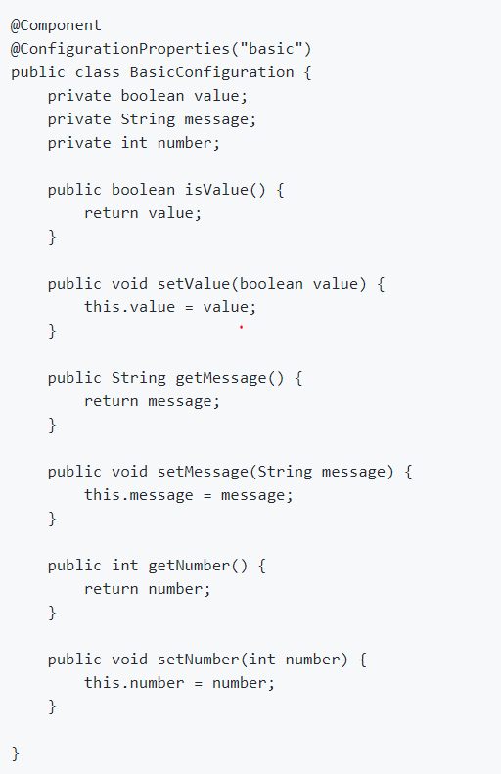
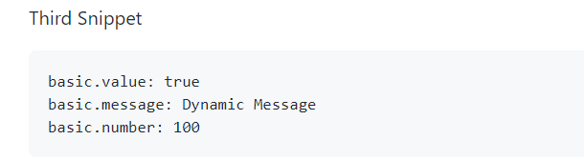
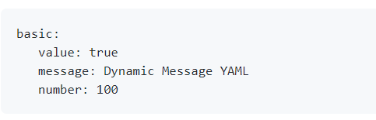
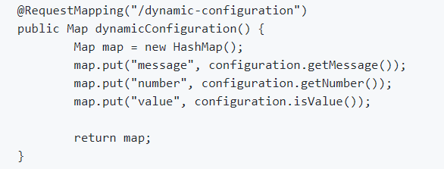
Type Safe Configuration

Slide 58
Understand Spring Data JPA
JPA is Java Persistence API
It helps us to map an object to a database
SpringDataJpa provides one more level of abstraction on top of JPA and it makes even more easier to store things down to the database.
Spring boot provides Spring data Jpa starter.
After that It tries to autoconfigure in and at class path it search for embedded database but could find it as dependency not added. So we need to add dependency of embedded database (H2) in order to resolve this error.
spring.datasource.url=jdbc:h2:mem:testdb
spring.data.jpa.repositories.bootstrap-mode=default
<dependency>
<groupId>org.springframework.boot</groupId>
<artifactId>spring-boot-starter-data-jpa</artifactId>
</dependency>
<dependency>
<groupId>com.h2database</groupId>
<artifactId>h2</artifactId>
</dependency>

Slide 59
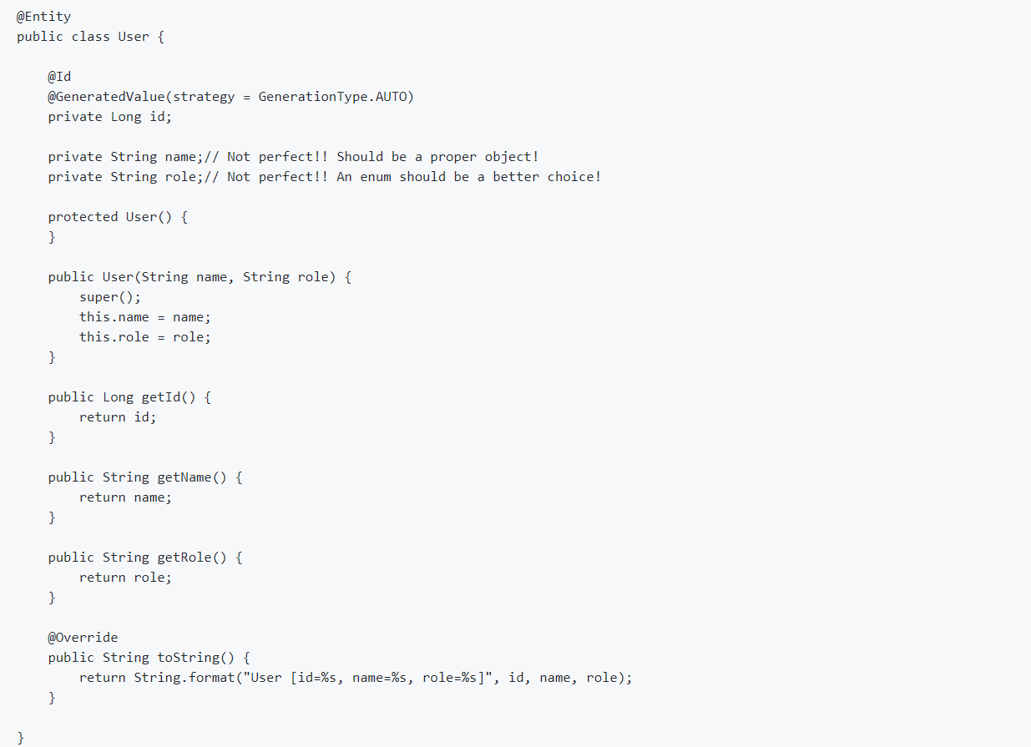
Create User Entity

Slide 60
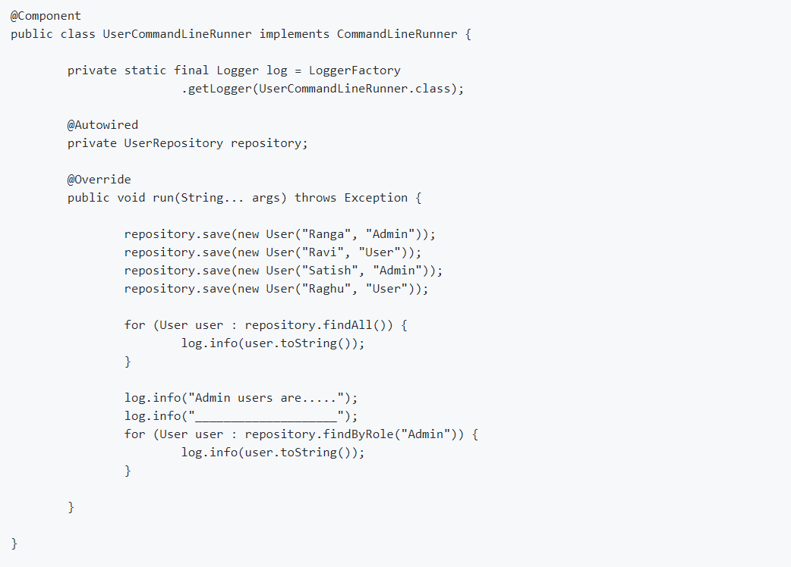
Populate Entity at Start Up:

Slide 61
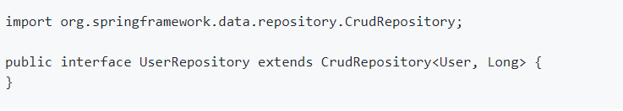
Interacting with DB using Repository

Slide 62
Interacting with DB using Repository
Look at H2 Console : http://localhost:8080/h2-console
Use db url - jdbc:h2:mem:testdb
Add findByRole method
spring.datasource.driver-class-name=com.mysql.jdbc.Driver
spring.datasource.url=jdbc:mysql://localhost:3306/test
spring.datasource.username=root
spring.datasource.password=admin
spring.datasource.initialize=true
spring.jpa.hibernate.ddl-auto=update
spring.jpa.show-sql=true
https://docs.spring.io/spring-data/jpa/docs/current/reference/html/#jpa.query-methods

Slide 63
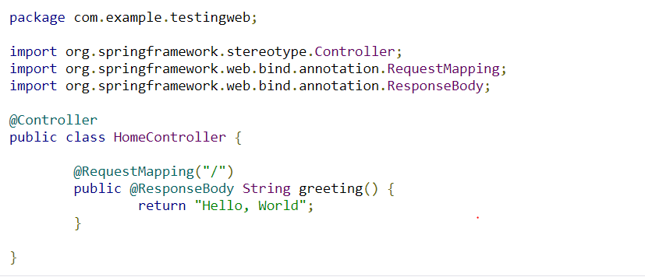
Simple Application using Spring Boot

Slide 64
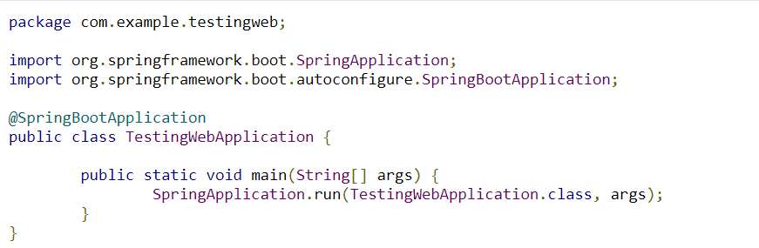
Simple Application using Spring Boot

Slide 65
@SpringBootApplication
@SpringBootApplication is a convenience annotation that adds all of the following:
@Configuration: Tags the class as a source of bean definitions for the application context.
@EnableAutoConfiguration: Tells Spring Boot to start adding beans based on classpath settings, other beans, and various property settings.
@EnableWebMvc: Flags the application as a web application and activates key behaviors, such as setting up a DispatcherServlet. Spring Boot adds it automatically when it sees spring-webmvc on the classpath.
@ComponentScan: Tells Spring to look for other components, configurations, and services in the the com.example.testingweb package, letting it find the HelloController class.

Slide 66
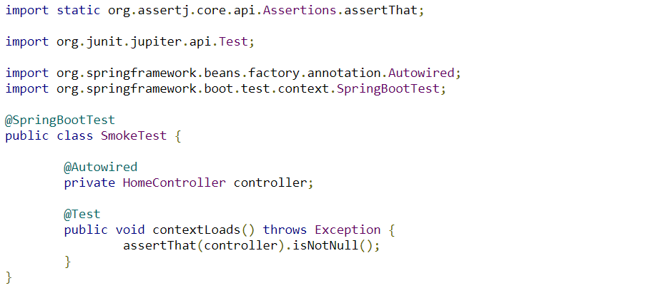
@SpringBootTest
The @SpringBootTest annotation tells Spring Boot to look for a main configuration class (one with @SpringBootApplication, for instance) and use that to start a Spring application context.
You can run this test in your IDE or on the command line (by running ./mvnw test), and it should pass.

Slide 67
Spring Boot Integration Test
<dependency>
<groupId>org.springframework.boot</groupId>
<artifactId>spring-boot-starter-test</artifactId>
<scope>test</scope>
</dependency>

Slide 68
Spring Boot Integration Test
It is nice to have a sanity check, but you should also write some tests that assert the behaviour of your application. To do that, you could start the application and listen for a connection (as it would do in production) and then send an HTTP request and assert the response.

Slide 69
Integration Test
Initialize and Launch Spring Boot Application
@RunWith(SpringRunner.class) – helps to launch a Spring Context
@SpringBootTest(classes = Application.class, webEnvironment = SpringBootTest.WebEnvironment.RANDOM_PORT)
SpringBootTest helps in launching a SpringBootApplication in a test
If this tests are running as part of continuous integration, this might be running on different server and that server might be running test for multiple application. In that case, it will be good to use random port
RANDOM_PORT -> Creates web application context and set the server port 0, which means it will dynamically trigger listening on random port.
Once we use ramdom port then we need to assign port using below annotation
@LocalServerPort private int port;
Invoke Service
Invoke URL : /surveys/Survey1/questions/Question1

Slide 70
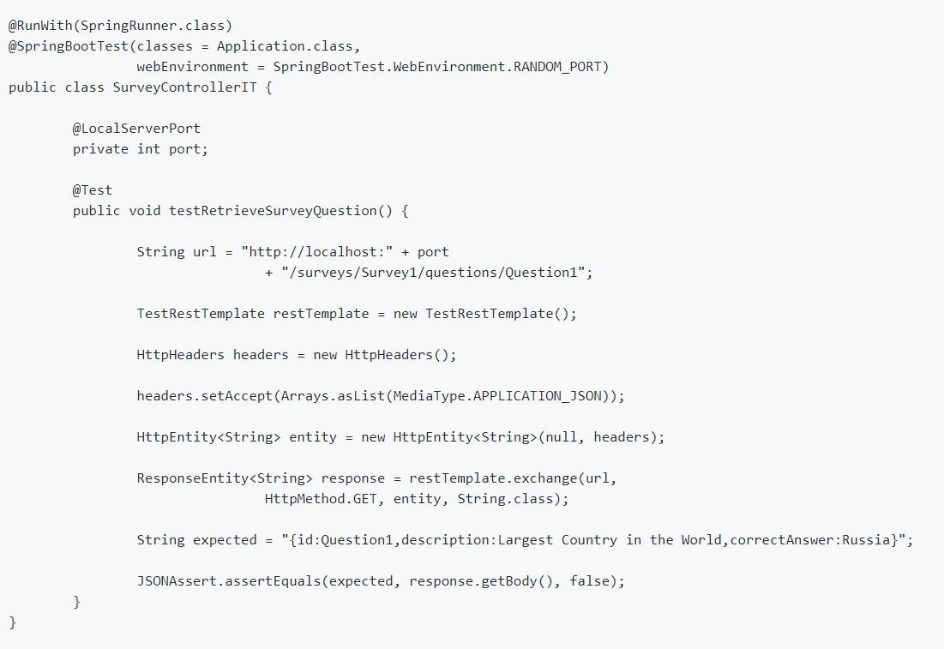
Un refactored Snippet

Slide 71
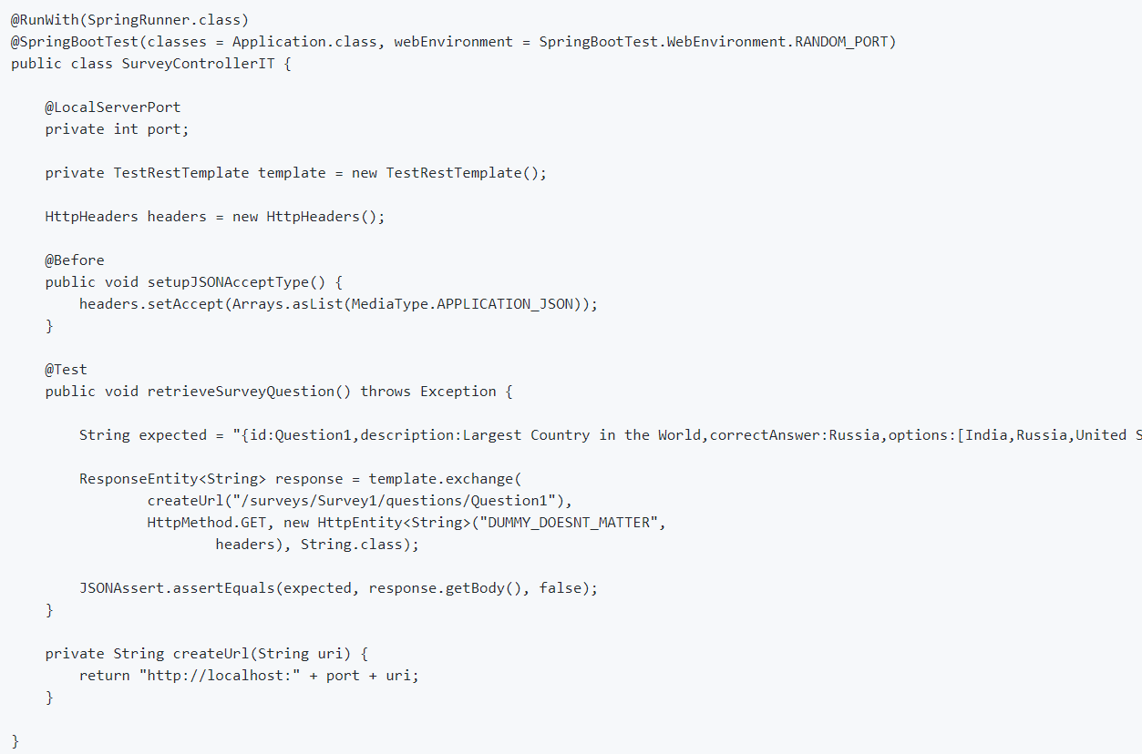
Refactored Snippet

Slide 72
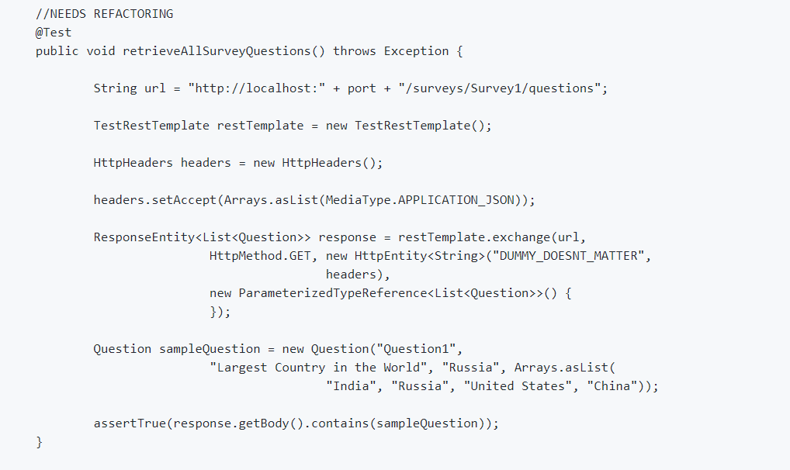
Test Retrieve All questions

Slide 73
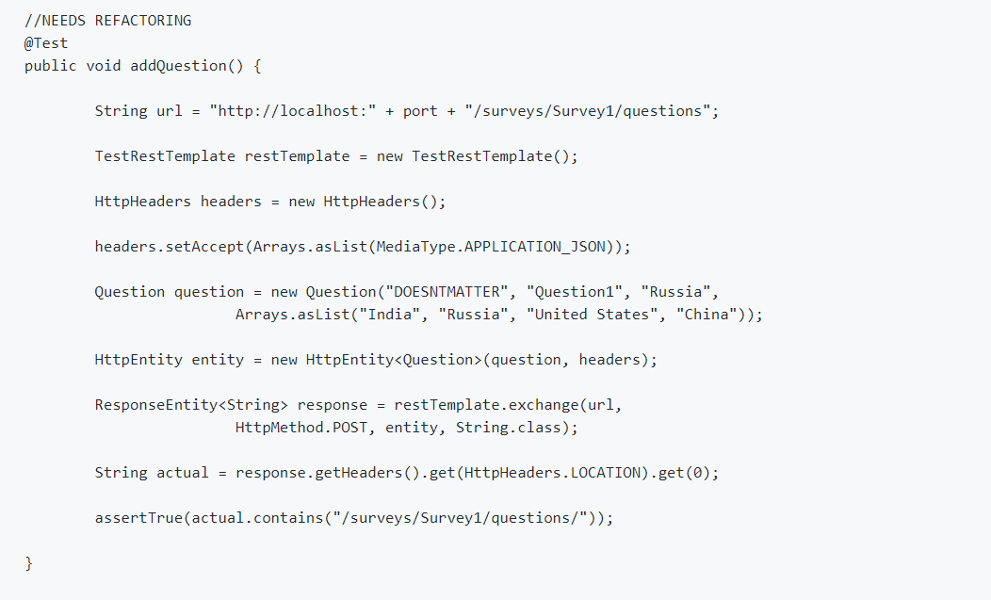
Test for Create Question (Post Request)

Slide 74
Unit test with Spring Boot and Mockito
Write a Unit Test for retrieving a specific question from a survey.
Different between Unit Test and Integration Test
Basics of Mocking
MockMvc framework
@MockBean

Slide 75
Introduction to JPA
We will try to understand how JPA solve the problem of Object relational mapping: The way application classes designed is different from the way we designed the tables. JPA provides mapping between application classes and table using Entities, Relationships. We will something called Entity Manager to manage your entities.
I would want to save Task to database, I create Task object give it to Entity Manager and save it to database.
Application Classes
FullTimeEmployee
Employee
PartTimeEmploye
Task
JPA Magic
Relationships
Entities
Mapping
EntityManager
JPQL
Criteria Api
Jdbc Queries
Database Server
EMPLOYEE_TASKS
TASKS
EMPLOYEE
TABLES

Slide 76
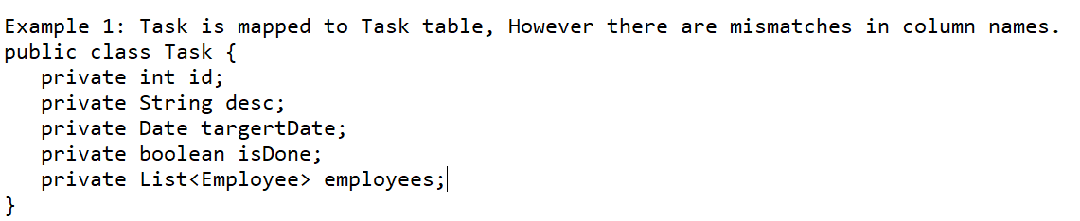
Object Relation Impedance mismatch
In Java Side we have objects and Database side we have tables how do we store data from objects to tables , the way you design java program using OOP, we use object-oriented concepts. How ever in the data base we use something called normalization.
The way , we have designed objects, is different from the way the relational databases are designed. The results is an impedance mismatch.
Object Oriented programming consists of concepts like encapsulation, inheritance, interfaces and polymorphism.
Relational databases are made up of tables with concepts like normalization.
Example of Object Relational Impedance mismatch:
I have Employee and Task . Each employee can have multiple task and each task can be shared between multiple employee. There is a many to many relationship between them. Let’s consider an example of impedance mismatch.

Slide 77
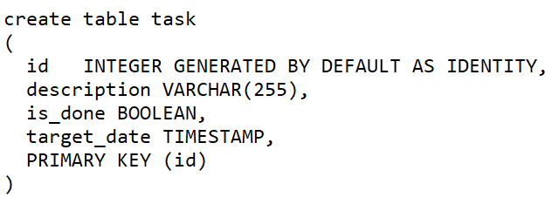
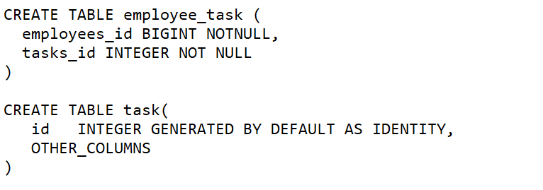
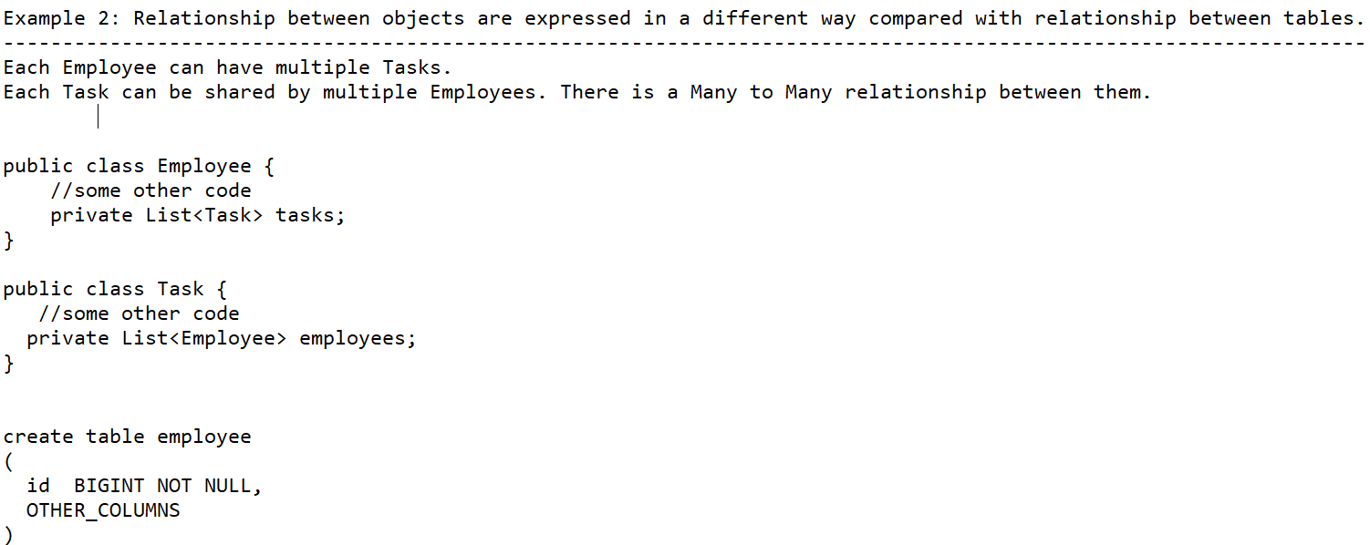
Object Relation Impedance mismatch

Slide 78
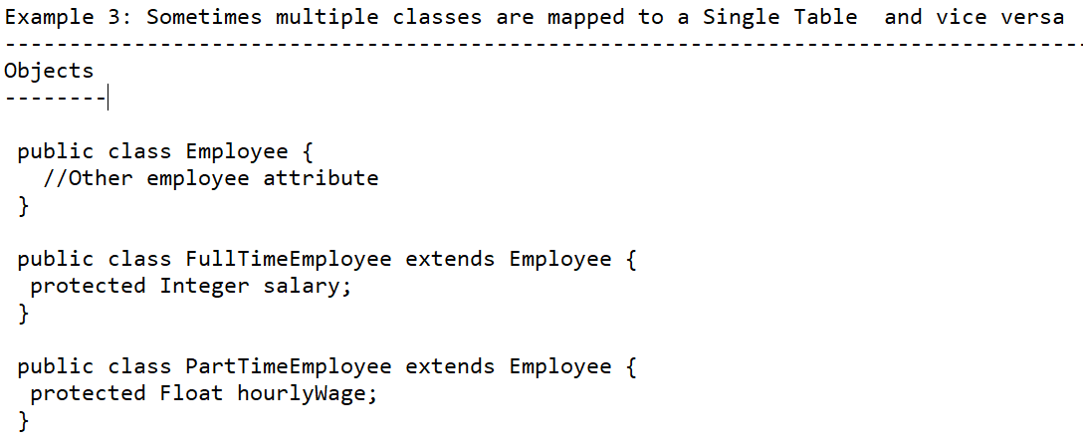
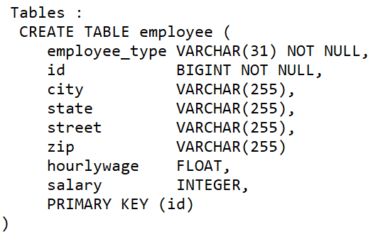
Object Relation Impedance mismatch

Slide 79
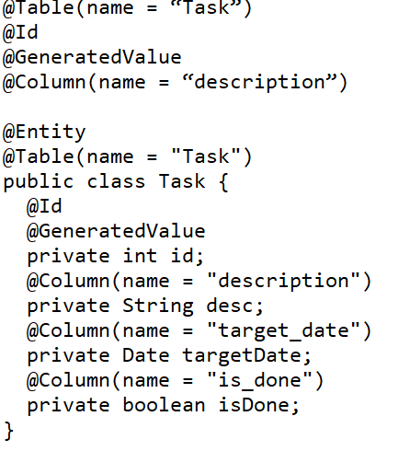
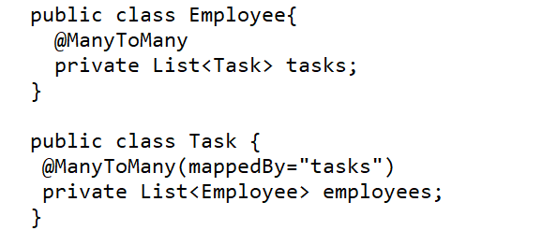
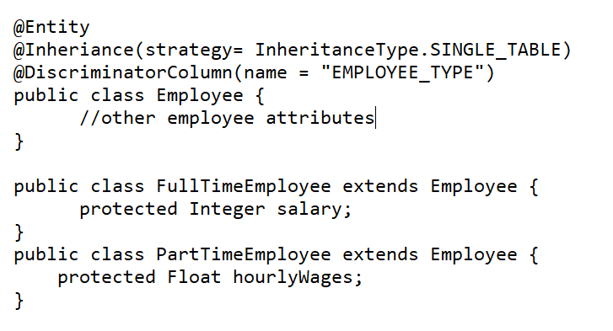
Example 1
Task table below is mapped to Task Object. How ever there are mismatches with column name. We will use JPA annotation to do the mapping.

Slide 80
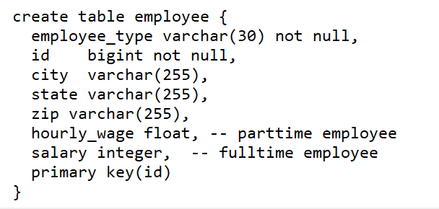
Example 1

