Slide 1
Deep Learning Software PyTorch
Department of Computer Science, NCTU
TA 陳昭宇
Some slides are from Stanford CS231n

Slide 2





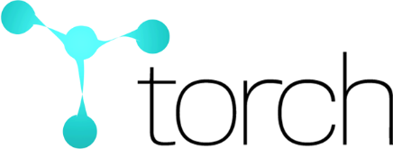


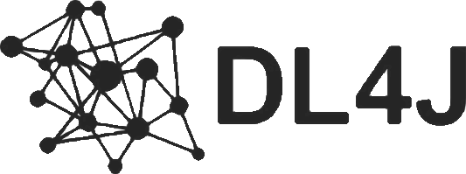


Frameworks
And others……

Slide 3

Frameworks
Most people use these
And others……

Slide 4
Frameworks
We will focus on this
And others……

Slide 5
The advantages of deep learning frameworks
Developing and testing new ideas are quickly
Computing gradients automatically
Running model structures on GPU is efficiently
Please use PyTorch to complete all your assignments !!

Slide 6


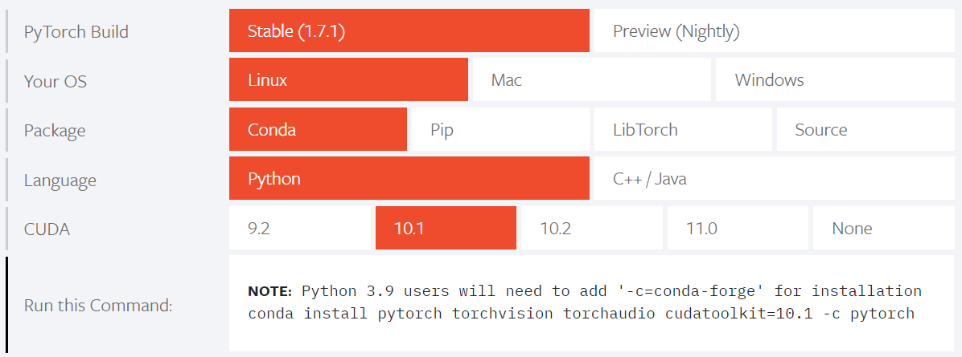
Install PyTorch
http://pytorch.org/
https://pytorch.org/get-started/previous-versions/
https://www.anaconda.com/
For this class we are using PyTorch version 1.7
This version makes a lot of changes to some of the core APIs around autograd, tensor construction, tensor datatypes, devices, etc
Be careful if you are looking at older PyTorch code!
TA’s environment

Slide 7
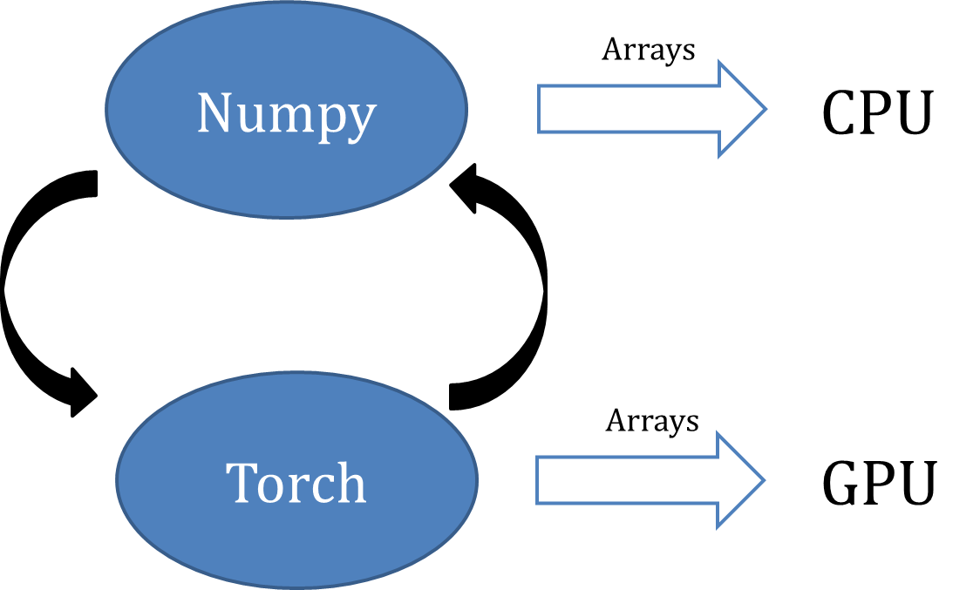
PyTorch Fundamental Concepts
Tensor : torch.Tensor is the central class of the package. It is like a numpy array but can run on GPU.
Autograd : The autograd package provides automatic differentiation for all operations on Tensors.
Module : A neural network layer stores both state and learnable weight.

Slide 8
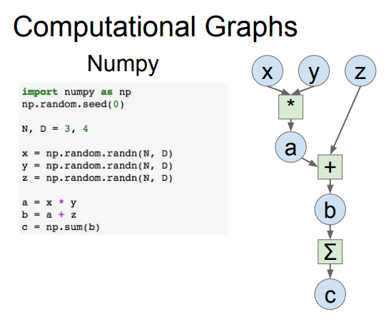

$$x×y+z$$
Neural network can be denoted as a directed acyclic graph

Slide 9
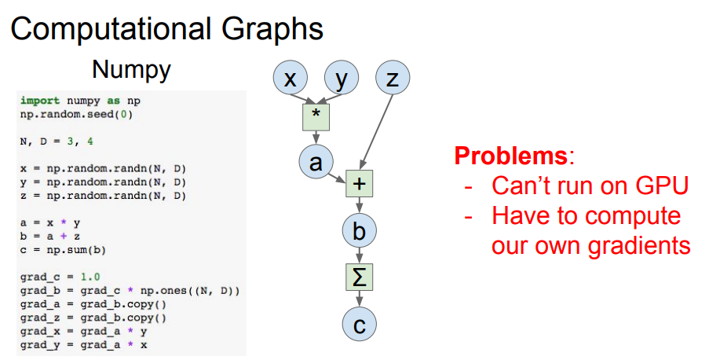
compute gradients

Slide 10
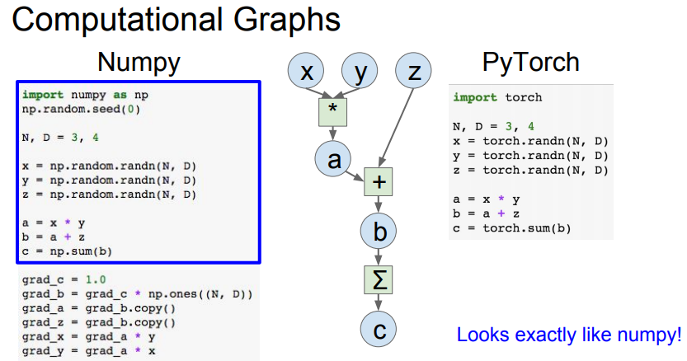

Slide 11
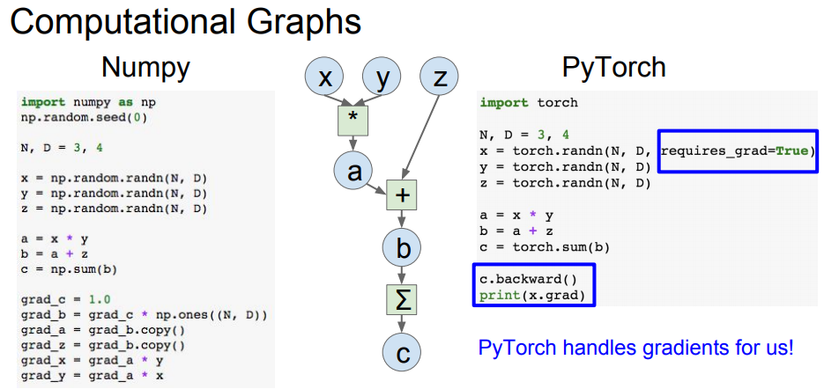
.backward() compute gradient

Slide 12
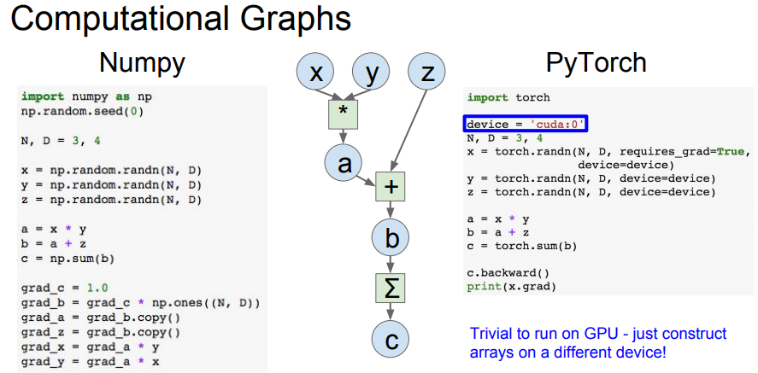

Slide 13

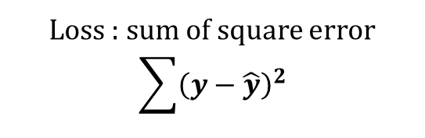

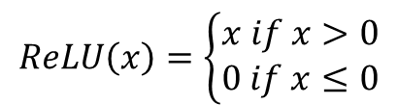


Example
2-layer network
Input: 1000 , batch size = 64
$$x:64×1000$$
Hidden Layer: 100
$$w1:1000×100$$
$$ReLU\left(x\right)=\left\{\begin{aligned}x if x>0 \\ 0 if x≤0\end{aligned}\right.$$
ReLU
Out Layer: 10
$$w2:100×10$$
Loss : sum of square error
$$\sum{{\left(y−\hat{y}\right)}^{2}}$$
$$y :64×10$$

Slide 14
Flow Chart
Prepare data
Create model
Forward pass
Repeat n times or until convergence
Training
Backward pass
Update weights

Slide 15
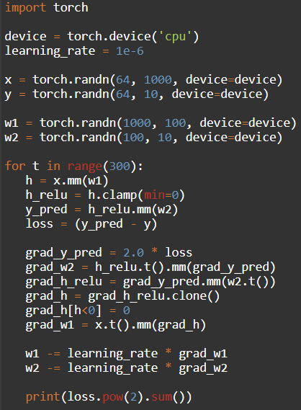
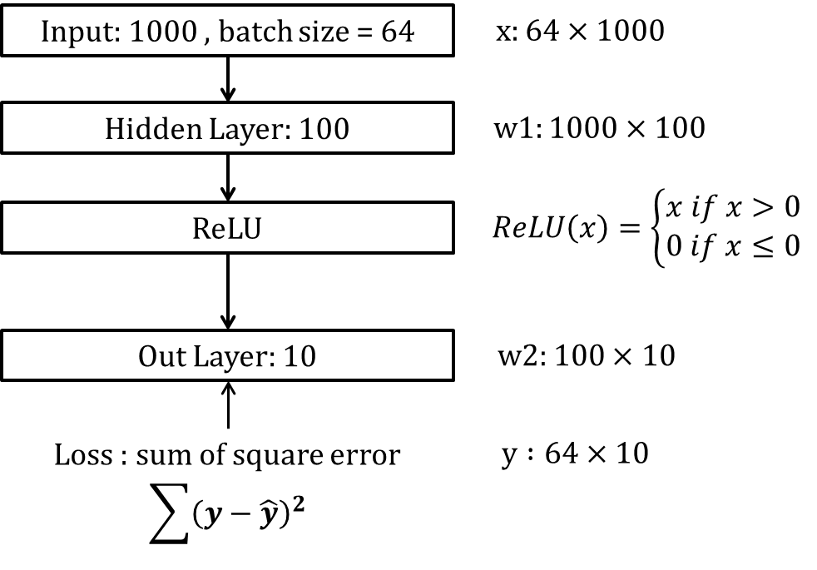
Step1. Prepare Data
PyTorch Tensors
Create random tensors as input and ground truth
To run on GPU, just use a different device, like a following:

Slide 16
Step2. Create Model
PyTorch Tensors
Create random tensors as layer weights

Slide 17
Step3. Forward pass
PyTorch Tensors
Compute predictions and loss

Slide 18
Step4. Backward pass
PyTorch Tensors
Manually compute gradients

Slide 19
Step5. Update Weights
PyTorch Tensors
Gradient descent step on weights

Slide 20
Easily implement your own deep learning model by using PyTorch

Slide 21
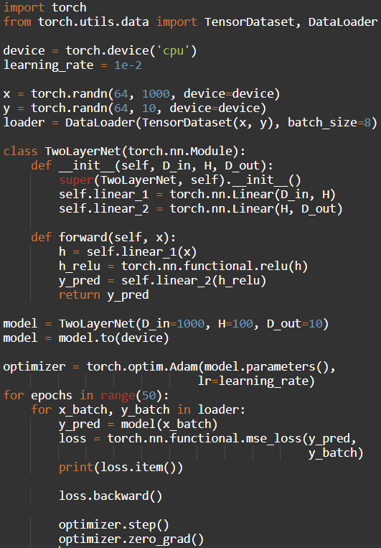
Step1. Prepare Data
PyTorch.utils.data
DataLoader wraps a Dataset and provides minibatches, shuffling, multithreading, for you
When you need to load custom data, just write your own Dataset class
Iterate over loader to form mini-batchs
https://github.com/utkuozbulak/pytorch-custom-dataset-examples

Slide 22
Step2. Create Model
PyTorch.nn
Higher-level wrapper for working with neural nets
Use this ! It will make your life easier
A PyTorch Module is a neural net layer, it can contain weights or other modules
Define your whole model as a single module

Slide 23
Step2. Create Model
PyTorch.nn
Initializer sets up two children (Module can contain Modules)

Slide 24
Step2. Create Model
PyTorch.nn
Define forward pass using child modules
No need to define backward – autograd will handle it

Slide 25
Step3. Forward pass
PyTorch.nn
Define forward pass using child modules
Feed data to model, and compute loss
nn.functional has useful helpers like loss functions

Slide 26
Step4. Backward pass PyTorch.autograd
Forward pass looks exactly the same as before, but we don’t need to track intermediate values
PyTorch keeps track of them for us in the computational graph
Compute gradient of loss with respect to all model weights (they have requires_grad=True)

Slide 27
Step5. Update Weights PyTorch.optim
Use an optimizer for different update rules
After computing gradients, use optimizer to update each model parameters and reset gradients

Slide 28
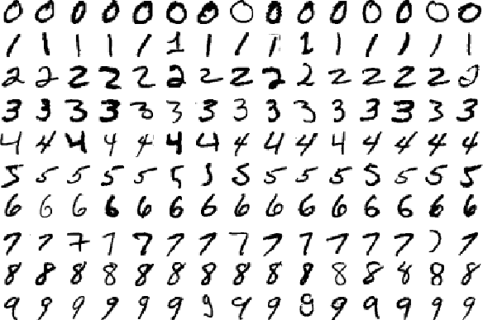
Real Application
MNIST example for PyTorch
https://github.com/pytorch/examples/tree/master/mnist

Slide 29
Build and train a CNN classifier
Data Loader
Define Network
Define Optimizer/Loss function
Learning rate scheduling
Training
Testing
Run and Save model

Slide 30
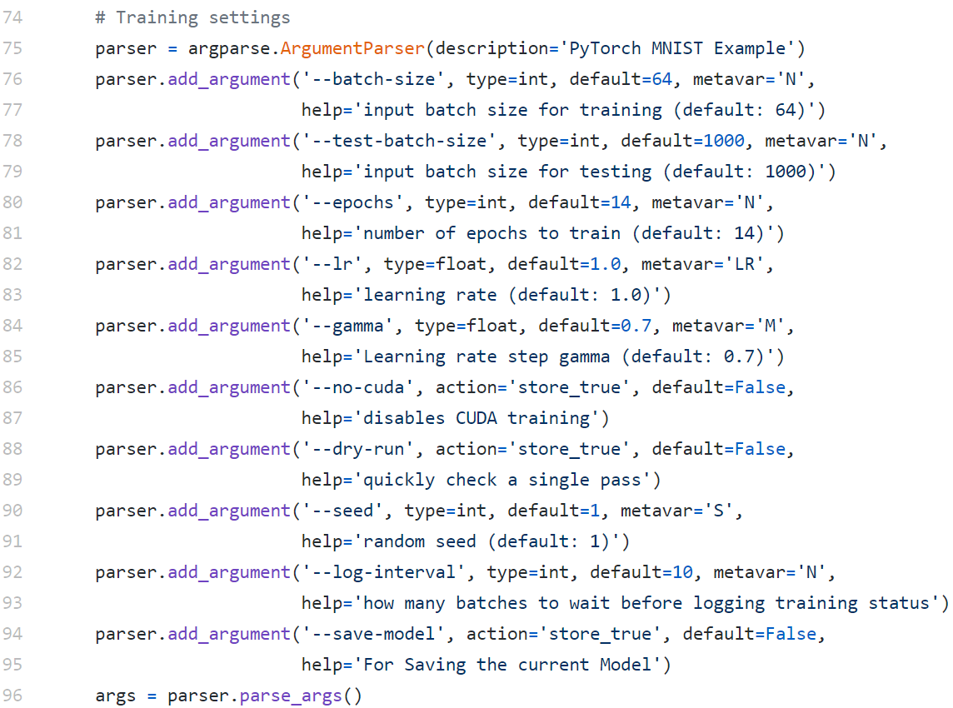
Set hyperparameters

Slide 31
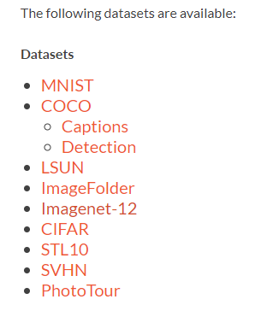
Data Loader
Pytorch offers data loaders for popular dataset

Slide 32
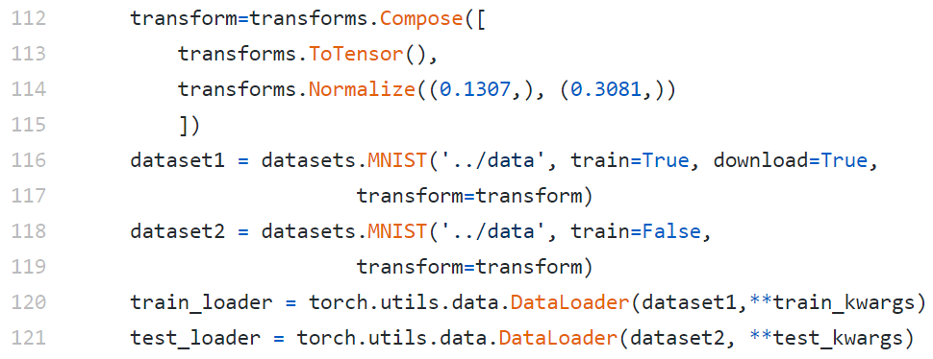
Data Loader

Slide 33
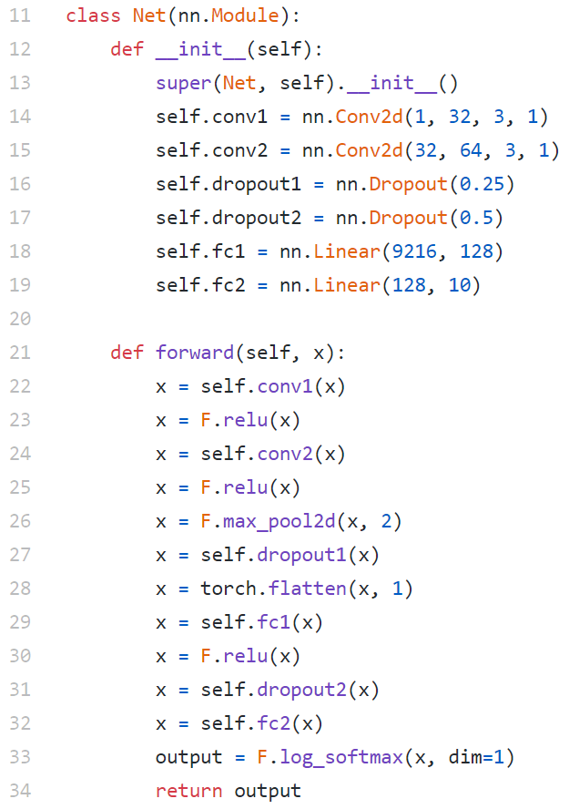
Define Network

Slide 34
Define Optimizer/Loss function
Negative log likelihood loss
Adadelta

Slide 35
Learning rate scheduling

Slide 36
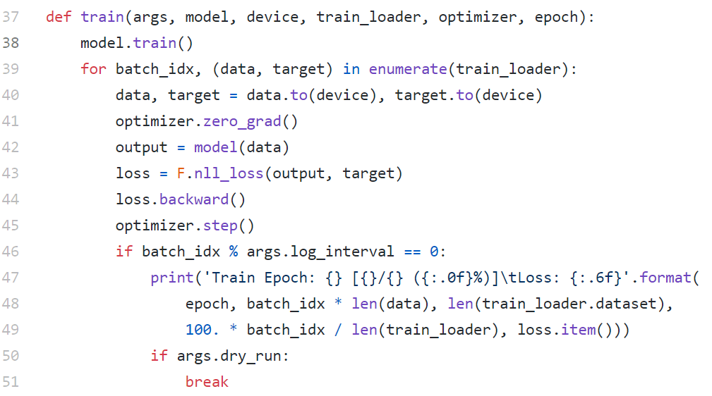
Training

Slide 37
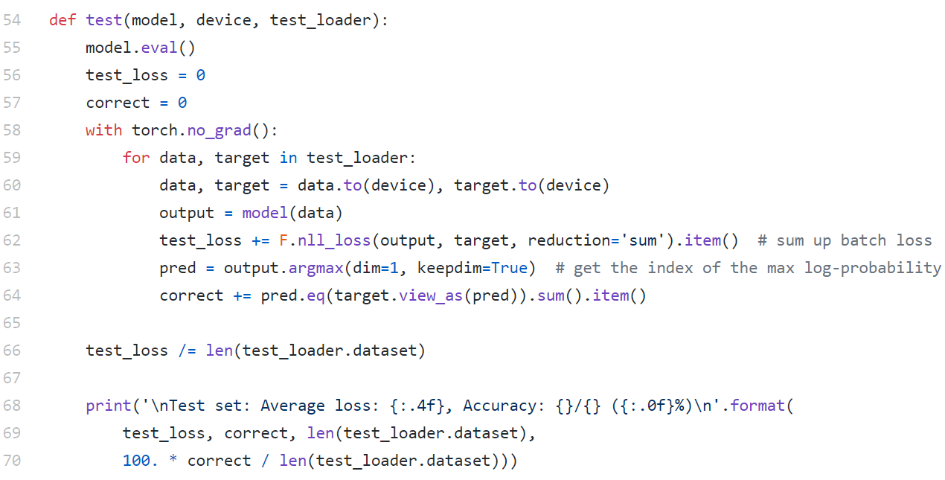
Testing

Slide 38
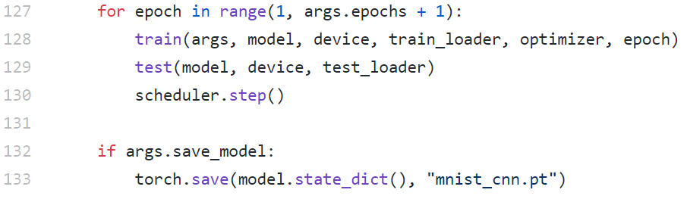
Run and Save model

