Slide 1
NCTU DLP Lab1 - Backpropagation
TA 陳璽存
March 23, 2020

Slide 2
Outline
Lab Objective
Important Date
Lab Description
Scoring Criteria
Notes:
This course is a graduate-level course, which was first offered in spring term of 2017.
It is instructed by two other professors and me.
Back then, about 55 students were enrolled in this course.
In fact, we had a lot more students hoping to take it.
But, we could accept only 60 of them due to limited GPUs we have.
This course was concluded with a workshop in July this summer, with 26 teams presenting their final projects.
In this workshop, we also invited few experts from the industry to grade the students’ performance.
Some of them were amazed by the diversity of the students’ projects.

Slide 3
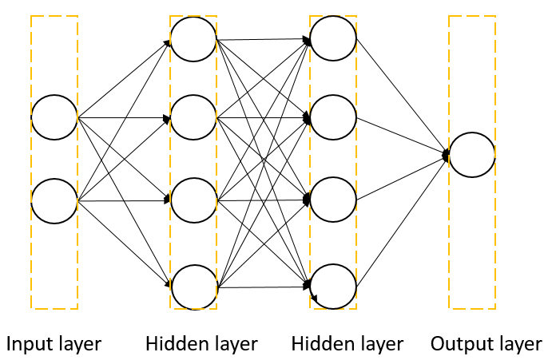
Lab Objective
In this lab, you will need to understand and implement a simple neural network with forward and backward pass using two hidden layers

Slide 4
Important Date
Report Submission Deadline: 3/30 (Tue) 12:00 p.m
Demo date: 3/30 (Tue)
Zip all files in one file
Report (.pdf)
Source code
name it like「DLP_LAB1_yourstudentID_name.zip」
ex: 「DLP_LAB1_309551009_陳璽存.zip」

Slide 5
Lab Description
Implement a simple neural network with two hidden layers
You can only use Numpy and other python standard libraries.
Plot your comparison figure showing the predictions and ground truth.
Plot your learning curve (loss, epoch).
Print the accuracy of your prediction.

Slide 6














Lab Description
$${ x}^{n}$$
Neural Network
$$Model$$
$$θ$$
$${ y}^{n}$$
$${ \hat{y}}^{n}$$
Loss Function
$$L(θ)$$
Input
Model
Output
Ground
truth
$$∇L\left(θ\right)=$$
$$\left[\begin{aligned}∂L\left(θ\right)/∂w_{1} \\ ∂L\left(θ\right)/∂w_{2} \\ ∂L\left(θ\right)/∂w_{3} \\ ⋮ \\ ⋮\end{aligned}\right]$$
$${Compute ∇L(θ}^{0})$$
$$θ^{1}={θ^{0} − ρ ∇L(θ}^{0})$$
$$θ=\{w_{1},w_{2},w_{3},w_{4},⋯\}$$
$${Compute ∇L(θ}^{1})$$
$$θ^{2}={θ^{0} − ρ ∇L(θ}^{1})$$
$${Compute ∇L(θ}^{2})$$
$$θ^{3}={θ^{0} − ρ ∇L(θ}^{2})$$
$$ρ :Learning rate$$

Slide 7
Lab Description – Flowchart
Prepare data
Create model
Forward pass
Repeat n times or until convergence
Training
Backward pass
Update weights

Slide 8
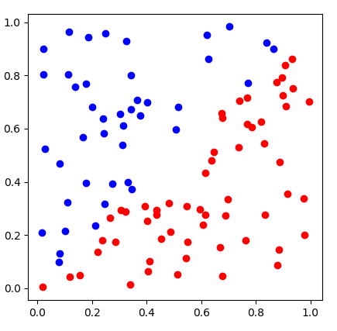
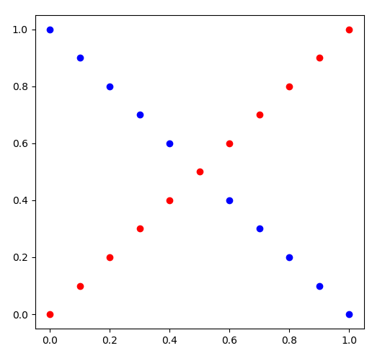
Lab Description - Data
generate_linear()
generate_XOR_easy()

Slide 9
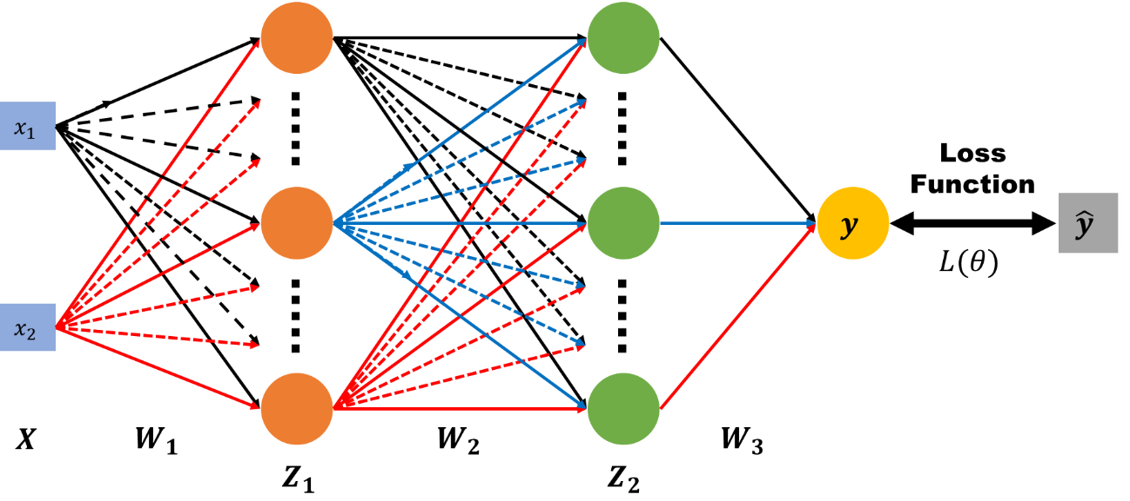
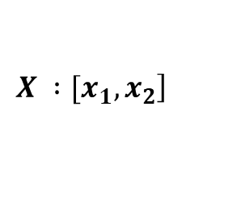


Lab Description – Architecture
$$\left.X :[x_{1}, x_{2}\right]$$
$$y : outputs$$
$$\hat{y} : ground truth$$
$W_{1}, W_{2}, W_{3}$ $: weight matrix of network layers$

Slide 10
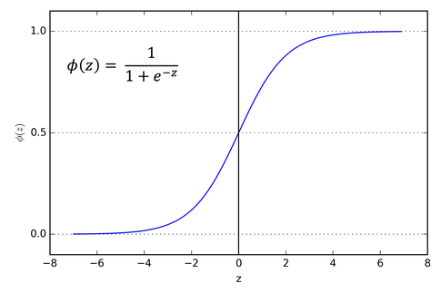
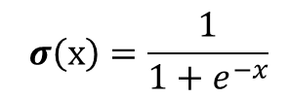
Lab Description – Forward
$Z_{1}=σ(XW_{1})$ $Z_{2}=σ(Z_{1}W_{2})$ $y=σ(Z_{2}W_{3})$
$$σ\left(x\right)=\frac{1}{1+e^{−x}}$$

Slide 11




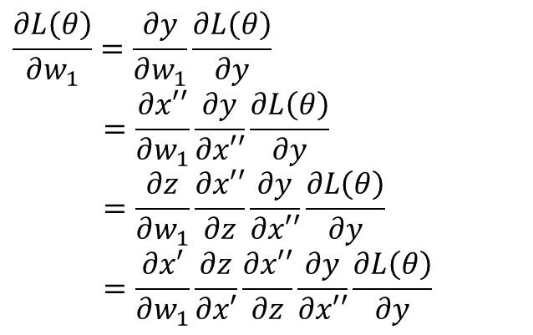







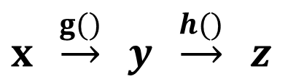
Lab Description – Backward
$$x′$$
$$z$$
$$x′′$$
$$x$$
$$y$$
$$\hat{y}$$
$$w_{1}$$
$${w′}_{1}$$
$$L(θ)$$
$x′=xw_{1}$ $z=σ(x′)$ $x′′=z{w′}_{1}$ $y=σ(x′′)$
$$\frac{∂L\left(θ\right)}{∂w_{1}}=\frac{∂y}{∂w_{1}}\frac{∂L\left(θ\right)}{∂y}$$
$$=\frac{∂x′′}{∂w_{1}}\frac{∂y}{∂x′′}\frac{∂L\left(θ\right)}{∂y}$$
$$=\frac{∂z}{∂w_{1}}\frac{∂x′′}{∂z}\frac{∂y}{∂x′′}\frac{∂L\left(θ\right)}{∂y}$$
$$=\frac{∂x′}{∂w_{1}}\frac{∂z}{∂x′}\frac{∂x′′}{∂z}\frac{∂y}{∂x′′}\frac{∂L\left(θ\right)}{∂y}$$
Chain rule
$y=g\left(x\right) z=h(y)$
$x \underset{→}{g()} y \underset{→}{h()} z$
$$\frac{dz}{dx}=\frac{dz}{dy} \frac{dy}{dx}$$

Slide 12
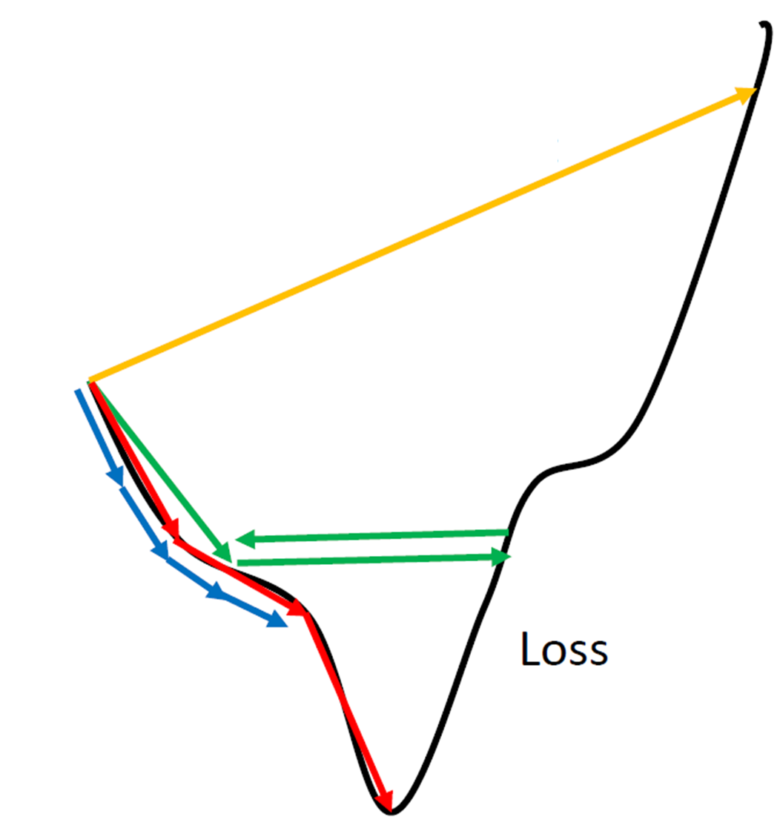










Lab Description – Gradient descent
Network Parameters
$$θ=\{w_{1},w_{2},w_{3},w_{4},⋯\}$$
$$∇L\left(θ\right)=$$
$$\left[\begin{aligned}∂L\left(θ\right)/∂w_{1} \\ ∂L\left(θ\right)/∂w_{2} \\ ∂L\left(θ\right)/∂w_{3} \\ ⋮ \\ ⋮\end{aligned}\right]$$
$${Compute ∇L(θ}^{0})$$
$$θ^{1}={θ^{0} − ρ ∇L(θ}^{0})$$
$$ρ :Learning rate$$
$${Compute ∇L(θ}^{1})$$
$$θ^{2}={θ^{0} − ρ ∇L(θ}^{1})$$
$${Compute ∇L(θ}^{2})$$
$$θ^{3}={θ^{0} − ρ ∇L(θ}^{2})$$
$$⋮$$
http://www.denizyuret.com/2015/03/alec-radfords-animations-for.html

Slide 13
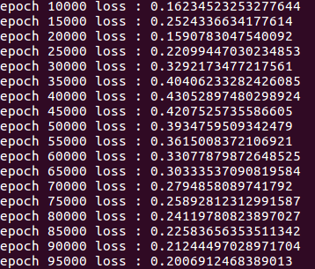
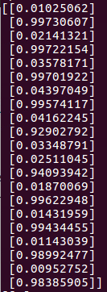
Lab Description - Prediction
In the training, you need to print loss
In the testing, you need to show your predictions, also the accuracy

Slide 14
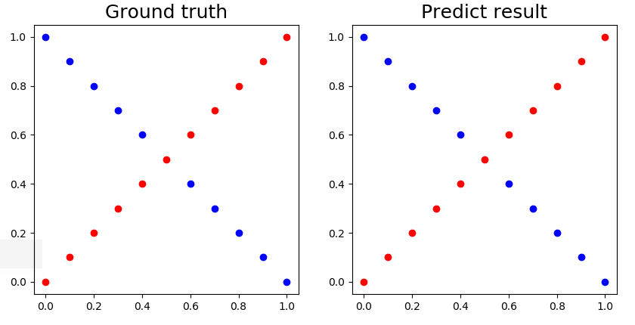
Lab Description - Prediction
Visualize the predictions and ground truth at the end of the training process

Slide 15
Scoring Criteria
Report (40%)
Demo(60%)
Experimental results (40%)
Questions (20%)
Late report or demo
Before 7/2.

Slide 16
Reference
http://www.denizyuret.com/2015/03/alec-radfords-animations-for.html
http://speech.ee.ntu.edu.tw/~tlkagk/courses_ML17_2.html

Slide 17
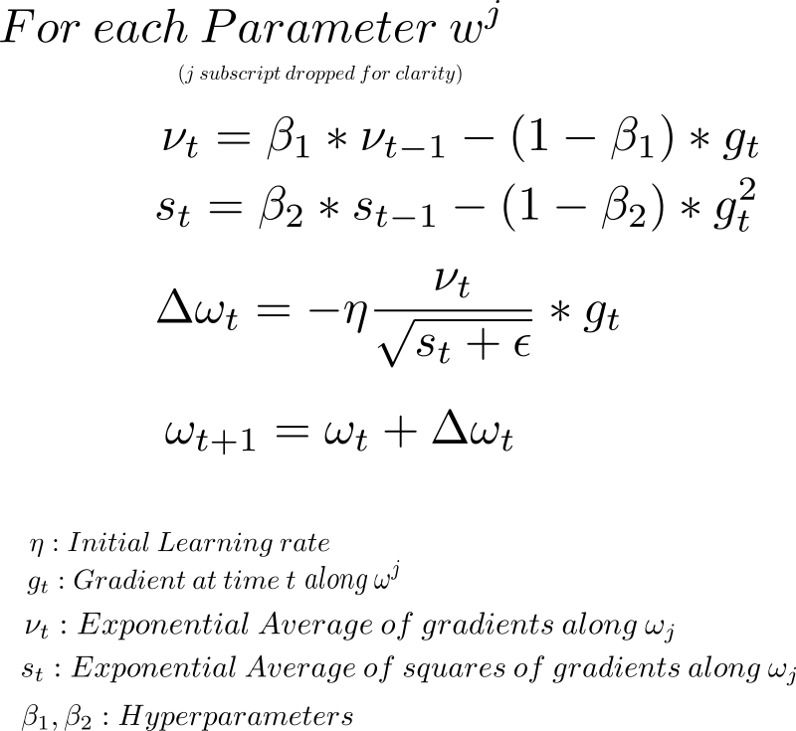
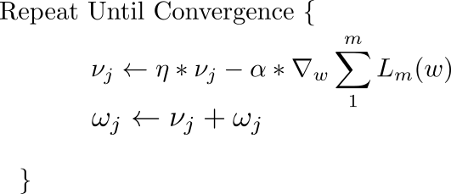
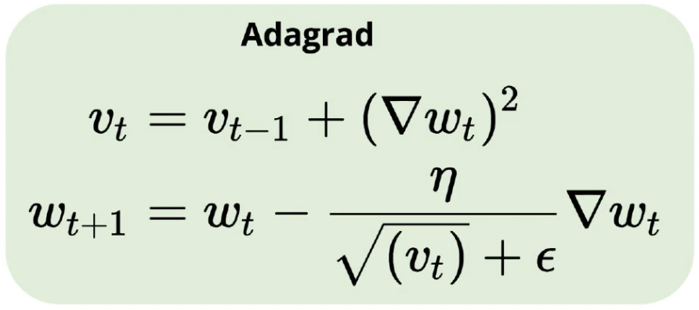
Optimizers
SGD – minibatch
Momentum
Adagrad
Adam

Slide 18
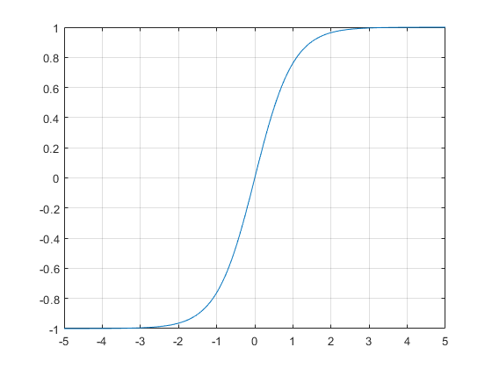
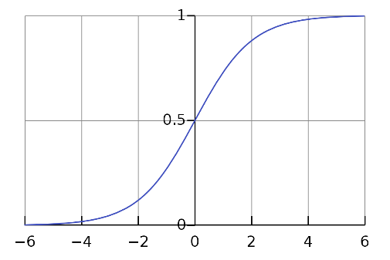
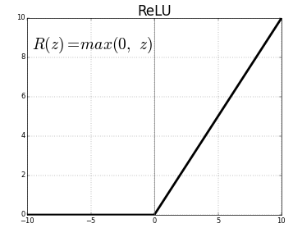
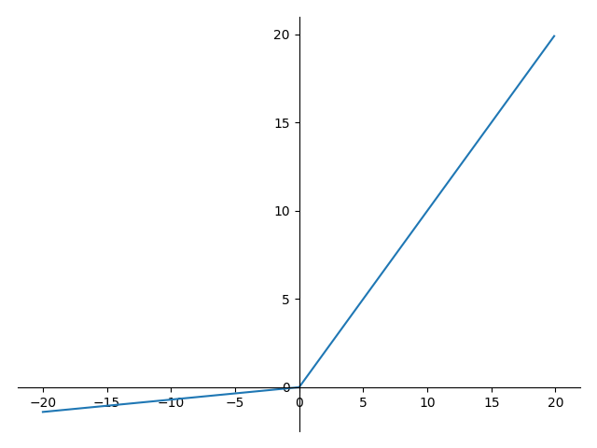
Activation functions
Sigmoid
Tanh
Relu
Leaky Relu

Slide 19
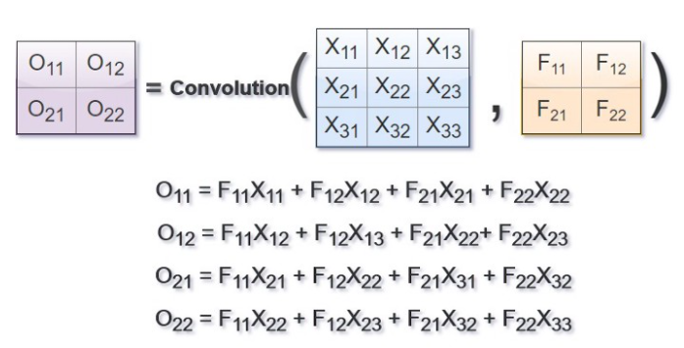
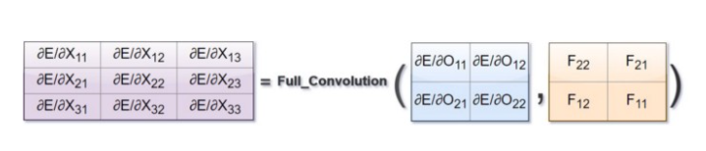
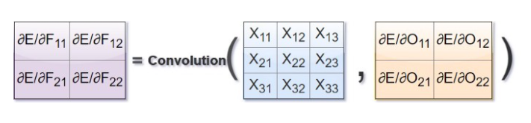
Backpropagation in Convolutional Neural Network
Reference : https://medium.com/@2017csm1006/forward-and-backpropagation-in-convolutional-neural-network-4dfa96d7b37e

