Slide 1
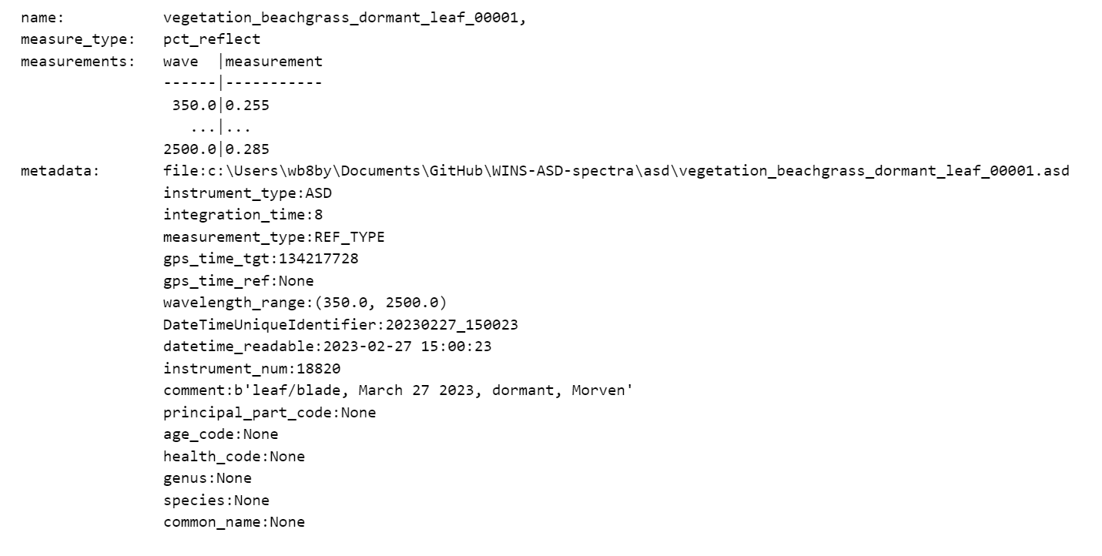
Nature Based Infrastructure
Deliverable: libMaker
[Software for making spectral libraries]
Part 01b.1 Reading raw ASD files, renaming using UPWINS convention, and saving as UPWINS ASD file.
Inputs:
L0 data:
UPWINS convention ASD file:
01b.1
.asd files
[Collected with
field spectrometer]
Read file with libMaker.read
Variable Class: libMaker.spectrum
[This is a custom class for spectra using the UPWINS conventions and metadata.]
Filed copied to directory Main_ASD_Dir
Renamed with UPWINS Convention:
UPWINS_LatinGenus_latinspecies_PincipalPart_agecode_healthcode_DateTimeUniqueIdentifier
Ammophila_breviligulata_SA_1G_H_20230227_150023.asd

Slide 2
Nature Based Infrastructure
Deliverable: libMaker
[Software for making spectral libraries]
Part 01b.2 Reading UPWINS ASD files, creating csv file with metadata, and saving
as ENVI .sli spectral library.
Inputs:
L0 data:
Pandas DataFrame class:
01b.2
UPWINS Convention ASD files
Read file with libMaker.read
Variable Class: libMaker.spectrum
…
Ammophila_breviligulata_SA_1G_H_20230227_150023.asd

Slide 3
APPENDIX: Nature Based Infrastructure
Plant Naming Codes
Examples
Bacc_hal_L_1G_H_00006
Ilex_vom_IS_RE_H_00001
Plant Codes:
Ammo_bre_SA_1G_H_DateTimeUniqueIdentifier
Bacc_hal_RS_1G_H_DateTimeUniqueIdentifier
Cham_fas_S_E_H_DateTimeUniqueIdentifier
Chas_lat_B_E_H_DateTimeUniqueIdentifier
Ilex_vom_IS_E_H_DateTimeUniqueIdentifier
Iva_fru_CS_RE_H_DateTimeUniqueIdentifier
More_pen_SA_PE_H_DateTimeUniqueIdentifier
Robi_his_SA_PE_H_DateTimeUniqueIdentifier
Rosa_rug_SA_1G_H_DateTimeUniqueIdentifier
Pani_vir_B_E_H_DateTimeUniqueIdentifier
Pani_ama_B_E_H_DateTimeUniqueIdentifier
Soli_sem_L_1G_H_DateTimeUniqueIdentifier
Soli_rug_L_1G_H_DateTimeUniqueIdentifier
For Non-Plant Collections
Specify Material, then Location. Examples:
Sand_Luegering Lettuce Farm_00001
Or
Material_Roadway_Farmname_00002
Plant Table for Reference:
Ammophila breviligulata American Beachgrass
Chasmanthium latifolium River Oats
Panicum amarum Coastal Panic Grass
Panicum virgatum Switch Grass
Solidago Sempervirens Seaside Goldenrod (Soli_sem)
Robinia hispida Bristly locust (Robi_his)
Morella pennsylvanica Northern Bayberry (More_pen)
Rosa rugosa Sandy Beach Rose (Rosa_rug)
Chamaecrista fasciculata Partridge Pea (Cham_fas)
Solidago Rugosa Wrinkleleaf goldenrod (Soli_sem)
Baccharis halimifolia Groundseltree (Bacc_hal)
Iva frutescens Jesuits Bark (Iva_fru)
Ilex vomitoria Yaupon Holly (Ilex_vom)
UPWINS_LatinGenus_latinspecies_PincipalPart_agecode_healthcode_DateTimeUniqueIdentifier
Principal Part Codes:
Mix MX
Dicot - Woody Vines (ex. Rosa Rugosa)
Shoot Apex SA
Leaf L
Internode Stem IS
Colar Sprout CS
Root Sprout RS
Lignin LG
Flower FL
Monocot - (ex. Chasmanthium, Panicum, )
Blade B
Seed S
Age Code:
Post Germination Emergence PE
Re-emergence RE
Emergence (from seed) E
Dormant D
Year 1 growth 1G
Year 1 Flowering 1F
Mature M
Health Code:
Healthy H
Drought Stress DS
Salt Stress SS
*For disease infestation or other plant specifics in terrestrial collection, please input information in metadata
Plant Code:
UPWINS_LatinGenus_latinspecies_PincipalPart_agecode_healthcode_DateTimeUniqueIdentifier
- Use 4 letters for Genus, and 3 for Species
- Latin species can be lowercase

Slide 4
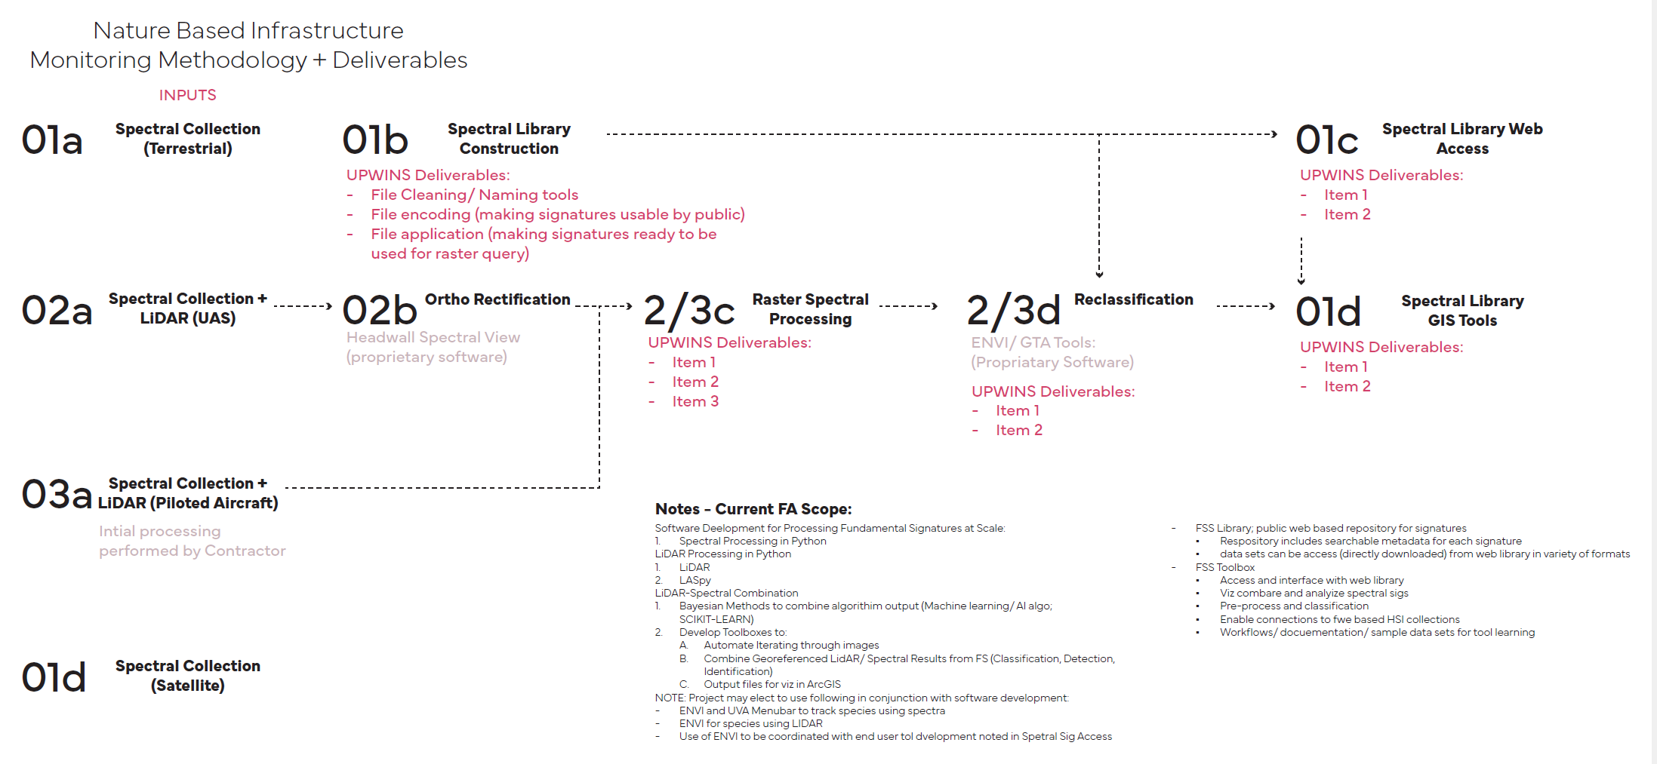
EXAMPLE PROCESSING DIAGRAM:

