Slide 1



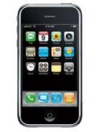
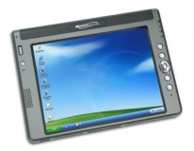


timemap
jQuery
HTTP
CoralWatch Server
Smartphones
Integration Tools
HTTP/FTP
Other
Repositories
SQL/JDBC
PostgreSQL
IMOS
PostGIS
PL/R Statistical Processing
Reef Check
CoralWatch Database

