Slide 1
RscProject
Project1
RscOrg
Team1
RscContext
RscRole
Designer
cxt1
RscOrg
Team2
RscRole
Checker
cxt2
cxt3
RscPerson
Sam
RscPerson
Bob
RscPerson
Bill

Slide 2
Technology
CustoProject
Project1
Contract
RscOrg
Team1
RscContext
RscRole
Designer
cxt1
RscOrg
Team2
RscRole
Checker
cxt2
cxt3
CustoPerson
CustoPerson
Sam
CustoPerson
Bob
CustoPerson
Bill

Slide 3
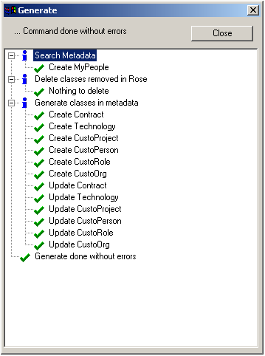

Slide 4
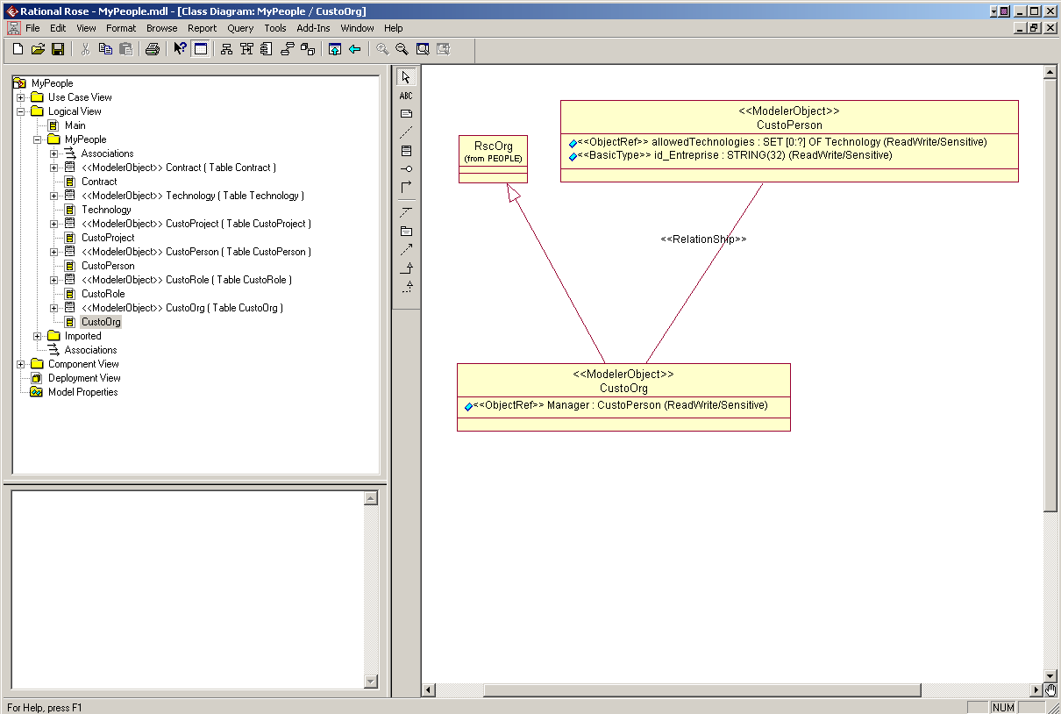

Slide 5
Project
Organization
Role
Person
DEFAULT
PROJECTCAR
PROJECTF1
ADMIN
DESIGN
MECHANIC
VPMADMIN
CHECKER
DESIGNER
ENGINEER
ADMIN
DESIGN
MECHANIC

Slide 6
Generate SQL scripts and needed files
Design the customized model
And update database
Generation of metadata file
Process 1 : Design
Process 2 : Publish in the database
(by admin ONLY)
Full People customization

