Slide 1
Coding Blends
CATTopBlend Operator
Notes:
This is the “Presentation title” page. Type the title of your presentation in the "Presentation title” field.
Cette page est la page de titre d’une présentation . Saisissez votre titre dans la zone « Titre de la présentation ».

Slide 2
SetCouplingMode
CATTopBlendCouplingMode_DomainGi (Gi = G0, G1, G2)
  Each Gi sub-domain/domain of one wire is associated with each Gi sub-domain/domain of the other wire. The extremities of sub-domain/domain are coupled.
CATTopBlendCouplingMode_Edge
  The coupling is carried out edge-by-edge. You must have the same number of vertices on each wire.

Slide 3
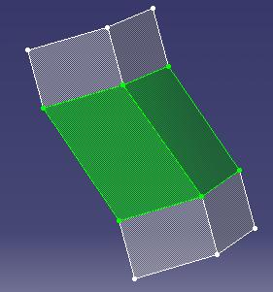
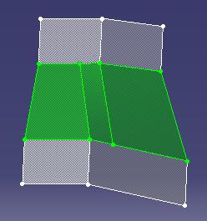
SetCouplingMode - Examples
Wire 1 and Wire 2 are G0
CATTopBlendCouplingMode_DomainG1
CATTopBlendCouplingMode_DomainG2
CATTopBlendCouplingMode_Edge
No coupling mode specified or CATTopBlendCouplingMode_DomainG0

Slide 4
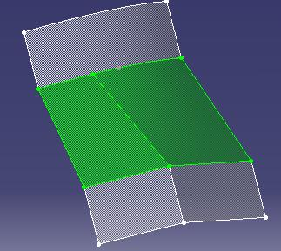
SetCouplingMode (cont’d)
Wire 1 G2 and Wire 2 G0
CATTopBlendCouplingMode_DomainG0
ERROR – not the same number of vertices
CATTopBlendCouplingMode_DomainG1CATTopBlendCouplingMode_DomainG2 CATTopBlendCouplingMode_Edge

Slide 5
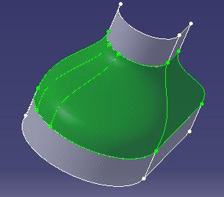
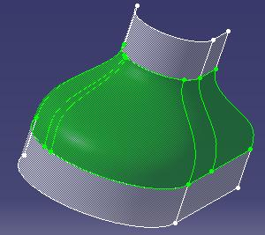
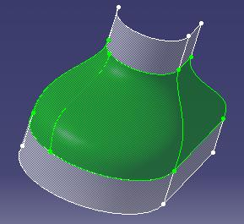
SetCouplingMode (cont’d)
Wire 1 G1 and Wire 2 are G1 –Same number of vertices/edges (sample provided)
CATTopBlendCouplingMode_DomainG2
CATTopBlendCouplingMode_DomainG0
CATTopBlendCouplingMode_DomainG1
CATTopBlendCouplingMode_Edge

Slide 6
SetCouplingLine
Wire 1 G1 and Wire 2 are G1 –Same number of vertices/edges
Note: The results below are obtained with SetTransitionContinuity.
CATTopBlendCouplingMode_DomainG2
CATTopBlendCouplingMode_DomainG0
CATTopBlendCouplingMode_DomainG1
CATTopBlendCouplingMode_Edge

Slide 7
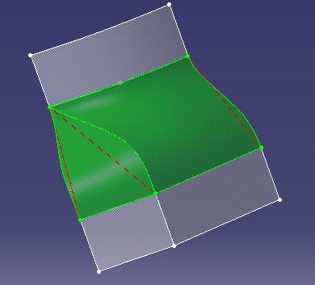
SetCouplingLines
Wire 1 G2 and Wire 2 G0 (sample provided)
Note: The result below is obtained with SetTransitionContinuity.
Three coupling lines

