Slide 1
Loan Default Prediction
Yuanhao Jiang

Slide 2
Outline
01
03
Problem Solving with Data
Getting the Data I Need
02
04
Making the Data Confess
Making the Data Fit for Use
05
Story Telling with Data

Slide 3
01
Problem Solving with Data

Slide 4
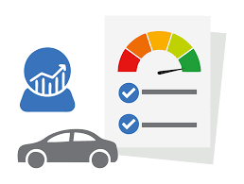
Problem solving with data
What does default mean?
Default is the failure to repay a debt, including interest or principal, on a loan.
What do we want to do?
Use visualization models to discover feature relationships, and use machine learning models to make loan classification predictions
Why making predictions is important?
As inclusive financing develops, the types and numbers of target customers are increasing. It influence every aspect of our lives.

Slide 5
Problem solving with data
Stakeholders
Banks
Internet company
Government
Investment company
Financial Institution

Slide 6
02
Getting the Data
I Need

Slide 7

Getting the Data I Need
CFF Big Data & Computing Intelligence Contest
https://www.datafountain.cn/competitions/530/datasets
(750000,42)
(10000,39)
(5000,38)

Slide 8
03
Making the Data Fit for Use

Slide 9
Data Preprocessing
Redundant features have been dropped.
Redundant Features | Description
F0-F4 | Anonymous features and there are too many missing values on them.
Region | We have post_code to gather the location of people.
Use | The use means the loan purpose category. The metadata doesn’t contain the meaning of categorical number
Censor_status | Metadata doesn’t explain it.
Titile
Policy_code

Slide 10
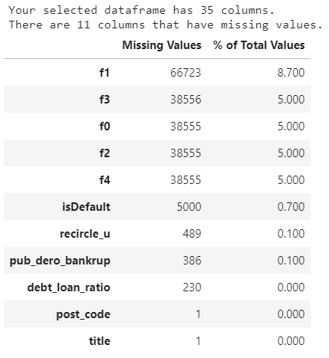
Data Preprocessing
Filled NAN values with mean values of corresponding columns.

Slide 11
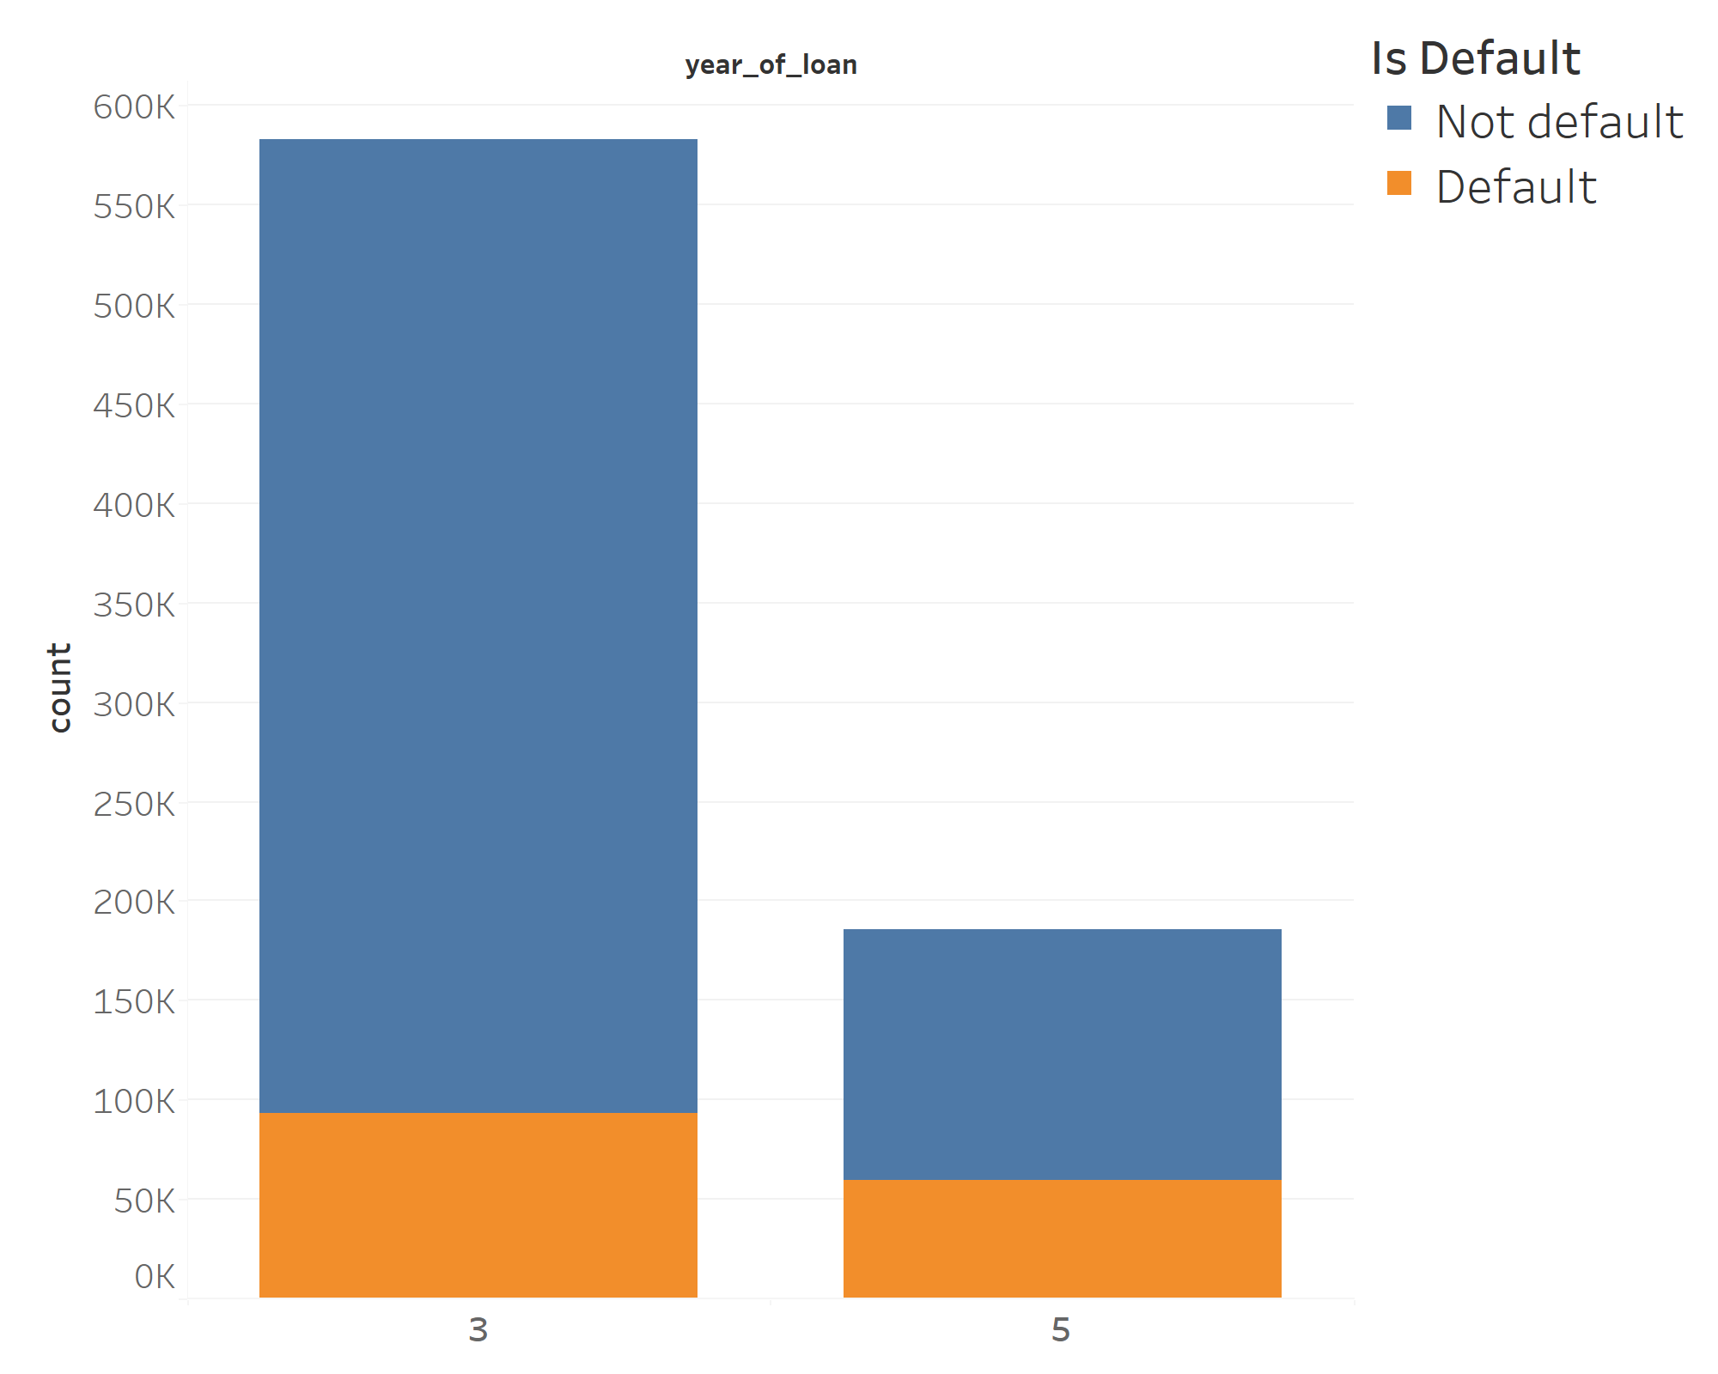
EDA
At first, we could see if they are default
and the distribution of year of loan.

Slide 12
EDA
A 3-year loan is less than that for a 5-year loan！

Slide 13
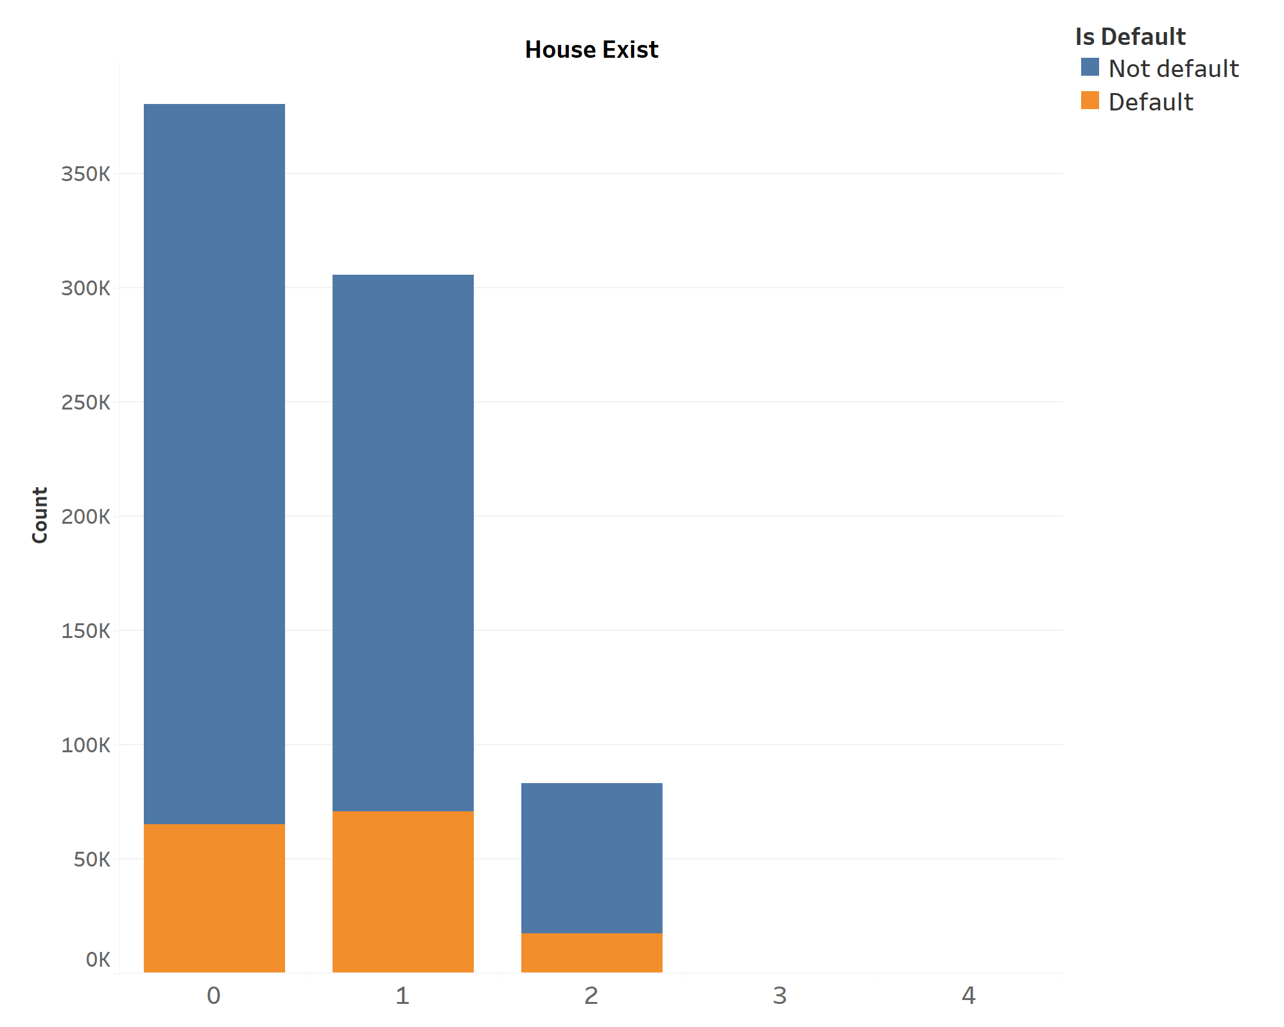
EDA
Half of the defaulters have
one or even two houses!

Slide 14
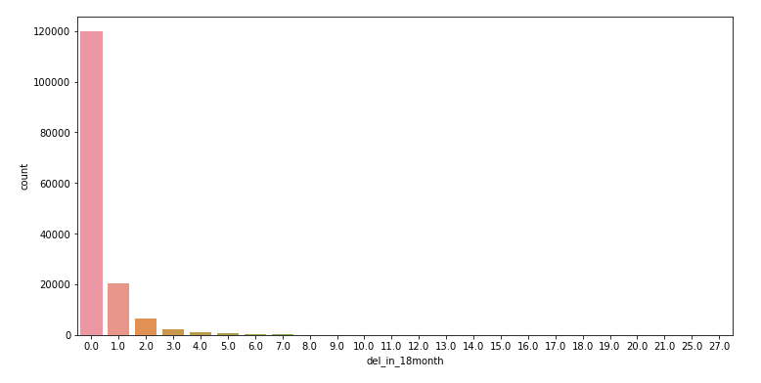
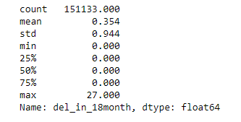
EDA
The vast majority of the data is 0.
This indicates that their recent credit is good,
and the majority of them did not default on their loans intentionally.

Slide 15
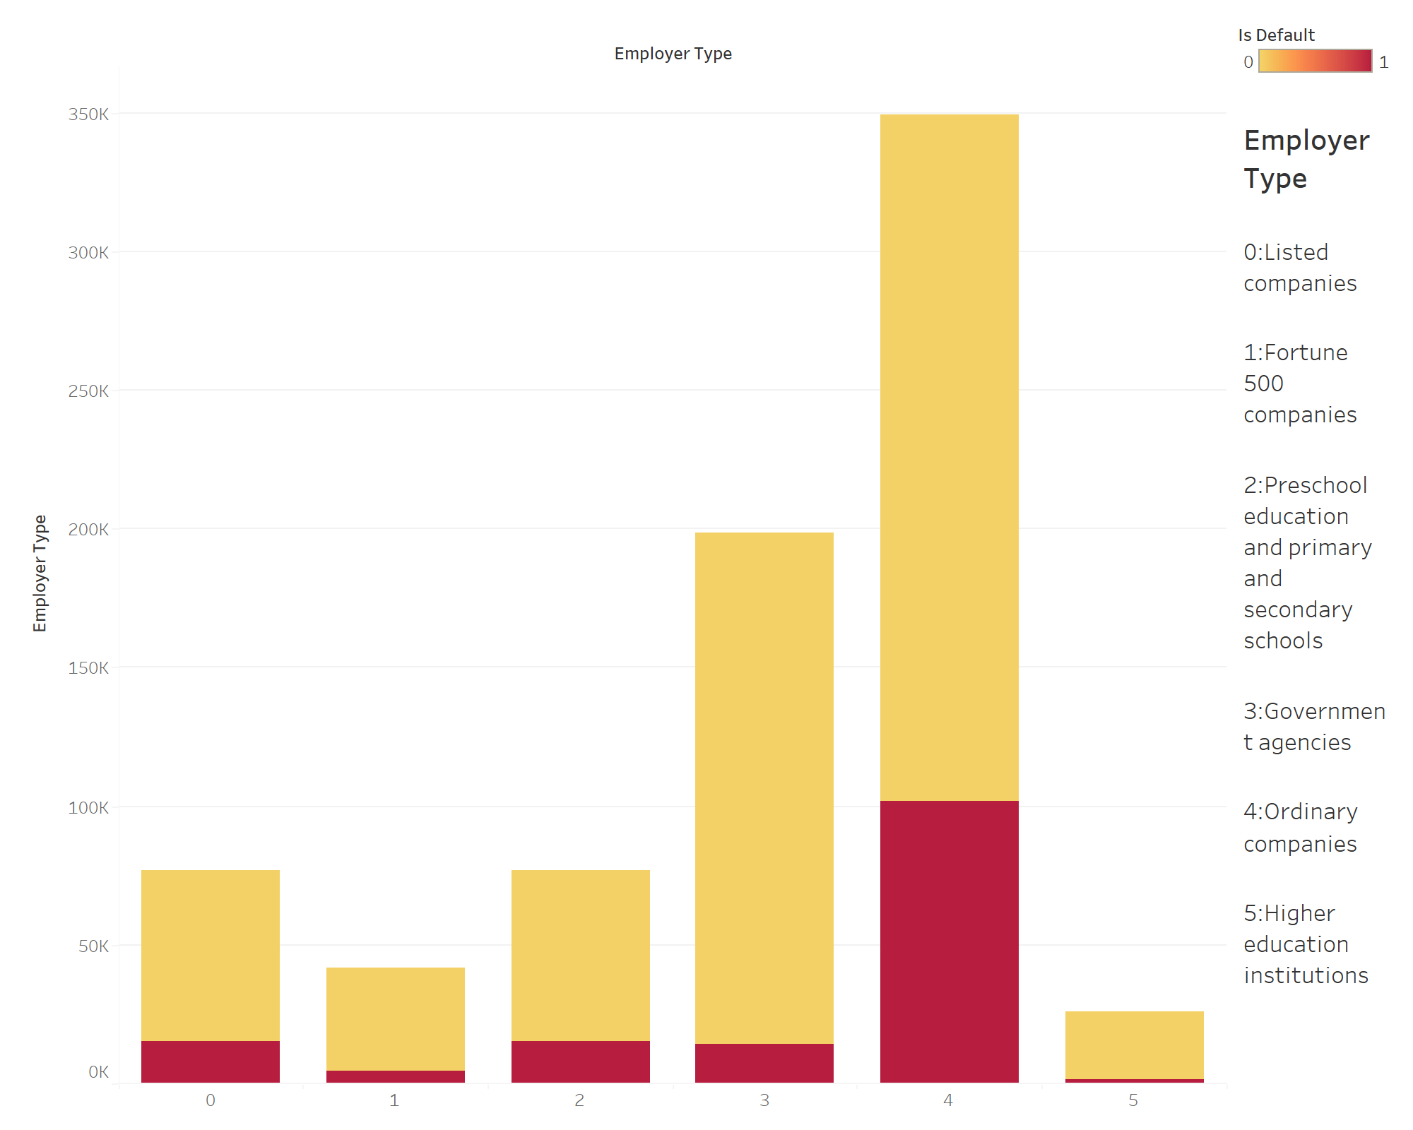
EDA
Employer Type
Employees in ordinary company
often loan and have high default rates.
Employees of Fortune 500 companies
and higher education rarely loan
and have low default rates.

Slide 16
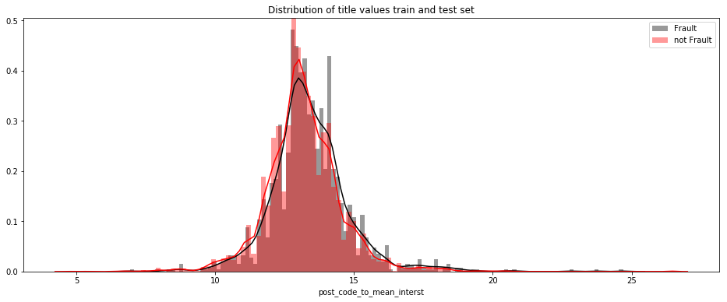
EDA
Cities with low interest rates will have lower default rates !

Slide 17
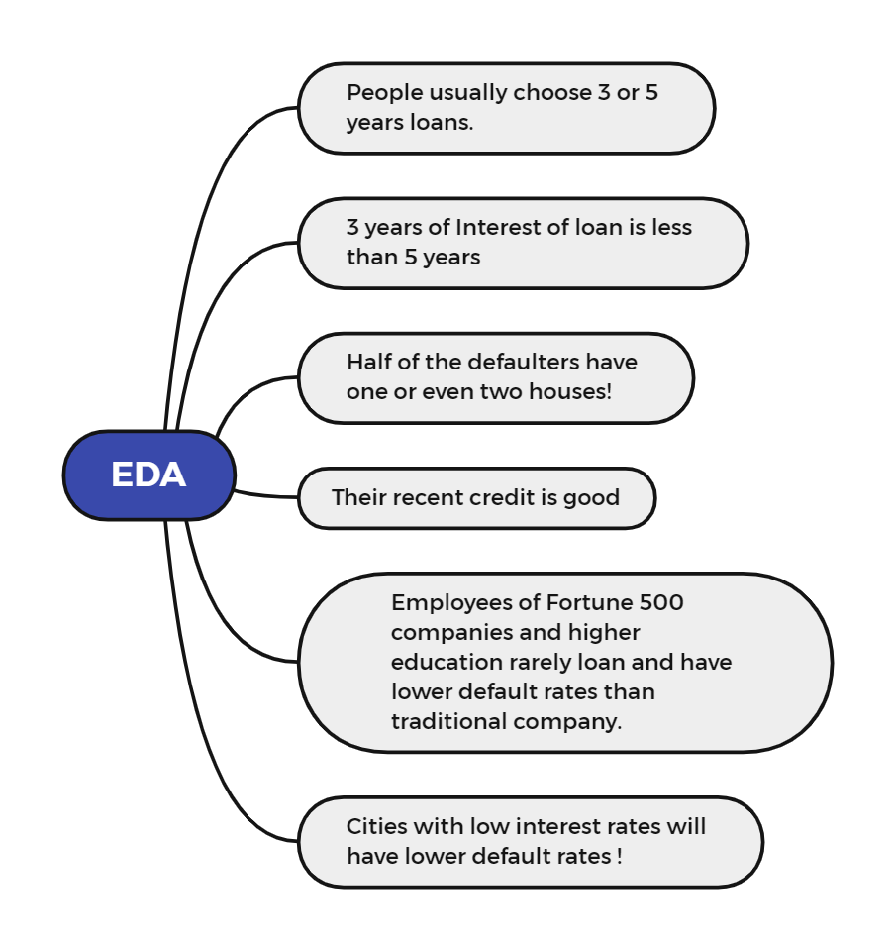
Summary

Slide 18
04
Making the Data Confess

Slide 19
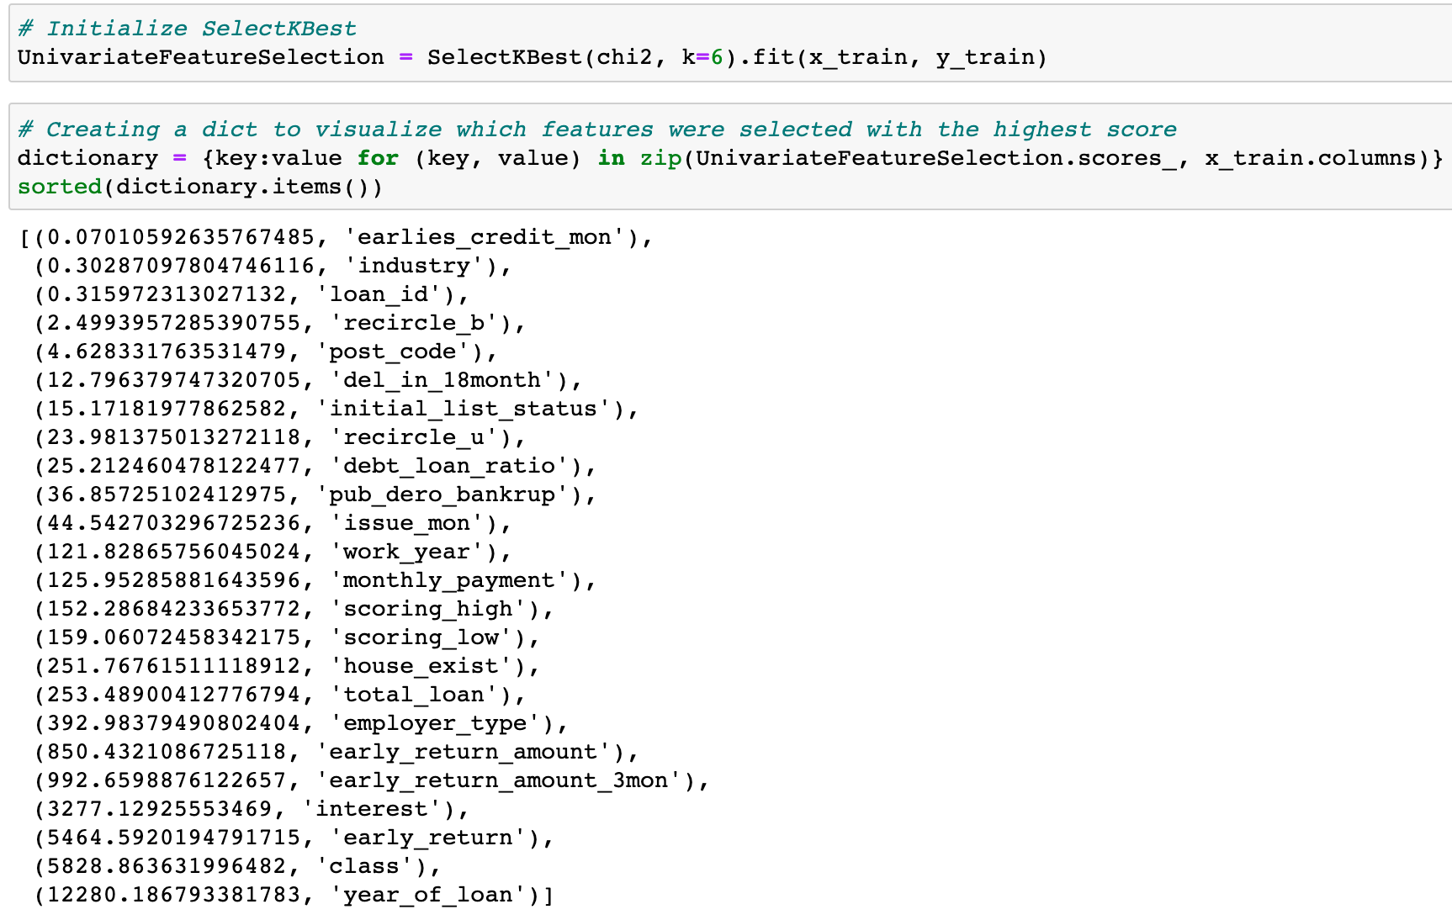
Feature Selection
Univariate Feature Selection

Slide 20
Fit Model
Input
Model
Output

Slide 21
INPUT
Input feature | Description
Year_of_loan | Duration of the loan
Class | Grades of credit evaluation
Early_return | Number of early repayments by the borrower
Interest | Current Loan Rates
Early_return_amount_3mon | Early repayment amount within the last 3 months
Early_return_amount | Accumulated amount of early repayment by the lender

Slide 22
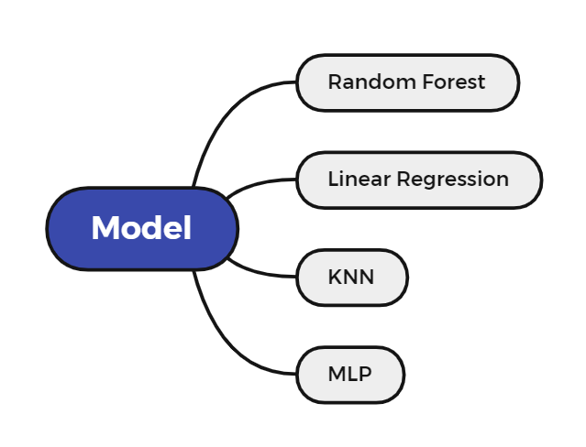
Model

Slide 23
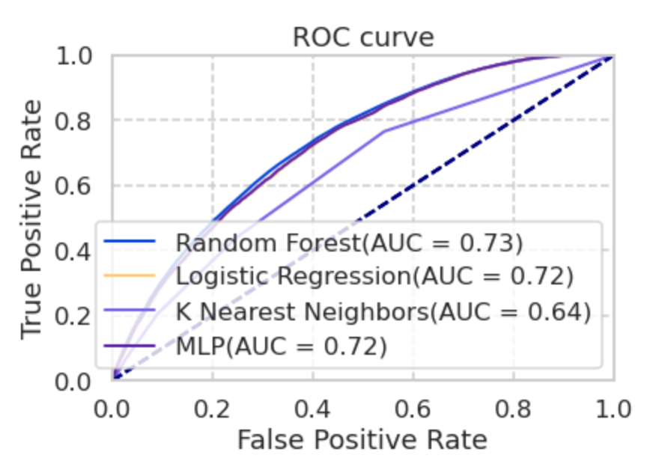
Fitting Models

Slide 24
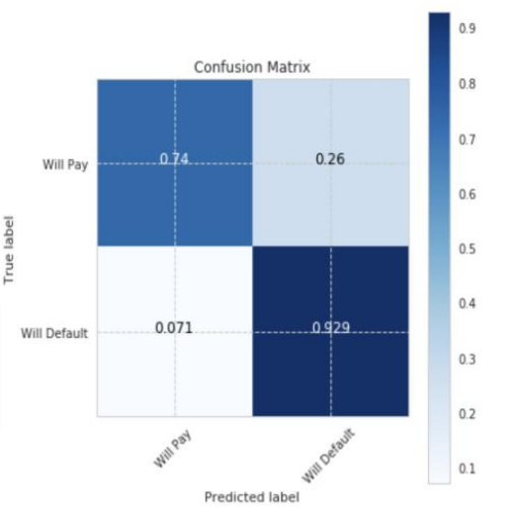
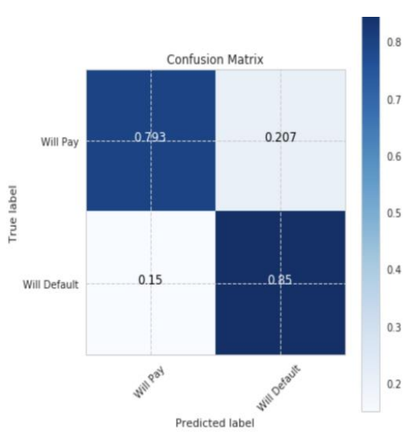
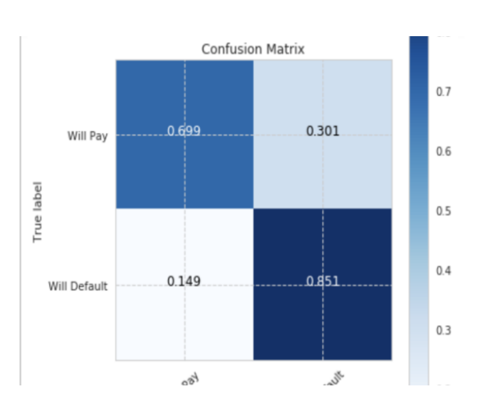
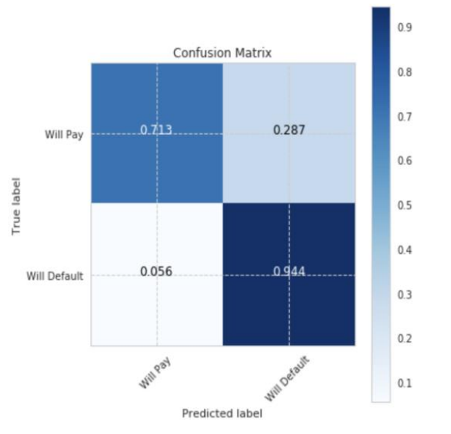
Models Evaluation
RF
Confusion
Matrix
MLP
Confusion
Matrix
Accuracy = 0.803
Accuracy = 0.802
Logisic Regression
Confusion
Matrix
KNN
Confusion Matrix
Accuracy = 0.802
Accuracy = 0.801

Slide 25
Models Evaluation
 | Random Forest | Linear Regression | KNN | MLP
ACCURACY | 0.80 | 0.80 | 0.76 | 0.80
F1 SOCRE | 0.89 | 0.89 | 0.86 | 0.89
AUC | 0.74 | 0.73 | 0.65 | 0.73

Slide 26
05
Storying Telling with Data

Slide 27
Thank You!

