Slide 1
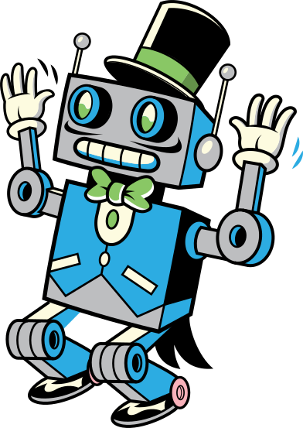
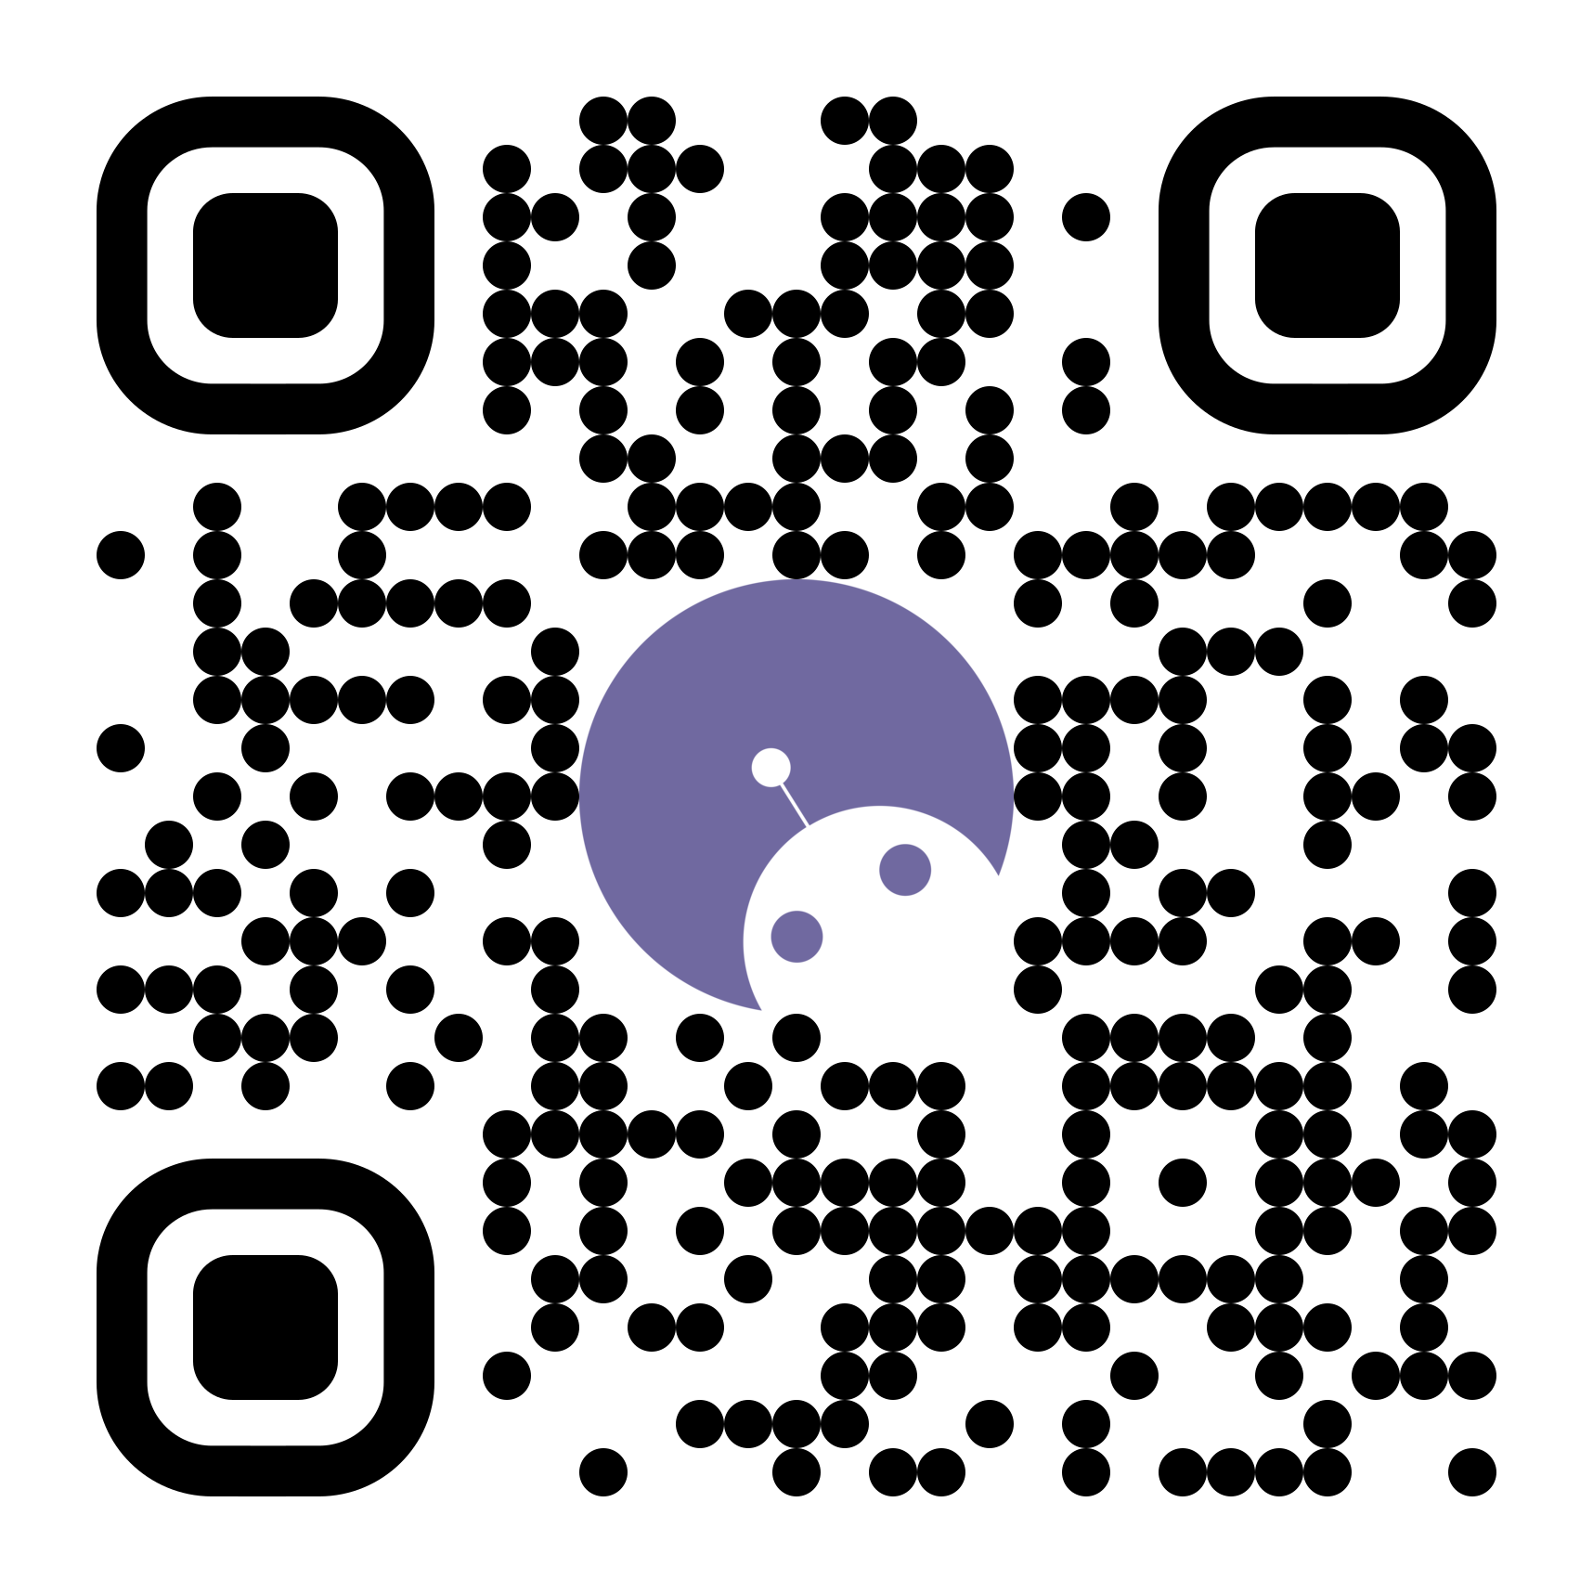

Intro to ROS2
Workshop 2026
LINKTREE
From a blank VM to a robot driving a turtlebot in Gazebo

Slide 2
Workshop Agenda
>_
0
VM Setup & Install
↓
4
Write a Subscriber
Import the VM; Ubuntu 22, ROS2 Humble, Gazebo
create_subscription and a callback
≡
1
What is ROS2?
▶
5
Build & Run
Nodes, topics, and services
colcon build, ros2 run, launch files
▦
2
Workspace & Package
⚙
6
Simulation
mars_ws, ros2 pkg create, the files it scaffolds
Controlling the TurtleBot3 in Gazebo
↑
3
Write a Publisher
▢
7
Challenge Task
Twist messages, create_publisher, create_timer
Extend the publisher with a simple state machine
ROS2 Workshop 2026
UQ MARS 2026

Slide 3
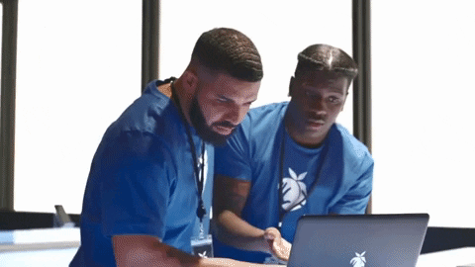
STEP 0
Before we start: the Virtual Machine
Ubuntu 22, ROS2 Humble, and Gazebo
1
Install a Virtual Machine
Get it running before the workshop, not during it.
2
Download the VM image
YOU
The provided .ova file, has ROS2 + Gazebo baked in.
UQ MARS
3
Import it
VirtualBox → File → Import Appliance → select the .ova
4
Log in
user: uqmars · password: uqmars
Optional: install Guest Additions (Devices → Insert Guest Additions CD → run VBoxGuestLinux in /media/uqmars/VboxGA) for better display scaling.
03

Slide 4
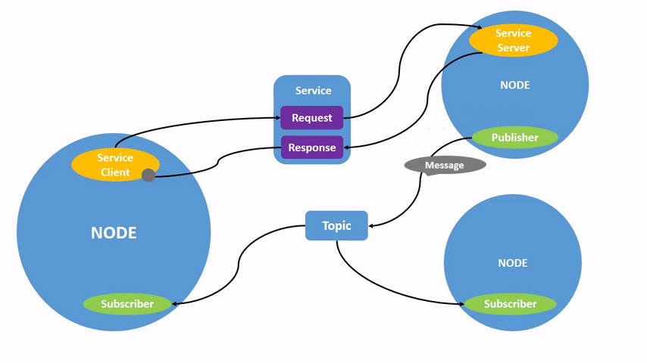
INTRODUCTION
What is ROS2, really?
Not an OS in the traditional sense: it's communication tooling that sits on top of Linux!
Robot Operating System is a set of libraries and tools for building robotics software.
Allows for communication between multiple robots and computers
Node
Topic
Service
One modular job e.g. drive motors, read a sensor. Talks to other nodes via topics or services.
A named channel for exchanging messages. Nodes publish onto it, or subscribe to read from it.
(Think of it like a bulletin board)
Call-and-response, unlike topics. A client requests, a node responds. Out of scope today.
Today we're using nodes and topics -> services are a story for another day.
04

Slide 5

STEP 1
Source ROS2 and make a workspace
A workspace is just a folder — where your packages live. You can have several for different projects.
Link this terminal to the ROS2 install:
source /opt/ros/humble/setup.bash
Add it to your .bashrc so it's automatic in every new terminal:
echo "source /opt/ros/humble/setup.bash" >> ~/.bashrc
Create the workspace folder:
mkdir -p ~/mars_ws/src
Everything we build today lives under ~/mars_ws/src.
05

Slide 6

STEP 2
Create a package
A package is an organisational unit — it bundles the executables and files ROS2 needs to run your code.
cd ~/mars_ws/src/ && ros2 pkg create --build-type ament_python my_package
This scaffolds a few key files:
package.xml
Metadata about the package
resource/my_package
Marker file so ROS2 recognises the package
setup.cfg
Links executables to ROS2
setup.py
Install instructions and entry points — we'll edit this
06

Slide 7

STEP 3
Write a publisher
my_package/my_package/my_publisher.py — sends a Twist message to /cmd_vel every 0.5s.
class TwistPublisher(Node):
def __init__(self):
super().__init__("twist_publisher")
self.twistPub_ = self.create_publisher(Twist, "/cmd_vel", 10)
self.timer_ = self.create_timer(0.5, self.timer_cb)
def timer_cb(self):
msg = Twist()
msg.linear.x = 1.0 # travel forward at 1 m/s
self.twistPub_.publish(msg)
self.get_logger().info("Sending Twist")
create_publisher(msg_type, topic_name, queue_size) — create_timer(seconds, callback)
Full main() with rclpy.init / spin / shutdown is in the repo — same pattern every time.
07

Slide 8
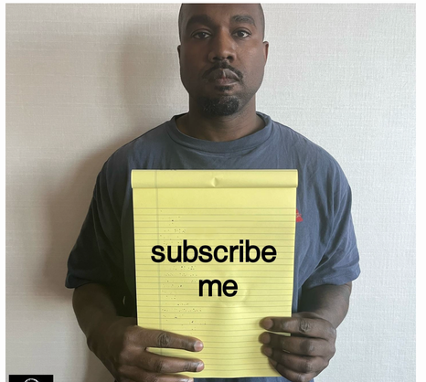
STEP 4
Write a subscriber
Same shape as the publisher, but with a callback instead of a timer.
class TwistSubscriber(Node):
def __init__(self):
super().__init__("twist_subscriber")
self.twistSub_ = self.create_subscription(
Twist, "/cmd_vel", self.twist_callback, 10)
def twist_callback(self, msg: Twist):
self.get_logger().info(
"RECEIVED: TWIST %f" % msg.linear.x)
create_subscription(msg_type, topic, callback, queue_size) — the callback fires automatically whenever a message arrives on /cmd_vel.
08

Slide 9
STEP 5
Using ‘--symlink-install’ means you can make changes in Python scripts or configuration files take without needing a full rebuild!
Wire it up and run it
Register both scripts as entry points in setup.py:
entry_points={
'console_scripts': [
"twist_talker = my_package.my_publisher:main",
"twist_listener = my_package.my_subscriber:main",
],
},
Build and run ONE terminal per node:
cd ~/mars_ws && colcon build --symlink-install && source install/setup.bash
ros2 run my_package twist_talker # terminal 1
ros2 run my_package twist_listener # terminal 2
Every new terminal needs the workspace re-sourced: . install/setup.bash
09

Slide 10
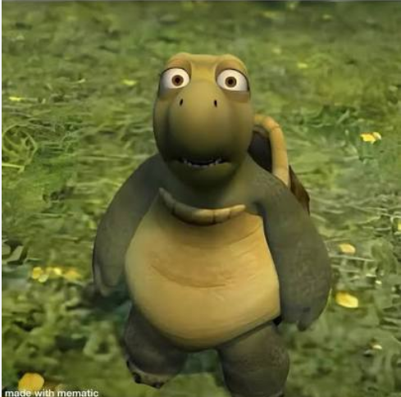
STEP 7
Point it at the simulator
Your publisher already speaks the right language — /cmd_vel is exactly what TurtleBot3 listens for.
sudo apt install ros-humble-turtlebot3*
export TURTLEBOT3_MODEL=burger
3
ros2 launch turtlebot3_gazebo turtlebot3_world.launch.py
Then, in another terminal:
Just run your publisher (or launch file) exactly as before — ros2 run my_package twist_talker. The simulated robot subscribes to /cmd_vel and moves.
11

Slide 11
Tips & Common Issues
Nothing happens in Gazebo
Confirm TURTLEBOT3_MODEL is exported in that terminal and the simulation has fully loaded.
‘export TURTLEBOT3_MODEL=waffle_pi’
Workspace not sourced
Each new terminal needs `source install/setup.bash`, otherwise ros2 run won't find your package.
Robot moves in a curve
If linear.x and angular.z are both non-zero, the robot won't drive straight or turn cleanly.
Robot stops moving
Make sure to keep publishing on the timer, a single message does NOT sustain motion
Use symlink install
So that changes in Python scripts or configuration files take effect without a full rebuild.
‘colcon build -–symlink-install’
Create Bash Aliases
Add shortcuts in your .bashrc file to combine workspace navigation, building, and environment sourcing into a single command.

Slide 12

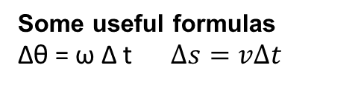
CHALLENGE TIME!!!
Now that you know how it works...
Can you make the robot drive itself in a square?
A small hint ;)
You already have everything you need (i.e. a publisher and the Twist message) Think about how to alternate between two kinds of motion, and how to know when to switch.
Some useful formulas
Δθ = ω Δ t $Δs=vΔt$
start
If you finish early
Try a different shape · try driving it in reverse · try making the size adjustable

Slide 13
GO FURTHER
Resources
Workshop repo
github.com/uqmars/workshop-resources — ROS2 folder, full solutions
ROS2 documentation
docs.ros.org/en/humble
Robotics Backend
roboticsbackend.com — blogs on ROS2 concepts
Automatic Addison
automaticaddison.com — TurtleBot3 & ROS2 tutorials
14

Slide 14
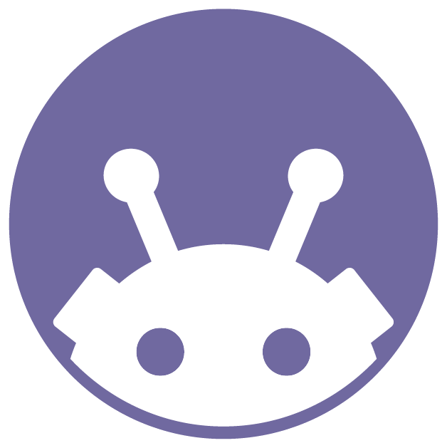
Thanks for attending!
Workshop code & resources
github.com/uqmars/workshop-resources/ROS2
UQ Mechatronics & Robotics Society

