Slide 1



Computer Vision
Workshop 2026
LINKTREE
From pixels to tracking — hands-on with OpenCV & Python
UQ MARS — Mechatronics & Robotics Society

Slide 2

What is Computer Vision?
Computer vision is a subfield of artificial intelligence (AI) that equips machines with the ability to process, analyze and interpret visual inputs such as images and videos. It uses machine learning to help computers and other systems derive meaningful information from visual data. – IBM
Capture
Process
Understand
Cameras and sensors collect raw visual data as grids of pixels
Algorithms filter, transform, and extract meaningful features
The system interprets what it sees — objects, motion, depth
Introduction
UQ MARS 2026

Slide 3
Why Do We Need Computer Vision?
Humans process visual information effortlessly… but for robots and software, it's one of the hardest problems in AI.
Robots need eyes
Autonomous systems can't interact with the world without understanding what's around them. Picking up objects, avoiding obstacles, navigating terrain is quite impossible without some sort of sensing.
Data is visual
Over 80% of the data generated today is visual. Cameras are cheap, everywhere, and produce rich information that structured sensors can't match.
Automation at scale
Inspecting products on a factory line, monitoring crops from drones, reading licence plates; tasks too repetitive or fast for humans alone.
Bridging the physical–digital gap
CV lets software reason about the real world. It turns pixels into measurements, decisions, and actions.
Introduction
UQ MARS 2026

Slide 4


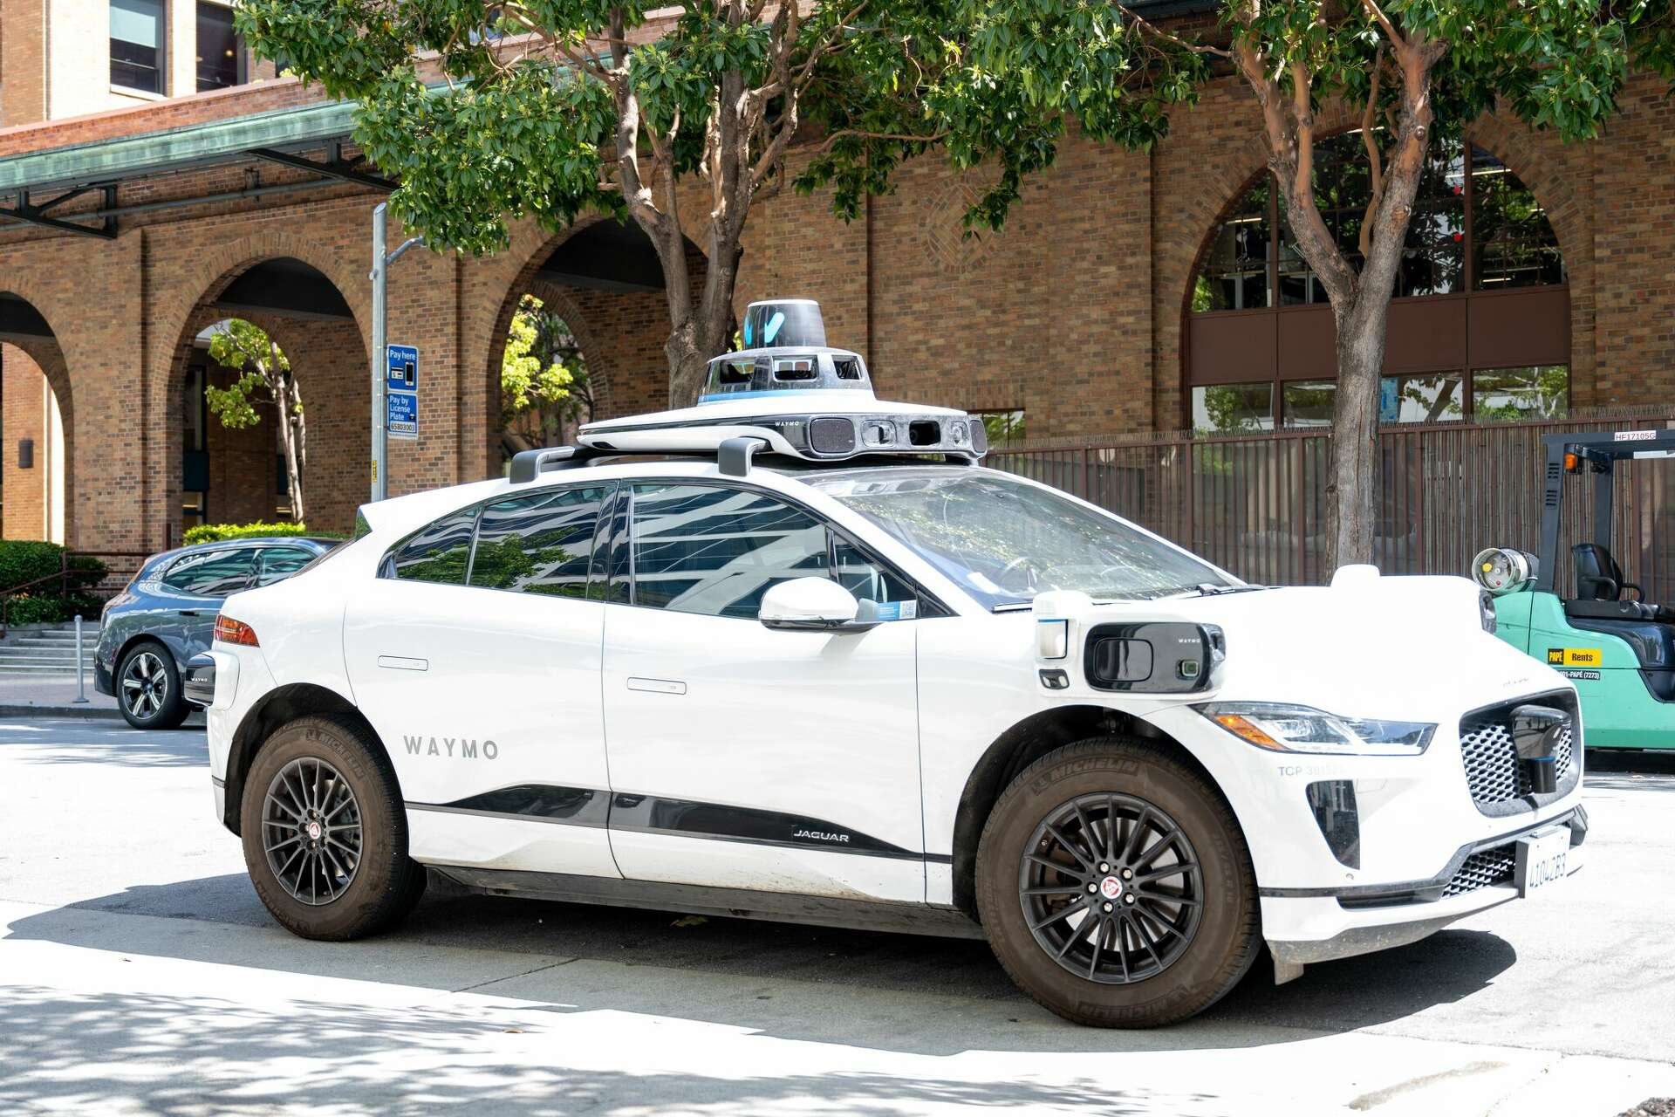
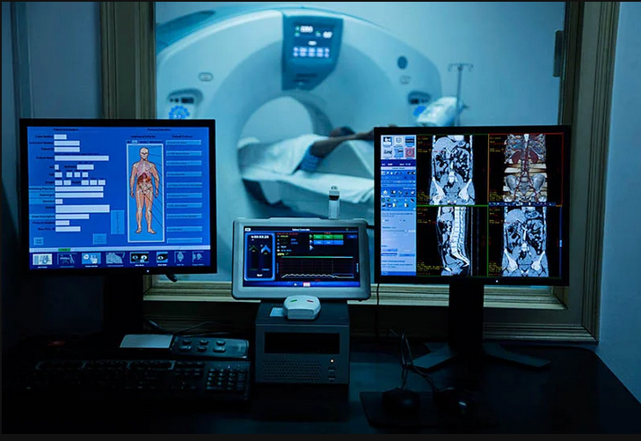
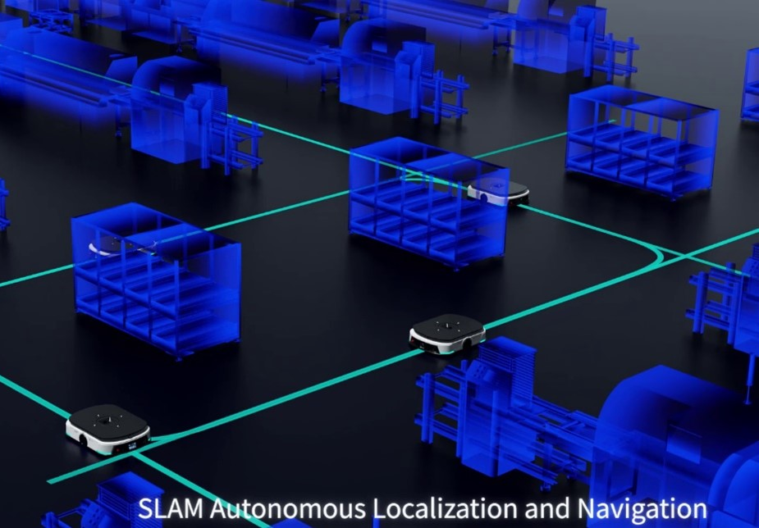
Applications of Computer Vision
Self-Driving Cars
Medical Imaging
Robotics & Manufacturing
Lane detection, pedestrian recognition, obstacle avoidance in real time
Detecting tumours in X-rays, analysing retinal scans, surgical guidance
Pick-and-place, quality inspection, bin picking, visual SLAM for navigation
Introduction
UQ MARS 2026

Slide 5
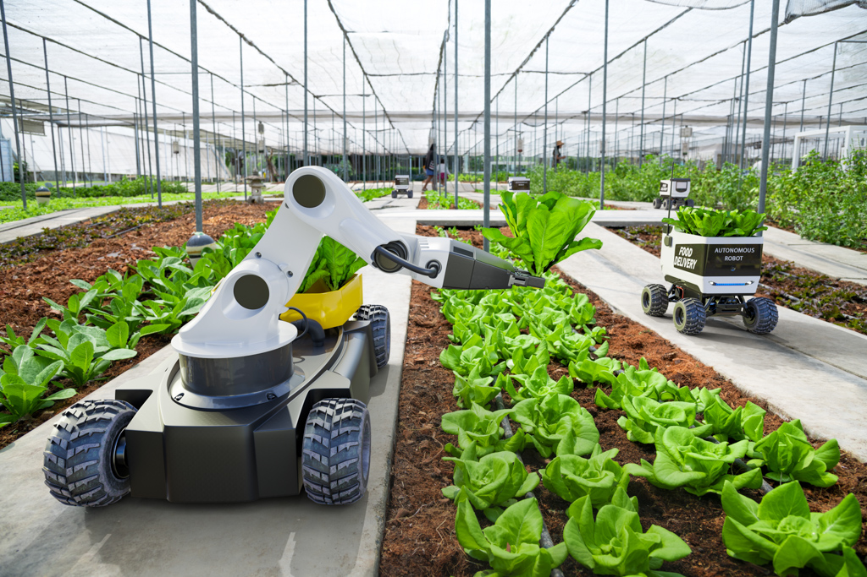
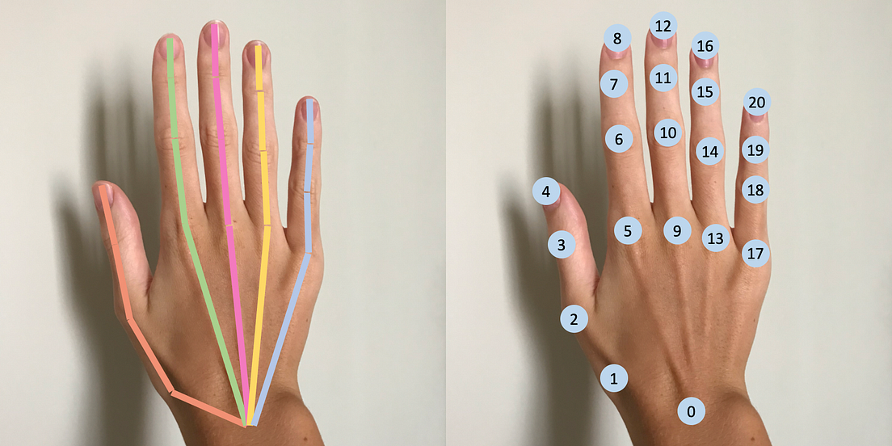
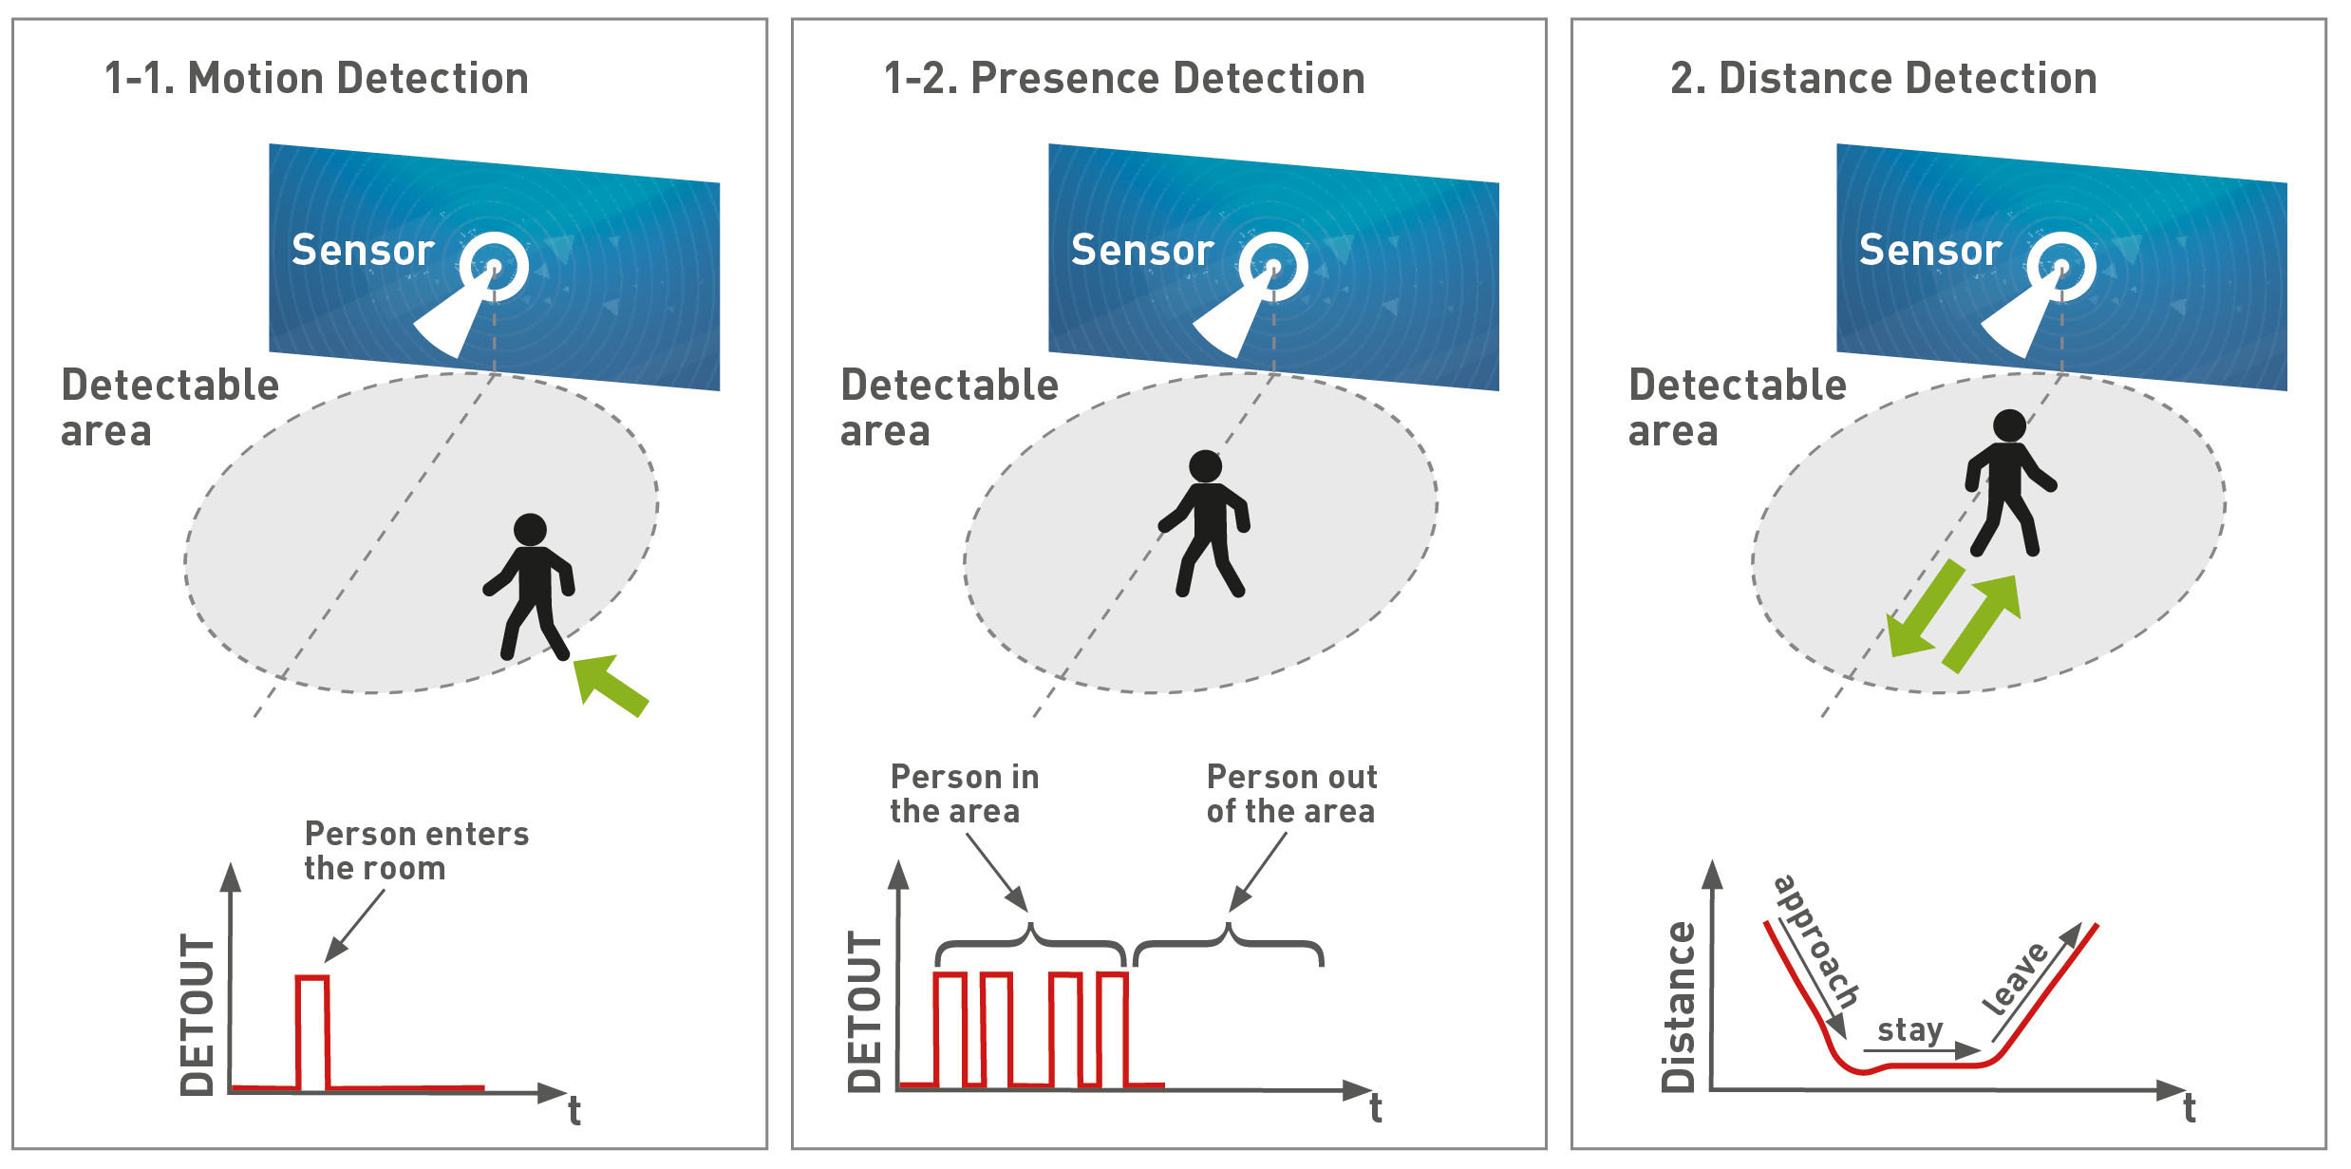


Applications of Computer Vision
Agriculture
AR / VR & Gaming
Security & Surveillance
Crop health monitoring, weed detection, yield estimation from drone imagery
Face tracking, hand pose estimation, scene reconstruction, depth sensing
Motion detection, anomaly detection, licence plate recognition
Introduction
UQ MARS 2026

Slide 6






Workshop Agenda
0
Setup & Install
OpenCV, NumPy, Matplotlib
1
Images & Colour Channels
Reading images, BGR channels, splitting & visualising
2
Image Operations
Grayscale, cropping, resizing, pixel manipulation
3
Webcam & Kernel Filters
Live video, convolution, blur, sharpen, edge detection
4
Camera Calibration
Chessboard detection, intrinsic parameters, undistortion
5
ArUco Markers & Pose
Marker detection, pose estimation, distance measurement
6
Object Recognition (CNNs)
Deep learning intro & Teachable Machine live demo
Computer Vision Workshop 2026
UQ MARS 2026

Slide 7
Setup & Installation
NumPy
N-dimensional arrays — the backbone of image data
conda create -n myenv
conda activate myenv
$ pip install numpy
$ pip install matplotlib
$ pip install opencv-python
Matplotlib
Plotting and visualising results
OpenCV
The go-to library for computer vision
Miniconda
Anaconda simplifies package management and deployment
Resources: github.com/uqmars/workshop-resources/CV/2026
Section 0 — Setup
UQ MARS 2026

Slide 8
01
Images & Colour Channels
Reading images, BGR channels, and visualising components

Slide 9
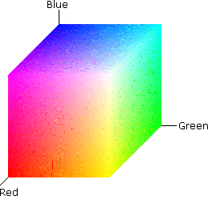
What is a Digital Image?
An image is a 3D NumPy array with shape:
(height, width, channels)
rows cols BGR=3
img.shape
(height, width, channels)
img.dtype
uint8 — values 0 to 255
OpenCV stores pixels in BGR order — Blue first, then Green, then Red.
img[y, x]
Access pixel at row y, col x → [B, G, R]
Section 1 — Images & Colour Channels
UQ MARS 2026

Slide 10
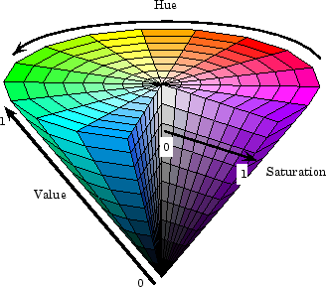
BGR vs HSV Colour Spaces
BGR (Blue-Green-Red)
HSV (Hue-Sat-Value)
Default format in OpenCV
Each channel: 0–255 intensity
Hard to isolate a specific colour
Hue = colour (0–180 in OpenCV)
Saturation = intensity of colour
Great for colour-based filtering!
Section 2 — Colour Spaces & Masking
UQ MARS 2026

Slide 11
Splitting & Visualising Channels
Each pixel has 3 values [B, G, R]. We can isolate each channel to see its contribution.
Blue
# Isolate the BLUE channel only
img_b = img.copy()
img_b[:, :, 1] = 0 # zero out green
img_b[:, :, 2] = 0 # zero out red
# Single-channel grayscale of blue
img_b_gray = img[:, :, 0]
[:, :, 0]
Green
[:, :, 1]
Red
[:, :, 2]
img_stack = np.hstack([img, img_b, img_g, img_r])
Tip: Use cv.setMouseCallback() to print the BGR value of any pixel when you click on it — great for debugging!
Section 1 — Images & Colour Channels
UQ MARS 2026

Slide 12
02
Image Operations
Grayscale, cropping, resizing, and pixel manipulation

Slide 13
Core Image Operations
Grayscale
cv.cvtColor(img, cv.COLOR_BGR2GRAY)
Single channel — intensity only
Crop
img[y:y+h, x:x+w, :]
NumPy slice — no copy needed
Resize
cv.resize(img, (128, 128))
Scale to any dimension
Set pixels
img[y:y+h, x:x+w] = [128,128,128]
Direct array assignment
Condition
img[np.mean(img, axis=2)==255] = [0,0,255]
Boolean masking on pixels
Section 2 — Image Operations
UQ MARS 2026

Slide 14
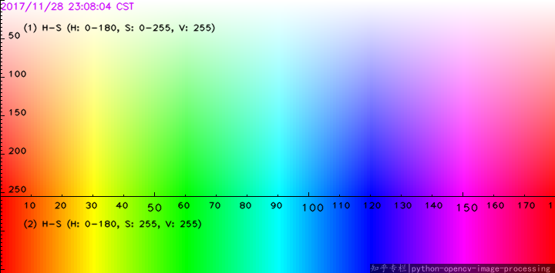
Reading Images with OpenCV
1-imageData.py
import cv2
img = cv2.imread(‘birb.png')
print(img.shape) # (H, W, C)
print(img.size) # total pixels
print(img.dtype) # uint8
cv2.imshow('Image_Name', img)
cv2.waitKey(0)
HSVopenCV.png
Key: OpenCV reads images in BGR order, not RGB! This matters for colour operations.
Section 1 — Image Data Structures
UQ MARS 2026

Slide 15
03
Webcam & Kernel Filters
Live video, convolution, blur, sharpen, edge detection, sepia

Slide 16
What is Convolution?
A kernel (small matrix) slides across the image. At each position, it multiplies overlapping pixels and sums the result into a single output pixel.
output = cv.filter2D(img, -1, kernel)
Box Blur
Gaussian
Sharpen
Sobel X
1 1 1
1 1 1
1 1 1
÷ 9
1 2 1
2 4 2
1 2 1
÷ 16
0 -1 0
-1 5 -1
0 -1 0
1 0 -1
2 0 -2
1 0 -1
Averages neighbours → smooth
Weighted average → less blocky
Emphasises centre → crisp edges
Detects vertical edges
Section 3 — Webcam & Kernels
UQ MARS 2026

Slide 17
Filter Gallery — Live Webcam Demo
Press SPACE to cycle through filters on the live webcam feed.
0
1
2
3
4
Unfiltered
Sharpen
Unsharp Mask
Box Blur
Gaussian 3×3
5
6
7
8
9
Gaussian 5×5
Sobel Edges
Sepia
Grainy Sepia
HSV Threshold
Section 3 — Webcam & Kernels
UQ MARS 2026

Slide 18
04
Camera Calibration
Chessboard detection, intrinsic parameters, and lens undistortion

Slide 19
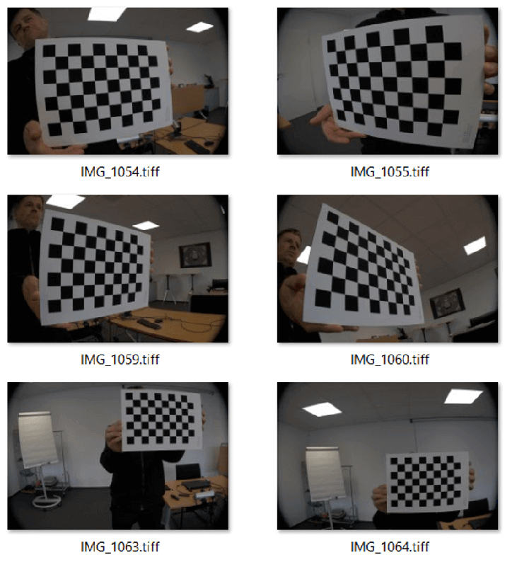
Why Calibrate a Camera?
Real lenses distort images. Calibration computes the camera's intrinsic parameters so we can correct for this and measure the real world accurately.
1
Capture chessboard images
Show a 9×6 chessboard from multiple angles. Press SPACE to capture each frame.
2
Find corners
cv.findChessboardCorners() detects the grid intersections automatically.
3
Refine sub-pixel
cv.cornerSubPix() refines corner positions for higher accuracy.
4
Calibrate
cv.calibrateCamera() computes the camera matrix (mtx) and distortion coefficients (dist).
5
Undistort
cv.undistort() applies the calibration to straighten out lens distortion.
Section 4 — Camera Calibration
UQ MARS 2026

Slide 20
The Camera Matrix
Calibration produces two key outputs that describe your camera's optics:
Camera Matrix (mtx)
Distortion Coefficients (dist)
[ fx 0 cx ]
[ 0 fy cy ]
[ 0 0 1 ]
[ k1, k2, p1, p2, k3 ]
k1, k2, k3 = radial distortion
p1, p2 = tangential distortion
These describe how straight lines in the real world become curved in the image.
fx, fy = focal lengths (pixels)
cx, cy = optical centre (principal point)
Section 4 — Camera Calibration
UQ MARS 2026

Slide 21
05
ArUco Markers &
Pose Estimation
Detecting markers, estimating 3D pose, measuring real-world distance

Slide 22

What are ArUco Markers?
ArUco markers are black-and-white square fiducial markers. Each has a unique binary pattern and ID. OpenCV can detect them instantly and compute their 3D pose relative to the camera.
1
2
3
4
Load dictionary
Detect markers
Estimate pose
Measure distance
aruco.Dictionary_get(
DICT_4X4_100)
aruco.detectMarkers(
img, aruco_dict)
aruco.estimatePose
SingleMarkers(...)
np.linalg.norm(
tvec1 - tvec2)
Section 5 — ArUco Markers
UQ MARS 2026

Slide 23
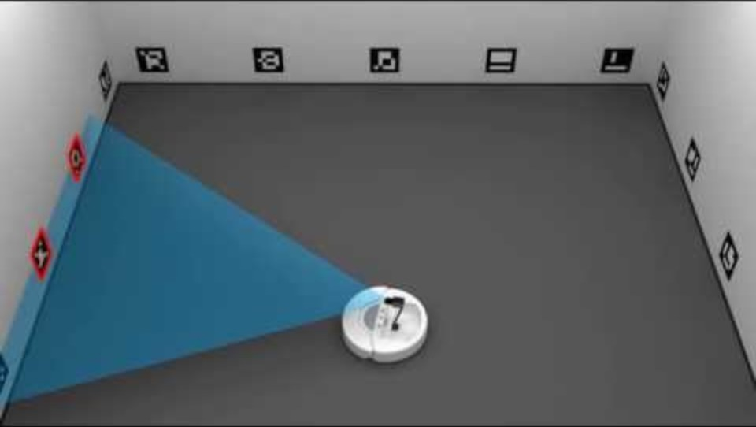
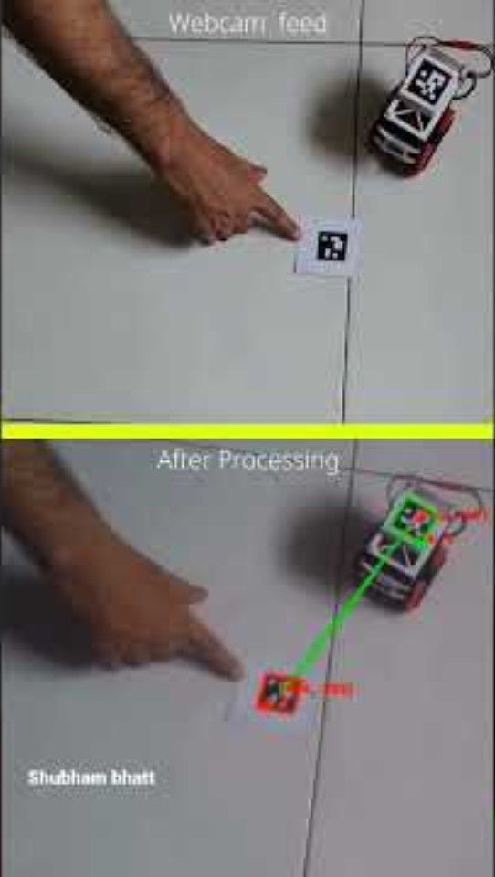
Applications of ArUco Markers
Section 5 — ArUco Markers
UQ MARS 2026

Slide 24
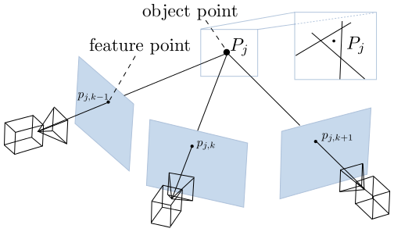
3D Pose & Distance Measurement
Pose Estimation
Distance Between Markers
estimatePoseSingleMarkers()
Returns for each marker:
rvec — rotation vector (3D orientation)
tvec — translation vector (3D position in metres)
Requires: camera_matrix + dist_coeffs from calibration, and the real marker size (e.g. 28mm).
if len(ids) == 2:
p1 = tvecs[0][0][0]
p2 = tvecs[1][0][0]
dist = np.linalg.norm(p1 - p2)
cv.putText(img,
f'{dist:.3f}m', ...)
Because tvecs are in real-world metres, the Euclidean distance between two markers gives a physical measurement directly from the camera feed.
Section 5 — ArUco Markers
UQ MARS 2026

Slide 25
06
Object Recognition
Using CNNs
From hand-crafted rules to learned features — deep learning meets vision

Slide 26
From Classical CV to Deep Learning
Classical CV (what we've done)
Deep Learning (CNNs)
You define the rules:
"Sharpen with this kernel"
"Detect this chessboard pattern"
"Look for this ArUco dictionary"
Works great when you know exactly what to look for. Struggles with variation i.e., lighting, angle, clutter.
The model learns the rules:
Show it 100s of labelled examples
It discovers what features matter
Generalises to new, unseen images
Handles variation in lighting, angle, and background. Needs data + compute, but far more flexible.
Section 6 — Object Recognition
UQ MARS 2026

Slide 27
How CNNs See
A Hierarchy of Features
A Convolutional Neural Network learns to recognise objects by building up from simple to complex features, layer by layer.
Input
Early Layers
Middle Layers
Deep Layers
Output
Raw pixel
values
Edges, lines,
corners
Shapes, textures,
patterns
Object parts —
eyes, wheels, fur
"This is a cat!“
🐈
The Key Insight
Convolution = sliding a small filter across the image to detect a specific pattern (edge, corner, texture). The network learns what filters to use — you don't have to design them by hand like we did with HSV thresholds. Each layer combines the previous layer's features into more abstract representations.
Section 6 — Object Recognition
UQ MARS 2026

Slide 28
Live Demo: Teachable Machine
Train your own image classifier in the browser — no code required!
teachablemachine.withgoogle.com
1
Create Classes
Define 2–3 categories you want to recognise (e.g. "pen", "phone", "nothing")
2
Record Samples
Use your webcam to capture ~50 images per class. Move the object around for variety.
3
Train the Model
Click "Train Model" — a CNN trains right in your browser in seconds using transfer learning.
4
Test It Live
Point your webcam at objects and watch the model classify in real time. Try to fool it!
Section 6 — Object Recognition
UQ MARS 2026

Slide 29
Key Takeaways
Images = NumPy Arrays
BGR order, uint8 values. Split channels to understand colour.
Operations are Array Ops
Crop, resize, mask — it's all NumPy slicing and OpenCV functions.
Kernels = Convolution
Small matrices that blur, sharpen, or detect edges when slid across the image.
Calibration Enables Measurement
Camera matrix + distortion coefficients let you reason about real-world geometry.
ArUco → 3D Pose
Fiducial markers give instant position & orientation. Measure distances in metres.
CNNs Learn to See
Deep learning replaces hand-crafted rules with learned features from data.
Summary
UQ MARS 2026

Slide 30

Thanks for attending!
Workshop code & resources
github.com/uqmars/workshop-resources/CV/2026
UQ Mechatronics & Robotics Society

