Slide 1
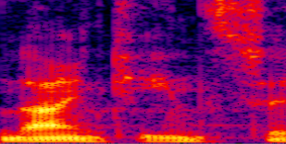
BxTx2N
microphone signal
concate
add
extracted feature mask
estimated near-end mask
concate
optimized near-end mask
BxTx4N
1D Conv Block
BxTx4N
BxTx4N
BxTx4N
GRU Block
GRU Block
estimated near-end re-mask
add
BxTx2N
BxTx2N
BxTx2N
BxTx4N
BxTx2N
BxTx2N
GRU Block
GRU Block
GRU Block
BxTx2N
Feature Extraction Network
Acoustic Separation Network
Mask Optimization Network
far-end signal
skip connection
skip connection

