Slide 1
TAPL: Dynamic Part-based Visual Tracking via Attention-guided Part Localization
CAI2/SPT3/ALG3
Xiaoxi Yu, Hantao Huang
29 Oct 2021

Slide 2
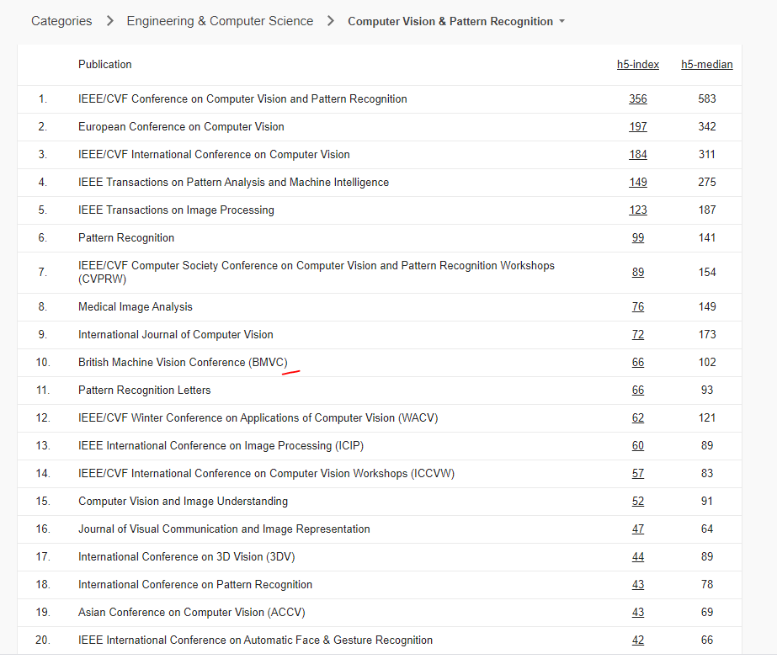
About BMVC
According to Google Scholar, BMVC ranks 10 for computer vision journal and conference.

Slide 3
Motivation
TAPL: Dynamic Part-based Visual Tracking via Attention-guided Part Localization
Object tracking remains a challenging task due to the unconstrained real-world scenarios:
deformation
occlusion
illumination change
cluttered background
Current solution:
Siamese network: target representation is fixed
Local pattern detector: detected local patterns are not associated with a clear physical meaning
Proposed method:
directly predicting target part locations from the target part representations
dynamic target part representation
an attention loss to impose attention-guided

Slide 4
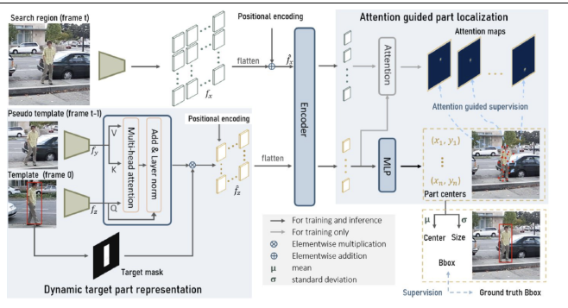

Method
Backbone (resnet50) to extract generalized high-level features(local part representation)
Target part representations are dynamically updated
Transformer encoder to globally encode information from all parts
Encoder output embedding of target parts are used to directly predict their locations in the search region with the attention-guided supervision
Bounding box is calculated with the part distribution

Slide 5
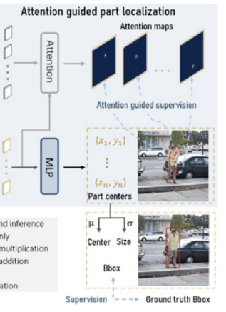



Method
Calculate bbox
Get relative position from MLP
Encoder output
Estimate the target bounding box center o and scale s based on the target parts distributions

Slide 6
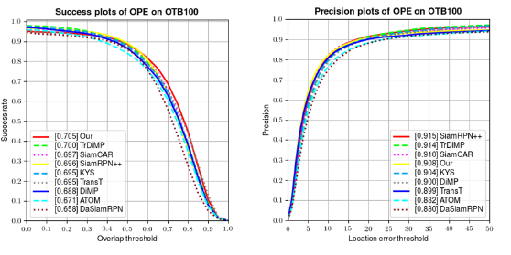

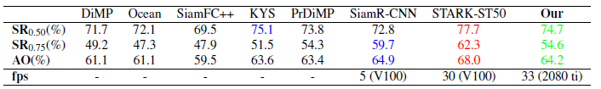
Result
Obtain more accurate bounding box under object deformation.
Efficient in handling large appearance change
Better generalization ability to track unseen objects
VOT2018
EAO: expected average overlap
AO: overlap rates
SR: success rate
success score: the overlap rate of the predicted and ground truth bounding boxes.
GOT10K

Slide 7
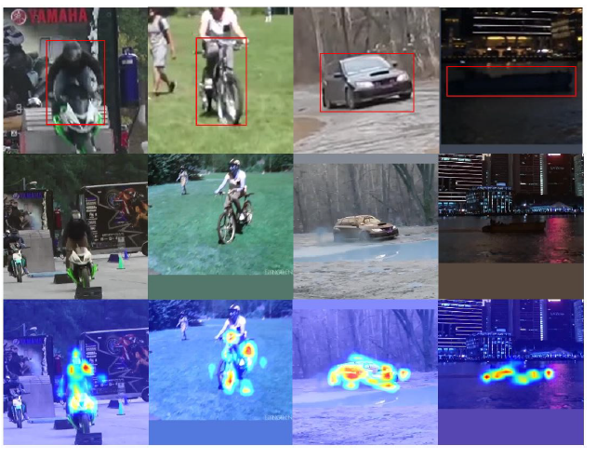
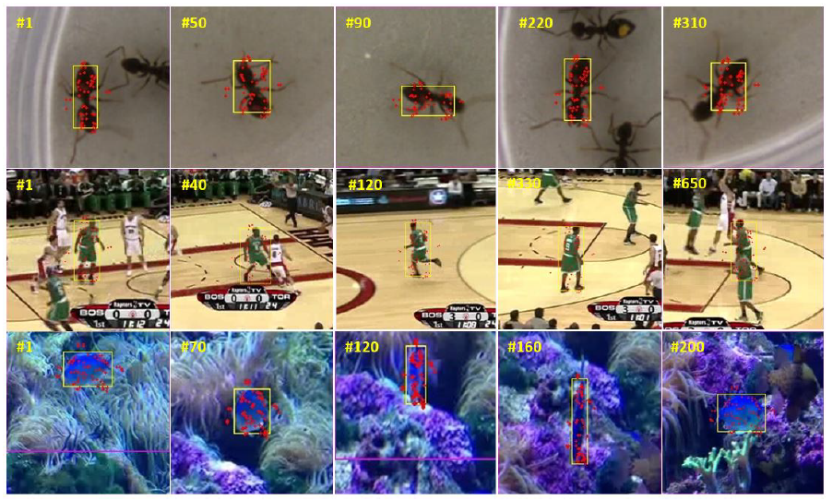
Result
Attributed to the accurate and flexible part localization, our tracker can estimate the bounding box precisely
Our network learns to attend to the foreground locations under large appearance changes

Slide 9
Method
Two stage:
directly predict target part locations
estimate the bounding box from their distribution
key components:
dynamic target part representation module
attention-guided part localization module

