Slide 1
Entity Framework Integration
John Lyndon Philip Planas
Software Developer 2, Open iT

Slide 2


Agenda
Introductions
Setting up the environment
Integration Proper
What is Entity Framework?
How to integrate your code to database?

Slide 3
Setting up the Environment
Check if the necessary tools are available in your system

Slide 4
Setting up the Environment
VS Code
Code Editor
Where we write our C# code.
.NET SDK
Code Compiler
Allows to create and execute C# applications.
Try:
dotnet –-version

Slide 5
Setting up the Environment
PostgreSQL
Database system (data storage)
Where data is permanently stored.
pgAdmin
Dashboard or Control Panel of PostgreSQL
A tool for managing and ease of configuration for the database system.

Slide 6
Quick Question
What do you think happens if we remove the database?
Can an application work without storing data?

Slide 7
Setting up the .NET Project
Setup all the necessary packages for .NET Project

Slide 8
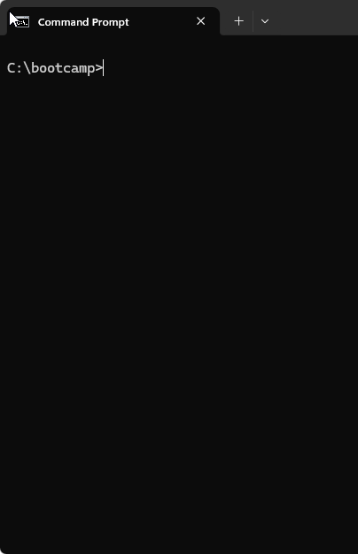
Creating the .NET Project
Create a folder named bootcamp in C:\.
C:\bootcamp
Open a command line on the folder.

Slide 9
Creating the .NET Project
Run the command:
dotnet new console –n BootcampEF
This will create a project named BootcampEF.
Part | Meaning
dotnet | .NET CLI
new | Create
Cosole | Console application
-n | Name
BootcampEF | Project Name

Slide 10
Creating the .NET Project
Open the project in VS Code by running the following command:
cd BootcampEF
code .
In VS Code, see what files are automatically created.

Slide 11
Installing Packages
EF Core Main Package (Entity Framework)
An ORM (Object-Relational Mapping) package is a library that lets you interact with a database using objects and methods instead of writing raw SQL queries. It maps database tables to programming language classes, and rows to objects, making database operations more intuitive and less error-prone.
In VS Code, open a new Terminal, then run the command:
dotnet add package Microsoft.EntityFrameworkCore

Slide 12
Installing Packages
Design Package
This package helps us use migrations. a migration is a way to track and apply changes to your database schema over time using code.
Run the command:
dotnet add package Microsoft.EntityFrameworkCore.Design

Slide 13
Installing Packages
PotgreSQL Provider
This package allows EF Core to communicate specifically with PostgreSQL.
Run the command:
dotnet add package Npgsql.EntityFrameworkCore.PostgreSQL
Notes:
“Entity Framework is database-independent, so we install providers depending on the database we use.”
“What do you think would happen if we forgot the PostgreSQL package?”

Slide 14
Integration Proper
Connect your code to the database

Slide 15
Creating the Model
A Model is:
A C# class that represents the structure of data in the database.
“A model is like a blueprint or template for our data.”
In Entity Framework Core, models represent database tables.”
Notes:
“Entity Framework is database-independent, so we install providers depending on the database we use.”
“What do you think would happen if we forgot the PostgreSQL package?”

Slide 16
Creating the Model
In VS Code, create a new file. Name the file as:
Student.cs
Add the following code:
public class Student { public int Id { get; set; } public string Name { get; set; } public string Course { get; set; } }
Notes:
“This file will contain the Student model or Student entity.”

Slide 17
The Model
public class Student
This creates a class named Student.
EntityFramework will convert this class into a database table.
public int Id
This becomes the Primary Key in the database table.
EF Core automatically recognizes a property named Id as the Primary Key.
Notes:
“Entity Framework is database-independent, so we install providers depending on the database we use.”
“What do you think would happen if we forgot the PostgreSQL package?”

Slide 18
The Model
public string Name
This becomes a column in the database named Name.
public string Course
This becomes a column in the database named Course.
C# Object | Database
Student | Student table
Id | Id column (PK)
Name | name column
Course | course column

Slide 19
Quick Game – Coding Relay
Rules of the game:
We need 6 players for this game.
Each player will be adding code lines one-by-one to complete the requirement.
The next player can do only 1 of the two things:
Add a new line of code.
Modify ONLY 1 line to correct the code.
Please code properly. One line per player ONLY!
The winning team will receive a PRIZE! ☺

Slide 20
Quick Game – Coding Relay
Create a model:
Name: Contacts
Properties:
Id: number
Name: text
Age: number
Gender: text
Address: text
Contact_Number: text
Email: text

Slide 21
Creating DBContext
DbContext is the heart of Entity Framework.
Manages database connection
Handles queries
Saves changes
Notes:
“Entity Framework is database-independent, so we install providers depending on the database we use.”
“What do you think would happen if we forgot the PostgreSQL package?”

Slide 22
Creating DBContext
In VS Code, create a new file. Name the file as:
StudentContext.cs
Add the following code:
using Microsoft.EntityFrameworkCore;
public class StudentContext : DbContext
{
public DbSet<Student> Students { get; set; }
protected override void OnConfiguring(DbContextOptionsBuilder optionsBuilder)
{
optionsBuilder.UseNpgsql(
"Host=localhost;Port=5432;Database=bootcamp;Username=postgres;Password=pa$$w0Rd"
);
}
}
Notes:
“Entity Framework is database-independent, so we install providers depending on the database we use.”
“What do you think would happen if we forgot the PostgreSQL package?”

Slide 23
The DBContext
DbSet<Student>
Represent the Student table or the Student model.
UseNpgsql()
Connect EF Core to PostgreSQL.
Connection String
A string containing necessary parameters needed to connect to the PostgreSQL sever.
Notes:
“Entity Framework is database-independent, so we install providers depending on the database we use.”
“What do you think would happen if we forgot the PostgreSQL package?”

Slide 24
Connection String
Host=localhost;Port=5432;Database=bootcamp;Username=postgres;Password=pa$$w0Rd
Parameter Name | Meaning
Host | Database server name (ip address or hostname)
Port | PostgreSQL port (commonly 5432)
Database | Database name
Username | Login username
Password | Login user password
Notes:
“Entity Framework is database-independent, so we install providers depending on the database we use.”
“What do you think would happen if we forgot the PostgreSQL package?”

Slide 25
Creating Migrations
Migrations allow EF Core to create database structures automatically.
A feature in Entity Framework Core that updates the database structure based on changes in our C# models.
Notes:
“Entity Framework is database-independent, so we install providers depending on the database we use.”
“What do you think would happen if we forgot the PostgreSQL package?”

Slide 26
Installing EF Migration Tool
To install the migration commands, run the command:
dotnet tool install –-global dotnet-ef
Notes:
“Entity Framework is database-independent, so we install providers depending on the database we use.”
“What do you think would happen if we forgot the PostgreSQL package?”

Slide 27
Adding Migration
To add migrations, run the command:
dotnet ef migrations add InitialCreate
InitialCreate – name of the migration
This reads the created models.
Generates migration files
Notes:
“Entity Framework is database-independent, so we install providers depending on the database we use.”
“What do you think would happen if we forgot the PostgreSQL package?”

Slide 28
Applying Migrations
To apply the migrations to the database, run the command:
dotnet ef database update
This applies the changes to the database based on the created migrations.
Notes:
“Entity Framework is database-independent, so we install providers depending on the database we use.”
“What do you think would happen if we forgot the PostgreSQL package?”

Slide 29
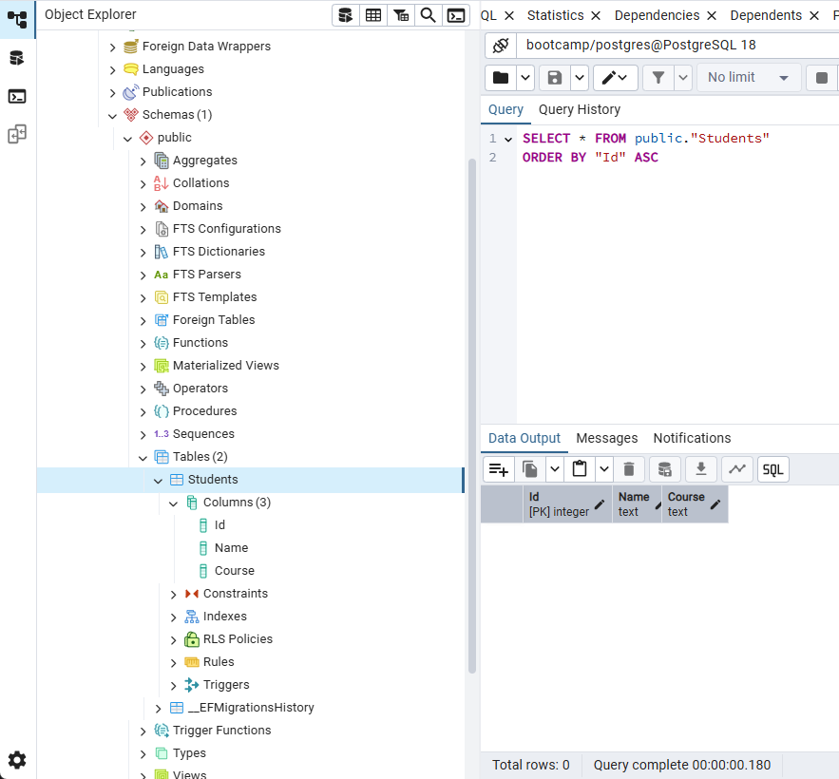
Refresh the Database
Open the pgAdmin and refresh the bootcampdatabase.
See that the Student table is created with the configured columns.
Notes:
“Entity Framework is database-independent, so we install providers depending on the database we use.”
“What do you think would happen if we forgot the PostgreSQL package?”

Slide 30
CRUD Operations
Four basic database operations.

Slide 31
CRUD Operations
Letter | Meaning
C | Create
R | Read
U | Update
D | Delete
Notes:
“Entity Framework is database-independent, so we install providers depending on the database we use.”
“What do you think would happen if we forgot the PostgreSQL package?”

Slide 32
Create
Add new record in the database
In VS Code, open Program.cs and overwrite the content with the following C# Code.
Once saved, in the Terminal, run the command:
dotnet run
Notes:
“Entity Framework is database-independent, so we install providers depending on the database we use.”
“What do you think would happen if we forgot the PostgreSQL package?”

Slide 33
Create
C# Code
using System;
using var context = new StudentContext();
var student = new Student
{
Name = "John",
Course = "IT"
};
context.Students.Add(student);
context.SaveChanges();
Console.WriteLine("Student Added!");
Explanation
Creates a connection object to the database using StudentContext.
Creates a new Student object in C#.
{
Sets the Name property of the student.
Sets the Course property of the student.
};
Prepare the record to be inserted into the Students table.
Saves the new student into PostgreSQL.
Displays a message in the terminal.
Notes:
“Entity Framework is database-independent, so we install providers depending on the database we use.”
“What do you think would happen if we forgot the PostgreSQL package?”

Slide 34
Read
Read records in the database
Still in Program.cs, add the following code.
Once saved, in the Terminal, run the command:
dotnet run
Notes:
“Entity Framework is database-independent, so we install providers depending on the database we use.”
“What do you think would happen if we forgot the PostgreSQL package?”

Slide 35
Read
C# Code
var students = context.Students.ToList(); Console.WriteLine("\nStudent List:"); foreach (var s in students) { Console.WriteLine($"{s.Id} - {s.Name} - {s.Course}"); }
Explanation
Retrieves all records from PostgreSQL.
Displays a message in the terminal.
Loops through each record in the table and displays each record.
Notes:
“Entity Framework is database-independent, so we install providers depending on the database we use.”
“What do you think would happen if we forgot the PostgreSQL package?”

Slide 36
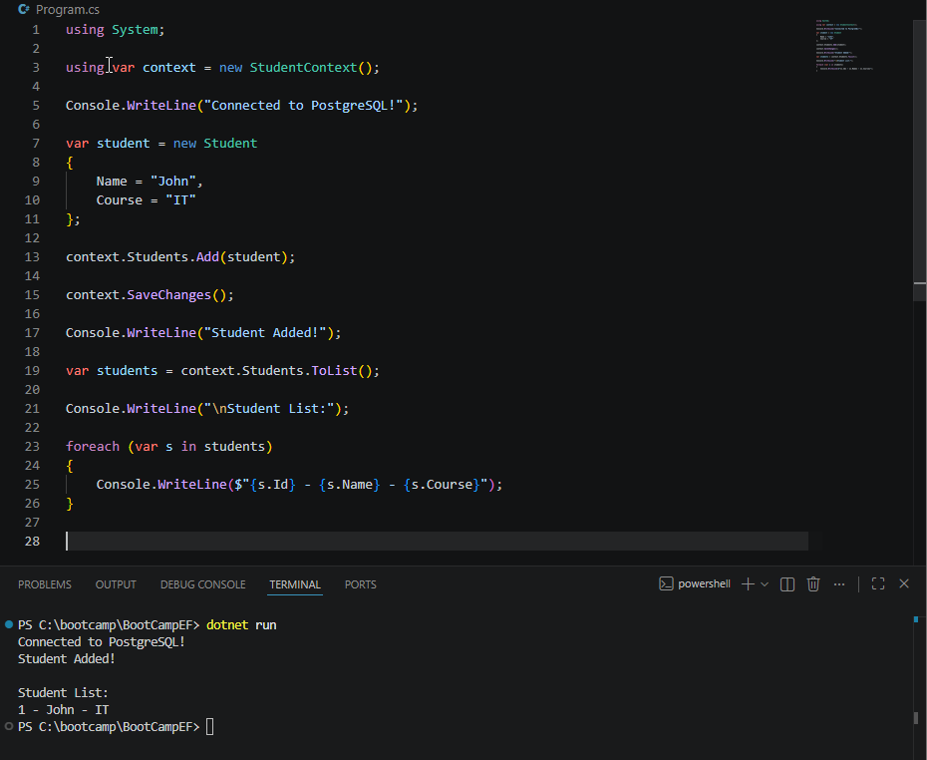
Read
Notes:
“Entity Framework is database-independent, so we install providers depending on the database we use.”
“What do you think would happen if we forgot the PostgreSQL package?”

Slide 37
Update
Change or modify a record in the database
Still in Program.cs, add the following code.
Once saved, in the Terminal, run the command:
dotnet run
Notes:
“Entity Framework is database-independent, so we install providers depending on the database we use.”
“What do you think would happen if we forgot the PostgreSQL package?”

Slide 38
Update
C# Code
var firstStudent = context.Students.FirstOrDefault();
if (firstStudent != null)
{
firstStudent.Name = "Updated John";
context.SaveChanges();
Console.WriteLine("\nStudent Updated!");
}
Explanation
Gets the first record in the Students table.
Check if any data is retrieved
{
Assign the Name property of the retrieved record to ‘Updated John’.
Save the changes to the database.
Displays a message in the terminal.
}
Notes:
“Entity Framework is database-independent, so we install providers depending on the database we use.”
“What do you think would happen if we forgot the PostgreSQL package?”

Slide 39
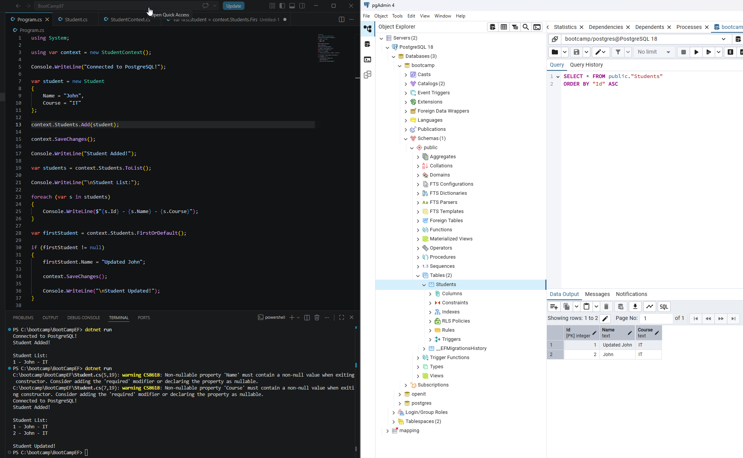
Update
Notes:
“Entity Framework is database-independent, so we install providers depending on the database we use.”
“What do you think would happen if we forgot the PostgreSQL package?”

Slide 40
Delete
Remove a record in the database
Still in Program.cs, comment our the Add and Update codes.
Add the following code before the Read code.
Once saved, in the Terminal, run the command:
dotnet run
Notes:
“Entity Framework is database-independent, so we install providers depending on the database we use.”
“What do you think would happen if we forgot the PostgreSQL package?”

Slide 41
Delete
C# Code
var deleteStudent = context.Students.FirstOrDefault();
if (deleteStudent != null)
{
context.Students.Remove(deleteStudent);
context.SaveChanges();
Console.WriteLine("\nStudent Deleted!");
}
Explanation
Get the first record in the Students table.
Check if there is any data retrieved
{
Prepares the record to be removed.
Remove the record and save the changes.
Displays a message in the terminal.
}
Notes:
“Entity Framework is database-independent, so we install providers depending on the database we use.”
“What do you think would happen if we forgot the PostgreSQL package?”

Slide 42
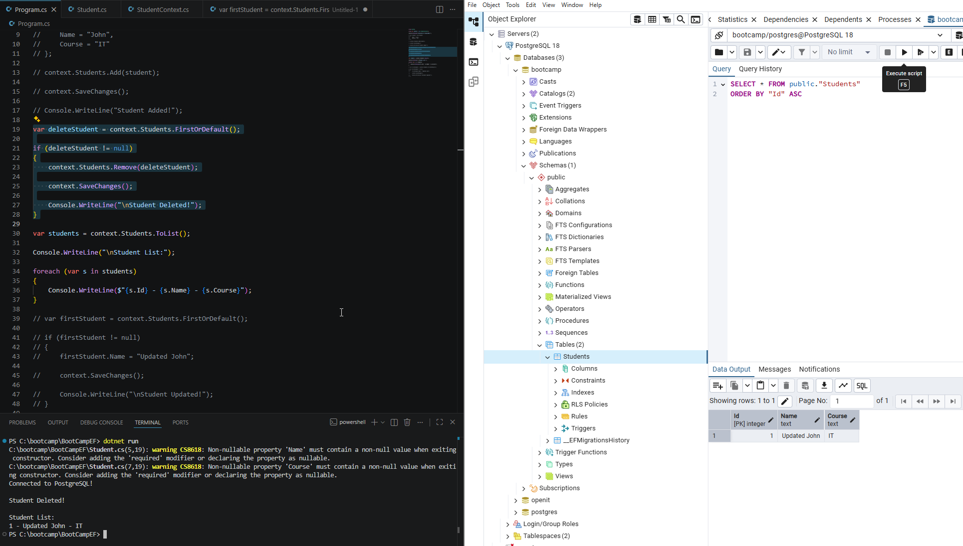
Delete
Notes:
“Entity Framework is database-independent, so we install providers depending on the database we use.”
“What do you think would happen if we forgot the PostgreSQL package?”

Slide 43
Relationships
Table connections

Slide 44
Relationships
This connects tables together.
This organizes connected data efficiently.
Without relationships:
Data becomes duplicated
Harder to manage
inconsistent
Notes:
“Entity Framework is database-independent, so we install providers depending on the database we use.”
“What do you think would happen if we forgot the PostgreSQL package?”

Slide 45
Types of Relationships
One-to-One
Example: One student is to one student number.
One-to-Many
Example: One student is to many courses.
Many-to-Many
Example: Many students is to many subjects.
Notes:
“Entity Framework is database-independent, so we install providers depending on the database we use.”
“What do you think would happen if we forgot the PostgreSQL package?”

Slide 46
Relationships
In VS Code, create a new file. Name the file as:
Course.cs
Add the following code:
public class Course { public int Id { get; set; } public string Name { get; set; } }
Notes:
“This file will contain the Student model or Student entity.”

Slide 47
Relationships
In VS Code, open the following file:
Student.cs
Overwrite the content with :
public class Student { public int Id { get; set; } public string Name { get; set; } public int CourseId { get; set; } public Course Course { get; set; } }
Notes:
“This file will contain the Student model or Student entity.”

Slide 48
Student Model
public int CourseId
This serve as the Foreign Key.
stores the ID of a related table.
public Course Course
This serves as a Navigation Property.
Which lets us access the related Course data.
Notes:
“Entity Framework is database-independent, so we install providers depending on the database we use.”
“What do you think would happen if we forgot the PostgreSQL package?”

Slide 49
Relationships
In VS Code, update the following file:
Course.cs
Overwrite the file with:
public class Course { public int Id { get; set; } public string Name { get; set; } public List<Student> Students { get; set; } }
Notes:
“This file will contain the Student model or Student entity.”

Slide 50
Course Model
public List<Student> Students
Relationship of Course and Students tables.
One Couse can contain Many students. (One-to-Many)
Notes:
“Entity Framework is database-independent, so we install providers depending on the database we use.”
“What do you think would happen if we forgot the PostgreSQL package?”

Slide 51
Update DBContext
In VS Code, open the following file:
StudentContext.cs
Overwrite the code with:
using Microsoft.EntityFrameworkCore;
public class StudentContext : DbContext
{
public DbSet<Student> Students { get; set; }
public DbSet<Course> Courses { get; set; }
protected override void OnConfiguring(DbContextOptionsBuilder optionsBuilder)
{
optionsBuilder.UseNpgsql(
"Host=localhost;Port=5432;Database=school_db;Username=postgres;Password=yourpassword"
);
}
}
Notes:
“Entity Framework is database-independent, so we install providers depending on the database we use.”
“What do you think would happen if we forgot the PostgreSQL package?”

Slide 52
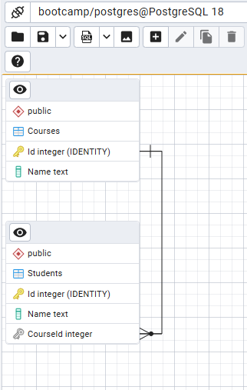
Applying Course Relationship
Please delete data in the Students table first!
In pgAdmin run the query: DELETE FROM public."Students"
Create a migration, run the command:
dotnet ef migrations add AddCourseRelationship
Update the database, run the command:
dotnet ef database update
Notes:
“Entity Framework is database-independent, so we install providers depending on the database we use.”
“What do you think would happen if we forgot the PostgreSQL package?”

Slide 53
Add a Course Add Relationship to Student
C# Code
using System;
using var context = new StudentContext();
var course = new Course
{
Name = “IT",
};
context.Courses.Add(course);
context.SaveChanges();
var student = new Student
{
Name = "John",
CourseId = course.Id
};
context.Students.Add(student);
context.SaveChanges();
Notes:
“Entity Framework is database-independent, so we install providers depending on the database we use.”
“What do you think would happen if we forgot the PostgreSQL package?”

Slide 54
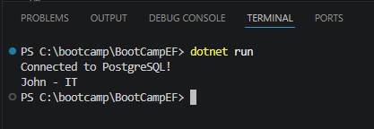
Retrieve Related Data
C# Code
using System;
using Microsoft.EntityFrameworkCore;
using var context = new StudentContext();
var students = context.Students
.Include(s => s.Course)
.ToList();
foreach (var s in students)
{
Console.WriteLine($"{s.Name} - {s.Course.Name}");
}
Explanation
Include - loads the related data
With Include – Course data loads too
Without Include – only Student data loads
Notes:
“Entity Framework is database-independent, so we install providers depending on the database we use.”
“What do you think would happen if we forgot the PostgreSQL package?”

Slide 55
Insert Multiple Students
C# Code
using System;
using Microsoft.EntityFrameworkCore;
using var context = new StudentContext();
var course = new Course
{
Name = “IS",
Students = new List<Student>
{
new Student { Name = “Johnson" },
new Student { Name = "Anna" },
new Student { Name = "Mark" }
}
};
context.Courses.Add(course);
context.SaveChanges();
Console.WriteLine("Course and students added!");
Explanation
Create an object Course with IT as Name and include the list of students.

Slide 56
Quick Activity
Please insert a Course
Name: CS
Students:
Mary
Joshua
Pia

Slide 57
EF Core Relationship Components
Component | Purpose
Foreign Key | Connect tables
Navigation Property | Access related database
Include() | Load related objects
Migration | Created DB relationships
Entity Framework Core relationships allow us to connect tables using C# classes, while PostgreSQL stores and enforces those relationships behind the scenes.”
Notes:
“Entity Framework is database-independent, so we install providers depending on the database we use.”
“What do you think would happen if we forgot the PostgreSQL package?”

Slide 58
Generated Query String
Display and investigate the generated query string

Slide 59
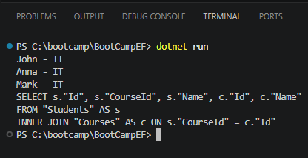
Generated Query String
C# Code
using System;
using Microsoft.EntityFrameworkCore;
using var context = new StudentContext();
var students = context.Students
.Include(s => s.Course)
.ToList();
foreach (var s in students)
{
Console.WriteLine($"{s.Name} - {s.Course.Name}");
}
Console.WriteLine( context.Students .Include(s => s.Course) .ToQueryString() );
Notes:
“Entity Framework is database-independent, so we install providers depending on the database we use.”
“What do you think would happen if we forgot the PostgreSQL package?”

Slide 60
Sorting Data
Organizing data retrieval based on a certain attribute

Slide 61
Sorting Data
var students = context.Students.ToList();
This retrieves data and convert it to list but the order of the data is unpredictable.
Databases do NOT guarantee order unless we explicitly sort.
Method | Purpose
OrderBy() | Ascending
OrderByDescending() | Descending
ThenBy() | Secondary sort
ThenByDescending() | Secondary descending
Notes:
“Entity Framework is database-independent, so we install providers depending on the database we use.”
“What do you think would happen if we forgot the PostgreSQL package?”

Slide 62
Sorting Data
C# Code
using System;
using Microsoft.EntityFrameworkCore;
using var context = new StudentContext();
var students = context.Students
.OrderBy(s => s.Name)
.ToList();
foreach (var s in students)
{
Console.WriteLine($"{s.Name} - {s.Name}");
}
Explanation
Sorts the data in ascending order
Sort using the Name property.

Slide 63
Difference between OrderBy() and ThenBy()
ThenBy()
Only works AFTER OrderBy() or OrderByDescending().
It sorts data after the first sorting condition from OrderBy().
Notes:
“Entity Framework is database-independent, so we install providers depending on the database we use.”
“What do you think would happen if we forgot the PostgreSQL package?”

Slide 64
ThenBy()
C# Code
using System;
using Microsoft.EntityFrameworkCore;
using var context = new StudentContext();
var students = context.Students
.Include(s => s.Course)
.OrderBy(s => s.Course.Name)
.ThenBy(s => s.Name)
.ToList();
foreach (var s in students)
{
Console.WriteLine($"{s.Course.Name} - {s. Name}");
}
Explanation
Sorts the data in ascending order
Sort using the Course Name property, then Name.

Slide 65
Setting Data Annotations
Property attributes for restrictions

Slide 66
Data Annotations
Data Annotations are attributes we place above properties to:
validate data
control database behavior
configure table columns
Data annotations are instructions we add to our model properties to control how the database behaves.
Notes:
“Entity Framework is database-independent, so we install providers depending on the database we use.”
“What do you think would happen if we forgot the PostgreSQL package?”

Slide 67
Most Common Data Annotations
Annotation | Purpose
[Required] | Cannot be NULL
[MaxLength(<number>)] | Maximum character
[MinLength<number>] | Minimum character
[Range(<number>, <number>)] | Numeric limits
[EmailAddress] | Emal validation
[Phone] | Phone validation
[Key] | Primary Key
[ForeignKey(<table>)] | Relationship
[NotMapped] | Ignore column
[Column] | Customize column
[Table] | Customize table name
[StringLength] | Min + Max length
Notes:
“Entity Framework is database-independent, so we install providers depending on the database we use.”
“What do you think would happen if we forgot the PostgreSQL package?”

Slide 68
Data Annotations Example
using System.ComponentModel.DataAnnotations;
public class Student
{
public int Id { get; set; }
[Required]
[MaxLength(50)]
public string Name { get; set; }
public int CourseId { get; set; }
public Course Course { get; set; }
}
Explanation
Required namespace
Set it to NOT NULL.
Set maximum length to 50.
To apply,please run the command:
dotnet ef migrations add AddAnnotationsName
dotnet ef database update
Notes:
Update your Student.cs model.

Slide 69
Coditional Query
Filter data based on conditions

Slide 70
Conditional Query
Id | Name | Course
1 | John | IT
2 | Maria | CS
3 | Anna | IT
SQL
SELECT * FROM “Students” WHERE “Course” = “IT”
C# (EF)
var students = context.Students
.Where(s => s.Course == "IT")
.ToList();
Notes:
For our current related tables, how will you do this query?

Slide 71
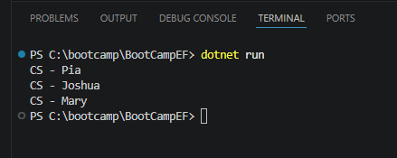
Conditional Query (Related table)
using System;
using Microsoft.EntityFrameworkCore;
using var context = new StudentContext();
var students = context.Students
.Include(s => s.Course)
.Where(s => s.Course.Name == "CS")
.ToList();
foreach (var s in students)
{
Console.WriteLine($"{s.Course.Name} - {s. Name}");
}

Slide 72
Activity
You have created the tables and inserted and retrieve data manually on your activity in PostgreSQL topic.
Action Points:
Convert the schema into a models. Please include proper relationships.
Create a function that will emulate the Part 2 (Seed Data)
Create a function that will retrieve Student Enrolment data.
The programs should start with a menu and the user can select from the two functions.

Slide 73
Get In Touch With Us
getstarted@openit.com

Slide 74
Thank You.

