Slide 1

GROUP 9
SCRUM MASTER – Dushyant Kaushik

Slide 2
CRYPTO-WALLET

Slide 3
PROBLEM
There are many different exchanges on which we trade and the exchanges only show the P/L of trading we’re doing only on their website .

Slide 4
PROBLEM
Which makes It is difficult to track overall P/L of investment in CryptoCurrency.

Slide 5
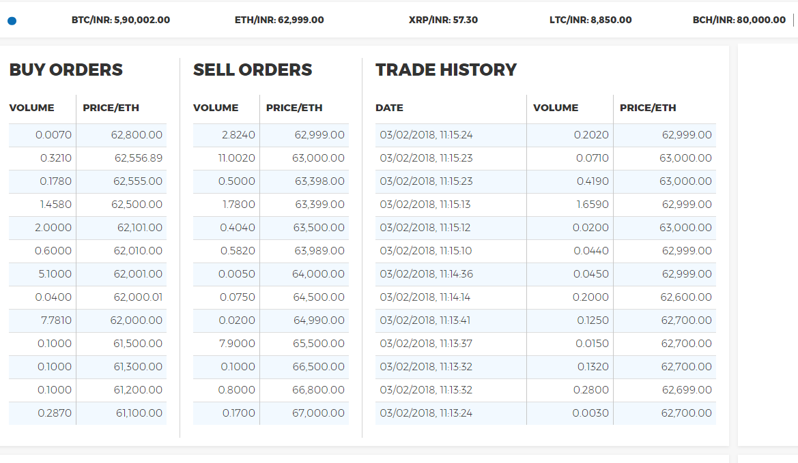
KOINEX

Slide 6
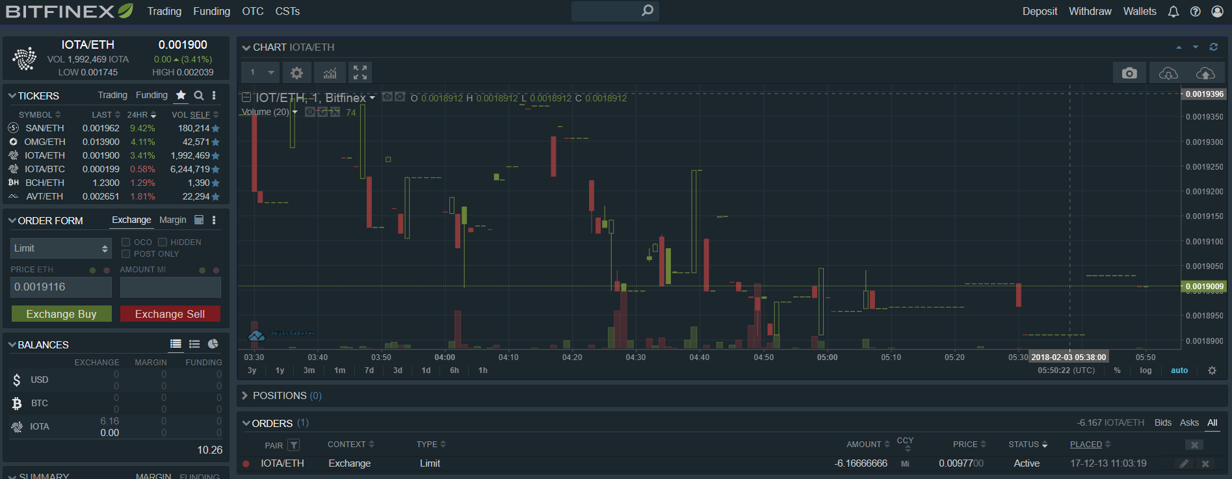
BITFINEX

Slide 7
SOLUTION
A complete portal where you can track all of your crypto currency investments on different exchanges.

Slide 8
SOLUTION
Keep up to date on total P/L for the total investment.
Also, P/L on per coin/token basis for better detailed analysis.

Slide 9
E-COMMERCE
This will a Business-to-Customer (service) type of e-commerce for which a small fee will be charged on monthly basis.

