Slide 1
Welcome Online Banking
Project Monthly Examination
Module-7

Slide 2
Sir Md. Rajaul Islam
Technologies we used :
Personal Information :
Java Server Faces (JSF)
Primefaces
Web application structure
Web Services
Hibernate
Mysql
Xml, css
Html
Md. Rahamat Ullah
Trainee ID : 1246188
Batch :J2EE-39
Exam:- 02/07/2019

Slide 3
To we used :
1. NetBeans 8.2
2. Hibernate
3. MySql
4. Tomcat 9.0

Slide 4
What does online Banking mean ?
Systems that enable bank customers to
access accounts and general Information on
bank products and services through a personal
computer or other intelligent device.

Slide 5
Scope of our project
Our system will contain the following features:
1. Allow the guest to apply for an account if he satisfies
bank’s conditions.
2. Allow the guest to calculate prices between different
currencies using the calculator web Service.

Slide 6
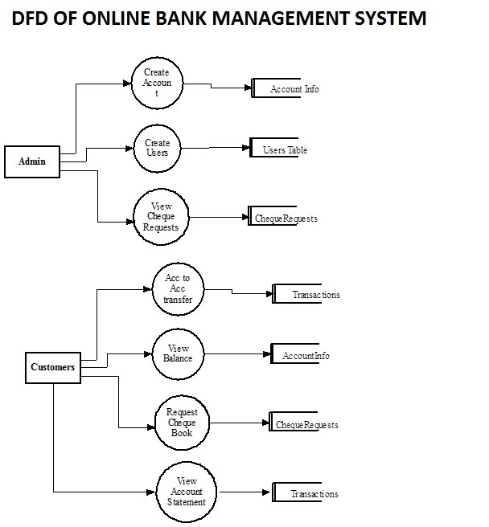
Use Case :

Slide 7
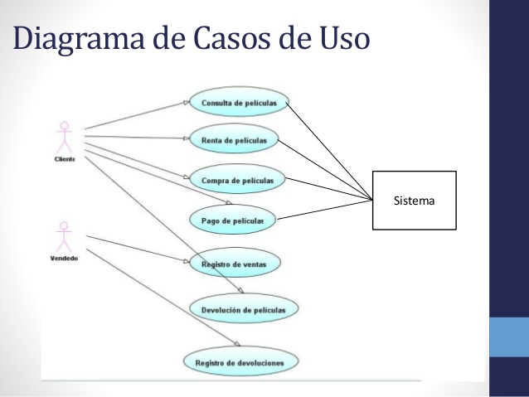
Diagrama User :

Slide 8
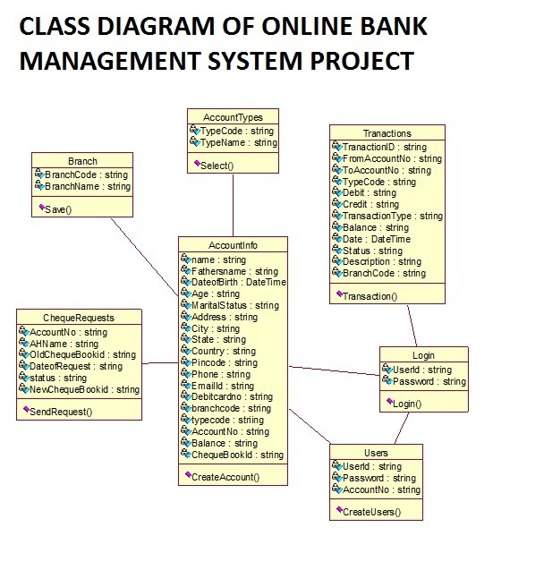
UML DIAGRAM :

Slide 9
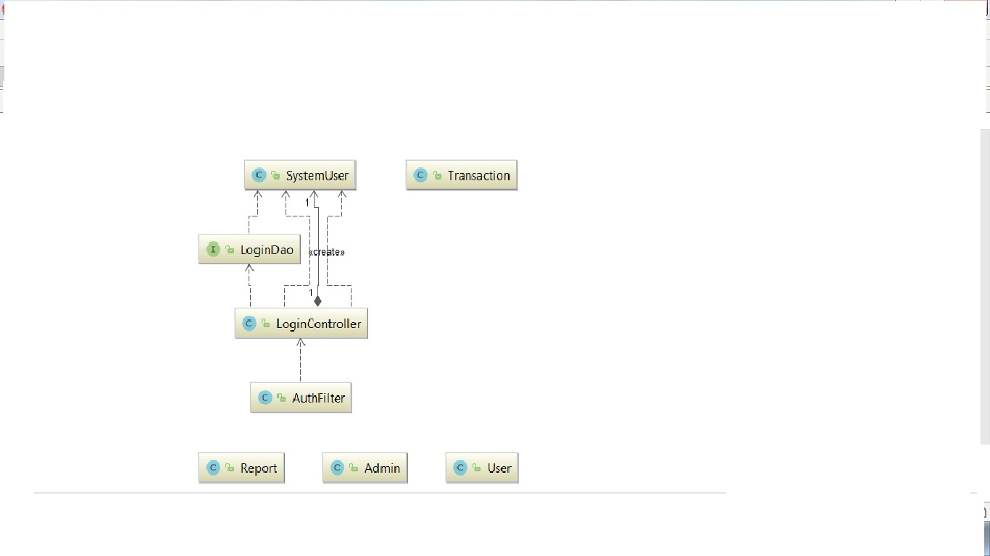
Data Diagram :

Slide 10
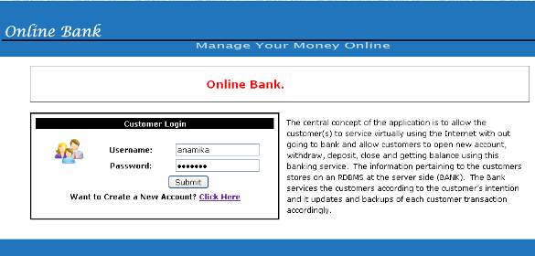
Login Page :

Slide 11
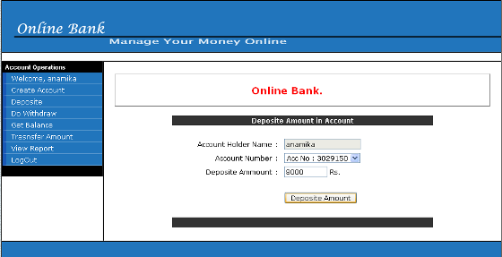
Account Check :

Slide 12
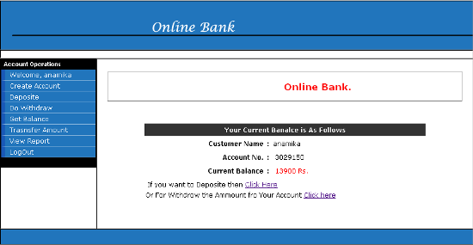
Account Valid Details :

Slide 13
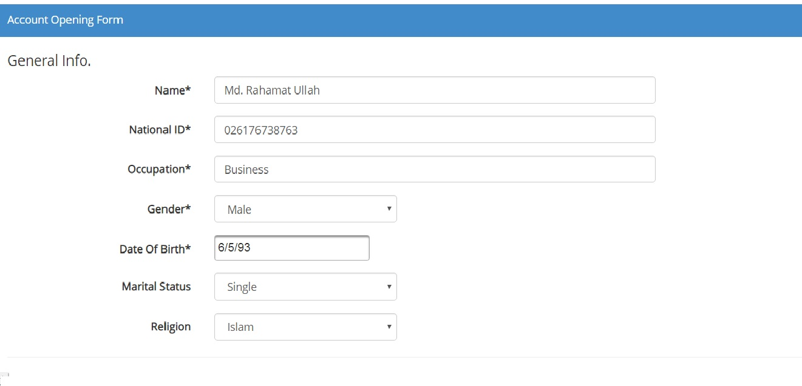
Account Opening Form :

Slide 14
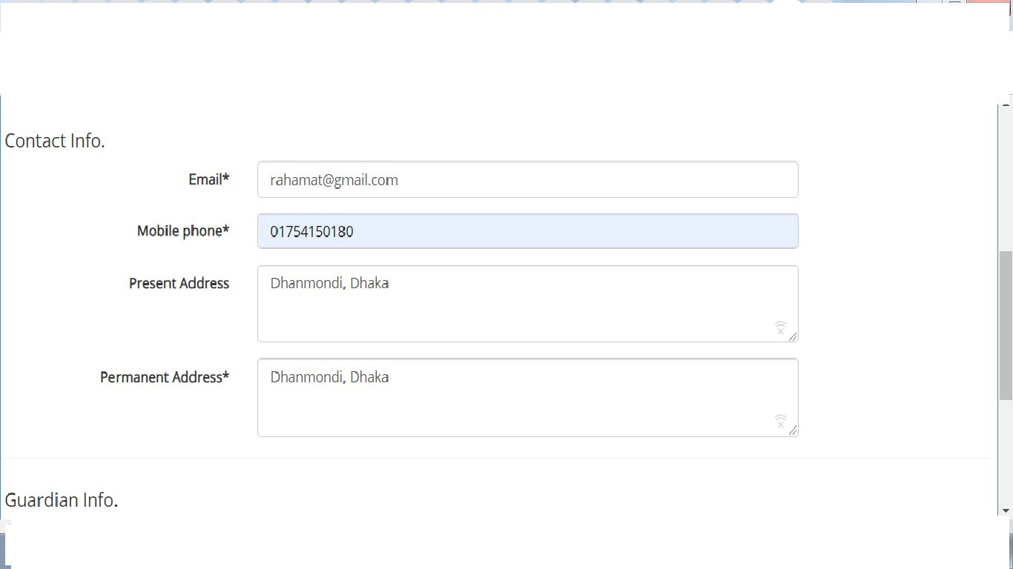

Slide 15
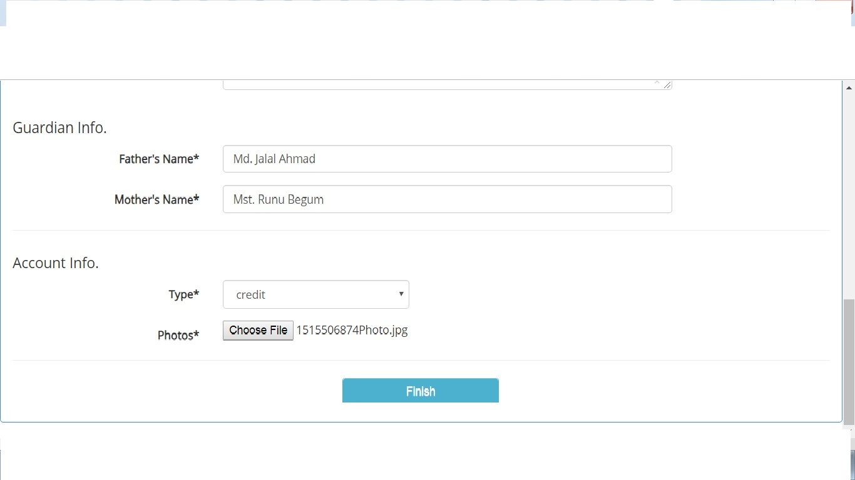

Slide 17
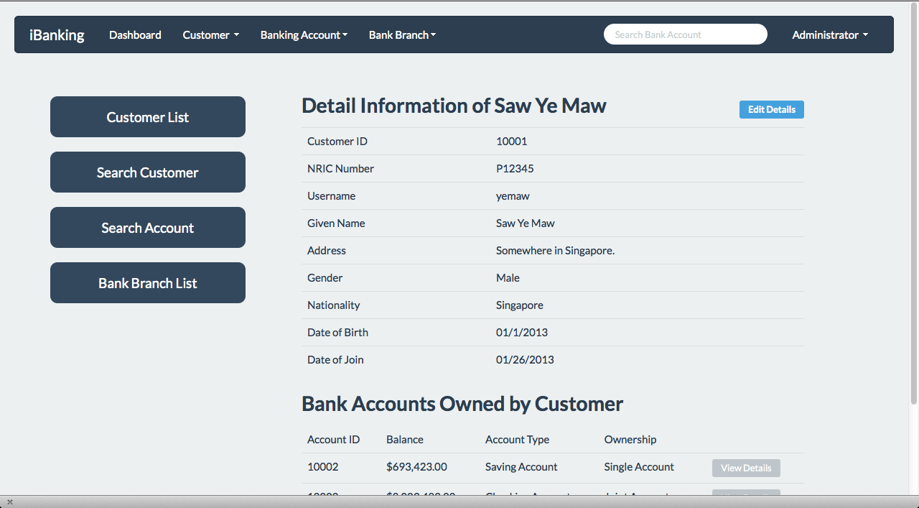
Details Data Show :

Slide 18
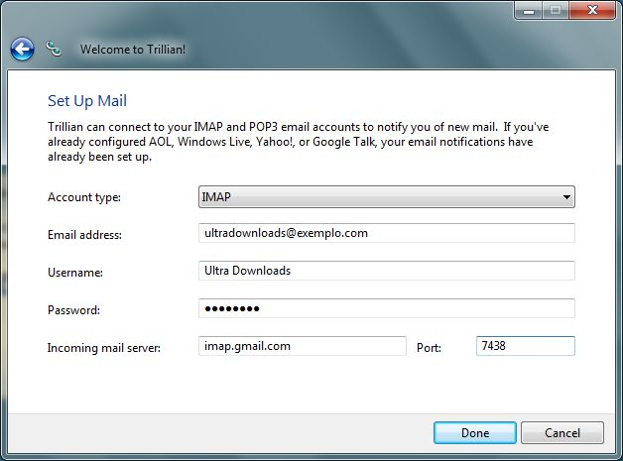
Mail Set Up :

Slide 19
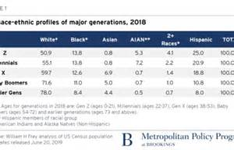
Bank Policy :

Slide 20
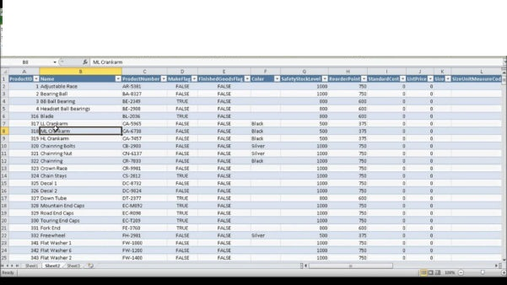
Daly Balance :

Slide 21
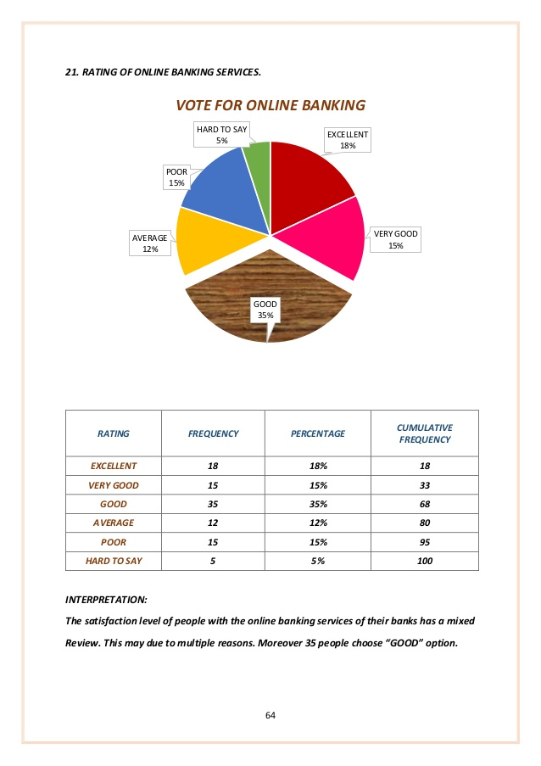
Rating For Bank :

Slide 22
Thank You
---

