Slide 1
Developing an IoT System
Uli Raich
Two lectures on Hardware and Software for the Internet of Things
Lecture 2: Accessing the “things” through the Internet
Presented online at the African Internet Summit Mauritius 2022

Slide 2
The “I” in IoT
To communicate with the IoT node over we Internet we must
Connect the Node to the WiFi network
Provide a WEB server
We may need additional protocols like “server side events” or WEB sockets accessed through JavaScript or
Communicate to an MQTT broker, which in turn sends or receives data from an MQTT publish or subscribe client

Slide 3
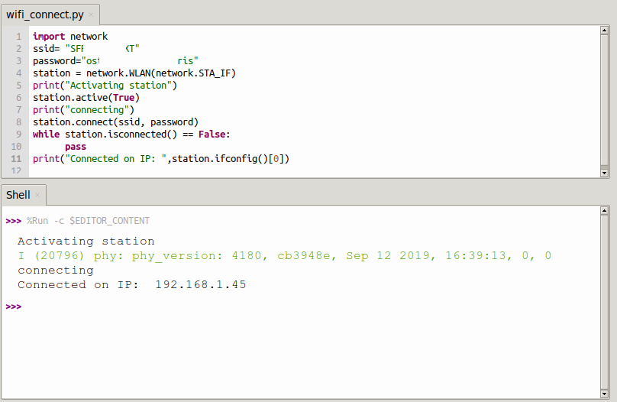
Connecting to the WiFi network
Micropython provides the WLAN class giving access to methods to
Activate the WiFi station and check the activation
Scan for nodes in the neighborhood
connect/disconnect
Get the network status
Get/set IP level information

Slide 4
A WiFi connection class
When working on IoT you must connect to the network very often.
I therefore wrote and integrated a module named wifi_connect
This makes connecting to the network super-simple:
from wifi_connect import *
connect()
connect also gets the current time from ntp and sets the real time clock on the ESP32
You can get the current time with
gmtTime() or
cetTime()
d

Slide 5
A simple TCP server/client example
The server:
create a socket
bind the host address to a port
listen for connection requests
accept the connection
receive data from the connection
send data to the connection
Close the connection

Slide 6
A simple TCP server/client example
The client:
create a socket
connect to the server
send data
receive data
Let’s try it on the PC first!
d

Slide 7
TCP server on the ESP32
There is no difference with respect to the code on the PC
Except prior connection to the WiFi network.
Now we can create a TCP server on the ESP32 that reads some sensors and sends the results to the PC
On the PC we can have a user friendly GUI application which treats and displays the data.
Example: A simple voltmeter. The analogue signal level is read from the ADC and its digitized value is displayed on the Voltmeter application.
d

Slide 8
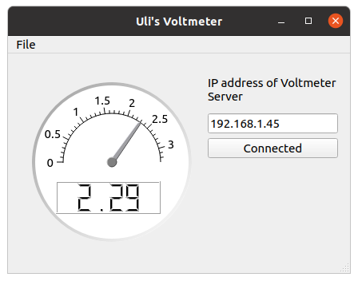
The voltmeter application
Like all the other examples the code is entirely written in Python
It uses the Qt5 widget set with the PyQt5 Python language binding
A full description on how to develop a Qt5 application in Python exceeds the scope of these lectures.
d

Slide 9
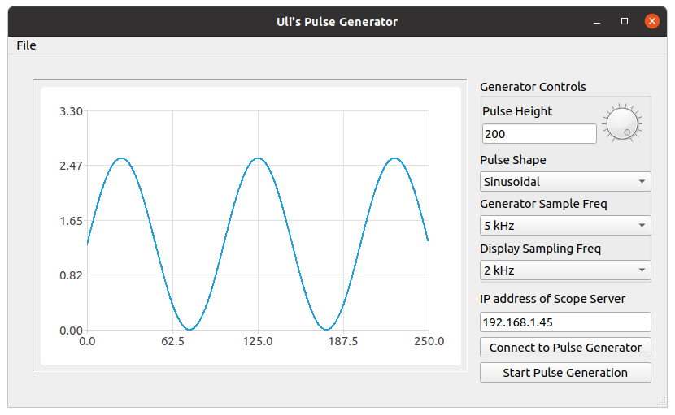
Other virtual instruments
A pulse generator

Slide 10
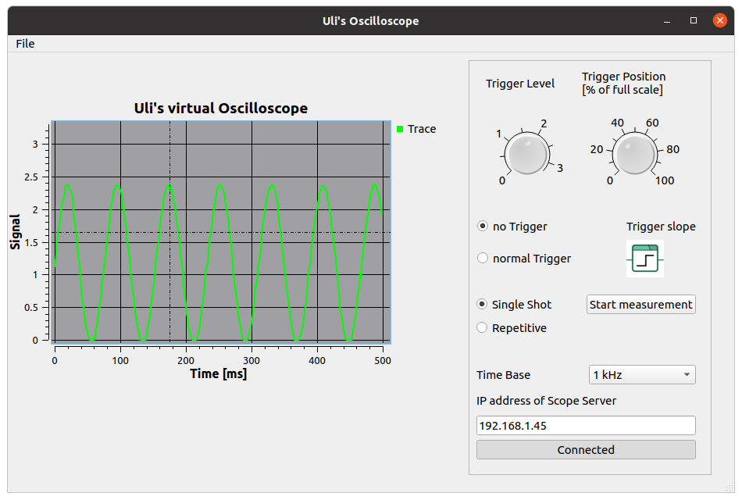
A virtual oscilloscope
A virtual oscilloscope showing the output of the pulse generator

Slide 11
A simple WEB server
As we have seen, MicroPython contains a socket class for network access and that is all that is needed to implement a simple WEB server.
To make things even simpler a basic framework name picoweb is available on github. I integrated this framework into the MicroPython binary to make it globally accessible

Slide 12
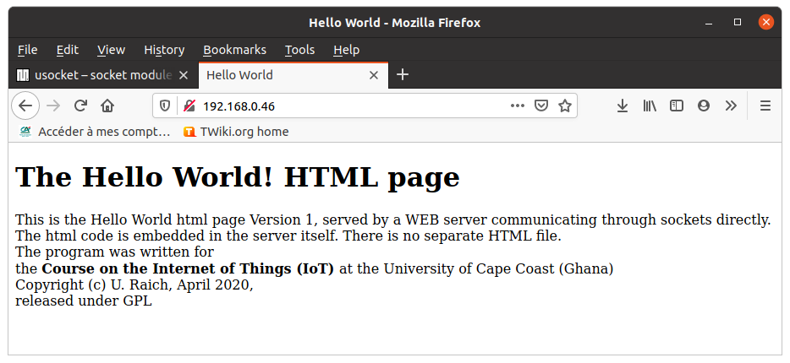
The first WEB page
d

Slide 13
picoweb
The picoweb module is a framework for writing WEB servers
If contains functionality to
Create and listen to HTTP requests on a socket
Handling routing
Parse HTTP requests
Prepare HTTP responses by sending the necessary header
Send HTTP pages stored in files
Handle templates
d

Slide 14
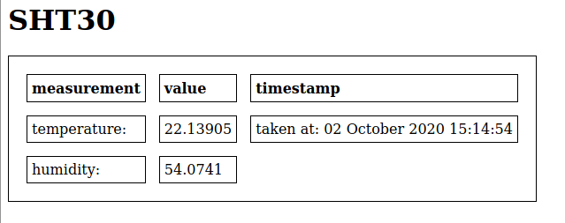
Integrating measurements into the WEB page
That is already not too bad!
However, we want to integrate measurements into the WEB page.
This can be done through templates
We define a HTML table and fill the entries with measurements made be the SHT30.
d

Slide 15
Server Side events
This is still not perfect because we have to update the whole HTML page if we want to get new measurements
We would like the WEB server make periodic measurements, which update the page on the browser (client) side whenever they are sent
This can be achieved through server side events
d

Slide 16
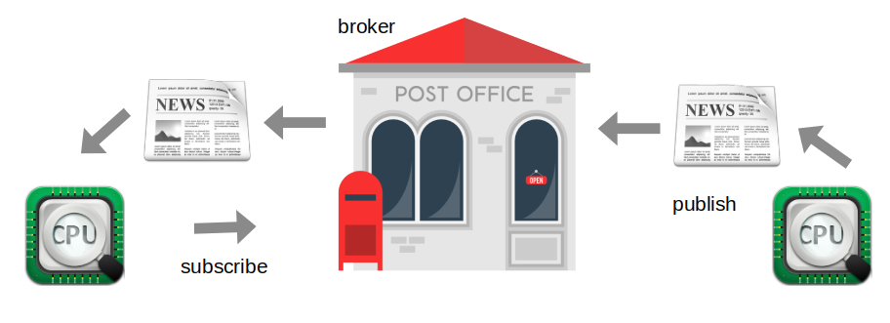
MQTT, another way to go online
Message Queuing Telemetry Transport: a publish-subscribe Protocol for IoT

Slide 17
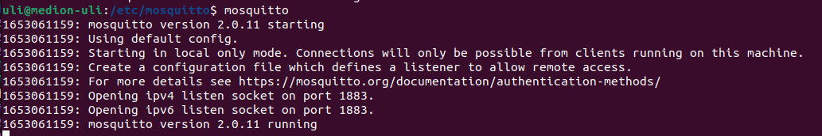
Setting up mosquitto
When starting mosquitto you see that we have to define an authentication method if we want to access the broker from a remote machine like the ESP32
The easiest way to accomplish this is a password file

Slide 18
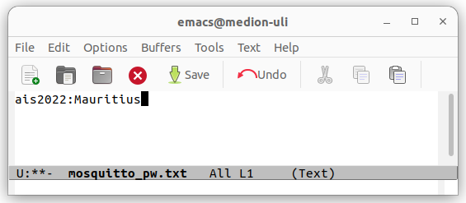
mosquitto password file
First we create a simple text file with a user name (ais2022) and a password (Mauritius)

Slide 19
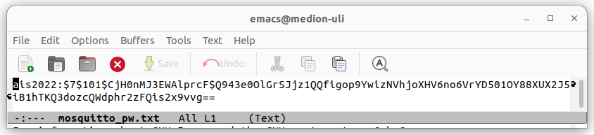
Encode password file
Then we encode it with mosquitto_passwd:
mosquitto_passwd -U mosquitto_pw.txt
… and we copy it to /etc/mosquitto/

Slide 20
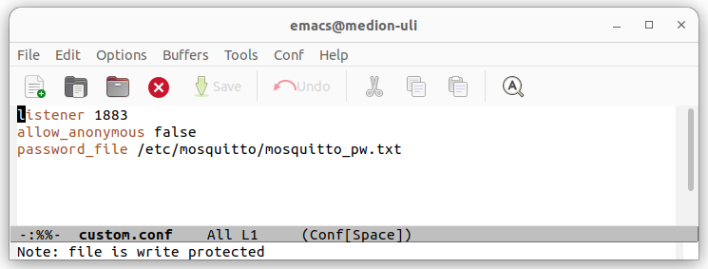
Adapting the config file
Finally we create a custom mosquitto config file, which is located in /etc/mosquitto/conf.d enabling the password file.

Slide 21
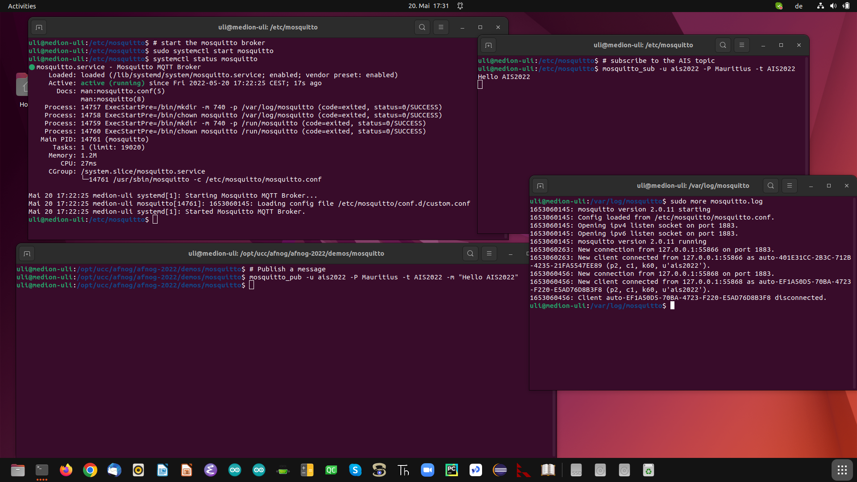
The mosquitto broker
d

Slide 22
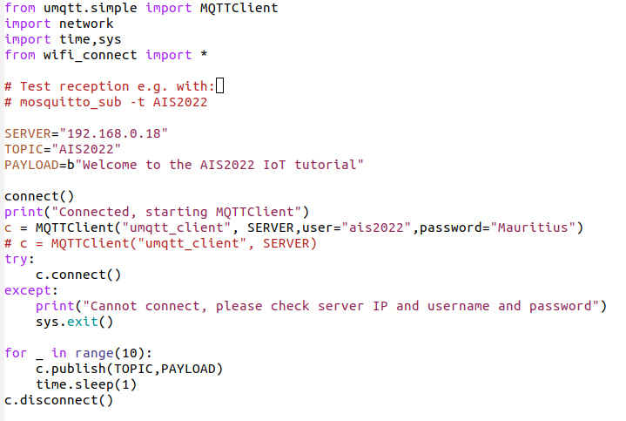
MQTT client on the ESP32
… and if I could have the MQTT client on the ESP32.
If it was the publishing client it could send measurements to the broker and thus to any subscribed client
If it was the subscribing client it could receive commands from the broker and thus from any publishing client
micropython-lib supplies the umqtt library giving us access to MQTT
d

Slide 23
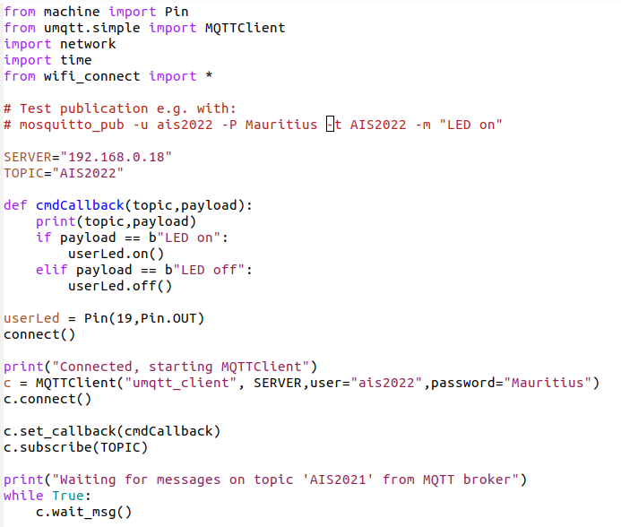
Subscribing client on the ESP32
d

Slide 24
Cayenne
myDevices Cayenne claims to be the world’s first drag and drop IoT builder.
It provides the MQTT broker and uses its own protocol on top of the MQTT messages to transfer information between itself and the IoT system.
It also supplies a dash board with widgets to graphically represent measured parameters.
It can work on many different types of micro-controllers and has language bindings for
C, C++
Arduino IDE
Python
Unfortunately the Cayenne Python librarydepends on the Eclipse Paho MQTT library and cannot be used with MicroPython without modification
However, the library is OpenSource and I managed to adapt it to MicroPython’s umqtt

Slide 25
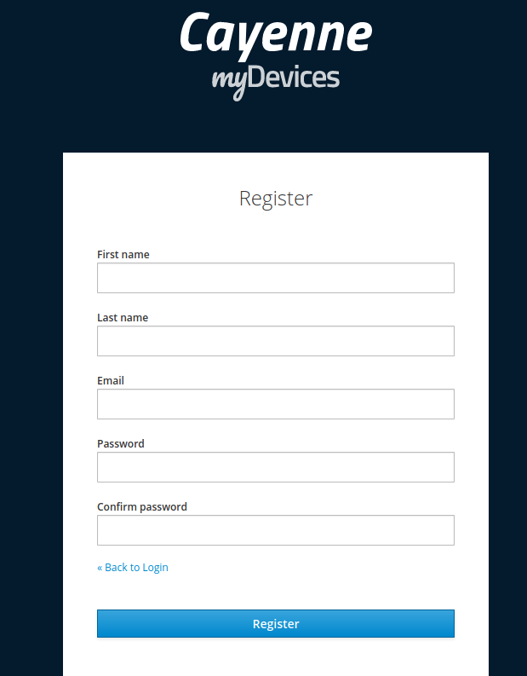
First steps
Register!
Registration will supply you with an
MQTT user name
MQTT password

Slide 26
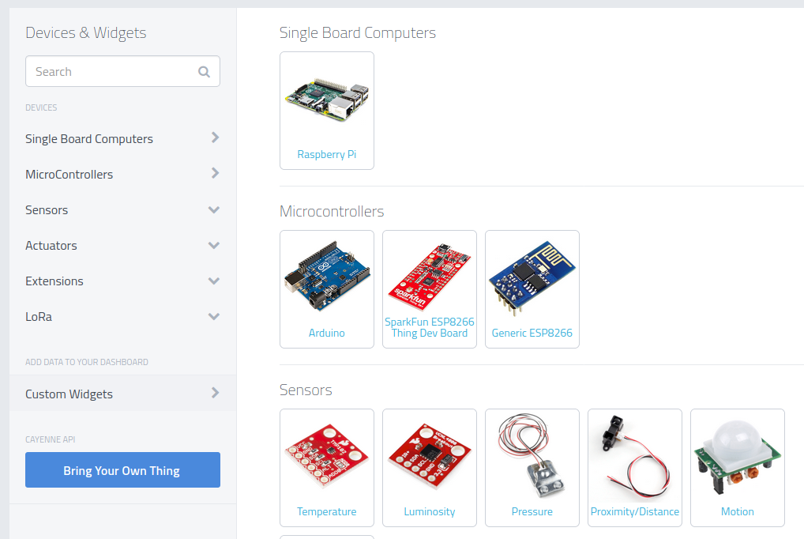
Create a new project

Slide 27
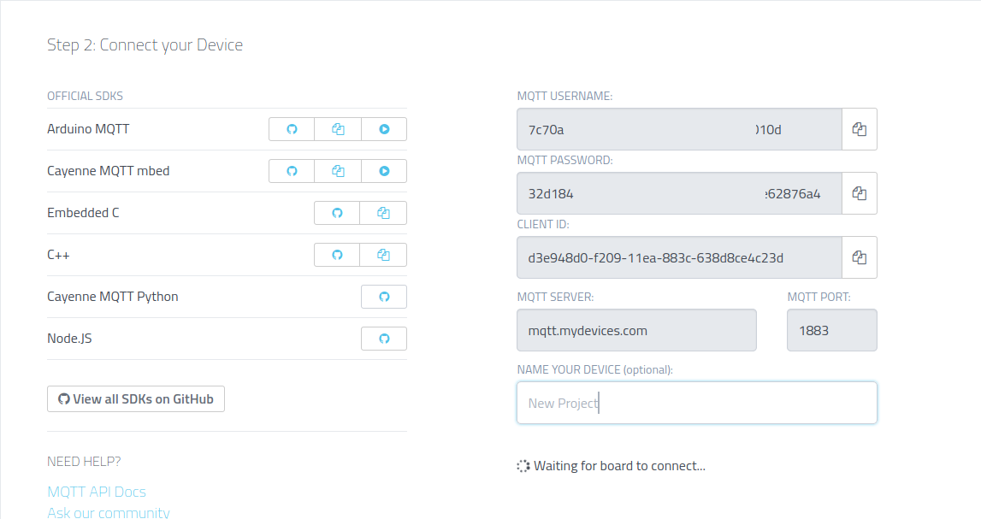
Cayenne credentials

Slide 28
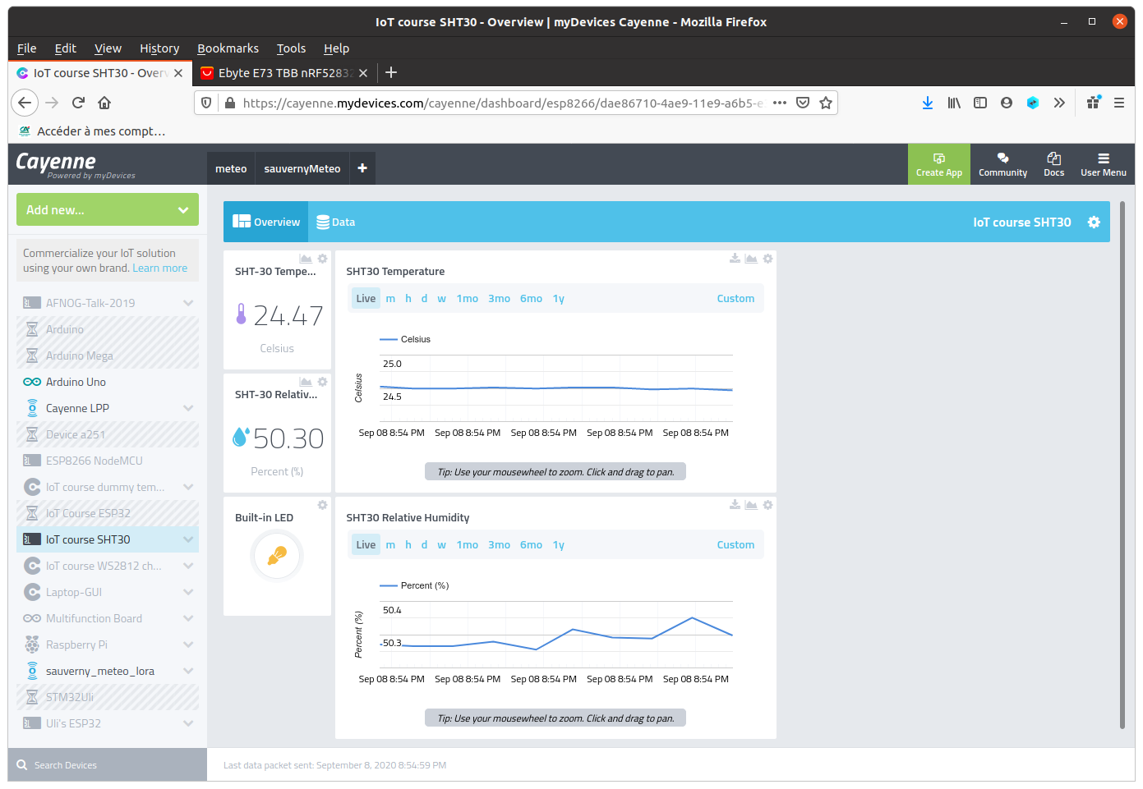
Cayenne dash board

Slide 29
What next
This tutorial showed only three different devices:
The SHT30 temperature and humidity sensor
The WS2812 addressable rgb LED ring
The linear potentiometer in conjunction with the on-chip ADC
However, there are many more WeMos D1 mini shields some of which are demonstrated in the IoT course prepared for the University of Cape Coast, Ghana.
The description is available on the Twiki under IoT Course in English as well as exercises proposed for these devices.
A slightly different french version is also available on the Twiki IoT Course in French
The solutions can be downloaded from my github repository.

Slide 30
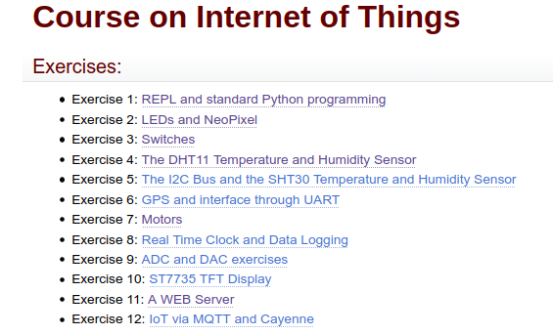
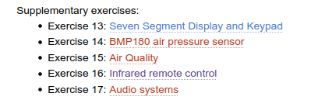
IoT course exercises

Slide 31
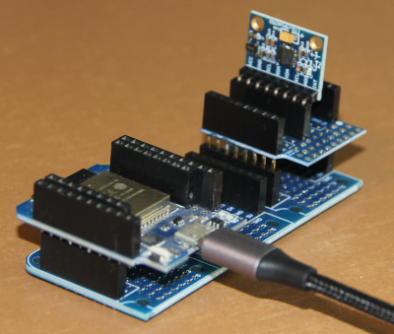
Adapt other sensor boards
There are plenty other sensor and actuator boards available, which can be adapted to the WeMos D1 mini bus using the prototype board.
Here is the example of an accelerometer and gyroscope
Writing drivers for sensor boards is not always a trivial task.
I ported a library for the MPU6050 driver originally written in C++ for the Arduino to MicroPython. The driver has 6000 lines of MicroPython Code

Slide 32
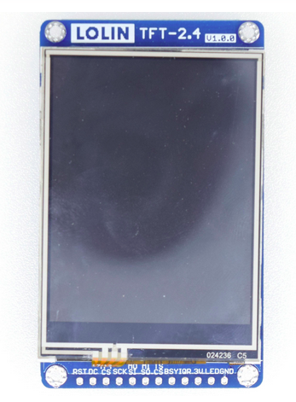
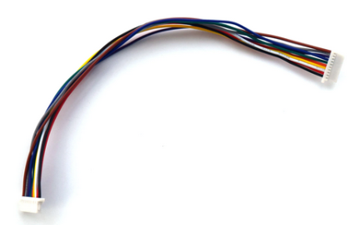
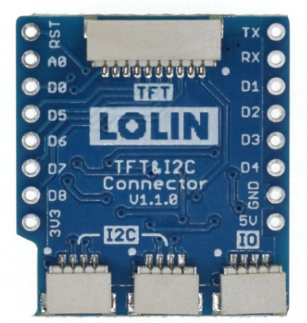
GUI on the IoT node
The Lolin 2.4 “ display features a touch panel in addition It uses an ili9341 graphics controller and has 320x240 pixel resolution
The lvgl GUI library supports this device and makes running of GUI applications on the ESP32 possible

Slide 33
Understanding GUI development
Graphical User Interfaces usually need big resources in memory and/or disk space usually not available on micro-controllers.
lvgl (the Light and Versatile Graphics Library) is adapted to few resources. It is written in C but has a MicroPython language binding where the Python calls are implemented as C code with a Python interface.
There is a MicroPython variant called lv_micropython, which has lvgl included in its firmware.
lvgl is available for several graphics controllers and it has a “simulator” using SDL to display the graphics on the unix port of lv_micropython.
Program development can be comfortably done on the PC and only the final GUI is transferred to the IoT hardware.
The system is so huge that you will need several months to study and use it.

Slide 34
LVGL look and feel
Lvgl has a big number of widgets: label, push button, slider, tab, menu
It allows complex animations
It uses callbacks to trigger user functions when interactions occur (a button is pressed)
Here is a demo showing off many of the widgets.
The demo is written in such a way that it adapts itself to the screen size of the display used.

Slide 35
TinyML
The other most fashionable subject in computer science today is Artificial Intelligence (AI) and Machine Learning (ML)
We have seen how to read out and interpret data from a temperature and humidity sensor but what do we have to do if we want to
understand spoken key words captured by a microphone ?
know if a person is in sight of a camera or not ?
understand gestures measured with an accelerometer ?
Such type of problems can be solved with Artificial Intelligence.

Slide 36
Creating AI models
Creating machine learning models and making them learn, requires large computing resources and there is no chance to do this on micro-controllers.
The model recognizing a person on an image is fed 120.000 images to make it learn to distinguish images with and without human beings.
My gaming PC with a GPU however can do this. The learning process may take hours or even days.
The final model however can be squeezed down in size in such a way that it fits into the micro-controller memory. The micro-controller code will read images from the camera and feed them into the previously prepared model. The model then answers if a person is there or not.

Slide 37
A lot to learn!
AI and machine learning requires quite a bit of knowledge:
The mathematics behind the algorithms is not always trivial
You need to know how to use a big number of Python libraries:
numpy
pandas
matplotlib
tensorflow, tensorflow light, tensorflow light micro, keras scikit-learn
and quite a few more
Maybe you will come back to AIS-2023 for a tutorial on tinyML?

Slide 38


