Slide 1
Small Physics Experiments
An Introduction to Physics Experimentation
Uli Raich (uli.raich@gmail.com)
This workshop provides hands-on exercises on
sensor readout and experiment control with actuators.
It is part of the African School of Fundamental Physics 2024

Slide 2
Physics Experimentation
In many of today’s physics experiments, some electronics is used to capture signals from sensors and to control the experiments through actuators
Sensors can measure
Temperature, relative air humidity, soil moisture, air pressure
Air pollution through particle detection or gaz analysis
Magnetics fields (e.g the earth magnetic field, which allows to build a compass)
Movement through accelerometers or gyroscopes
Distance through ultrasound or lasers

Slide 3
Actuators
Actuators are used to control the experiment
These can be:
Digital on/off signals, relays
Analog signal levels controlling e.g. an amplifier
Different types of motors

Slide 4
How to build a simple experiment
A typical experiment consists of
The sensor and actuator
A computer to read the sensor values and/or drive the actuators
A program reading the results and displaying and storing them
An analysis program for data evaluation

Slide 5
Types of computers
We all use PCs and hand phones, which are controlled by computers.
The PCs are rather powerful, they have large resources of disk space and memory and they are equipped with network interfaces, but they lack other hardware interfaces. PCs are relatively expensive.
Microcontrollers have much less resources and usually no hard disk. Modern µCs have WiFi interfaces and they have hardware interfaces to
  GPIO (General Purpose IO lines)
  I2C instrumentation bus
  SPI serial peripheral interface
Prices can be very low (ours costs 4 US$)

Slide 6
Course layout
There will be short lecture parts explaining the system and giving a few online examples
Most of the time will be spent on hands-on exercises where you will set up a simple experiment yourself.
The sensors will be simulated by a simple pushbutton switch for digital signals, and a slider potentiometer for analogue signals.
We also have 2 real sensors measuring temperature humidity and air pressure.
A mono color, user programmable LED as well as a rgb LED ring with seven LEDs are used as a simple display.
A 128x64 pixel OLED display is used to print results from measurements.
Data can also be transferred to the PC and plotted there.

Slide 7
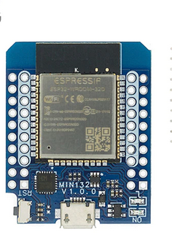
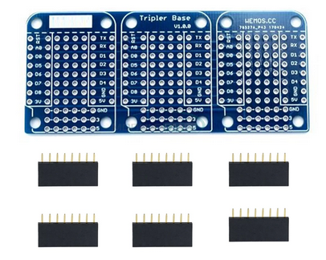
Simulating an experiment
To simulate an experiment we have a bus system
an ESP32 micro-controller to connect the sensor to the uC
The CPU card has a user programmable LED
and an USB to serial interface

Slide 8
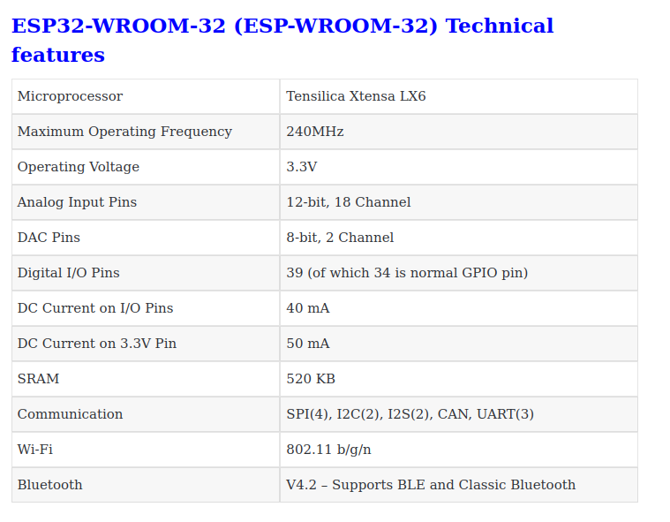
ESP32 specifications
All this for 4 US$

Slide 9
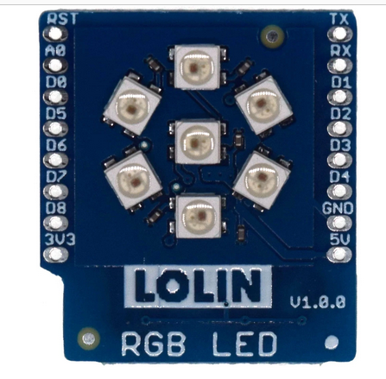
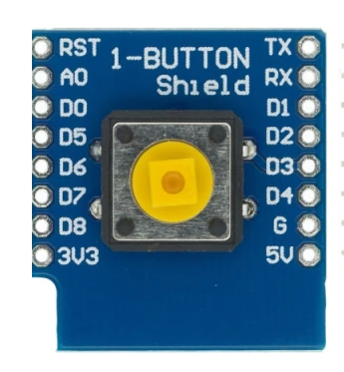
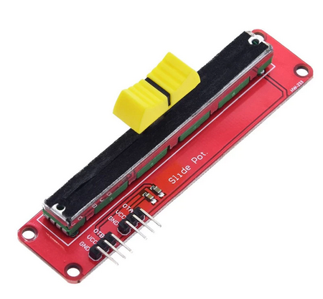
Sensor and actuator
a pushbutton allows
to generate digital
signals
a potentiometer
creates analog
signal levels
a simple display with
7 rgb LEDs

Slide 10
How to use these devices
To interact with the devices we must write readout and control programs.
These days, a very popular programming language is Python.
Standard Python (CPython) uses huge libraries and can be very resource hungry but resources are scarce on the micro-controller.
A stripped down Python interpreter: MicroPython is already installed in flash memory on the CPU board.
We can connect the CPU card to the PC using a micro USB cable. The CPU converts USB to serial and we can use an serial terminal emulator for communication.

Slide 11
Documentation
The documentation for the course is available at:
https://github.com/uraich/ASP2024/wiki
Program code is found here:
https://github.com/uraich/ASP2024
The MicroPython documentation is here:
https://docs.micropython.org/en/latest/
For more information on IoT have a look at
https://afnog.iotworkshop.africa/do/view/IoT_Course_English/WebHome or
https://afnog.iotworkshop.africa/do/view/IoT_Course_French/WebHome

Slide 12
Connecting to the ESP32
Connection of the ESP32 micro-controller to the PC is simple:
Just connect the micro USB cable to the PC. This will also power the ESP32.
You should see the power LED on the ESP32 coming on.

Slide 13
Programming Tools
We have a series of tools allowing us to program the ESP32 micro-controller:
thonny is an Integrated Development Environment (IDE) to
  Edit programs and save them on the PC or the ESP32 file system
  Transfer the programs to the ESP32
  Run them
  Print the results
  Interact with the MicroPython Interpreter
minicom is a serial terminal emulator that can talk to the MicroPython on the ESP32
ampy allows to transfer file to and from the ESP32 via the serial line and to run programs

Slide 14
Tools
The main tool we will be using is thonny
thonny is a simple Integrated Development Environment (IDE) which allows
talking to the Read Evaluate and Print Loop (REPL) of the MicroPython interpreter
editing scripts, saving them on files on the PC or the ESP32 and executing them with print output going to its shell window
file transfer between the PC and the ESP32
minicom is a virtual serial terminal connecting to REPL on the ESP32
ampy allows file transfers and running of programs on the ESP32

Slide 15
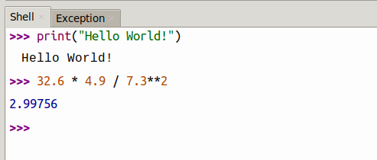
Talking to MicroPython
Since MicroPython is an interpreted language we can talk to the interpreter directly. When started we get a prompt saying that the REPL (Read, Execute and Print Loop) is ready to receive commands.
Python can be used as a calculator.

Slide 16
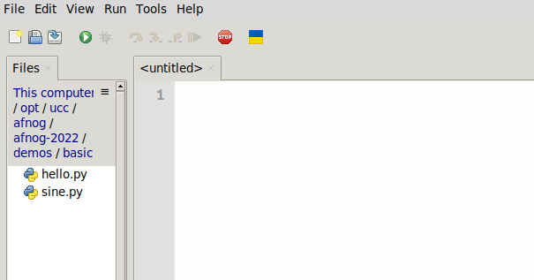
Programming
Talking to the interpreter is fine but we want to be able to write a program and have it executed.
For those who don’t know Python, here is a link
to the Python tutorial.
and here the link to the MicroPython documentation
Create a new Python file with File →New
This will create an editor window labeled <untitled>
Save this (empty) file and the window
title will change to the filename
Now let’s write our hello world program
and execute it

Slide 17
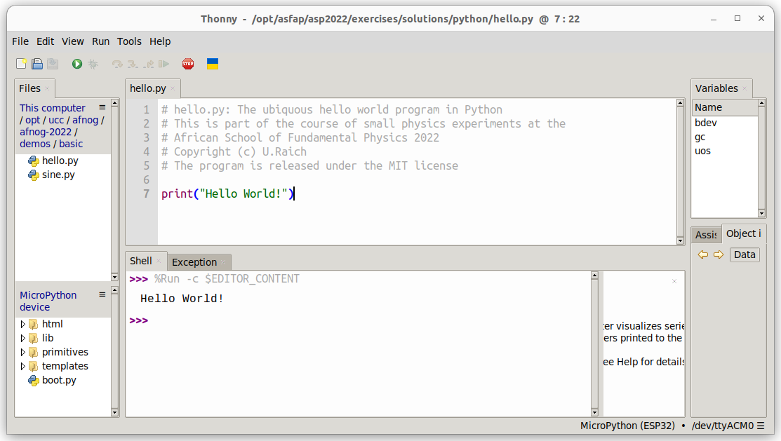
thonny

Slide 18
Assignment
In Python the “=” signal does not represent an equation but an assignment
a=6 # assigns the integer value 5 to the variable a
# the “#” sign denotes a comment
f=5.8 # assigns the floating point value 5.8 to the
# variable f
b=True # b takes the boolean value true
s=”Hello” # s is assigned the string “Hello”
l=[1,2,3,5] # l is a list with values 1,2,3,5
t=(1,2,3,5) # t is a tuple with the same values
# tuples are similar to lists but they are
# immutable
a = a+3 # would be a illegal equation but is a perfectly legal
# assignment
print(a,f,b,s,l,t)
Types are assigned automatically

Slide 19
Arithmetic
The basic arithmetic operations work as expected:
s=5+7
a=5
b=7
sum = a+b
difference = a-b
product = a*b
division = a/b # yields a float value
div_int = a//b # yields an integer division,
# only integer part of the division is taken
# into account

Slide 20
Lists
Often we want to group variables into lists
my_list = [0,5,3,8,4]
my_list[0] denotes the first element in the list (0 in this case)
my_list[4] is the last element in the list (4)
len(my_list) gives you the number of elements (5)
In Python, list elements can have any type. During the exercises we will however mainly use lists with elements of the same (e.g. integer) type.
Lists are particularly useful with loops.

Slide 21
Conditions
We can execute one part of our program or another one depending on conditions
a,b = 5,7
if a > b:
print(“a is bigger than b”) # note that the body of the condition
# is indented
# all the indented code is executed if the
# condition evaluates to true
elif a < b:
print(“a is smaller than b”)
else:
print(“a and b are equal”)
Comparison operators are:
< smaller than, > bigger than
== are equal, != are not equal

Slide 22
loops
A computer is particularly good at repeating things without making errors, something humans find extremely boring.
In Python we have 2 types of loops:
for i in range(5):
print(“Hello World”) # prints “Hello World” 5 times)
i = 5
while i > 0:
print(“Hello World”) # does the same thing
i -= 1 # different syntax for i=i–1
while True:
print(“Hello World!”) # will print forever
i=5
while True:
print(“Hello World”)
i -= 1
if i == 0:
break # breaks out of the loop
Now you should be ready to try yourself: First practical part. Please consult the exercise sheet and please ask if things are unclear!

Slide 23
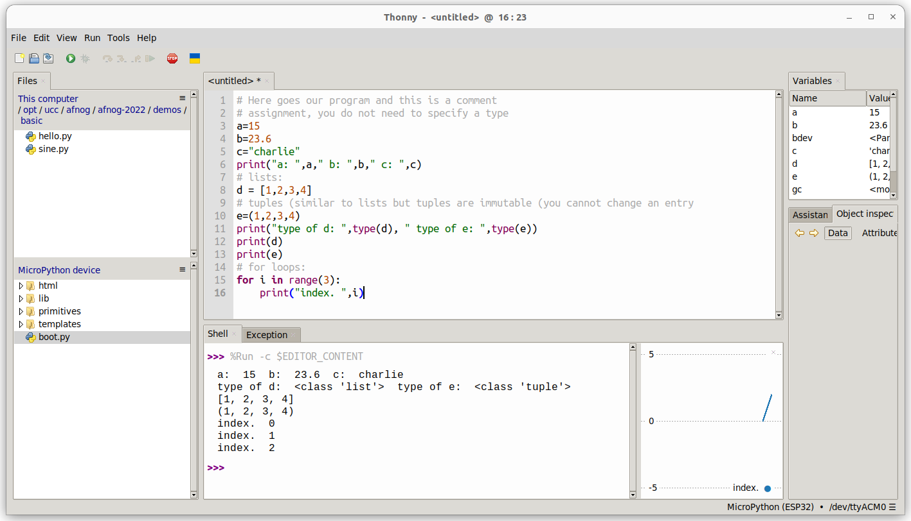
Some programming
Exercise session

Slide 24
Modules
Libraries are arranged as modules and/or classes
The time module has functions that delay execution by a certain time
Modules (or functions from modules) must be imported:
import time
while True:
print(“Hello World!”)
time.sleep(1) # or time.sleep_ms(1000) delay execution # for 1s

Slide 25
The math module
The math module supplies mathematical functions.
Instead of importing the whole module you may also import individual functions
from math import sin,radians
# The sin function takes angles in radians
# The radians() function converts degrees to radians
print(“sin(30°) = “,sin(radians(30))
You could also import the whole math module and call the sin function with math.sin:
import math
print(“sin(30°) = “,math.sin(math.radians(30))

Slide 26
Creating you own function
You can also create you own function
Imagine you want to have a function sin_deg which calculates the sin function taking angles in degrees instead of radians
from math import sin,radians
def sin_deg(angle): # definition of a function # calculating the in function for # angles in degrees
return sin(radians(angle)) # return s the sin value
# calling the function
print(sin_deg(30)) # print sin(30 degrees)
# angle in sin_deg becomes 30

Slide 27
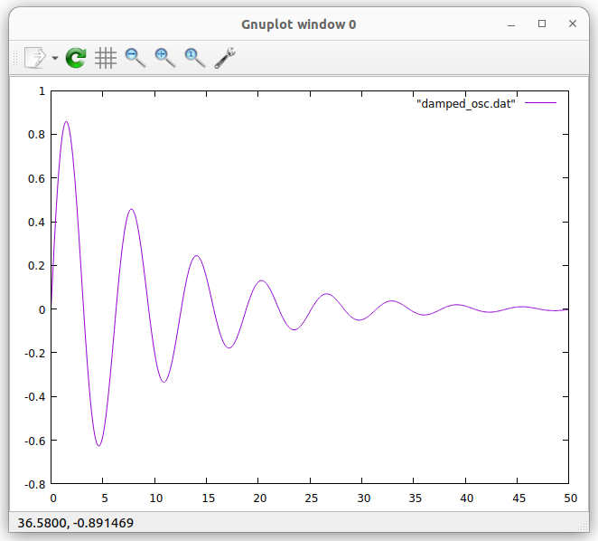
Plotting a function
is the formula of a damped oscillator
Can we plot its shape?
from math import exp,sin
def damped_osc(x): # calculates the damped # oscillator function
return exp(-x/10)*sin(x)
for i in range(500): # calculate 500 values
print(i/10,damped_osc(i/10)) # and print them
You can run the program on CPython (on the PC) redirecting its output
to damped_osc.dat python3 damped_osc.py > damped _osc.dat
Or on the ESP32 with (make sure thonny is not running!):
ampy run damped_osc.py > damped_osc.dat
Then plot it in gnuplot with
plot “damped_osc.dat” with lines
Let’s try all this in another exercise session
Exercise session

Slide 28
Hardware access
Up to now, all programs could be run in Cpython (python3) on the PC or on MicroPython on the ESP32. (sleep_ms does not exist on Cpython but can be replaced by sleep)
The ESP32 has hardware interfaces for
General Purpose IO lines
The I2C bus and SPI, the Serial Peripheral Interface (We will use I2C)
I2S for audio signals
WiFi and BlueTooth

Slide 29
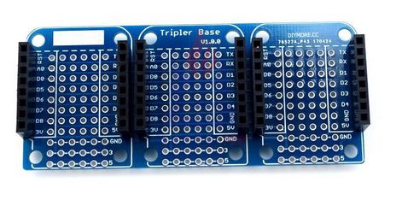
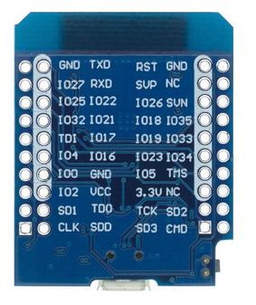
The triple board
The triple board acts as a bus system. The pins of the individual slots are connected. We put the CPU board into one of the slots and the sensor or actuator shield onto another and the triple board connects the pins.

Slide 30
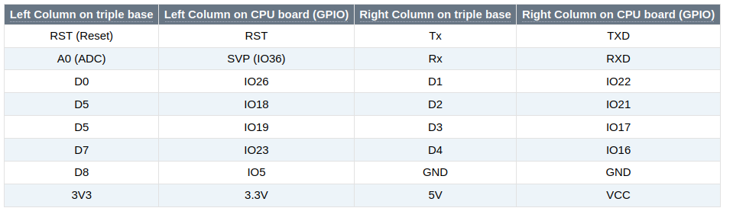
ESP32 CPU pinout
IOxx represents the GPIO pin numbers. IO26 corresponds to GPIO 26

Slide 31
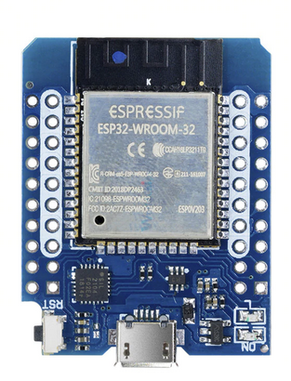
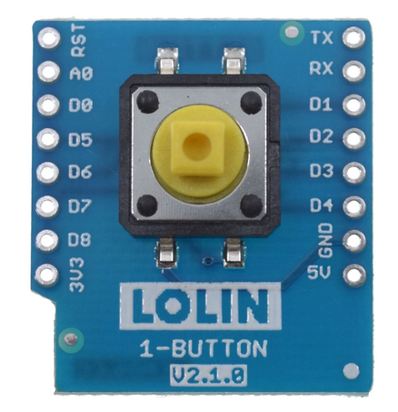
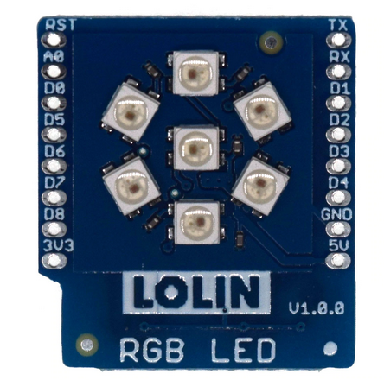
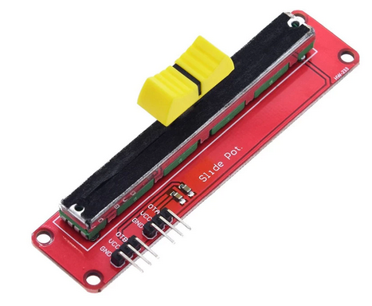
Sensor and actuator shields
During ASP2022 we used only 4 different devices:
The user LED on the
CPU board
The push button
The RGB LED ring
With 7 LEDs
The slider
potentiometer

Slide 32
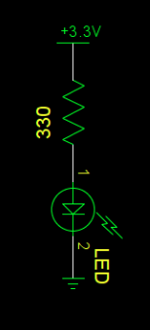
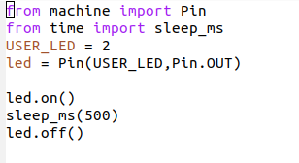
Interfacing a LED
In order to drive an LED you just need a digital signal level:
Vcc to switch the LED on
GND to switch it off
Micropython has a driver for GPIO (General Purpose I/O)
in the machine module named Pin
Using a loop you can easily create a blinking program

Slide 33
Python classes
We will not write our own classes (even though you may want to try!) but only use classes written others and already included in the MicroPython firmware.
Classes encapsulate data and functions (methods)
An __init__ method is used to create an object and initialize its data
Sub-classes inherit all properties of their parent classes
Classes are used as hardware drivers
You may have a look at https://github.com/uraich/IoT-Course/tree/master/modules
for examples

Slide 34
Using the Pin class
Access to GPIO lines is provided by the Pin class
from machine import Pin imports the class Pin from module machine
LED_PIN = 2
led = Pin(LED_PIN,Pin.OUT) creates an instance of the Pin class
Pin.OUT is a class variable
calls the __init__ constructor method
led.on() and led.off() are methods of the Pin class

Slide 35
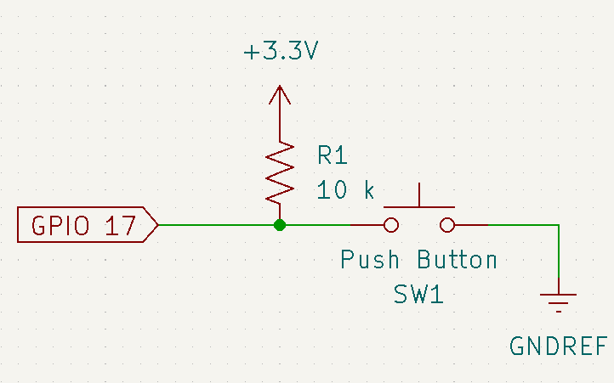
Switch hardware
The pushbutton is connected to GND on one side and to Vcc via a pull-up resistor on the other.
On the pushbutton shield you find no resistor!
The ESP32 GPIO interface can add this resistor using a programmed command.

Slide 36
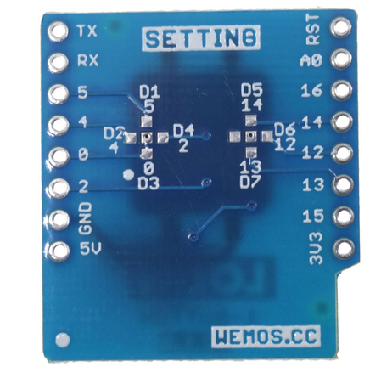
Which GPIO line ?
The data line is jumpered to D3 (see back of the
pushbutton board.
D3 corresponds to GPIO 17 according to the
ESP32 CPU pinout table

Slide 37
Reading the switch
The switch is connected to GPIO 17
from machine import Pin
from time import sleep_ms
# Define an input pin on GPIO 17 and add a pull-up resistor
switch = Pin(17,Pin.IN,Pin.PULL_UP)
while True:
# if the button is released then there is no connection to
# GND. The pull-up resistor pulls the level to 3.3V
if switch.value():
print(“push button is released”)
else:
print(“push button is pressed”)
sleep_ms(100)
Let’s try all this. Remove the ESP32 from power, insert the push button shield and re-power the boards. Check the exercises on the user programmable LED and the switch.

Slide 38
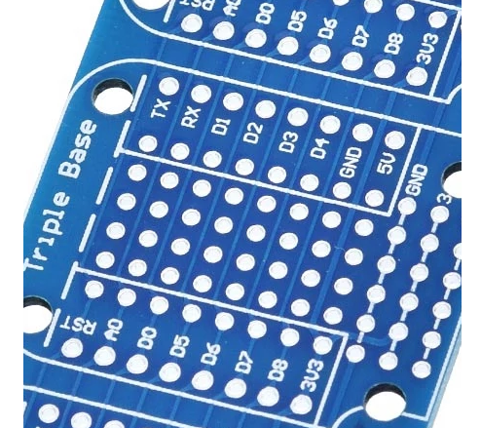
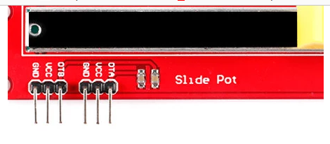
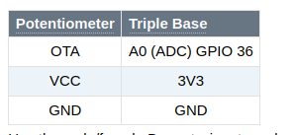
Connecting the potentiometer
While the switch and the LED shield can simply be plugged onto the triple base, this is not the case for the potentiometer.
The potentiometer must be connected using 3 Dupont wires:

Slide 39
Reading the Potentiometer
The 12 bit Analogue to Digital Converter (ADC) splits the signal level range into 4096 slices. If the signal falls into a slice then the corresponding number is returned.
The level range for the ESP32 ADC is 0..1V. However, an attenuator in front of the ADC allows adapting the range to 0..3.3V. We will use 11 dB attenuation.
MicroPython supplies the driver necessary to read out the ADC.

Slide 40
ADC readout program
from machine import ADC,Pin
from time import sleep_ms
# create an ADC object on pin 36 with 11dB attenuation
slider = ADC(Pin(36, atten=ADC.ATTN_11DB)
while True:
# Read the ADC every 100 ms and print the result
print(“Raw 12 bit value from slider: “,slider.read())
sleep_ms(100)
Exercise session

Slide 41
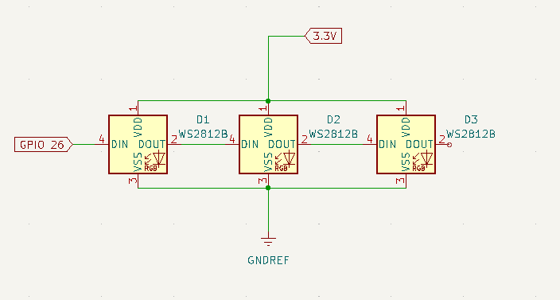
The rgb LED ring
In contrast to the user programmable LED on the CPU card the rgb LED ring uses WS2812B cascadable, addressable rgb (red,green,blue) LEDs.
On the rgb LED shield there are 7 of these LEDs but you can find LED chains with tens or even hundreds of these LEDs

Slide 42
The NeoPixel driver
Programming the WS2812B LEDs can be quite complex because of the communication protocol between the CPU and the LEDs, whose timing must be strictly respected.
MicroPython supplies a NeoPixel driver which implements this protocol and makes programming the rgb LED shield a piece of cake.

Slide 43
Programming the WS2812B
from machine import Pin
from neopixel import NeoPixel
NO_OF_LEDS = 7
pin = Pin(26,Pin.OUT) # define the communication pin as output
# create a NeoPixel object on GPIO 26 for 7 LEDs
ws2812b = NeoPixel(pin,NO_OF_PINS)
red = (31,0,0) # a tuple with r,g,b values, here pure red
ws2812b[0]=red # set LED no 0 to red
ws2812b.write() # communicate it to the LEDs
The color components are defined as 8 bit values (0..255)
With the maximum intensity the WS2812B is extremely bright and might even damage your eyes if you look directly into it.
I therefore recommend to limit color intensities to 31

Slide 44
Remapping the LED number
We have two versions of LED rings, each with 7 WS2812 LEDs. The difference is the numbering of the LEDs: On the original LED ring the LEDs are numbered in clock-wise order on the new one (with home made interface) they are numbered anti-clockwise.
Using a mapping table can resolve the problem:
# pixel mapping
pixelMap = [0,5,4,3,2,1,6]
The numbers in the mapping array are the physical addresses of the LEDs, such that pixelMap[0] is the top LED, pixelMap[1 .. 5] are the following LEDS in clock-wise order and pixelMap[6] is the center LED.
Of course we need to figure out the physical addresses first!

Slide 45
LED number
How do we know, which LED number corresponds to which physical LED?
We cannot know, because it depends on how the LED shield is cabled.
We can easily find out however:
Light each LED number (0..6) for 1 s (e.g. in red, setting the colors to 31,0,0) and make sure all other LEDs are switched of (color value: 0,0,0)
Observe the sequence at which the LEDs light up
Exercise session

Slide 46
A small project
As a small project, let us read the slider and set a LED on the rgb LED ring depending on the signal level. At the smallest signal, the top LED will be lit.
At the next level it will be the LED next to it, going in clockwise direction until we reach the LED left to the top one.
Light the middle LED for the highest signal level.
Signal levels are often represented in colors:
Blue (cold) for the lowest level
Red for a very high level
White for the highest level.

Slide 47
Colors
For the project we only use the basic colors:
Blue (0,0,31)
Cyan (0,31,31)
Green you find the others yourself...
Yellow
Magenta
Red
White
Light the LED with the color corresponding to the signal level.
Exercise session

Slide 48
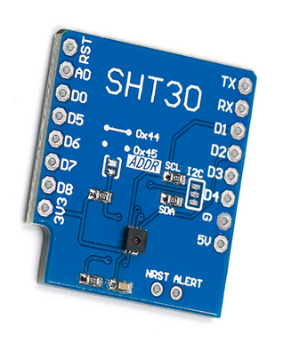
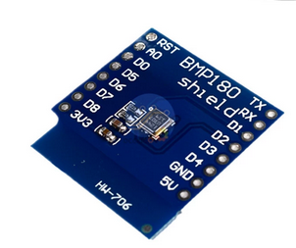
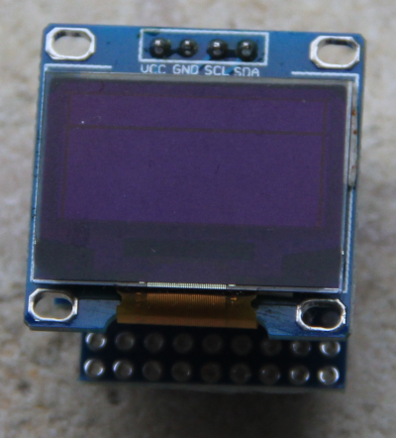
Adding real sensors
To demonstrate, how to use real sensors and a local display we added:
SHT30 temperature and
humidity sensor
BMP180 air pressure and
Temperature sensor
128x64 pixel OLED display

Slide 49
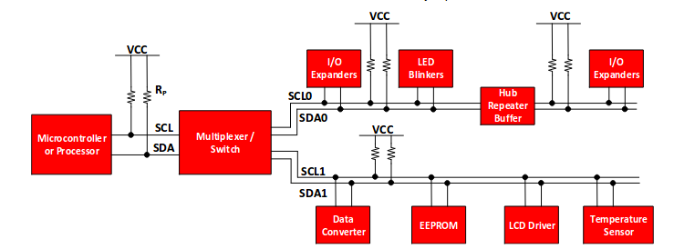
The I2C bus
The Inter-Integrated Circuit (I2C) bus was invented by Philips in the early 1980. It is used by many sensors to communicate their data to the CPU.

Slide 50
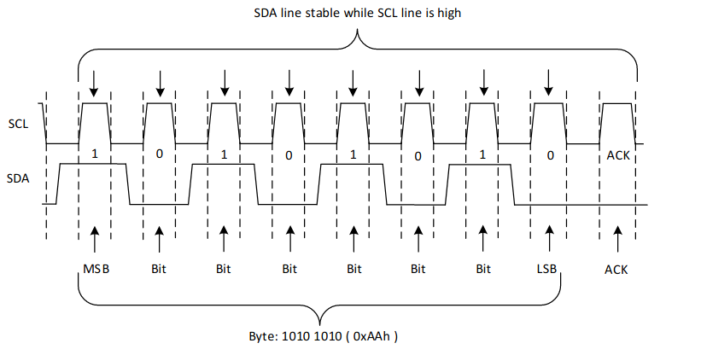
Data transfers

Slide 51
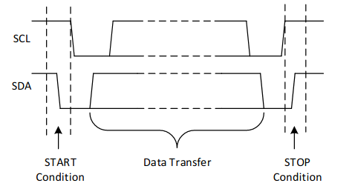
Start and stop conditions

Slide 52
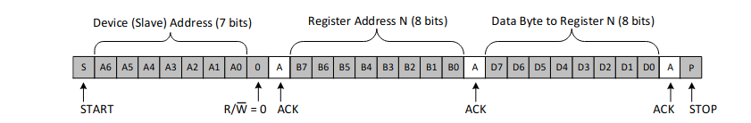
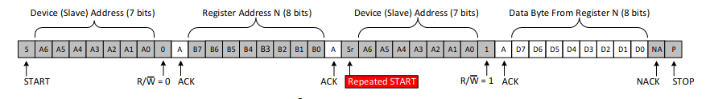
The I2C protocol
Write to the bus
Read from the bus
7 bit device address + R/W bit

Slide 53
I2C addressing
The I2C bus uses the master/slave paradigm. The CPU acts as the master and the sensors act as slaves.
The I2C bus uses 7 address bits (the 8th bit is the R/W line). A maximum of 128 slaves can therefore be connected to a single master.
The ESP32 has two hardware I2C buses, but MicroPython also provides a software I2C implementation using bit-banging on any GPIO line.
The pins for SCL (the I2C clock line) and SDA (the I2C data line) are
SCL: GPIO 22
SDA: GPIO 21
Control and readout of an I2C based sensor requires a driver accessing it using the MicroPython I2C driver calls.

Slide 54
MicroPython’s I2C driver
The documentation of I2C in the MicroPython manual is found here:
https://docs.micropython.org/en/latest/esp32/quickref.html#software-i2c-bus
and here
https://docs.micropython.org/en/latest/library/machine.I2C.html#machine.I2C
On the ESP32 CPU:
scl : GPIO 22
sda: GPIO 21

Slide 55
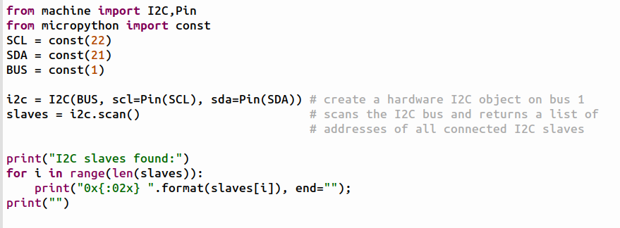
Creating an I2C object

Slide 56
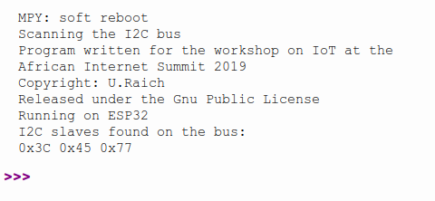
Result of I2C scan
0x3c: SSD1306 display controller
0x45: SHT30 temperature and humidity sensor
0x77: BMP180 temperature and air pressure sensor

Slide 57
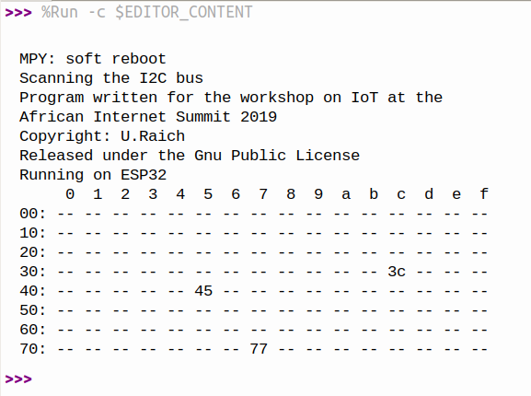
Scanning the I2C bus
Scanning the I2C bus is needed
each time a new I2C module is
connected.
Since this is used very often, it
makes sense to improve the
output of the program.
d

Slide 58
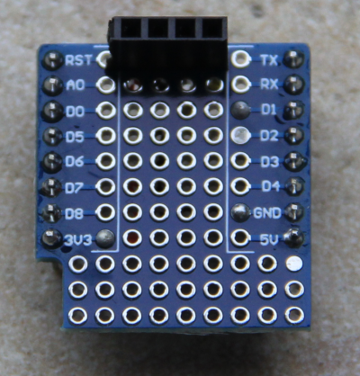
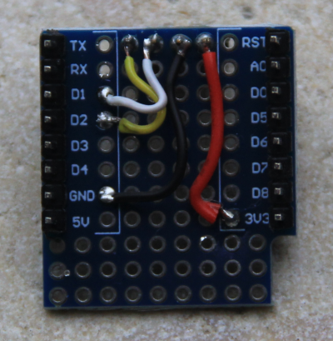
SSD1306 and 128x64 pixel display
A Wemos D1 display module exists but its resolution of 64x48 pixels is a bit too restrictive
It is however not difficult to mount a 128x64 pixel display onto a prototype board since only 4 connections must be made.

Slide 59
Programming the display
The SSD1306 communicates through I2C and on the BMP180 we will see how the registers of an I2C module can be read and written.
Programming the SSD1306 directly can be a daunting task. You must know all the nitty gritty details of the chip. Have a look at the SSD1306 data sheet to understand the details.
Fortunately a SSD1306 driver class is already available on the MicroPython firmware. It is a sub-class of framebuf, which provides a big number of drawing primitives.
The framebuf class does not write into SSD1306 pixel memory but into a memory buffer of the same size.
The show() method copies the framebuffer memory to the SSD1306 pixel memory.

Slide 60
The SSD1306 class
Let’s see how we could write some text and some graphics onto the display using the SSD1306 driver:
Once display is defined we can use the drawing functions like
For more information and examples see
https://docs.micropython.org/en/latest/esp8266/tutorial/ssd1306.html

Slide 61

Placing text
The SSD1306 driver used a font table where the pixel values for each character is defined. The standard font uses 8x8 pixels, where the horizontal space between characters is included.
Vertically we keep a distance of 2 pixels between text lines.
The characters are placed using pixel coordinates
where the top left pixel has coordinates (0,0) and
the bottom right (127,63)

Slide 62
The framebuf class
The SSD1306 is a sub-class of framebuf inheriting all graphics primitive defined there.
The framebuf class is described here:
https://docs.micropython.org/en/latest/library/framebuf.html

Slide 63

The BPM180
The BMP180 measures the atmospheric pressure and the air temperature.
Each device is individually calibrated and the calibration values are stored on the chip.
The BMP180 uses the I2C protocol to communicate
with the micro-controller and has the I2C address of 0x77.
The photo below shows the BPM180 shield.
Here is the BMP180 data sheet

Slide 64
Strategy of BMP180 programming
Import the necessary MicroPython modules (I2C, Pin, utime …)
Define BMP180 constants:
  I2C address
  Register addresses
  Command codes
Create the I2C object
Check if the BMP180 is connect to the bus. Also check ID register
Start a measurement
Read raw values
Convert to physical values using the calibration stored on the chip

Slide 65
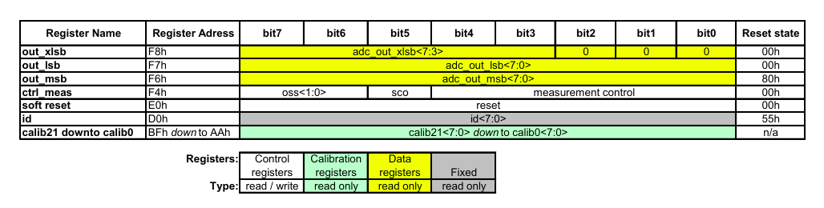
Writing and reading registers
We can try reading and writing registers on the BMP180, which has a somewhat limited number of registers
The diagram below shows its register map. A good test is reading the ID register which will return the constant 0x55

Slide 66
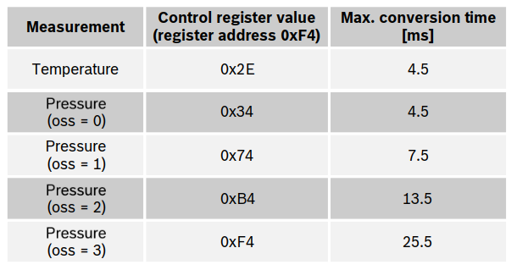
Making a measurement

Slide 67
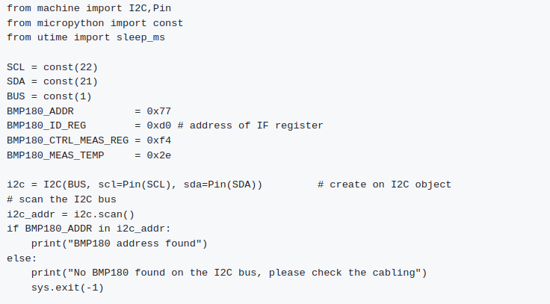
Definitions and I2C object creation

Slide 68
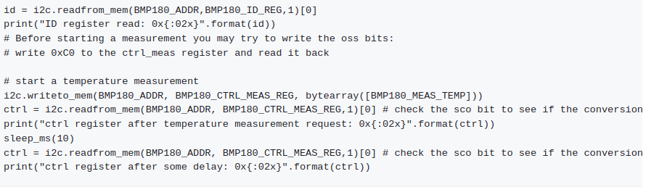
Register reading and writing

Slide 69
The BMP180 class
Starting a measurement, reading the uncalibrated results and particularly the algorithm converting the raw values to physical values using the calibration data is rather complex.
And this is the case for most sensors and actuators.
Often some kind soul has taken the time and made the effort to understand all the details of the data sheet and has produced a driver class hiding all the complexity.
A constructor method is provided to create a BMP180 class and a few more methods are available to start the measurement and to read the physical result.
The conversion from raw to physical values is hidden in the class.
The Bmp180Class is already included in the MicroPython firmware.

Slide 70

Using the BMP180 class
Creating a Bmp180Class object is simple:
The constructor
Creates an I2C object
Checks if a slave is connected on I2C address 0x77
Checks the ID register
Reads all the calibration values
Sets the resolution to ultra-high

Slide 71
Making a measurement
Here are a few methods provided by the driver:
measure() : starts a measurement
getTemperature() : reads the temperature in °C
getPressure(): reads the air pressure in hPa
setResolution(resolution): sets the measurement resolution to
  ULTRA_LOW_POWER,
  STANDARD_POWER,
  HIGH_RESOLUTION,
  ULTRA_HIGH_RESOLUTION
getResolution() : read the current resolution
chipID(): read the chip ID register

Slide 72
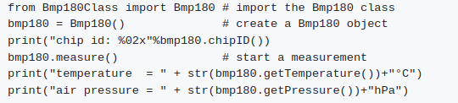
Simple measurement code
This makes the measurement program super simple:

Slide 73
The SHT30
The SHT30 is an I2C based temperature and humidity sensor.
Again the driver is already installed in the interpreter
The full documentation in on the IoT Twiki, and the
data sheet is here.

Slide 74
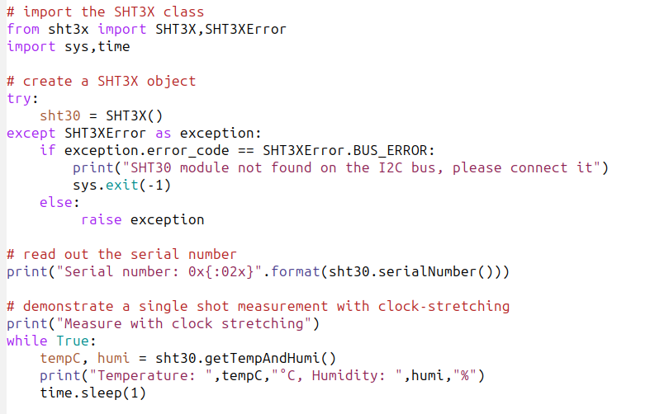
Reading the SHT30

Slide 75
The weather station
In the meantime we know
How to read temperature and humidity
How to read air pressure
How to write text to the OLED display
This allows us to build a simple weather station

Slide 76
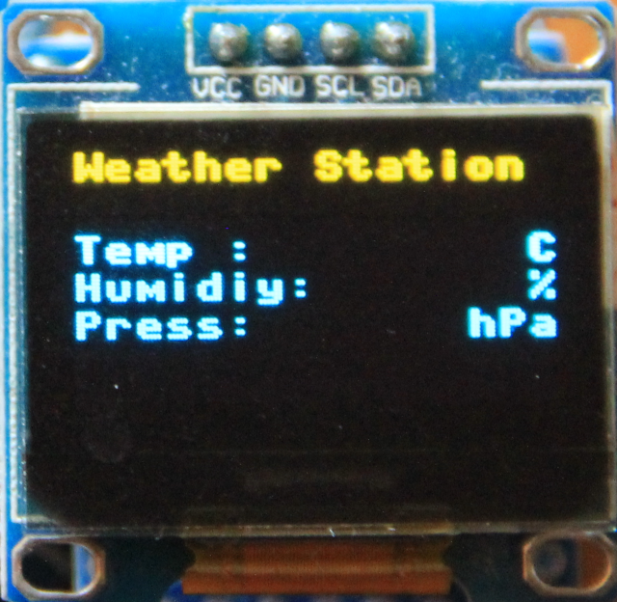
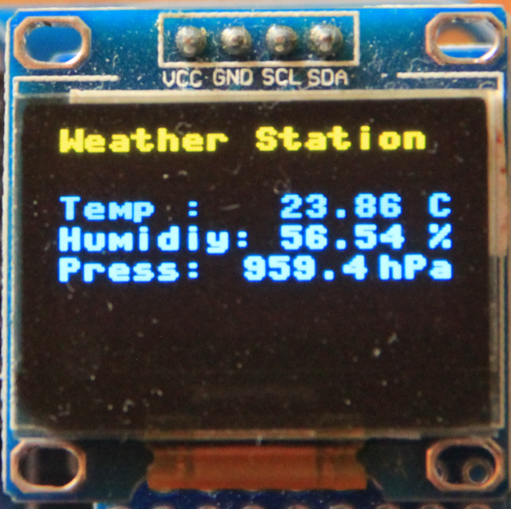
Creating the weather display
First create a text frame with
constant text
Make a measurement every second and
place the result into the frame

Slide 77

Converting float to string
The values read from the sensors are floating point values, the display however only takes strings of characters
The values temperature (tempC) is converted into a string with 2 digits before the decimal point and 2 after.
tString is is a character string of 5 ASCII character that can we written to the display

Slide 78
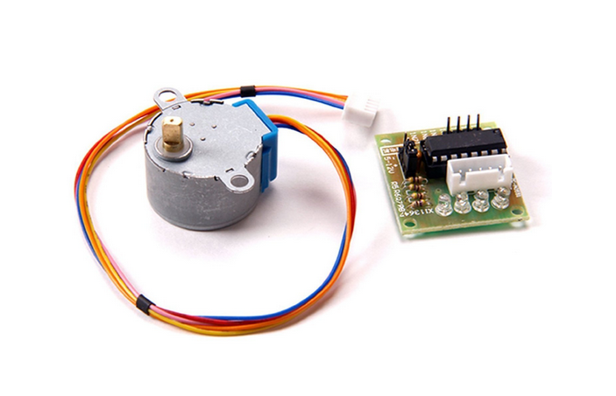
Stepping motors
The 27BJY-48 stepper motor an its ULN-2803 driver module

Slide 79
DC versus stepping motors
While DC motors simply spin when they are powered, stepping motors can be moved in defined steps and thus positioned very precisely.
They contain 2 coils which can be powered in positive or negative direction making the current flow in normal or reverse direction and thus creating magnetic fields of opposite polarity
The rotor has a series of magnets (16 in case of the 28BYJ-48 which we are using) with alternating opposite polarization.
A north pole followed by a south pole followed by a north pole and so on.
The motor base has 2*16 teeth which can be polarized as north or south poles depending on the direction of the coil current
Here is the 28BJJ-48 data sheet

Slide 80
The driver
The maximum current that a GPIO pin on the Raspberry Pi can deliver is 60 mA which is insufficient to power the motor coils.
We therefore need a driver circuit (Darlington stage) to amplify this current. In our case we use the ULN-2803 chip
The little PCB has 4 LEDs on it to show which of the 2 coils is powered and in which direction. This is very useful to demonstrate which signals are sent to the motor and it illustrates nicely the functioning of the motor.

Slide 81
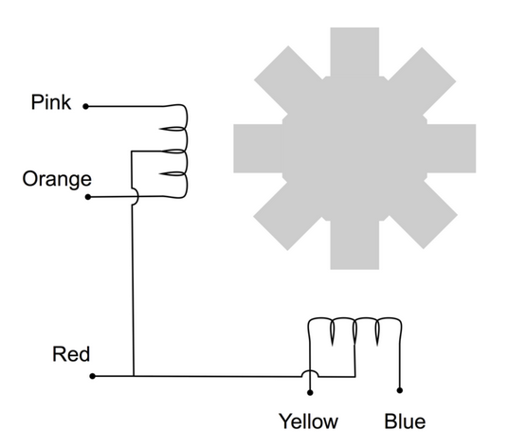
Connecting the driver to the motor
As we can see from the connections that when powering the pink line the coil current is flowing in one direction while when powering the orange line it is flowing in the opposite direction

Slide 82
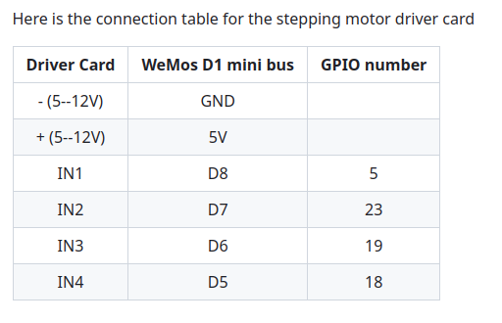
Connecting the driver card to the ESP32

Slide 83
A Youtube Video

Slide 84
Movement Single Phase Forward
S
N
N
S
Coil 1
S
N
N
S
Coil 2
Rotor North Pole

Slide 85

Signal Table for Single Phase Forward
We have seen in the last slide how we have to power the coils to make the stepping motor move by 1 cycle, which is 4 steps in case of Single Phase Forward stepping
How does this translate into a program?
_{We connect the 4 phases}
(coil 1 forward, coil 2 backward,
coil 1 backward, coil 2 forward) to 4 GPIO pins
Then we create the following signal table,
which is a 2-dimensional array of booleans:

Slide 86
Single Step forward (and backward) works fine but we can do better.
Up to now we have always powered only one coil at a time. It is however possible to power both coils at the same time.
This will draw of course more current but the motor will get a higher torque and can therefore handle bigger loads

Slide 87
Other modes of operation
Single Step forward (and backward) works fine but we can do better.
Up to now we have always powered only one coil at a time. It is however possible to power both coils at the same time.
This will draw of course more current but the motor will get a higher torque and can therefore handle bigger loads

Slide 88
Movement Double Phase Forward
S
N
N
N
S
S
S
S
N
N
S
S
N
N
N
Coil 1
N
N
S
S
S
N
N
S
Coil 2
Rotor North Pole

Slide 89

Double Step Forward Table
Of course our signal table must change correspondingly, our program to send out the signals for one full cycle stays the same however.

Slide 90
Programming double step forward mode
For this, nothing much is to be said:
We change the table, but since the program is independent from the contents of the stepping table, the code stays strictly the same

Slide 91
Position of rotor in doubleStepForward mode
An important point to note is that the rotor moves half a step further than in single StepForward because its north pole is now attracted by the top and the bottom south poles.
By first powering only the upper coil, then powering both coils then powering again only one pole of the lower coil it should be possible to move the motor by half steps only and by doing so increase its resolution.
This is what we call half step mode and it is a combination of single and double step forward modes.
The torque of the motor is less than in double step forward and the speed is only about half because now we need 8 steps for a full cycle.

Slide 92
Movement Half Step Forward
N
N
S
N
S
S
S
Coil 1
N
S
N
N
S
S
S
S
N
N
S
S
S
S
N
S
S
N
S
S
S
N
N
N
N
N
N
S
N
S
S
N
N
N
N
N
N
S
S
S
N
S
S
N
N
S
Coil 2
S
S
North Pole

Slide 93

Half Step Forward Table

Slide 94
Programming Half Step Mode
Again, apart from the fact that we must now pass through a table of 8 entries instead of 4 the program does not change.
If we use the signature of all bits being zero as end of table indicator then no change at all is required.

Slide 95
The stepper motor class
Like for the sensors, a driver module exists for the stepping motor with the following methods:
steppingMotor(): the constructor method defines the GPIO pins to be used and creates the tables explained before for the different stepping modes. "Single Step Forward" is selected as default mode and the wait time between steps is set to 2 ms.
clrAll(): sets all 4 phase pins to GND.

Slide 96
Stepper motor methods
stepMode(mode): sets the stepping mode (or returns the currently set mode if mode == None). The modes can be
  SINGLE_PHASE_FORWARD
  SINGLE_PHASE_BACKWARD
  DOUBLE_PHASE_FORWARD
  DOUBLE_PHASE_BACKWARD
  HALF_STEP_FORWARD
  HALF_STEP_BACKWARD
waitAfterSteps(no_of_ms): read (if no_of_steps==None) or write the wait time between steps. Possible values: 2 .. 1000
move(no_of_steps): Move the number of steps, using the currently selected mode and wait time between steps

