Slide 1
Small Physics Experiments
An Introduction to Physics Experimentation
Uli Raich
This workshop provides hands-on exercises on
sensor readout and experiment control with actuators.
It is part of the African School of Fundamental Physics 2022

Slide 2
Physics Experimentation
In many of today’s physics experiments, some electronics is used to capture signals from sensors and to control the experiments through actuators
Sensors can measure
Temperature, relative air humidity, soil moisture, air pressure
Air pollution through particle detection or gaz analysis
Magnetics fields (e.g the earth magnetic field, which allows to build a compass)
Movement through accelerometers or gyroscopes
Distance through ultrasound or lasers

Slide 3
Actuators
Actuators are used to control the experiment
These can be:
Digital on/off signals, relays
Analog signal levels controlling e.g. an amplifier
Different types of motors

Slide 4
How to build a simple experiment
A typical experiment consists of
The sensor and actuator
A computer to read the sensor values and/or drive the actuators
A program reading the results and displaying and storing them
An analysis program for data evaluation

Slide 5
Types of computers
We all use PCs and hand phones, which are controlled by computers.
The PCs are rather powerful, they have large resources of disk space and memory and they are equipped with network interfaces, but they lack other hardware interfaces. PCs are relatively expensive.
Microcontrollers have much less resources and usually no hard disk. Modern µCs have WiFi interfaces and they have hardware interfaces to
  GPIO (General Purpose IO lines)
  I2C instrumentation bus
  SPI serial peripheral interface
Prices can be very low (ours costs 4 US$)

Slide 6
Course layout
There will be short lecture parts explaining the system and giving a few online examples
Most of the time will be spent on hands-on exercises where you will set up a simple experiment yourself.
The sensors will be simulated by a simple pushbutton switch for digital signals, and a slider potentiometer for analogue signals.
We also have a mono color user programmable LED as well as a rgb LED ring with seven LEDs used as a simple display.
Data can also be transferred to the PC and plotted there.

Slide 7
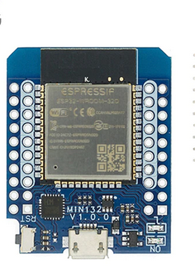
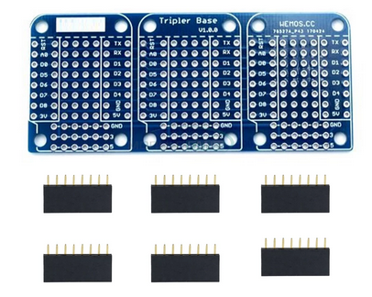
Simulating an experiment
To simulate an experiment we have a bus system
an ESP32 micro-controller to connect the sensor to the uC
The CPU card has a user programmable LED
and an USB to serial interface

Slide 8
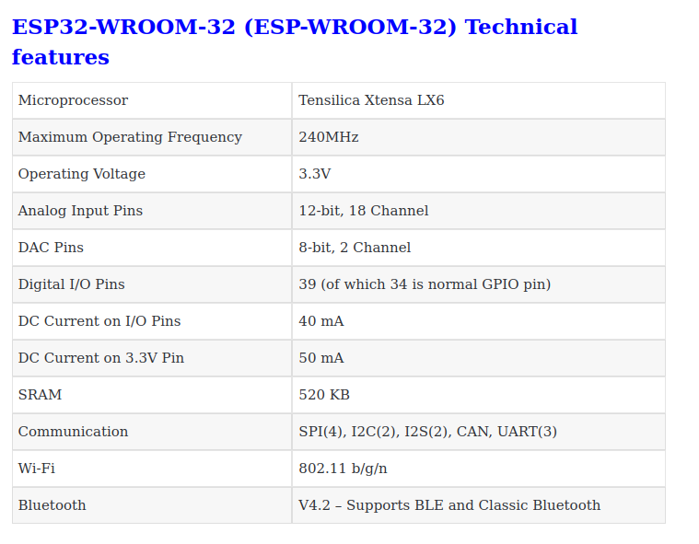
ESP32 specifications
All this for 4 US$

Slide 9
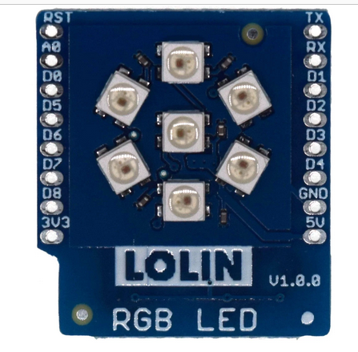
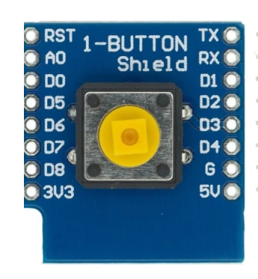
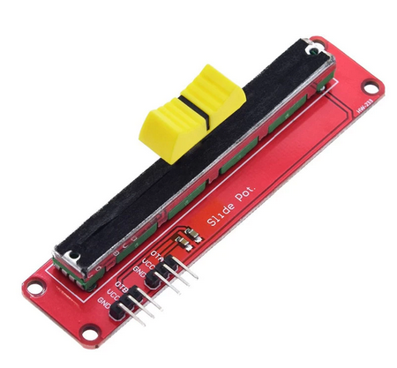
Sensor and actuator
a pushbutton allows
to generate digital
signals
a potentiometer
creates analog
signal levels
a simple display with
7 rgb LEDs

Slide 10
How to use these devices
To interact with the devices we must write readout and control programs.
These days, a very popular programming language is Python.
Standard Python (CPython) uses huge libraries and can be very resource hungry but resources are scarce on the micro-controller.
A stripped down Python interpreter: MicroPython is already installed in flash memory on the CPU board.
We can connect the CPU card to the PC using a micro USB cable. The CPU converts USB to serial and we can use an serial terminal emulator for communication.

Slide 11
Documentation
The documentation for the course is available at:
https://afnog.iotworkshop.africa/do/view/AFNOG/ASP2022
The MicroPython documentation is here:
https://docs.micropython.org/en/latest/

Slide 12
Connecting to the ESP32
Connection of the ESP32 micro-controller to the PC is simple:
Just connect the micro USB cable to the PC. This will also power the ESP32.
You should see the power LED on the ESP32 coming on.

Slide 13
Programming Tools
We have a series of tools allowing us to program the ESP32 micro-controller:
thonny is an Integrated Development Environment (IDE) to
  Edit programs and save them on the PC or the ESP32 file system
  Transfer the programs to the ESP32
  Run them
  Print the results
  Interact with the MicroPython Interpreter
minicom is a serial terminal emulator that can talk to the MicroPython on the ESP32
ampy allows to transfer file to and from the ESP32 via the serial line and to run programs

Slide 14
Tools
The main tool we will be using is thonny
thonny is a simple Integrated Development Environment (IDE) which allows
talking to the Read Evaluate and Print Loop (REPL) of the MicroPython interpreter
editing scripts, saving them on files on the PC or the ESP32 and executing them with print output going to its shell window
file transfer between the PC and the ESP32
minicom is a virtual serial terminal connecting to REPL on the ESP32
ampy allows file transfers and running of programs on the ESP32

Slide 15
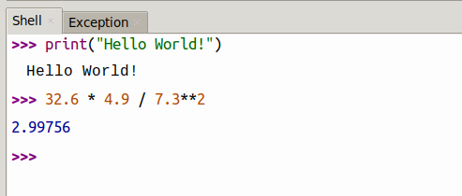
Talking to MicroPython
Since MicroPython is an interpreted language we can talk to the interpreter directly. When started we get a prompt saying that the REPL (Read, Execute and Print Loop) is ready to receive commands.
Python can be used as a calculator.

Slide 16
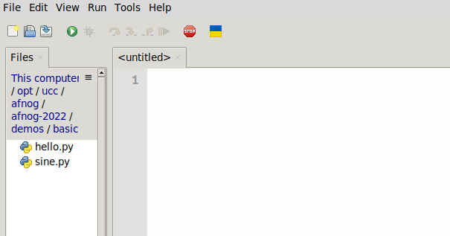
Programming
Talking to the interpreter is fine but we want to be able to write a program and have it executed.
For those who don’t know Python, here is a link
to the Python tutorial.
and here the link to the MicroPython documentation
Create a new Python file with File →New
This will create an editor window labeled <untitled>
Save this (empty) file and the window
title will change to the filename
Now let’s write our hello world program
and execute it

Slide 17
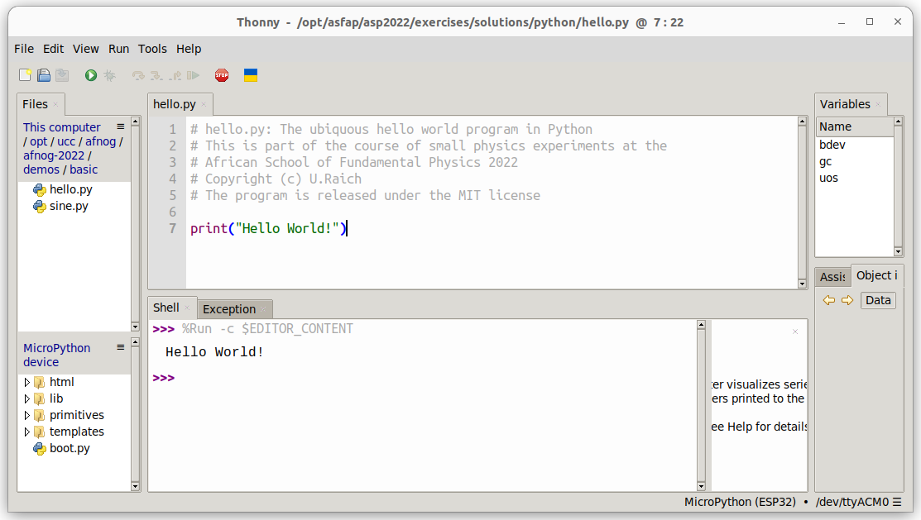
thonny

Slide 18
Assignment
In Python the “=” signal does not represent an equation but an assignment
a=6 # assigns the integer value 5 to the variable a
# the “#” sign denotes a comment
f=5.8 # assigns the floating point value 5.8 to the
# variable f
b=True # b takes the boolean value true
s=”Hello” # s is assigned the string “Hello”
l=[1,2,3,5] # l is a list with values 1,2,3,5
t=(1,2,3,5) # t is a tuple with the same values
# tuples are similar to lists but they are
# immutable
a = a+3 # would be a illegal equation but is a perfectly legal
# assignment
print(a,f,b,s,l,t)
Types are assigned automatically

Slide 19
Arithmetic
The basic arithmetic operations work as expected:
s=5+7
a=5
b=7
sum = a+b
difference = a-b
product = a*b
division = a/b # yields a float value
div_int = a//b # yields an integer division,
# only integer part of the division is taken
# into account

Slide 20
Conditions
We can execute one part of our program or another one depending on conditions
a,b = 5,7
if a > b:
print(“a is bigger than b”) # note that the body of the condition
# is indented
# all the indented code is executed if the
# condition evaluates to true
elif a < b:
print(“a is smaller than b”)
else:
print(“a and b are equal”)
Comparison operators are:
< smaller than, > bigger than
== are equal, != are not equal

Slide 21
loops
A computer is particularly good a repeating things without making errors, something humans find extremely boring.
In Python we have 2 types of loops:
for i in range(5):
print(“Hello World”) # prints “Hello World” 5 times)
i = 5
while i > 0:
print(“Hello World”) # does the same thing
i -= 1 # different syntax for i=i–1
while True:
print(“Hello World!”) # will print forever
i=5
while True:
print(“Hello World”)
i -= 1
if i == 0:
break # breaks out of the loop
Now you should be ready to try yourself: First practical part. Please consult the exercise sheet and please ask if things are unclear!

Slide 22
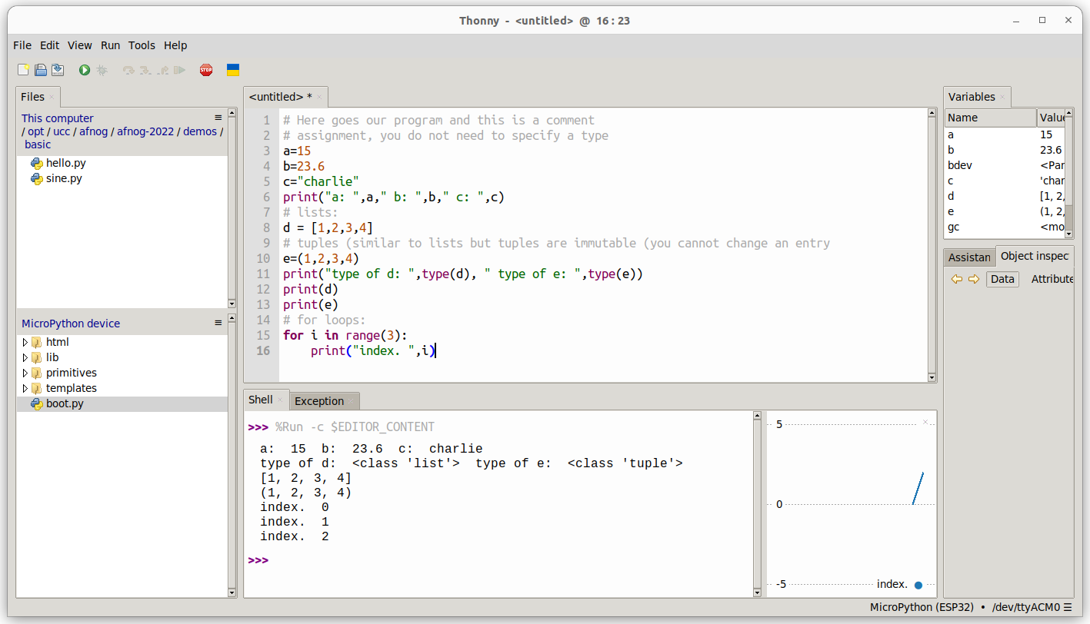
Some programming

Slide 23
Modules
Libraries are arranged as modules and/or classes
The time module has functions that delay execution by a certain time
Modules (or functions from modules) must be imported:
import time
while True:
print(“Hello World!”)
time.sleep(1) # or time.sleep_ms(1000) delay execution # for 1s

Slide 24
The math module
The math module supplies mathematical functions.
Instead of importing the whole module you may also import individual functions
from math import sin,radians
# The sin function takes angles in radians
# The radians() function converts degrees to radians
print(“sin(30°) = “,sin(radians(30))
You could also import the whole math module and call the sin function with math.sin:
import math
print(“sin(30°) = “,math.sin(math.radians(30))

Slide 25
Creating you own function
You can also create you own function
Imagine you want to have a function sin_deg which calculates the sin function taking angles in degrees instead of radians
from math import sin,radians
def sin_deg(angle): # definition of a function # calculating the in function for # angles in degrees
return sin(radians(angle)) # return s the sin value
# calling the function
print(sin_deg(30)) # print sin(30 degrees)
# angle in sin_deg becomes 30

Slide 26
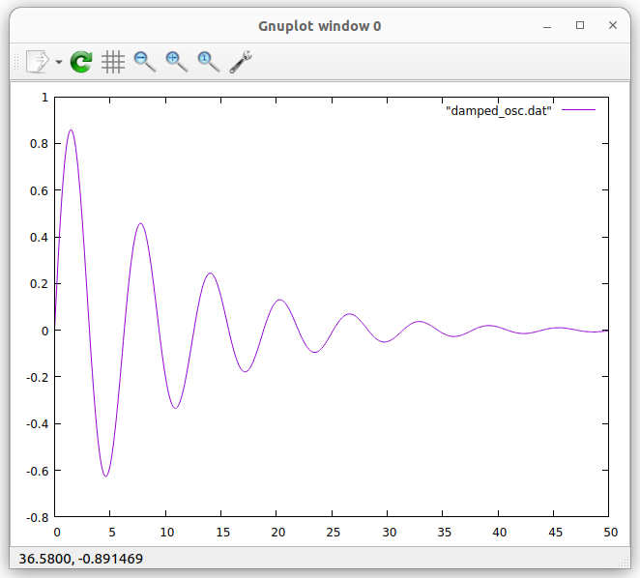
Plotting a function
is the formula of a damped oscillator
Can we plot its shape?
from math import exp,sin
def damped_osc(x): # calculates the damped # oscillator function
return exp(-1/10)*sin(x)
for i in range(500): # calculate 500 values
print(i/10,damped_osc(i/10)) # and print them
You can run the program on CPython (on the PC) redirecting its output to damped_osc.dat
python3 damped_osc.py > damped _osc.dat
Or on the ESP32 with:
ampy run damped_osc.py > damped_osc.dat
Then plot it in gnuplot with
plot “damped_osc.dat” with lines
Let’s try all this in another exercise session

Slide 27
Hardware access
Up to now, all programs could be run in Cpython (python3) on the PC or on MicroPython on the ESP32. (sleep_ms does not exist on Cpython but can be replaced by sleep)
The ESP32 has hardware interfaces for
General Purpose IO lines (GPIO, we will only use these)
The I2C bus and SPI, the Serial Peripheral Interface
I2S for audio signals
WiFi and BlueTooth

Slide 28
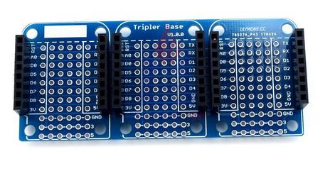
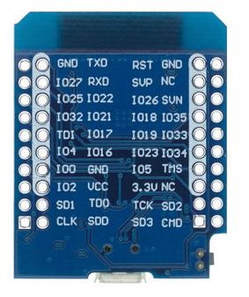
The triple board
The triple board acts as a bus system. The pins of the individual slots are connected. We put the CPU board into one of the slots and the sensor or actuator shield onto another and the triple board connects the pins.

Slide 29
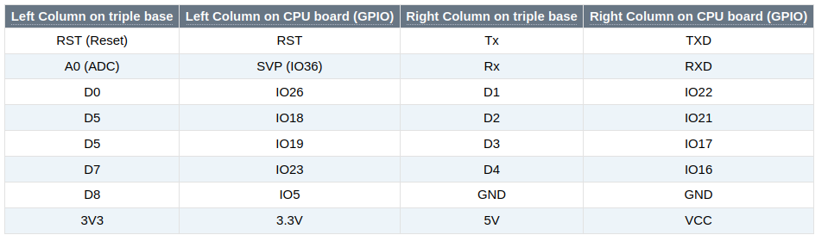
ESP32 CPU pinout
IOxx represents the GPIO pin numbers. IO26 corresponds to GPIO 26

Slide 30
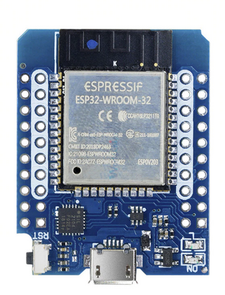
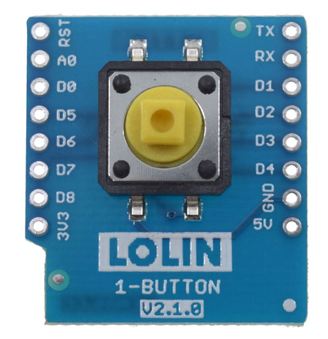
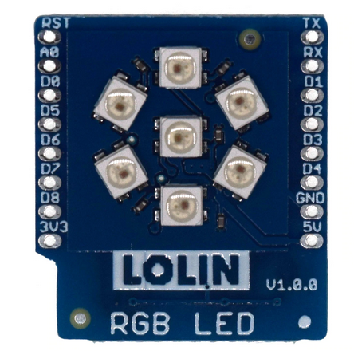
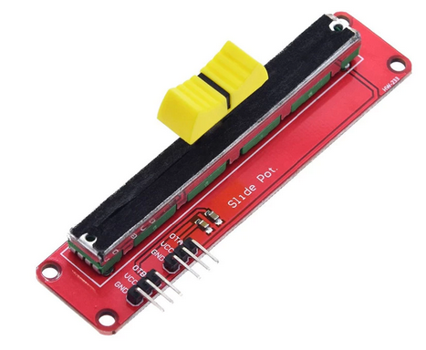
Sensor and actuator shields
For this short course we only use 4 different devices:
The user LED on the
CPU board
The push button
The RGB LED ring
With 7 LEDs
The slider
potentiometer

Slide 31
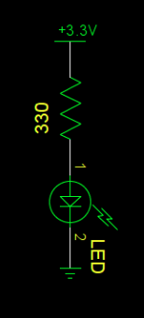
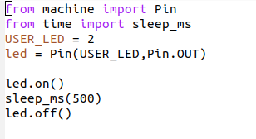
Interfacing a LED
In order to drive an LED you just need a digital signal level:
Vcc to switch the LED on
GND to switch it off
Micropython has a driver for GPIO (General Purpose I/O)
in the machine module named Pin
Using a loop you can easily create a blinking program

Slide 32
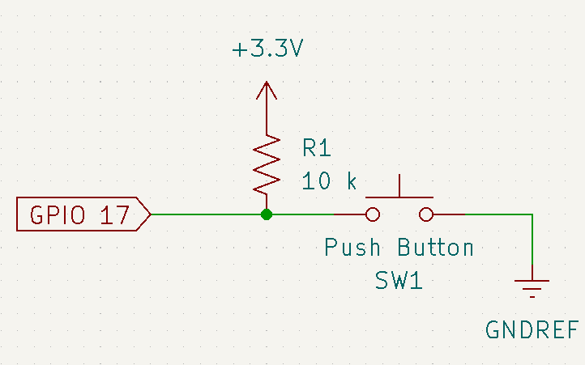
Switch hardware
The pushbutton is connected to GND on one side and to Vcc via a pull-up resistor on the other.
On the pushbutton shield you find no resistor!
The ESP32 GPIO interface can add this resistor using a programmed command.

Slide 33
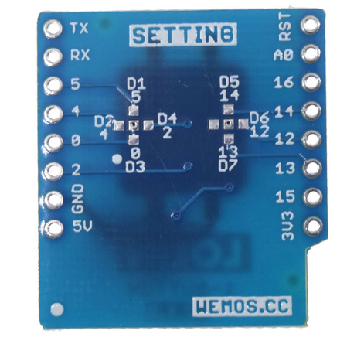
Which GPIO line ?
The data line is jumpered to D3 (see back of the
pushbutton board.
D3 corresponds to GPIO 17 according to the
ESP32 CPU pinout table

Slide 34
Reading the switch
The switch is connected to GPIO 17
from machine import Pin
from time import sleep_ms
# Define an input pin on GPIO 17 and add a pull-up resistor
switch = Pin(17,Pin.IN,Pin.PULL_UP)
while True:
# if the button is released then there is no connection to
# GND. The pull-up resistor pulls the level to 3.3V
if switch.value():
print(“push button is released”)
else:
print(“push button is pressed”)
sleep_ms(100)
Let’s try all this. Remove the ESP32 from power, insert the push button shield and re-power the boards. Check the exercises on the user programmable LED and the switch.

Slide 35
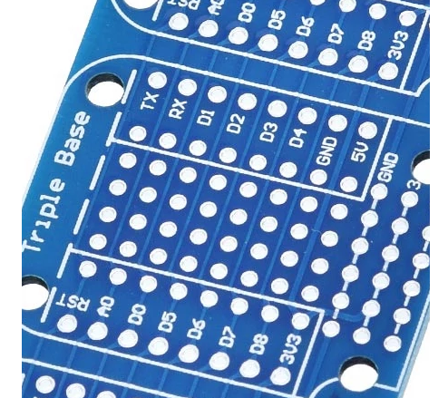
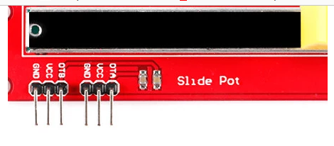
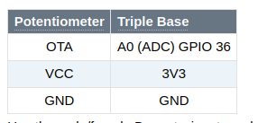
Connecting the potentiometer
While the switch and the LED shield can simply be plugged onto the triple base, this is not the case for the potentiometer.
The potentiometer must be connected using 3 Dupont wires:

Slide 36
Reading the Potentiometer
The 12 bit Analogue to Digital Converter (ADC) splits the signal level range into 4096 slices. If the signal falls into a slice then the corresponding number is returned.
The level range for the ESP32 ADC is 0..1V. However, an attenuator in front of the ADC allows adapting the range to 0..3.3V. We will use 11 dB attenuation.
MicroPython supplies the driver necessary to read out the ADC.

Slide 37
ADC readout program
from machine import ADC,Pin
from time import sleep_ms
# create an ADC object on pin 36 with 11dB attenuation
slider = ADC(Pin(36, atten=ADC.ATTN_11DB)
while True:
# Read the ADC every 100 ms and print the result
print(“Raw 12 bit value from slider: “,slider.read())
sleep_ms(100)

Slide 38
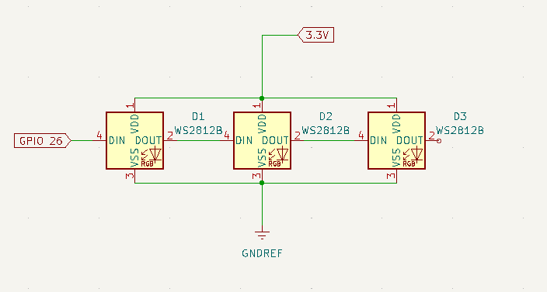
The rgb LED ring
In contrast to the user programmable LED on the CPU card the rgb LED ring uses WS2812B cascadable, addressable rgb (red,green,blue) LEDs.
On the rgb LED shield there are 7 of these LEDs but you can find LED chains with tens or even hundreds of these LEDs

Slide 39
The NeoPixel driver
Programming the WS2812B LEDs can be quite complex because of the communication protocol between the CPU and the LEDs, whose timing must be strictly respected.
MicroPython supplies a NeoPixel driver which implements this protocol and makes programming the rgb LED shield a piece of cake.

Slide 40
Programming the WS2812B
from machine import Pin
from neopixel import NeoPixel
NO_OF_LEDS = 7
pin = Pin(26,Pin.OUT) # define the communication pin as output
# create a NeoPixel object on GPIO 26 for 7 LEDs
ws2812b = NeoPixel(pin,NO_OF_PINS)
red = (31,0,0) # a tuple with r,g,b values, here pure red
ws2812b[0]=red # set LED no 0 to red
ws2812b.write() # communicate it to the LEDs
The color components are defined as 8 bit values (0..255)
With the maximum intensity the WS2812B is extremely bright and might even damage your eyes if you look directly into it.
I therefore recommend to limit color intensities to 31

Slide 41
LED number
How do we know, which LED number corresponds to which physical LED?
We cannot know, because it depends on how the LED shield is cabled.
We can easily find out however:
Light each LED number (0..6) for 1 s (e.g. in red, setting the colors to 31,0,0) and make sure all other LEDs are switched of (color value: 0,0,0)
Observe the sequence at which the LEDs light up

Slide 42
A small project
As a small project, let us read the slider and set a LED on the rgb LED ring depending on the signal level. At the smallest signal, the top LED will be lit.
At the next level it will be the LED next to it, going in clockwise direction until we reach the LED left to the top one.
Light the middle LED for the highest signal level.
Signal levels are often represented in colors:
Blue (cold) for the lowest level
Red for a very high level
White for the highest level.

Slide 43
Colors
For the project we only use the basic colors:
Blue (0,0,31)
Cyan (0,31,31)
Green you find the others yourself...
Yellow
Magenta
Red
White
Light the LED with the color corresponding to the signal level.

