Slide 1
IoT workshop at ASP-2024
Most physics experiments today use electronics and a computer readout to get at the measurement results.
The IoT workshop uses very low cost equipment to demonstrate how such an experiment can be conducted

Slide 2
The equipment we had in 2022
CPU card
back plane bus
7 rgb LED ring
push button
linear potentiometer
micro USB cable for flash programming and serial connection
Total cost for 17 kits: 222.10 Euros

Slide 3
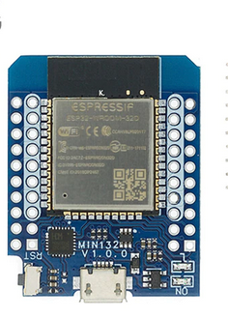
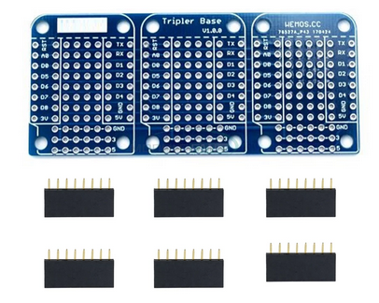
Simulating an experiment
To simulate an experiment we have a bus system
an ESP32 micro-controller to connect the sensor to the uC
The CPU card has a user programmable LED
and an USB to serial interface

Slide 4
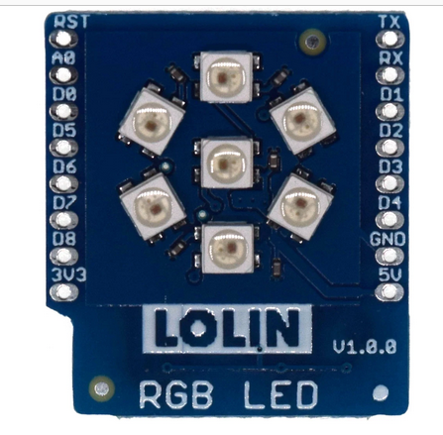
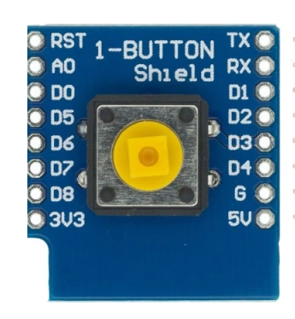
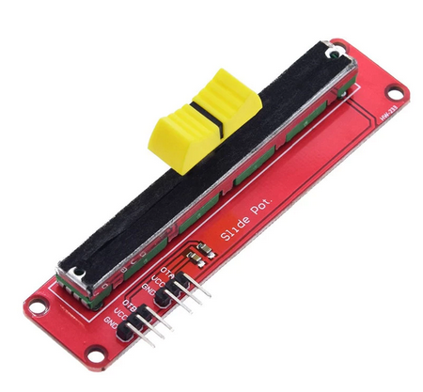
Sensor and actuator
a pushbutton allows
to generate digital
signals
a potentiometer
creates analog
signal levels
a simple display with
7 rgb LEDs

Slide 5
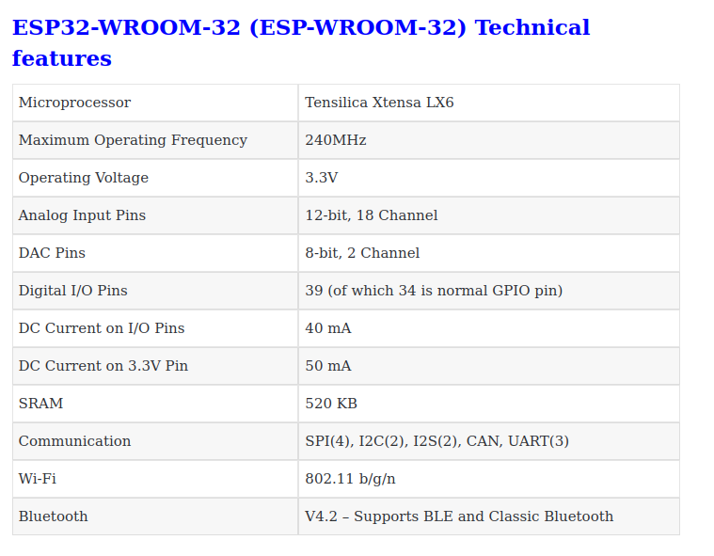
ESP32 specifications
All this for 4 US$

Slide 6
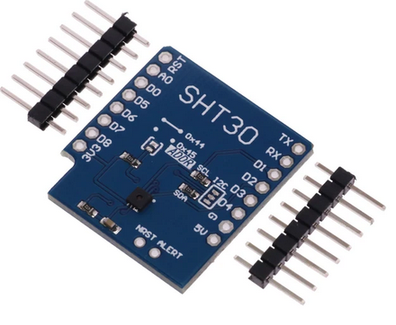
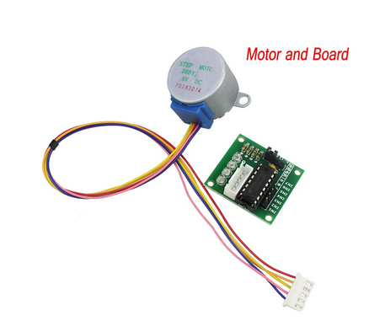
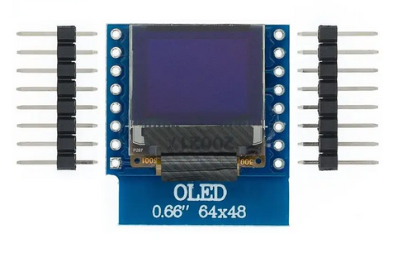
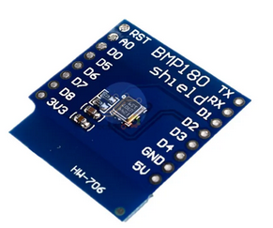
New devices for ASP 2024
Stepping motor and
controller
SHT30 temperature and
humidity sensor
BMP180 barometric
pressure sensor

Slide 7
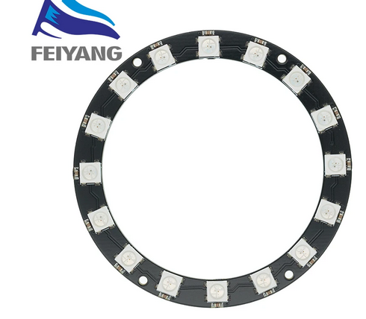
Replacement of phased out module
Replacement of the
7 rgb LED ring
Total cost of all devices including
solder wire & shipping: ~400 Euros

Slide 8
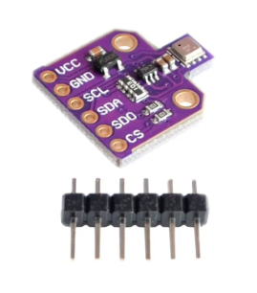
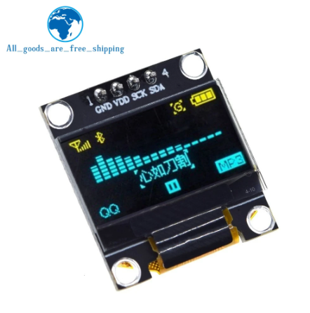
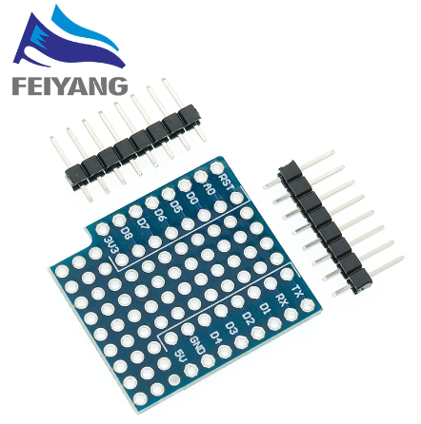
The alternatives
These need to be adapted with a prototype board

Slide 9
Additional requirements
The boards come which pins, not soldered. If I get them to my home, I will have to solder them all (several thousand solder points), flash the Python interpreter onto the ESP32 CPU and test all sets
The total price of all sets exceeds the limit where I can import them without customs declaration (~ 350 – 400 Euros)
1 PC per student is needed for software development, preferably with USB port to connect the ESP32 to the PC. (USB-2 is sufficient)

