Slide 1
IoT Air Quality System
Jacob Mb. Taamté (mtjfirst@yahoo.fr)
LCD 20x4 Screen Presented at the Workshop – IoT4AQ
March 2024, Bambey, Sénégal

Slide 2
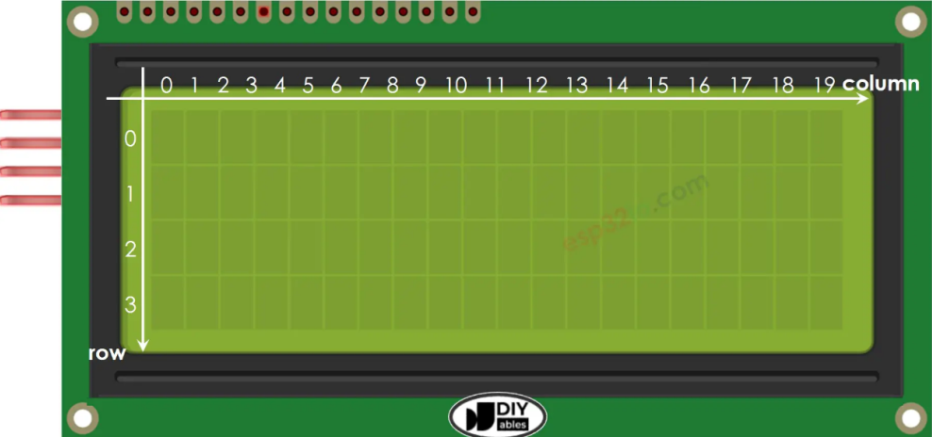
LCD 20x4 screen
The 20x4 LCD screen can display 4 lines (rows) with 20 characters (columns) per line simultaneously. The color of the characters is white and the screen has a blue background. The contrast is adjustable thanks to the pre-soldered I2C module. The screen can connect to an Arduino, Raspberry Pi, ESP32, ESP8266, etc. It has 4 pins:
GND : Ground ;
VCC : supply voltage pin;
SDA : Serial Data Line;
SCL : Serial Clock Line.

Slide 3
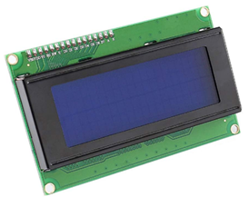
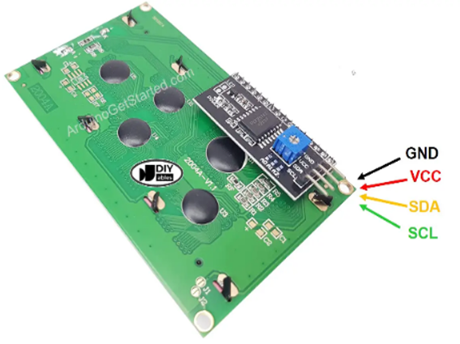
Technical characteristics
Interface: I2C, I2C address: 0x20
Software version: 0022
SDA (DATA) -> I2C Data signal
SCL (CLOCK) -> I2C Clock signal
Pin Definition: GND, VCC, SDA, SCL
Backlight (blue with white color)
Supply voltage: 5V
PCB size: 60mm*99mm

Slide 4
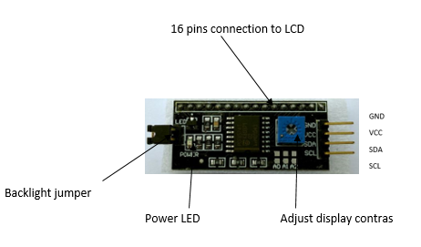
How to Use I2C Serial LCD 20X4
I2C (Inter-Integrated Circuit) is a computer bus designed by Philips for home automation and electronics applications. It allows us to easily connect a microprocessor and different circuits. The connection is made via two lines:
SDA (Serial Data Line): bidirectional data line,
SCL (Serial Clock Line): bidirectional synchronization clock line.

Slide 5
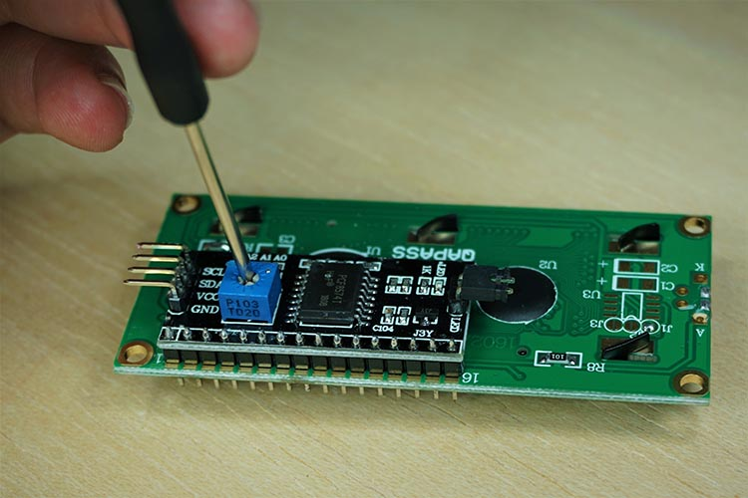
How to Use I2C Serial LCD 20X4
The advantage of using an I2C LCD is that the wiring is really simple. You just need to wire the SDA and SCL pins.
Additionally, it comes with a built-in potentiometer that you can use to adjust the contrast between the background and the characters on the LCD screen. On a “normal” LCD, you need to add a potentiometer to the circuit to adjust the contrast.

Slide 6
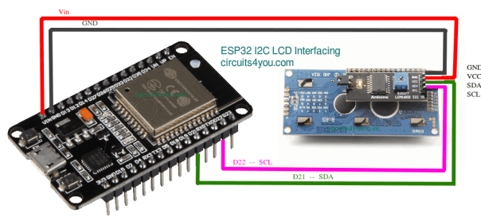
How to Use I2C Serial LCD 20X4
We'll learn how to wire the display, install the library, and try sample code for writing text to the LCD.
Step 1: Installing I2C LCD Library for ESP32
Library : https://github.com/nhatuan84/esp32-lcd/blob/master/LiquidCrystal_I2C.h
This library is tested for different types of LCD displays like 16×2 and 20×4 with ESP32.
Step 2: Interface ESP32 With I2C LCD Module
Make connections with ESP32
I2C LCD Module ESP32 GND <——————-> GND VCC <——————-> Vin SDA <——————-> GPIO 21 SCL <——————-> GPIO 22

Slide 7
How to program LCD 20X4 for I2C
Thanks to the LiquidCrystal_I2C library, the using LCD is very simple
#include <LiquidCrystal_I2C.h> // Library for LCD
Declare a LiquidCrystal_I2C object with I2C address, the number of columns, the number of rows
(LCD default address is 0x27, we can also have 0x3F ):
LiquidCrystal_I2C lcd(0x27, 20, 4); // I2C address 0x27, 20 column and 4 rows
Initialize the LCD
lcd.init(); //initialize the lcd
lcd.backlight(); //open the backlight
Move cursor to the desired position (columns_index, row_index)
lcd.setCursor(column_index, row_index);
Print a message to the LCD
lcd.print("Hello World!");

Slide 8
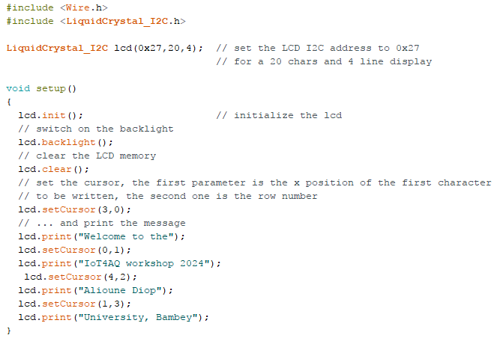
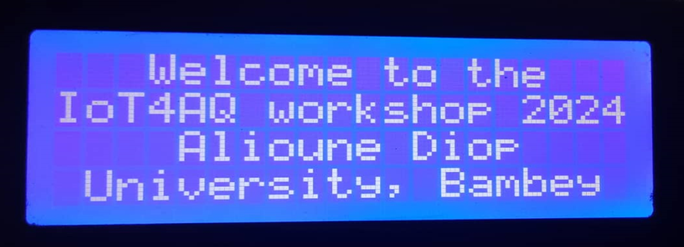
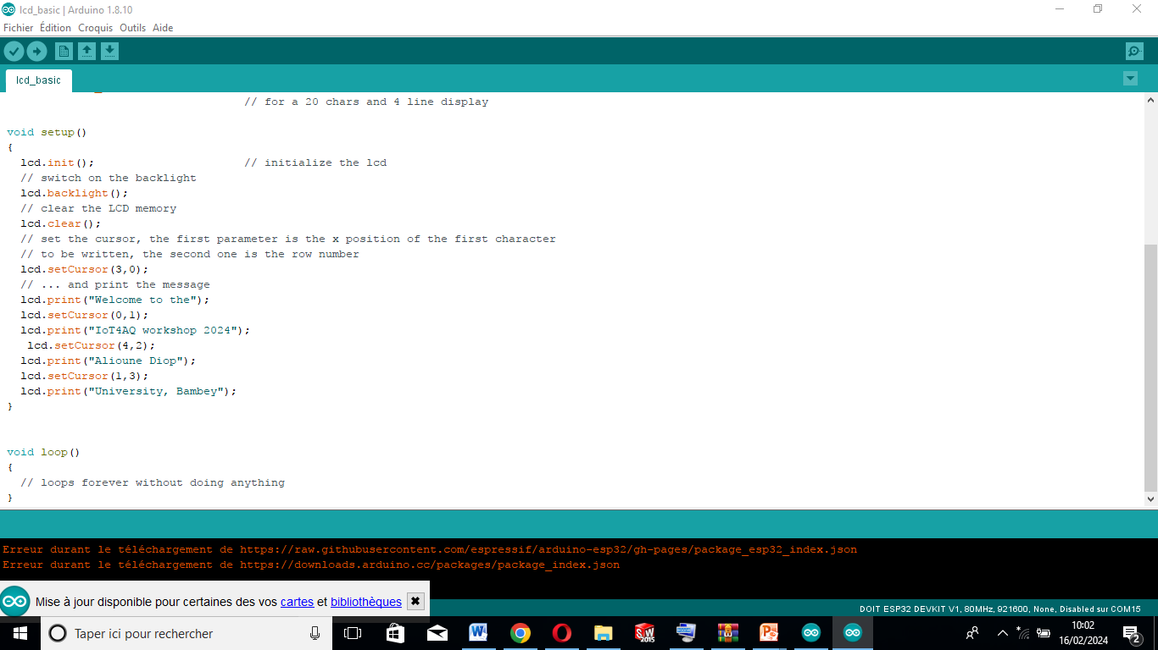
lcd_basic.ino

