Slide 1
IoT Air Quality System
Jacob Mb. Taamté (mtjfirst@yahoo.fr)
Plantower PMS5003 sensor Presented at the Workshop – IoT4AQ
March 2024, Bambey, Sénégal

Slide 2
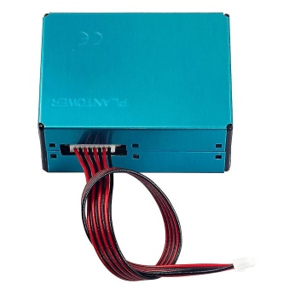
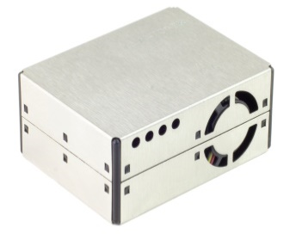
Plantower PMS5003 sensor
Plantower PMS5003 is a kind of digital and universal particle concentration sensor, which can be used to obtain the number of airborne particles. This sensor, low cost precision particulate matter (PM), is a laser dust sensor that uses the principle of laser light scattering to measure the value of dust particles of different sizes (PM1, PM2.5 , PM10) in the air.
This sensor can be inserted into variable instruments related to the concentration of suspended particles in the air or other environmental improvement equipments to provide correct concentration data in time.

Slide 3
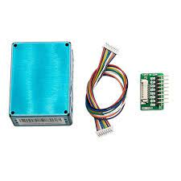
Technical characteristics
Measuring range : 0.3~1.0；1.0~2.5；2.5~10 μm;
Effective range : 0~500 μg/m³;
Maximum range : * ≥1000 μg/m³;
Resolution : 1 μg/m³;
Standard volume : 0.1L;
Power supply DC : Typ: 5.0 / Min: 4.5 / Max : 5.5V;
Active current : ≤ 100 mA;
Standby current : ≤ 200 μA;
Weight (cable and adapter included) : 42.2g.

Slide 4
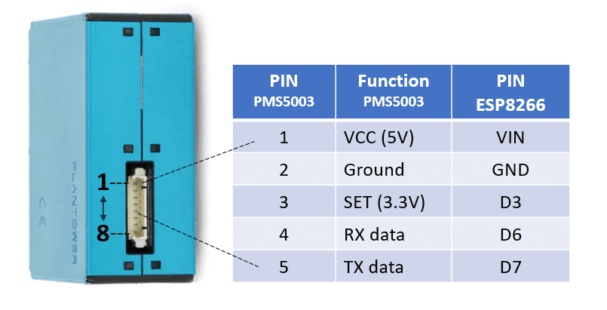
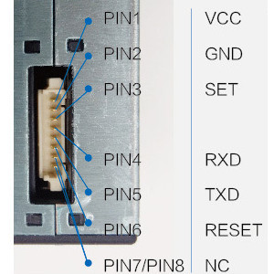
PMS5003 pinout
RXD (Transmission Data or Serial port receiving pin/TTL);
TXD (Reception Data or Serial port sending pin/TTL).
TX and RX are used to transmit and receive data respectively between the sensor and the microcontroller.

Slide 5
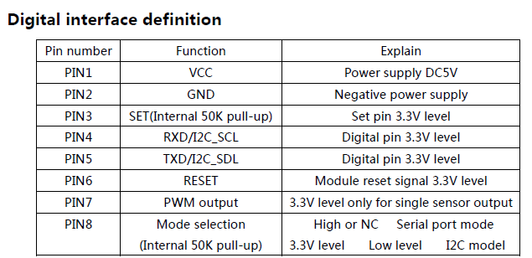
PMS5003 pinout

Slide 6
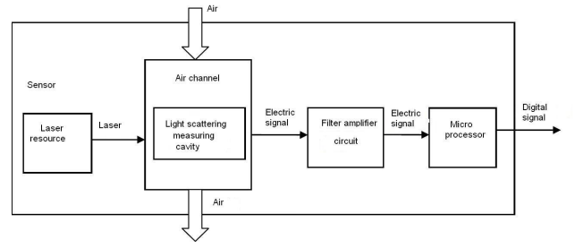
PMS5003 Working principle
Laser scattering principle is used for such sensor, i.e. produce scattering by using laser to radiate suspending particles in the air, then collect scattering light in a certain degree, and finally obtain the curve of scattering light change with time. In the end, equivalent particle diameter and the number of particles with different diameter per unit volume can be calculated by microprocessor based on MIE theory. The functional diagram which presents each part of the sensor is as follows.

Slide 7
How to program PMS5003 sensor with ESP32 board
We will learn how to wire the PMS5003 sensor, install the library, and try sample code to measure particle concentrations.
Step 1: Installing PMS5003 Library for ESP32
Library : https://github.com/avaldebe/PMserial
This library is tested on the different types of PMS5003 sensors presented with ESP32.

Slide 8
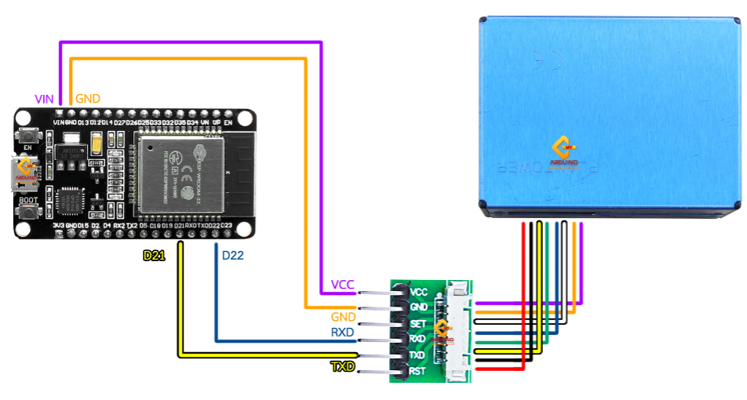
Connect the dust sensor PMS5003 with the ESP32 board
Step 2: Interface ESP32 With PMS5003 Module
Standard connection pinout
PMS5003 | ESP32 board
RXD | D17 (TX2)
TXD | D16 (RX2)
GND | GND
5V | VIN

Slide 9
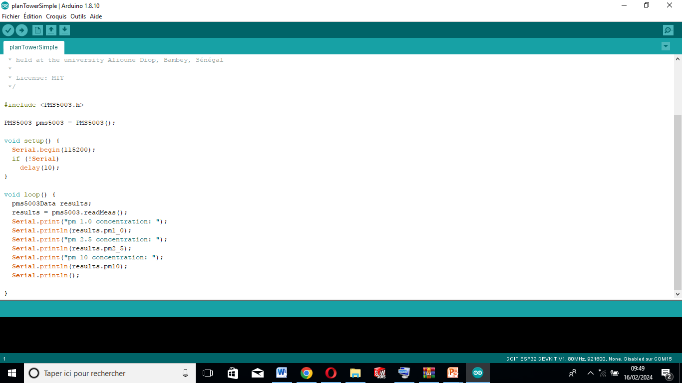
How to program PMS5003 sensor with ESP32 board
Step 3: Code ESP32 and PMS5003 with PlanTowerSimple.ino

