Slide 1
IoT Air Quality System
Jacob Mb. Taamté (mtjfirst@yahoo.fr)
Programming of the Workshop Project Presented at the Workshop – IoT4AQ
March 2024, Bambey, Sénégal

Slide 2
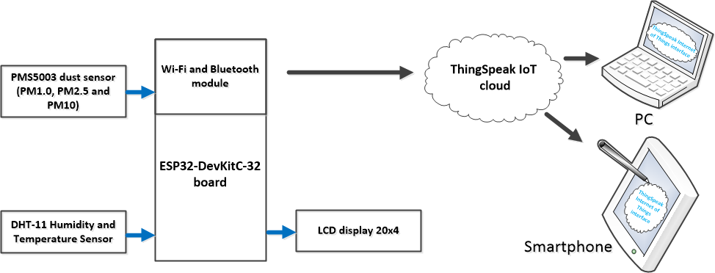
Workshop Project

Slide 3
Connect and test components
Write the operating program for each sensor and electronic component to be used (sensors: PMS5003 and DHT11, components: LCD);
Individually program and test the operation of these sensors ;
Create your account on the Thingspeak platform, customize it and copy the API key;
Write and test the data transmission program (Wi-Fi and Thingspeak) to the Cloud platform by inserting in this program: the API keys, the channel number, the name and password of your personal WiFi;
Gradually merge the programs to obtain a final program of the system;
Compile the programs at each stage and correct errors if they occur;
Assemble the device and upload the final program;
Power the device and check its operation on LCD, Serial monitor of IDE Arduino and the Thingspeak platform.

Slide 4
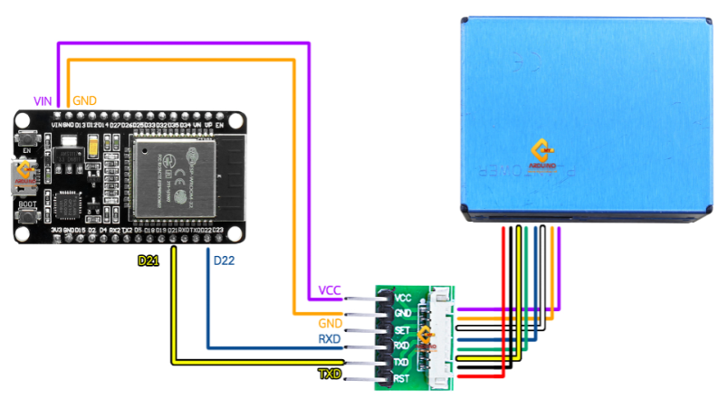
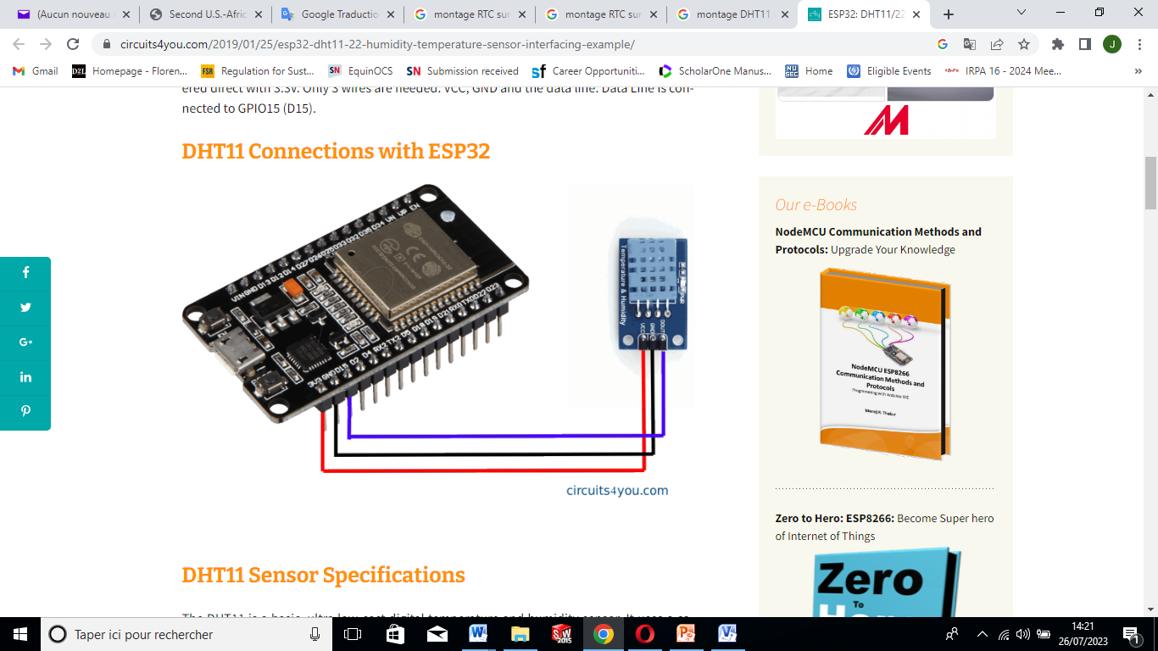
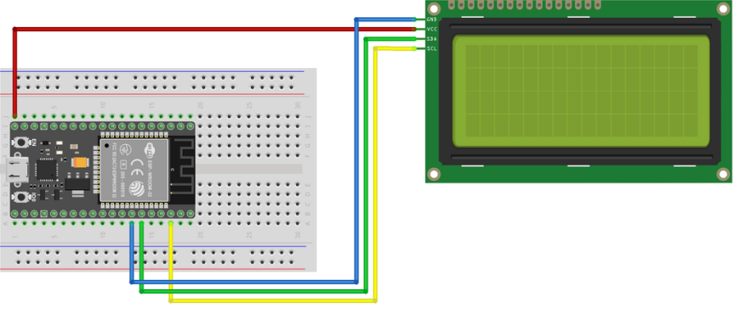
Connect and test components
Connection pinout
LCD I2C 20x4 | ESP32 board
SDA | D21
SCL | D22
GND | GND
5V | VIN
Standard connection pinout
PMS5003 | ESP32 board
RXD | D17 (TX2)
TXD | D16 (RX2)
GND | GND
5V | VIN
Connection pinout
DHT11 | ESP32 board
SIGNAL (Out) | GPIO15 (D15)
GND | GND
5V | VIN

Slide 5
Connect and test components
Program to use :
Workshop_demo3.ino : which already summarizes the program of
Thingspeak, Wifi, PMS5003, LCD 20x4 and that of DHT11.

Slide 6
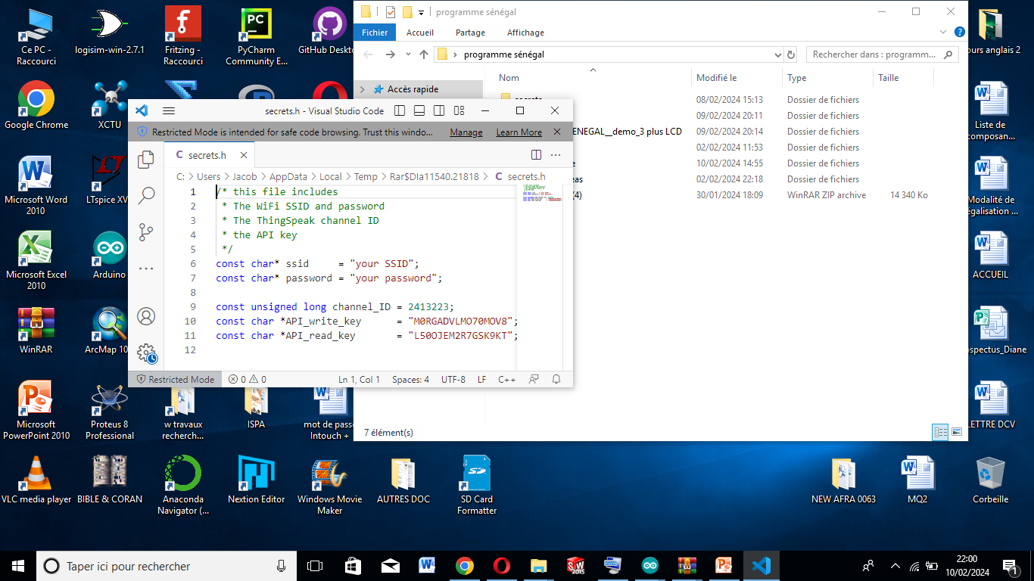
Connect and test components
Customization of the system program for its connection to ThingSpeak

Slide 7
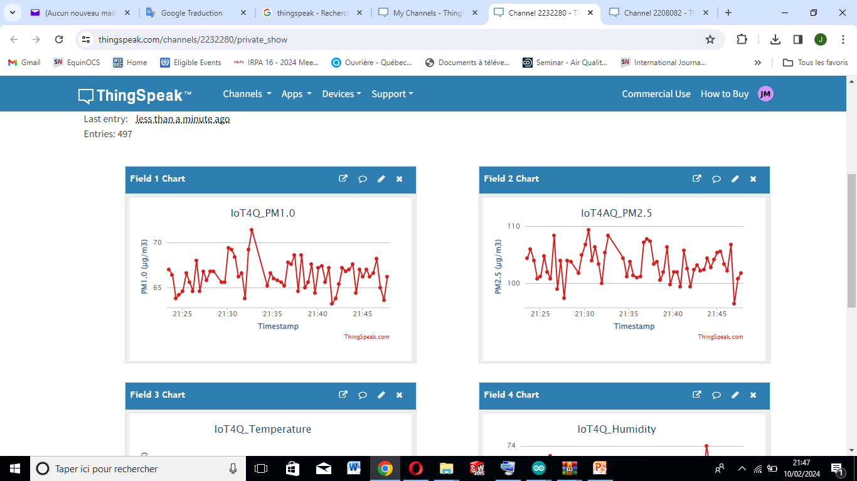
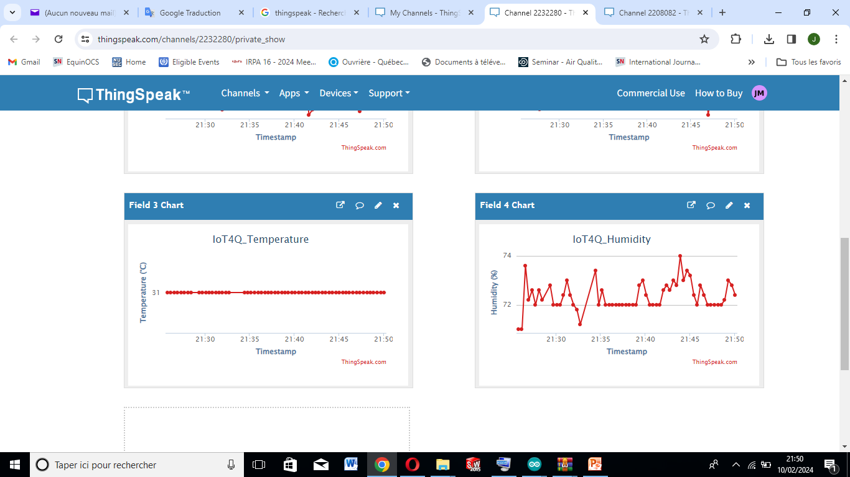
Connect and test components
PM1.0 (µg/m³)
PM2.5 (µg/m³)
Temperature (°C)
Relative Humidity (%)

