Slide 1
IoT Air Quality System
Uli Raich (uli.raich@gmail.com)
The DHT11 temperature and humidity sensor
Presented at the Workshop – IoT4AQ
March 2024, Bambey, Sénégal

Slide 2
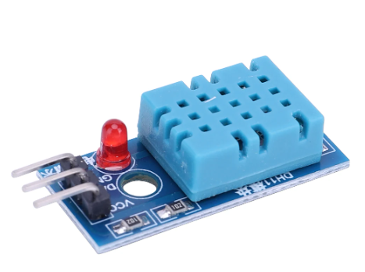
DHT11 sensor
The DHT11 is a popular temperature and humidity sensor
It contains the sensors, analogue to digital conversion and a processor sending the measurement results over its own proprietary serial protocol
It uses only 3 pins:
Vcc (3.3V)
GND
Data

Slide 3
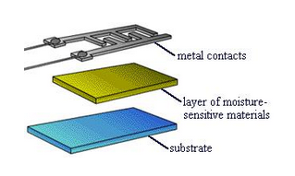
The humidity sensor
Variations in relative humidity produce a change of resistivity, which is measured.
The resistance of certain hygroscopic materials such as hygroscopic salts have such a property
These materials are mounted as thin films on the substrate with metal contacts
The devices can be very small

Slide 4
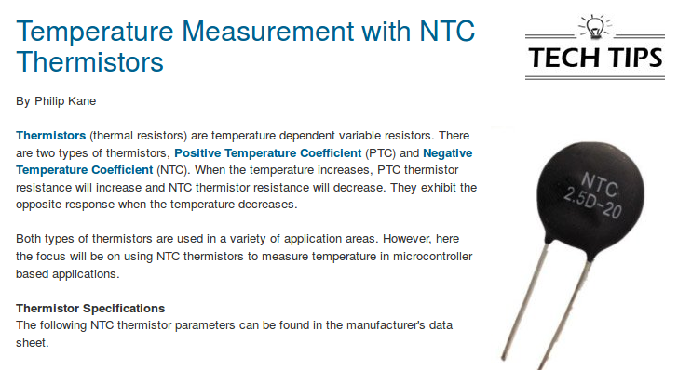
The temperature sensor

Slide 5
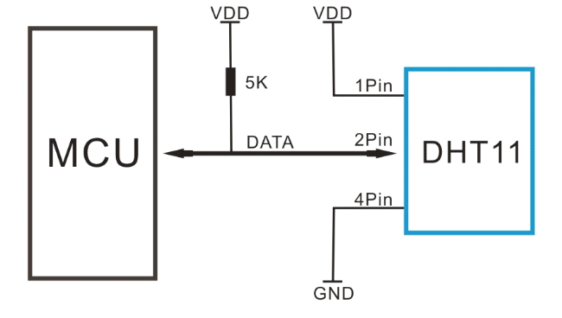
The connections

Slide 6
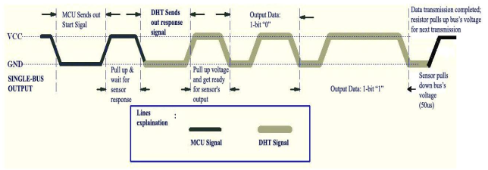
Communication process
The processor initiates a measurement cycle pulling the data line down for 18 ms (data line is output to the CPU)
It releases the line and waits for 20-40 µs (data line now input)
The DHT11 sends a 80 µs start signal
40 data bits follow: 26-28 µs : zero, 70 µs one

Slide 7
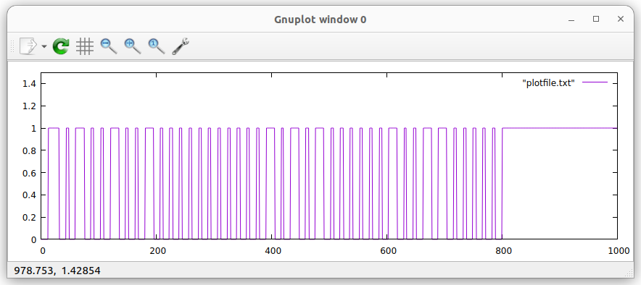
The full protocol
Humidity integral
Humidity decimal
Temperature integral
Temperature decimal
Checksum

Slide 8
DHT11 Arduino Library
Getting the DHT11 measurements looks difficult. However, it is possible to write libraries that hide all the protocol details and that provide a small number of functions needed to easily access temperature and humidity values.
The DHT11 library implements DHT11 access as a C++ class.
A class is a data type incorporating data and functions into a single object.
To access the library a definition file must be included.
#include <DHT11.h>
is treated by the gcc pre-processor.

Slide 9
Arduino Library Structure
Arduino libraries usually contain
The source code ( in the src folder) + include file
A library.properties file specifying
its name
its author
version number
on which hardware it runs
examples

Slide 10
DHT11 class methods
DHT11 DHT11(int data_pin); // the object constructor
void setDelay(ms_delay); // sets the delay between 2 measurements (default 500 ms) I need at least 1.2s.
int readHumidity()
int readTemperature() These methods return the measured values or DHT11::ERROR:TIMEOUT (253) or DHT11:ERROR:CHECKSUM (254)
int readTemperatureHumidity(int &temperature, int &humidity) returns 0 if ok, DHT11::ERROR:TIMEOUT (253) or DHT11:ERROR:CHECKSUM (254) otherwise
static String getErrorString(int errorCode): prints a humanly readable error message

Slide 11
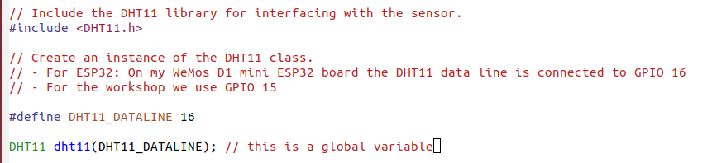
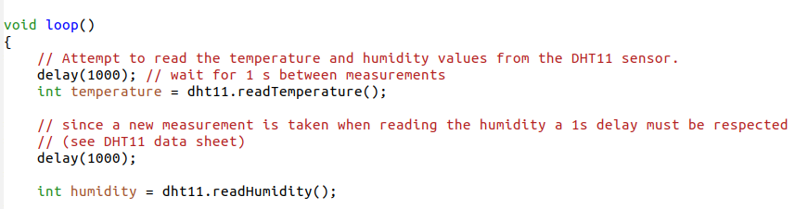
An example

Slide 12
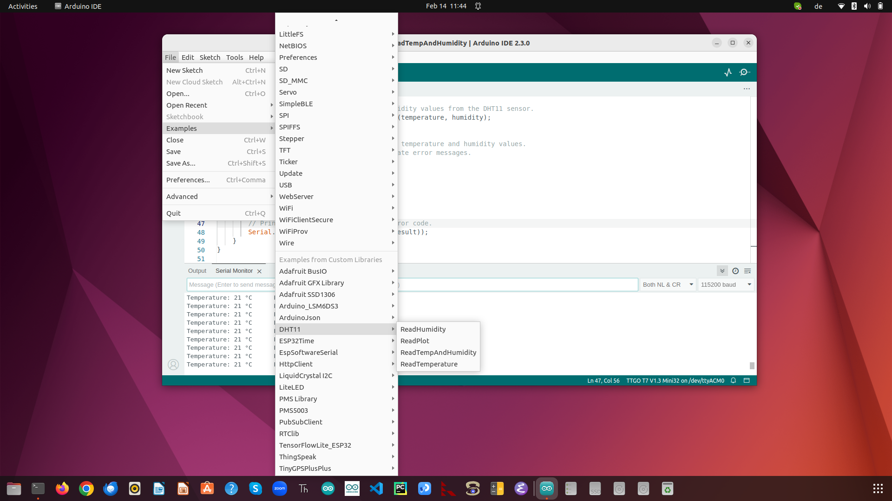
examples

