Slide 1
IoT Air Quality System
Uli Raich (uli.raich@gmail.com)
Introduction to the hardware
Presented at the Workshop – IoT4AQ
March 2024, Bambey, Sénégal

Slide 2
Resources
The slides and the code of all demo programs are available for download
at https://github.com/uraich/IoT4AQ/tree/main/workshop
Please also have a look at the Wiki pages:
https://github.com/uraich/IoT4AQ/wiki

Slide 3
What is IoT?
Wikipedia:
The Internet of Things (IoT) describes physical objects (or groups of such objects) with sensors, processing ability, software and other technologies that connect and exchange data with other devices and systems over the internet or any other communication networks

Slide 4
IoT
The name “Internet of Things” already suggests that there are two distinct components to it:
Things, which are represented by sensors and actuators. We therefore must have a means to read out these sensors and to control the actuators. Hardware interfaces are needed for this.
Internet, we must be able to send data read from the sensors to the Internet and receive commands for the actuators from it. This means that we need a network interwork and the software to run the network protocols.

Slide 5
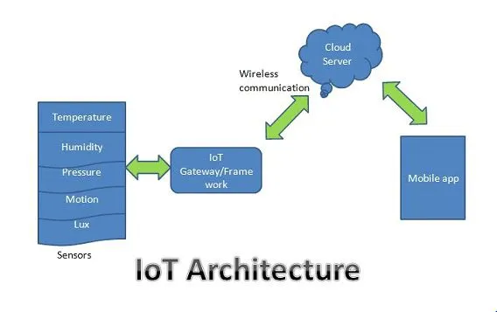
IoT system architecture

Slide 6
What is an IoT system composed of?
We need:
Sensors and actuators
A processor powerful enough to run the network protocol layers
A network interface: either Ethernet of WiFi
Interfaces to the sensors and actuators:
General Purpose I/O (GPIO) lines
I2C, I2S, SPI, serial interfaces
The cost for the controller should be in a good relation with the cost of the things

Slide 7
which micro-controller?
Question of
Needs (how much memory, which speed, which interfaces …)
Budget
Software environment and programming language
Most common: Arduino SDK
MicroPython
Taste

Slide 8
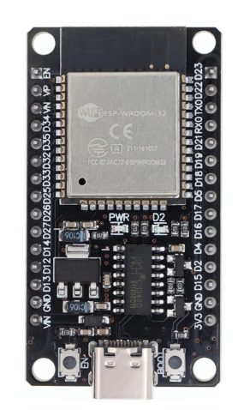
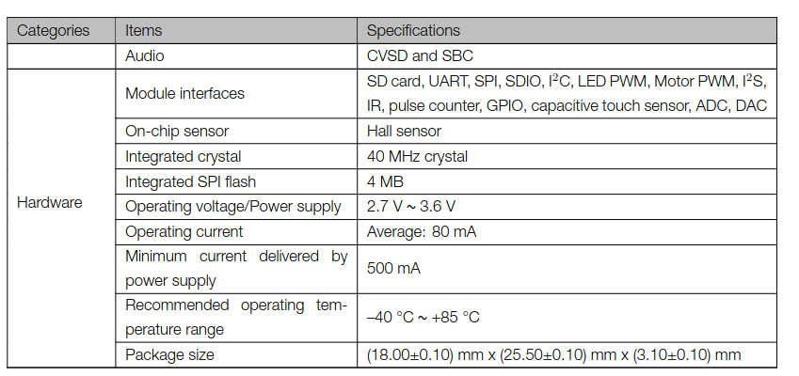
The micro-controller

Slide 9
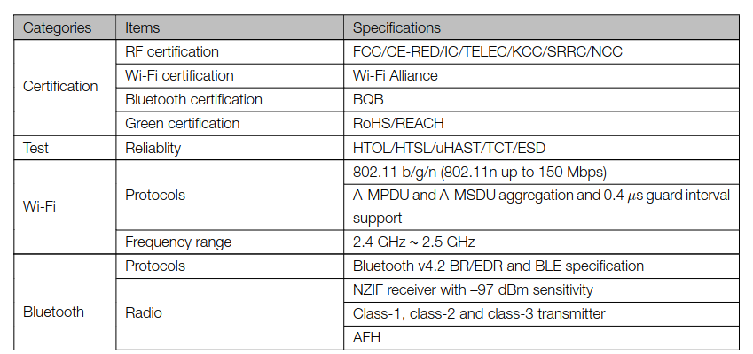
ESP32 network connection

Slide 10
Programming the micro-controller
Depending on the processor used, several programming environments are available. For the ESP32 you have:
esp-idf (ESP integrated development framework) provided by Espressif (not recommended for a beginner programmer)
The Arduino SDK (Software Development Kit) originally developed for the Atmel Atmega chips but today available for many micro-controllers including the ESP32.
MicroPython. A stripped down Python-3 interpreter with additional features needed by micro-controllers available for several chips including the ESP32.
In these lectures we use the Arduino SDK

Slide 11
Interfacing to the “things”
The ESP32 has a big number of interfaces implemented on the chip:
GPIO pins
PWM
Capacitive touch sensor
I2C (Inter Integrated Circuit) interface
SPI (Serial Peripheral Interface) interface
Analogue to digital converter
Digital to analogue converter
Timer

Slide 12
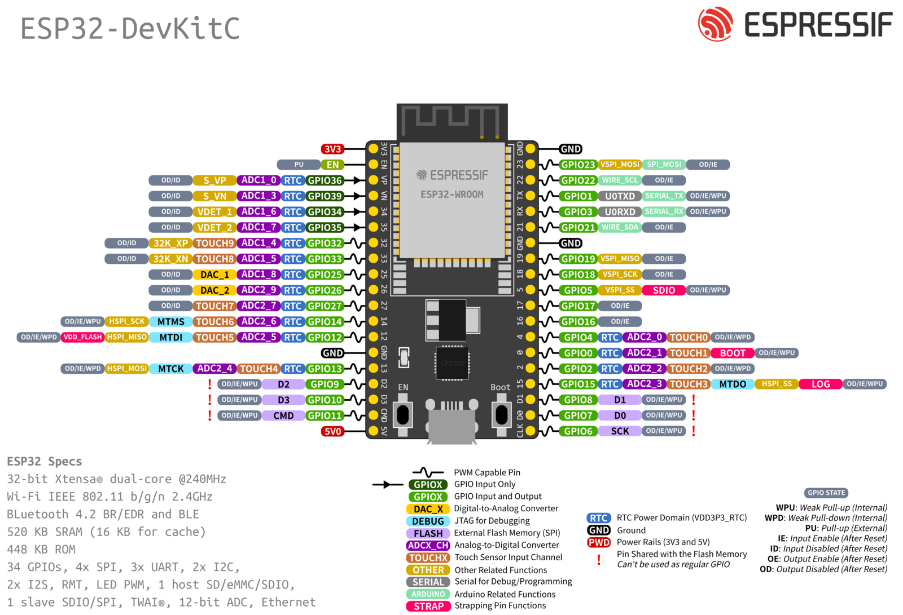
ESP32 pinout

Slide 13
Checking the system
In C the ubiquitous “hello world” program checks if
You can edit a program
You can compile and link it
You can run it
On embedded systems the simplest program possible is often the “blinking led” program
It shows that you can access the system and that interfacing works

