Slide 1
IoT Air Quality System
Uli Raich (uli.raich@gmail.com)
The RTCs (Real Time Clocks)
Presented at the Workshop – IoT4AQ
March 2024, Bambey, Sénégal

Slide 2
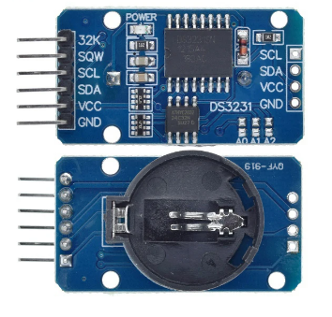
The DS3231
Our system has two Real Time Clocks:
The external DS3231, with battery backup
The ESP32 internal RTC
When the ESP32 is reset, the RTC will show
1. Jan. 1970 00:00:00
If it is connected to the Internet, date and time can be recuperated through the NTP (Network Time Protocol) and the ESP32 RTC can be set
If it has no Internet access, time and date must be retrieved from the battery backed DS3231, which must be previously set.

Slide 3
Usage of RTC
Depending on Internet access we need:
If Internet access is available:
Read date and time via NTP and set the ESP32 RTC Use this information to set the DS3231
Use the time from the ESP32 RTC
If there is no Internet access:
If the DS3231 is already set: Copy its date and time information to the ESP32 RTC. Use the date and time information from the ESP32 RTC
If the DS3231 is not set: Set it manually. Define date and time in a date_time string and set the DS3231 correspondingly. Then do the same thing as the point above.

Slide 4
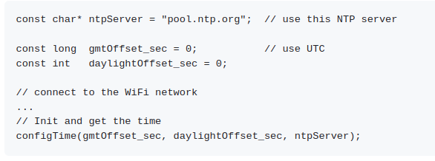
Setting the ESP32 RTC

Slide 5
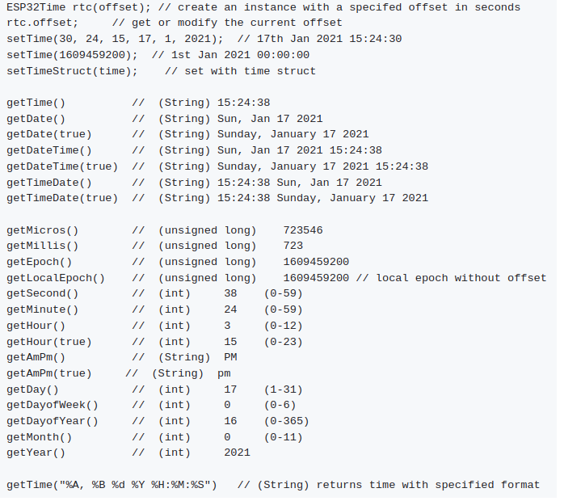
ESP32Time

Slide 6
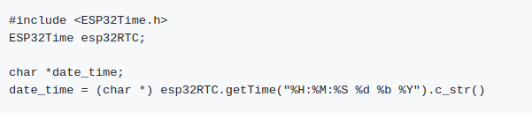
String
The String type is not zero terminated char * string we have seen before but the C++ String class.
You can convert a C++ String class to a zero terminated string with
c_string = CppString.c_str()

Slide 7
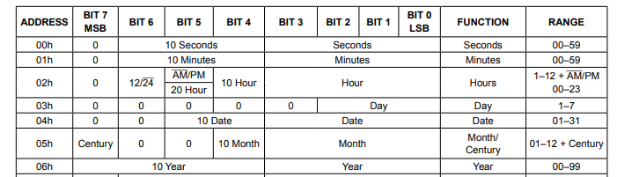
DS3231 registers
The alarm registers are not shown

Slide 8
Control and status registers
The highest significant bit of the control register allows to switch the oscillator on (bit is zero) and off (bit is 1)
The highest significant bit in the status register shows if the oscillator is switched off or has been switched off in the past.
When setting the DS3231 date and time both bits should be reset

Slide 9
Setting the DS3231 using RTClib
RTClib contains classes to access three different types of RTCs:
DS3231 Precision RTC
PCF8523 RTC
DS1307 RTC
Documentation for the DS3231 class

Slide 10
DS3231 methods
These are the methods we use:
RTC_DS3231 ds3231; // define an RTC_DS3231 object
ds3231.begin(); // initialize the I2C bus, returns true if // successful
ds3231.lostPower(); // returns true if the oscillator was stopped
ds3231.adjust(const DateTime &dt); // sets time and date
ds3231.now(); // returns a DateTime structure with the current // date and time

Slide 11
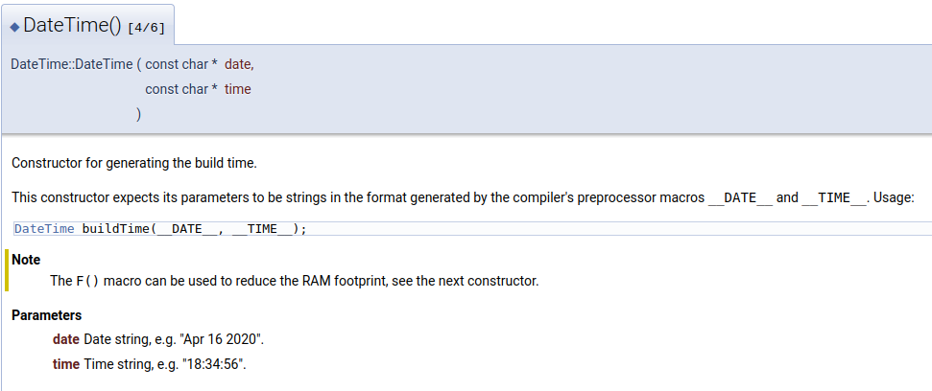
DateTime structure
There are different ways to create a DateTime structure e.g.

Slide 12
Creating Date and Time Strings
It is not difficult to create the corresponding date and time strings with calls from the ESP32Time library:
dateString = esp32RTC.getTime("%b %d %Y");
timeString = esp32RTC.getTime();
will do the trick. Be careful: These return C++ Strings while
ds3231.adjust(const char *date, const char *time)
expects zero terminate C type strings.

